Slide 1

Tetromino
05/2025-6998
This slide deck was prepared by Shawn Chan, Predoctoral Research Associate at INSEAD, as additional material to the role play “Tetromino”.
To access INSEAD teaching materials, go to https://publishing.insead.edu/.
Copyright © 2025 Shawn Chan.
NO PART OF THIS PUBLICATION MAY BE COPIED, STORED, TRANSMITTED, TRANSLATED, REPRODUCED OR DISTRIBUTED IN ANY FORM, MEDIUM, APPLICATION, OR SYSTEM WITHOUT THE PERMISSION OF THE COPYRIGHT OWNER. SUCH RESTRICTION SHALL ALSO COVER AI SYSTEMS AND AI MODELS.

Slide 2
Team on Team Negotiation: Tetromino
Process:
  Negotiation between Anastasia, Bodana, Cyril, and Dmitry
  Organize yourselves into groups of 4; groups of 5 double up 1 role
  Read only your own role information sheet; do not show your role information sheet to others
  Share (or don’t share) whatever you choose verbally
Timeline (2 hours in total):
  Read your role and plan a strategy with your teammate (Anastasia & Bodana, Cyril & Dmitry (max 45 min)
  Negotiate team on team with all 4 characters (1 hour)
    Side meeting are allowed if the other party agrees
    Text messages and emails are allowed
  Exchange feedback with at least 1 counterpart, more if you have time
  Take a break (15 min)
Notes:
There are four roles: Anastasia, Bodana, Cyril, and Dmitry.
Anastasia and Bodana are a team of employees, and Cyril and Dmitry are a team of managers.
The ideal negotiation group has 4 participants, one for each character. You can double up a role, in other words have two Cyrils, if you are a group of 5. However you cannot have less than 4 participants, since all of the roles are essential for the case.
Share (or don’t share) whatever you choose verbally, but don’t show your physical information sheet to others. You can’t say “look it says so right here, I’m telling the truth!” This makes it too easy to show you are not lying. In life, we have to try to convince others of our sincerity with our words.
You have 45 minutes to read your role materials and plan a strategy with your teammate: Anastasia with Bodana, and Cyril with Dmitry. Then 1 hour for the team on team negotiation with all four characters.
Side meeting are allowed if the other party agrees. So for example Cyril and Bodana can have a side meeting, but only if they both consent. Text messages, either to your own teammate or someone on the other team, are allowed at any time. But the other party is not obligated to read them.
If you finish early, exchange some feedback with your counterparts.
You should also have time for a 15 minute break.
The lecture will begin again in 2 hours. Please try to find partners you know less well than the others, and to the extent you can different people than in your previous negotiations. [Participants form groups of 4 or 5, the instructor hands out role materials, and the participants negotiate.]
[During the negotiations, the instructor should walk around and take mental or written notes on some of the negotiations, highlighting tactics and reactions that can be brought up later during the debriefs when participants are asked to share their experiences or when key teaching points are made].
Note: An alternative approach to creating the pairings is for the instructor to pair participants up herself/himself, either by creating groups before class begins or ad-hoc now during the lecture.
Note: There must be at least one participant in each role for this negotiation. The negotiation exercise will not work properly if no one has one or more roles. If participants are not divisible into groups of 3, have more than 1 participant in one or more roles.

Slide 3
Group | Anastasia | Bodana | Cyril | Dmitry | BOR
1
2
3
4
5
6
7
8
9
10
11
Notes:
Here are your breakout room slides for this exercise. Please grab your role materials– they are printed in the color that matches the color of the column your name is listed in on the slide. Then pair up with your three partners, and enjoy the exercise! [Participants get their role materials and go to negotiate].
Note: This template participant pairings slide is for if the instructor sorts participants into negotiation groups beforehand. Participant’ individual names are added in the respective columns. If this slide is used, the color background for each role on the slide above should match the color of the role materials that are handed out to participants, to avoid confusion. The “BOR” column refers to “Breakout Room” and only applies if the instructor has special rooms for the participants to negotiate in. “GROUP” refers to negotiation group number, in other words each group of participants who negotiate together.
Note: For each group, there must be at least one participant in each role for this negotiation. The negotiation exercise will not work properly if no one has one or more roles. If participants are not divisible into groups of 3, have more than 1 participant in one or more roles.

Slide 4
Notes:
Note: Placeholder slide to avoid spoilers

Slide 5
Notes:
Note: Placeholder slide to avoid spoilers

Slide 6

Buzz Groups: Tetromino
Please share with someone from a different negotiation group
One the other team did well in terms of coordinating strategies
One thing your team could have done differently
Notes:
[Participants have returned from their negotiations]. Welcome back! I hope you enjoyed the case. We will now debrief Tetromino.
Please take 3 minutes and share with someone nearby who was in a different negotiation group. One thing that the other team did well in Tetromino in terms of coordinating strategies, and one thing your team could have done better. The idea is to give each other a peek into the dynamics in someone else’s negotiation group. Different people with the same role but different strategies, different counterparts, and different dynamics between them likely had very different negotiation processes and outcomes. [Participants discuss in small groups].

Slide 7
Issue | Anastasia | Bodana | Cyril | Dmitry
Revenue Split (Creators vs. Company) | Unrealistic ideal: 99% Creators, 1% Company Legitimacy: Only 1% of work was done on company time Power: Can file lawsuit to block commercial release of game for 15 years |  | Aspiration: 5% or less to Creators, 95% or more to Company | Aspiration: 20% Creators, 80% Company Bottom line: 40% Creators, 60% Company
 |  |  | Legitimacy: Know A&B used company hardware and time Power: Company has legal claim to 100% of game under national law
Revenue Split (Between Creators) | 70-30 her way Legitimacy: Came up with base code | 50-50 split Legitimacy: Visuals and code equally important in gaming | Prefers Bodana benefit less than Anastasia from Tetromino due the former’s behavior | Indifferent
Employment Status | Save own job and report Cyril’s behavior to Dmitry | Get Cyril fired | Decide on outside offer Get Dmitry to fire Bodana and Anastasia Provoke Bodana (e.g., extreme offers) Monitor and fire employees who play Tetromino | Mediate the conflicts on the product development team Retain Cyril & get NeuroVox Fire employees who behave unprofessionally (potentially after obtaining Tetromino and/or NeuroVox)
Staffing | Does not know what is needed to deliver Tetromino | Transfer 10 company employees to the Tetromino team | Hire more staff for Product Development Division or at least prevent attrition | Split Product Development Division, with about half the staff working on Tetromino
Notes:
You probably discovered much of this during the negotiation, or debriefing with the other participants afterward. But in case there are any resolved information asymmetries, here are the perspectives of the four characters.
Anastasia and Bodana believe that by rights they should get 99% of revenues since only 1% of the time they spent developing Tetromino was during work hours. Dmitry is thinking of an 80-20 split the company’s way, with 20% going to the creators for their contribution and to incentivize innovation among employees. The absolute most he can concede, at least in the short run, is 40% since the company must capture value from new revenue streams soon to avoid bankruptcy. Cyril does not want to incentivize employees going rogue and prefers to give them much less, especially Bodana due to what he perceives as her bad behavior.
Due secret to tracking software, Dmitry knows that Anastasia and Bodana used company time and equipment to develop Tetromino, and under national law could therefore seize the IP unilaterally. However, one or both of the creators could file lawsuit to block commercial release of game for 15 years, by which time the company may not even exist.
The creators have some differences in preferences and goals. Since she came up with the idea and did the programming, Anastasia wants to split whatever revenues they are able to get 70-30 between herself and Bodana, who prefers a 50-50 split. Bodana’s legitimacy is that design and programming are on fairly even footing in the gaming industry.
Anastasia is keen to keep her job but is also willing to risk calling Cyril out for what she sees as his poor leadership. Bodana doesn’t care that much about her job, and wants Cyril to lose his.
On his side, Cyril has received an attractive outside offer with a higher salary and may just quit if unhappy with how the negotiation goes. This gives him leverage over Dmitry, who knows this would sink the NeuroVox project.
Cyril wants Anastasia and especially Bodana fired, and may try to provoke Bodana to discredit her with Dmitry who he knows cares a lot about professionalism and honesty. In fact, Cyril wants anyone caught playing Tetromino at the company to be fired.
Dmitry hopes to mediate the conflicts on the product development team and get both Tetromino and NeuroVox to market. Making this difficult, the Product Development division has only 30 further employes to divide between the projects, and creating a Tetromino team of 10 – Bodana’s preference if the game is to be delivered in 3 months – will necessarily slow down the timeline for NeuroVox. This could really frustrate Cyril who went into the negotiation hoping to make new hires for his division rather than see it shrink.

Slide 8
Your Negotiation Process
How was it negotiating in a team?
Were you ever misaligned with your teammate during the team on team negotiation?
Does anyone feel betrayed by their teammate?
Did you have any side channel discussions? In person or by text?
Did any coalitions form? Between whom and against whom?
What did players do to try to get each other fired?
Who lied to whom about what?
Notes:
Let’s talk about your negotiation process.
How was it negotiating in a team? Were you ever misaligned with your teammate during the team on team negotiation? [Participants share experiences]. The research shows that negotiation teams do better than solo individuals at both creating and claiming value. Creating because there are more minds in the room. Claiming because groups exert social pressure on lone individuals. But the team advantage in negotiation only emerges if they present a coordinated strategy at the bargaining table. So its critical to invest time and energy in the preparation beforehand within each team.
Does anyone feel betrayed by their teammate? For example, does Cyril feel betrayed by Dmitry, or Bodana by Anastasia? [Participants share experiences].
Did you have any side channel discussions? In person or by text? [Participants share experiences]. Side channel conversations, where 2 or more characters have a discussion without the others, tend to favor coalition formation where characters form alliances at the expense of others.
On that note, did any coalitions form? Between whom and against whom? [Participants share experiences]. Cyril, Dmitry, and Anastasia could gang up on Bodana. Or everybody else could gang up on Cyril.
What did players do to try to get each other fired? [Participants share experiences]. It’s high risk for Bodana and Cyril to try to push each other out of the company. They make just get themselves fired by Dmitry, who doesn’t have much tolerance for such behavior. Or, it just might work.
Who lied to whom about what? [Participants share experiences]. If you were Bodana, sorry we set you up. Your character wants to prevent Cyril and Dmitry from finding out she and Anastasia used company equipment and time to create Tetromino, so that they can start their own video game company as a backup plan. But Dmitry already knows you used company time due to secret tracking software, making this option impossible.
References re negotiating in teams
Thompson, L., E., Peterson, S. W., Brodt. S. (1996). Team negotiation: An examination of integrative and distributive bargaining. Journal of Personality and Social Psychology, 70(1), 66–78.
References on individual vs group incentives
Bertrand, M., & Mullainathan, S. (2001). Are CEOs rewarded for luck? The ones without principals are. Quarterly Journal of Economics, 116, 901–932
http://m.qje.oxfordjournals.org/content/116/3/901.abstract
Jensen, M. C., & Meckling, W.H. (1976). Theory of the firm: Managerial behavior, agency costs and ownership structure. Journal of Financial Economics, 3(4), 305-360.
Rutherford, R., Springer, T. & Yavas, A. (2005). Conflicts between principals and agents: evidence from residential brokerage. Journal of Financial Economics, 76, 627-665.
References re coalitions
Bäck, H., & Dumont, P. (2008). Making the first move. Public Choice, 135(3–4), 353–373. https://doi.org/10.1007/s11127- 007-9267-5
Baron, D. P., & Ferejohn, J. A. (1989). Bargaining in legislatures. The American Political Science Review, 83(4), 1181-1206.
Beersma, B., & de Dreu, C. K. W. (2002). Integrative and distributive negotiation in small groups: Effects of task structure, decision rule, and social motive. Organizational Behavior and Human Decision Processes, 87(2), 227-252.
Block, P. (1987). The Empowered Manager: Positive Political Skills at Work. San Francisco: Jossey-Bass Publishers.
Brion, S., & Anderson, C. (2013). The loss of power: how illusions of alliance contribute to powerholders’ downfall. Organizational Behavior and Human Decision Processes, 121, 129–139.
Caplow, T. (1956). A theory of coalitions in the triad. American Sociological Review, 21(4), 489–493. https://doi.org/10.2307/ 2088718
Chertkoff, J. M. (1966). The effects of probability of future success on coalition formation. Journal of Experimental Social Psychology, 2(3), 265–277. https://doi.org/10.1016/0022- 1031(66)90083-7
Chertkoff, J. M., & Braden, J. L. (1974). Effects of experience and bargaining restrictions on coalition formation. Journal of Personality and Social Psychology, 30(1), 169–177. https:// doi.org/10.1037/h0036615
Diermeier, D. (2006). Coalition government. In Oxford Handbook of Political Economy, ed. B. Weingast and D. Wittman. New York: Oxford University Press.
Diermeier, D., & Gailmard, S. (2006). Self-Interest, Inequality, and Entitlement in Majoritarian Decision-Making. Quarterly Journal of Political Science, 1(4), 327-350.
Diermeier, D., & Merlo, A. (2000). Government turnover in parliamentary democracies. Journal of Economic Theory, 94, 46-79.
Diermeier, D., Eraslan, H., & Merlo, A. (2003). A structural model of government formation. Econometrica, 71(1), 27-70.
Diermeier, D., Swaab, R.I., Medvec, V., & Kern, M.C. (2008). The micro-dynamics of coalition formation. Political Research Quarterly, 61, 484-501.
DeLuca, J.M. (1992). Political Savvy: Systematic Approaches to Leadership behind-the-Scenes. Horsham: LRP Publications.
Falcão, H. (2010). Value Negotiation: How to Finally Get the Win- Win Right. Singapore: Prentice Hall.
Galinsky, A. D. (2004). Should you make the first offer? Negotiation, 7, pp. 1-4.
Gamson, W. A. (1961). A theory of coalition formation. American Sociological Review, 26(3), 373–382. https://doi.org/10.1257/ aer.90.4.1072
Gamson, W. A. (1961). An experimental test of a theory of coalition formation. American Sociological Review, 26(4), 565– 573. https://doi.org/10.2307/2090255
Gamson, W. A. (1964). Experimental studies of coalition formation. Advances in Experimental Social Psychology, 1, 81–110. https://doi.org/10.1016/S0065-2601(08)60049-0
Gunia, B. C., Swaab, R. I., Sivanathan, N. & Galinsky, A. D. (2013). The remarkable robustness of the first-offer effect: Across cultures, power, and issues. Personality and Social Psychology Bulletin, 39, 1547 – 1558.
Huffaker, D., Swaab, R.I., & Diermeier, D. (2011). The language of coalition formation in online multiparty negotiations. Journal of Language and Social Psychology, 30, 66-81.
Kahan, J. P., & Rapoport, A. (1984). Theories of coalition formation. New York: Erlbaum.
Kern, M. C., Brett, J. M., Weingart, L. R., & Eck, C. S. (2020). The “fixed” pie perception and strategy in dyadic versus multiparty negotiations. Organizational Behavior and Human Decision Processes, 157, 143-158. https://doi.org/10.1016/j.obhdp.2020.01.001
Komorita, S. S. (1984). Coalition bargaining. Advances in Experimental Social Psychology, 18(1), 183–245. https://doi.org/ 10.1016/S0065-2601(08)60145-8
Komorita, S. S., Aquino, K. F., & Ellis, A. L. (1989). Coalition bargaining: A comparison of theories based on allocation norms and theories based on bargaining strength. Social Psychology Quarterly, 52(3), 183–196. https://doi. org/10.2307/2786713
Komorita, S. S., & Chertkoff, J. M. (1973). A bargaining theory of coalition formation. Psychological Review, 80(3), 149–162. https://doi.org/10.1037/h0034341 K
Komorita, S. S., & Meek, D. D. (1978). Generality and validity of some theories of coalition formation. Journal of Personality and Social Psychology, 36(4), 392–404. https:// doi.org/10.1037//0022-3514.36.4.392
Komorita, S. S., & Parks, C. D. (1995). Interpersonal relations: Mixed-motive interaction. Annual Review of Psychology, 46, 183–20
Kravitz, D. A. (1981). Effects of resources and alternatives on coalition formation. Journal of Personality and Social Psychology, 41(1), 87–98.
Mannix, E.A. (1993). The influence of power, distribution norms and task meeting structure on resource allocation in small group negotiation. International Journal of Conflict Management, 4, 5–23.
Mannix, E.A. (1993). Organizations as resource dilemmas: the effects of power balance on coalition formation in small groups. Organizational Behavior and Human Decision Processes, 55, 1–22.
Mannix, E.A. (1994). Will we meet again? Effects of power, distribution norms, and scope of future interaction in small group negotiation. International Journal of Conflict Management, 5, 343–368.
Mannix, E.A., Thompson, L.L., & Bazerman, M.H. (1989). Negotiation in small groups. Journal of Applied Psychology, 74, 508–517.
Miller, C. E., & Wong, J. (1986). Coalition behavior: Effects of earned versus unearned resources. Organizational Behavior and Human Decision Processes, 38(2), 257–277.
Murnighan, J. K. (1991). The game of 4-3-2. In J. K. Murnighan (Ed.) The dynamics of bargaining games (pp. 129–139). Prentice-Hall.
Pinkley, R. L., Conlon, D. E., Sawyer, J. E., Sleesman, D. J., Vandewalle, D., & Kuenzi, M. (2019). The power of phantom alternatives in negotiation: How what could be haunts what is? Organizational Behavior and Human Decision Processes, 151, 34–48. https://doi.org/10.1016/j.obhdp.2018.12.008
Polzer, J. T., Mannix, E. A., & Neale, M. A. (1998). Interest alignment and coalitions in multiparty negotiation. Academy of Management Journal, 41, 42-54.
Riker, W. H. (1962). The theory of political coalitions. New Haven: Yale University Press.
Suesse, J.M., & Ibarra, H. (1997). Building Coalitions. Harvard Business School. 9-497-055.
Swaab, R. I., Phillips, K. W., & Schaerer, M. (2016). Secret conversation opportunities facilitate minority influence in virtual groups: The influence on majority power, information processing, and decision quality. Organizational Behavior and Human Decision Processes, 133, 17-31.
Swaab, R.I., Galinsky, A.D., Medvec, V., & Diermeier, D.A. (2012). The communication orientation model: Explaining the diverse effects of sight, sound, and synchronicity on negotiation and group decision-making outcomes. Personality and Social Psychology Review, 16, 25-53.
Sinaceur, M., Maddux, W., Vasiljevic, D., Nuckel, R., & Galinsky, A. D. (2013). Good things come to those who wait: Late first offers facilitate creative agreements in negotiation. Personality and Social Psychology Bulletin, 39, 814-825.
Suesse, J.M., & Ibarra, H. (1997). Building Coalitions. Harvard Business School. 9-497-055.
Swaab, R.I., Phillips, K.W.P., Diermeier, D., & Medvec, V. (2008). The pros and cons of dyadic side conversations in small groups: The impact of group norms and task type. Small Group Research, 39, 372-390.
Swaab, R.I., Kern, M.C., Medvec, V., & Diermeier, D. (2009). Who says what to whom? The impact of communication setting and channel on exclusion from multiparty negotiation agreements. Social Cognition, 27, 381-397.
Swaab, R.I., Postmes, T., & Spears, R. (2008). Identity formation in multiparty negotiations. British Journal of Social Psychology, 47, 167-187.
Thompson, L. (2001). The Mind and Heart of the Negotiator (2nd Edition). Upper Saddle River, NJ: Prentice Hall, 2nd edition
van Beest, I., Steinel, W., & Murnighan, J. K. (2011). Honesty pays: On the benefits of having and disclosing information in coalition bargaining. Journal of Experimental Social Psychology, 47(4), 738–747. https://doi.org/10.1016/j.jesp.2011.02.013
Van Beest, I., & Van Dijk, E. (2007). Self-interest and fairness in coalition formation: A social utility approach to understanding partner selection and payoff allocations in groups. European Review of Social Psychology, 18, 1-43.
Van Beest, I., Van Dijk, E., De Dreu, C. K. W., & Wilke, H. A. M. (2005). Do-no-harm in coalition formation: Why losses inhibit exclusion and promote fairness cognitions. Journal of Experimental Social Psychology, 41, 609-617
van Beest, I., van Dijk, E., & Wilke, H. (2004). Resources and alternatives in coalition formation: The effects on payoff, self-serving behaviour, and bargaining length. European Journal of Social Psychology, 34(6), 713–728. https://doi.org/10.1002/ejsp.226
van Beest, I., van Dijk, E., & Wilke, H. (2004). The interplay of self-interest and equity in coalition formation. European Journal of Social Psychology, 34(5), 547–565. https://doi. org/10.1002/ejsp.216
Van Beest, I., Van Kleef, G. A., & Van Dijk, E. (2008). Get angry, get out: The interpersonal effects of anger communication in multiparty negotiation. Journal of Experimental Social Psychology, 44, 993-1002.
van Beest, I., Wilke, H., & van Dijk, E. (2003). The excluded player in coalition formation. Personality & Social Psychology Bulletin, 29(2), 237–247. https://doi.org/10.1177/0146167202239049
Van Beest, I., Wilke, H., & Van Dijk, E. (2004). The interplay of self-interest and equity in coalition formation. European of Journal of Social Psychology, 34, 547-565.
Van Beest, I., & Williams, K. D. (2006). When inclusion costs and ostracism pays, ostracism still hurts. Journal of Personality and Social Psychology, 91, 918-928.
van Dijk, E., De Cremer, D., & Handgraaf, M. J. J. (2004). Social value orientations and the strategic use of fairness in ultimatum bargaining. Journal of Experimental Social Psychology, 40(6), 697–707. https://doi.org/10.1016/j.jesp.2004.03.002
Vinacke, W. E., & Arkoff, A. (1957). An experimental study of coalitions in the triad. American Sociological Review, 22(4), 406–414. https://doi.org/10.2307/2089158
Vinacke, W. E., Crowell, D. C., Dien, D., & Young, V. (1964). The effect of information about strategy on a three-person game. Behavioral Science, 11(3), 180–189. https://doi.org/https://doi. org/10.1002/bs.3830110305
Warwick, P. V. (1996). Coalition government membership in West European parliamentary democracies. British Journal of Political Science, 26(4), 471–499. https://doi.org/10.1017/ S0007123400007572
Wilke, H., & Mulder, M. (1971). Coalition formation on the gameboard. European Journal of Social Psychology, 1(3), 339–355. https://doi.org/10.1002/ejsp.2420010305
Wilke, H., & Mulder, M. (1974). A comparison of rotation versus non-rotation in coalition formation experiments. European Journal of Social Psychology, 4(1), 99–102. https://doi.org/ 10.1002/ejsp.2420040109
Wissink, J., Ilja van Beest, I., Pronk, T., & van de Ven, N. (2021). Strength is still a weakness in coalition formation: Replicating and understanding the strength-is-weakness effect. Personality and Social Psychology Bulletin.
https://journals.sagepub.com/doi/full/10.1177/01461672211005883

Slide 9
Your Outcomes: Tetromino
Were you able to reach an agreement, or are you going to court?
If you reached a deal, how are you splitting the revenue? Between the company and creators? Between the two creators?
Were Bodana or Anastasia fired? If yes, now or after the game is delivered? Did they quit? If they stayed, with a promotion?
How many employees were transferred from the Product Development Division to a new Tetromino team?
Did Cyril quit? Fired by Dmitry? Now or after NeuroVox is delivered?
Any other aspects of your negotiation outcome worth sharing?
Notes:
Did any groups not reach a deal? Why not? [If any groups did not reach a deal, they share their experiences first]. Did any groups almost reach an impasse? [Participants share experiences].
If you reached a deal, how are you splitting the revenue? Between the company and creators? Between the two creators? [Participants share experiences]. Usually the revenue split between the two creators favors Anastasia over Bodana, but splits between the company and two creators vary wildly, from as little as 5% to as much as the max of 40% to the creators.
Were Bodana or Anastasia fired? If yes, now or after the game is delivered? Dmitry has it in his role that he might negotiate a deal for the Tetromino rights, then fire the creators afterward. [Participants share experiences].
Did Bodana quit? She prefers her past employer and is not particularly inclined to save her job at VoiceTech. Did you quit due to the failure to reach a deal, or with a settlement for Tetromino? Did any Anastasias leave with her? [Participants share experiences].
If still employed at the firm, were Anastasia or Bodana promoted? [Participants share experiences]. Often they become heads of a new video game team or even division, with fancy titles.
How many employees were transferred from the Product Development Division to develop Tetromino? [Participants share experiences]. If 10 employees are transferred to the Tetromino team, NeuroVox can still be delivered within 6 months. But Cyril may feel humiliated and quit, sinking NeuroVox.
Did Cyril quit? Fired by Dmitry? Now or after NeuroVox is delivered? [Participants share experiences]. We once had a negotiation group in which Dmitry negotiated a win-win that allowed Tetromino and NeuroVox to both get finished within 6 months, but then fired Anastasia, Bodana, and Cyril afterward due to their perceived dishonesty and lack of professionalism during the negotiation. It was a surprise to all of them, they didn’t realize the bad impression they had made.
Any other aspects of your negotiation outcome worth sharing? [Participants share experiences]. Sometimes negotiation groups separate IP rights and financial revenues, or talk about sequel games and spinoffs.

Slide 10
Possible win-win outcome
No lawsuit (a poor outcome for everyone except Cyril)
Cyril does not quit and Anastasia and Bodana keep their jobs
Revenue split favoring the company, especially early on since they are heading towards bankruptcy
Anastasia and Bodana are no longer supervised by Cyril and are promoted to leaders of a new video game sub-division
The NeuroVox and Tetromino teams retain enough members to finish both their products within 6 months
If Tetromino is finished first and is successful, the money will be used to expand Cyril’s division and deliver NeuroVox
Playing Tetromino during work hours is banned at the company with Dmitry’s support for monitoring and dismissals
Notes:
Here’s a possible value maximizing outcome. No lawsuit, which a poor option for everyone except maybe Cyril since Bodana and Anastasia will both be fired and he can keep the other 30 employees in his division.
Cyril does not quit or get fired, and Anastasia and Bodana keep their jobs.
A revenue split favoring the company is necessary for a deal, since Dmitry cannot concede more than 40% of revenues max, at least in the short run. It would arguably be value creating to have early revenues favor the company more than later revenues, since the company is heading towards bankruptcy. Anastasia and Bodana could capture long-run value by building in a contingency agreement that their percentage goes up over time if their game is a huge hit.
Anastasia and Bodana are no longer supervised by Cyril and are promoted to leaders of a new video game sub-division, addressing their underlying interests not to have to deal with each other without anyone being fired.
The NeuroVox and Tetromino teams retain enough members to finish both their products within 6 months.
Tetromino requires less people and can be finished faster than NeuroVox. You could agree that if Tetromino is released first and is successful, the money will be used to restaff and if possible expand Cyril’s division.
As per Cyril’s strong preference, playing Tetromino during work hours is banned at the company with Dmitry’s support for monitoring and dismissals. Or perhaps using some sort of blocking software.

Slide 11
The true story
Notes:
Can you guess the true story? [Participants try to guess, usually one or more get it right].

Slide 12
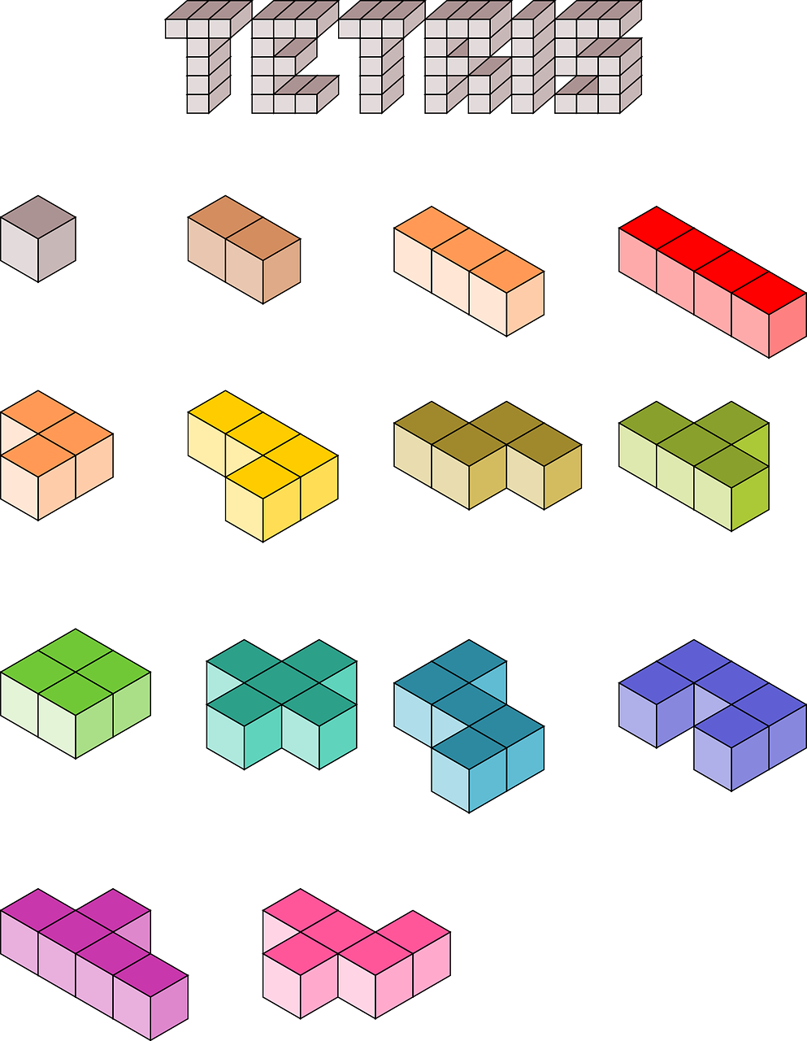
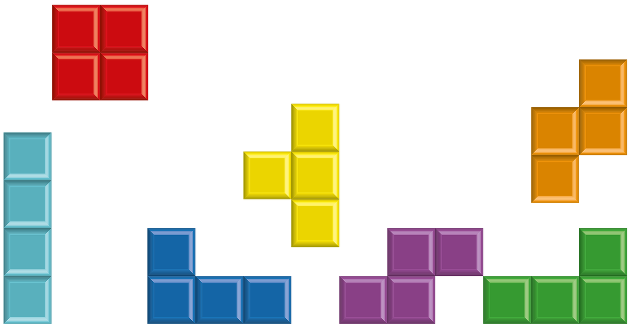
Notes:
That’s right. Tetromino is inspired by the 1980s game Tetris.
Photo sources
https://pixabay.com/illustrations/cube-tetris-play-blocs-bloc-1678974/
https://pixabay.com/vectors/tetris-computer-game-building-blocks-151430/

Slide 13
The true story
Anastasia = Alexey Pajitnov, the programmer of Tetris
Bodana = Vladimir Pokhilko, the designer for Tetris
Alexey and Vladimir created the game together as a side project while working at Russian Academy of Sciences in the early 1980s
Cyril = Bosses of the Russian Academy of Sciences
  Furious that their employees were spending all day playing Tetris instead of doing their jobs
Dmitry = ELORG, state-owned enterprise responsible for computing imports and exports in the Soviet Union
  Saw the potential in Tetris and wanted to monetize it
Notes:
Anastasia is really Alexey Pajitnov and Bodana is really Vladimir Pokhilko, the programmer and designer for Tetris respectively. In the early 1980s Alexey and Vladimir were colleagues at the Russian Academy of Sciences and created the game together as a side project.
In real life, Cyril and Dmitry were entities rather than people. Cyril represents the Russian Academy of Sciences, who were furious that their employees were spending all day playing Tetris instead of doing their jobs. Dmitry represents ELORG, state-owned enterprise responsible for all computing imports and exports in the then Soviet Union. Like Dmitry, when they found about the game ELORG quickly saw the potential in Tetris and wanted to monetize it.

Slide 14
What Happened Next in Real Life?

Slide 15
What Happened Next in Real Life?
The Soviet government (ELORG) unilaterally seized the rights to Tetris

Slide 16
What Happened Next in Real Life?
The Soviet government (ELORG) unilaterally seized the rights to Tetris
From 1984 to 1986, there was an intense battle over Tetris licensing rights between the game’s creators, the Soviet Union, and third-party licensors

Slide 17
What Happened Next in Real Life?
The Soviet government (ELORG) unilaterally seized the rights to Tetris
From 1984 to 1986, there was an intense battle over Tetris licensing rights between the game’s creators, the Soviet Union, and third-party licensors
In 1991, the Soviet Union collapsed

Slide 18
What Happened Next in Real Life?
The Soviet government (ELORG) unilaterally seized the rights to Tetris
From 1984 to 1986, there was an intense battle over Tetris licensing rights between the game’s creators, the Soviet Union, and third-party licensors
In 1991, the Soviet Union collapsed
In 1996, Alexey Pajitnov (Anastasia) finally received his first royalty from Tetris after its IP rights were awarded to him, eventually making $20m USD

Slide 19
What Happened Next in Real Life?
The Soviet government (ELORG) unilaterally seized the rights to Tetris
From 1984 to 1986, there was an intense battle over Tetris licensing rights between the game’s creators, the Soviet Union, and third-party licensors
In 1991, the Soviet Union collapsed
In 1996, Alexey Pajitnov (Anastasia) finally received his first royalty from Tetris after its IP rights were awarded to him, eventually making $20m USD
Vladimir Pokhilko (Bodana) received nothing

Slide 20
What Happened Next in Real Life?
The Soviet government (ELORG) unilaterally seized the rights to Tetris
From 1984 to 1986, there was an intense battle over Tetris licensing rights between the game’s creators, the Soviet Union, and third-party licensors
In 1991, the Soviet Union collapsed
In 1996, Alexey Pajitnov (Anastasia) finally received his first royalty from Tetris after its IP rights were awarded to him, eventually making $20m USD
Vladimir Pokhilko (Bodana) received nothing
Struggling financially, Vladimir murdered his wife and son and committed suicide in 1998, leaving a note stating “I’ve been eaten alive”

Slide 21
What Happened Next in Real Life?
The Soviet government (ELORG) unilaterally seized the rights to Tetris
From 1984 to 1986, there was an intense battle over Tetris licensing rights between the game’s creators, the Soviet Union, and third-party licensors
In 1991, the Soviet Union collapsed
In 1996, Alexey Pajitnov (Anastasia) finally received his first royalty from Tetris after its IP rights were awarded to him, eventually making $20m USD
Vladimir Pokhilko (Bodana) received nothing
Struggling financially, Vladimir murdered his wife and son and committed suicide in 1998, leaving a note stating “I’ve been eaten alive”
A day later a Japanese company offered Vladimir $200,000 for his services helping design video games

Slide 22
What Happened Next in Real Life?
The Soviet government (ELORG) unilaterally seized the rights to Tetris
From 1984 to 1986, there was an intense battle over Tetris licensing rights between the game’s creators, the Soviet Union, and third-party licensors
In 1991, the Soviet Union collapsed
In 1996, Alexey Pajitnov (Anastasia) finally received his first royalty from Tetris after its IP rights were awarded to him, eventually making $20m USD
Vladimir Pokhilko (Bodana) received nothing
Struggling financially, Vladimir murdered his wife and son and committed suicide in 1998, leaving a note stating “I’ve been eaten alive”
A day later a Japanese company offered Vladimir $200,000 for his services helping design video games
Alexey moved the U.S. where his son tragically died in a ski accident

Slide 23
What Happened Next in Real Life?
The Soviet government (ELORG) unilaterally seized the rights to Tetris
From 1984 to 1986, there was an intense battle over Tetris licensing rights between the game’s creators, the Soviet Union, and third-party licensors
In 1991, the Soviet Union collapsed
In 1996, Alexey Pajitnov (Anastasia) finally received his first royalty from Tetris after its IP rights were awarded to him, eventually making $20m USD
Vladimir Pokhilko (Bodana) received nothing
Struggling financially, Vladimir murdered his wife and son and committed suicide in 1998, leaving a note stating “I’ve been eaten alive”
A day later a Japanese company offered Vladimir $200,000 for his services helping design video games
Alexey moved the U.S. where his son tragically died in a ski accident
Tetris has sold over 500 million units and is widely regarded as one of the greatest video games ever made
Notes:
[The instructor paraphrases the bullet points]
The bizarre circumstances of Vladimir’s death have led to conspiracy theories, for example that he and his family were murdered by the mafia.
Sources
https://www.historyvshollywood.com/reelfaces/tetris-movie/
https://www.theguardian.com/film/2023/mar/30/tetris-movie-true-story
https://time.com/6266810/tetris-movie-apple-tv-true-story/
https://variety.com/2023/biz/news/tetris-stays-true-to-real-life-events-based-video-games-origin-1235563756/
https://iesemba.com/2022/08/interview-with-vadim-gerasimov-creator-of-tetris/
https://en.wikipedia.org/wiki/Tetris
https://en.wikipedia.org/wiki/Vladimir_Pokhilko
https://en.wikipedia.org/wiki/Alexey_Pajitnov
http://www.computer-timeline.com/timeline/3348/
https://www.sfgate.com/news/article/pushed-past-the-brink-3305027.php
https://www.timeextension.com/features/flashback-the-tragic-story-behind-the-man-who-helped-create-tetris
https://chooser.ae/alexey-pajitnov-net-worth-a-look-into-the-creator-of-tetris-and-his-success/
https://www.telefonica.com/en/communication-room/blog/best-selling-video-games-in-history/#:~:text=1%20Tetris,the%20computer%20engineer%20Aleks%C3%A9i%20P%C3%A1zhitnov.

Slide 24

Notes:
Thank you for coming!
Image source:
https://pixabay.com/photos/game-over-game-over-computer-2720584/

