Slide 1
The Union Negotiation
06/2024-6922
This slide deck was prepared by Marcos Bruno, INSEAD MBA Alumni, under the supervision of Martin Schweinsberg, Associate Professor of Organisational Behaviour at ESMT Berlin, Horacio Falcão, Professor of Management Practice of Decision Sciences at INSEAD, and Eric Uhlmann, Professor of Organisational Behaviour at INSEAD as additional material to the role play “The Union Negotiation”.
To access INSEAD teaching materials, go to https://publishing.insead.edu/.
Copyright © 2024 Martin Schweinsberg, Horacio Falcão, Eric Uhlmann.
COPIES MAY NOT BE MADE WITHOUT PERMISSION. NO PART OF THIS PUBLICATION MAY BE, COPIED, STORED, TRANSMITTED, TRANSLATED, REPRODUCED OR DISTRIBUTED IN ANY FORM OR MEDIUM WHATSOEVER WITHOUT THE PERMISSION OF THE COPYRIGHT OWNER.

Slide 2
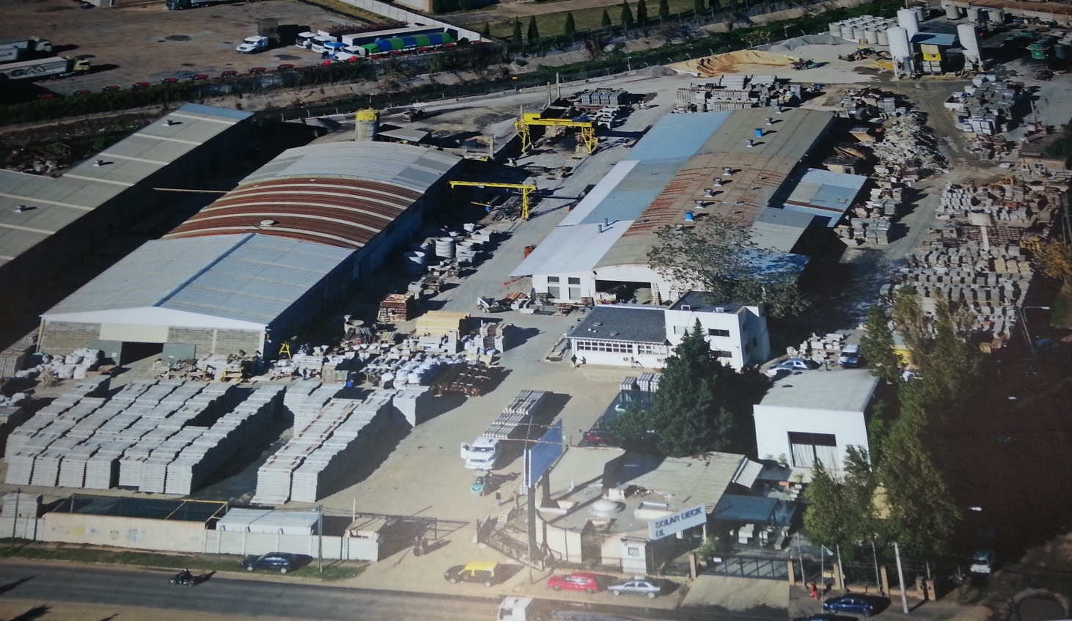
The Union Case
Based on a true story
Notes:
Today we have a discussion case about a series of strategic and ethical dilemmas faced by a family business.
Note: One option for teaching this discussion case is to simply roll through this PowerPoint deck. Another is to hand out hard copies of the case and walk students the right decision by decision, giving them time to read each page before debating what to do next. A third is to assign students to debate different points of view. See the Teaching Note for The Union Case for more details on the latter two options.
Source of photo:
Personal photo by author of The Union Case

Slide 3
The Family Business
Concrear is an industrial manufacturing plant in Central America
Founded by Diego Morales and still owned and operated by the Morales family
Youngest son, Andres Morales (25 years old) placed in charge of labor relations
Dealing with the Workers Confederation, a corrupt union that steals construction materials, inflates payable employee hours, and forces the employees to give them the extra wages
Notes:
The case deals with a family firm called “Concrear,” a manufacturing plant in Central America. It was founded by family patriarch Diego Morales and is still owned and operated by the Morales family. The protagonist of the case is the family’s youngest son, Andres Morales, who at only 25 years of age is placed in charge of labor relations. This may sound like kind of a crazy situation, but its common practice in family firms to give young people a lot of responsibility early. It also gives the family someone they can trust in an important position.
Andres’ huge problem is the notoriously corrupt but government-promoted Workers Confederation union that represents practically all of the factory workers in this small country. The year earlier, the Morales family caught the union stealing construction materials by burying them in the sand that was to be donated to the union. When the trucks were later loaded they would take not only the sand but also the construction materials. They also caught the Workers Confederation forcing the employees to falsely inflate their payable hours and then give the union the extra wages. So just in recent memory, the union has stolen company property and extorted employees. This is a really corrupt and dirty union.

Slide 4

The Second Factory
The company is now expanding operations
Plan to build a second factory and hire 80 employees
In an isolated region with few factories and minimal union presence
Notes:
The company is now expanding operations, planning to build a second factory and hire 80 new employees there. The second factory will be located in an isolated region with few factories and minimal union presence.
Source of photo:
Personal photo by author of The Union Case

Slide 5
What would you do?
1. Contact the Workers Confederation now and invite them to early talks regarding the new factory?
2. Wait until the second factory reaches the maximum number of employees that the Workers Confederation will allow without a union delegate and then reach out to the union?
3. Try to avoid unions altogether given the isolated area?
Notes:
So a question for the class: what would you do? Would you:
1. Contact the Workers Confederation now and invite them to early talks regarding the new factory? So bring in the union from the very beginning?
2. Wait until the second factory reaches the maximum number of employees that the Workers Confederation will allow without a union delegate and then reach out to the union?
3. Try to avoid unions altogether? Since its an isolated area, maybe union involvement doesn’t need to happen at all. This is perfectly legal, the “maximum number of employees without a union” limit is a policy of the Workers Confederation, not national law. You don’t legally have to have a union.
What I would like you to do is each quietly right down your preferred strategy on a piece of paper, without taking to one another. Then we will share as a class. [Students write their choice quietly]. Okay, let's tally votes! By show of hands, who chose Option One? Two? Three? [The students raise their hand for each of the options and the instructor tallies their votes on a flipchart, whiteboard, or blackboard].
[For example:
Option 1: X votes
Option 2: X votes
Option 3: X votes]
Why do you prefer your option? [Class discusses].

Slide 6
Andres decided to attempt to avoid unions all together
Notes:
He chose option 3, to attempt to avoid unions all together by opening the factory in an isolated area and hoping for the best.

Slide 7
Andres decided to attempt to avoid unions all together … which worked for a year.
Notes:
This worked for a whole year.

Slide 8
The Fiasco
Andres decided to attempt to avoid unions all together … which worked for a year.
Realized layoffs would be necessary at the second factory due to economic downturn
Heard rumors that workers enrolling in a militant illegal union called Collective Action
Francisco, one of the workers, insulted the plant manager and was fired
Andres arrived at the factory and saw pile of burning tires outside the factory entrance and large flags for Collective Action hanging from the front gates. Strike!
Notes:
A year later, there was still no union at Concrear’s second factory, which was good news to Andres.
But there was also bad news. A general economic downturn meant that fewer orders were coming in. Andres realized that Concrear had hired too many workers, making layoffs of at least 40 people– half of the total employees at the second factory-- necessary.
Just a few weeks after deciding to lay off a significant part of the workforce, Andres heard that someone was enrolling the workers in a militant workers’ federation called Collective Action. Collective Action was not recognized by the government as a legitimate union like the Workers Confederation. In fact, Collective Action was an illegal militant union.
And then came the spark that ignited the flames. Francisco, one of the workers, used profanity toward the plant manager and was fired.
The next morning, the whole plant was on strike, over just this one dismissal! When Andres arrived at the factory in his car he saw a pile of burning tires outside the factory entrance, and large flags for Collective Action hanging from the front gates.

Slide 9
Realistically assess your alternatives
BATNA or Best Alternative to a Negotiated Agreement:
  What you will do if you don’t reach a deal
Beware a Fantasized Alternative to a Negotiated Agreement (FATNA)
  Fantasy: No union involvement
  Real alternatives included a militant extralegal union
The quality of options depends on the real alternatives
Notes:
Your BATNA is your Best Alternative to a Negotiated Agreement. What you will do if you don’t reach a deal
In considering their alternatives, negotiators should realistically assess what could really happen if they walk away from or decide to not engage in a negotiation. Otherwise you could end up relying on a FATNA or Fantasized Alternative to a Negotiated Agreement. This is a pie in the sky alternative that is unlikely to materialize. In The Union Case, Andres relies on the FATNA of no union involvement, when his real alternatives included a militant extralegal union that was even worse that the first union.
Remember also the quality of options is always relative, it depends on the alternatives. Firing an underperforming employee only makes sense if you have someone better. Avoiding a union because it is corrupt makes a less sense if there are much worse unions you could end up with.

Slide 10
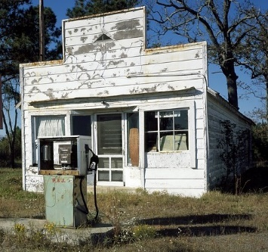
The Call
Andres received a call on his private cell phone from Collective Action’s leadership
Summoning him to an isolated gas station for a meeting
Notes:
So Andres is sitting in his car outside the factory watching the protesters and burning tires and giant Collective Action banners when his phone rings. Its from Collective Action’s leadership. He asks himself, how did they get my cellphone number? The union leaders want him to come to an isolated gas station for a meeting.
Source of photo:
https://pixabay.com/en/petrol-stations-gas-pump-petrol-gas-1638027/

Slide 11
What would you do?
1. You drive to the gas station alone in your car?
2. You call a few of the management to come along with you to the gas station?
3. You call a few policemen to come along with you to the gas station, just in case?
4. You say that you will only meet them at your office and schedule a time for them to do so?
5. You call the police to disband the illegal activity at your factory and to arrest the troublemakers who invited you to meet at a suspicious venue with a clear intent to kidnap or coerce you?
Notes:
So a question for the class: what would you do? Would you:
1. Drive to the gas station alone in your car?
2. Call someone from management to come along with you to the gas station?
3. Call a few policemen to come along with you to the gas station?
4. Say that you will only meet them at your office and schedule a time?
5. Call the police to disband the illegal activity at your factory and arrest guys trying to kidnap you?
What I would like you to do is each quietly right down your preferred strategy on a piece of paper, without taking to one another. Then we will share as a class. [Students write their choice quietly]. Okay, let's tally votes! By show of hands, who chose Option One? Two? Three? Four? Five? [The students raise their hand for each of the options and the instructor tallies their votes on a flipchart, whiteboard, or blackboard].
[For example:
Option 1: X votes
Option 2: X votes
Option 3: X votes
Option 4: X votes
Option 5: X votes]
Why do you prefer your option? [Class discusses].

Slide 12
“The Bull”
Andres drove to the gas station alone in his car
  Wanted to show his father he could handle the situation alone, a common motivation in family firms
Was met by four pick-up trucks with fifteen large, aggressive looking members of the illegal union
Approached by the “The Bull” their heavily muscled, tattooed, bald leader
  Yelled at Andres, accusing Concrear of acting unethically
  Demanding that Concrear re-hire Francisco and recognize Collective Action as their official union
Notes:
Andres drove to the gas station alone in his car. I know that sounds crazy, but this is a common dynamic in family firms. Andres wanted to show his father he could handle the situation alone. At the gas station, he was met by four pick-up trucks with fifteen large, aggressive looking members of the illegal union. Their leader was the “The Bull” -- heavily muscled, tattooed, and bald. Looks like he just got out of prison. The Bull yelled at Andres, accusing Concrear of acting unethically, and demanded that the company re-hire Francisco and recognize Collective Action as their official union.

Slide 13
What would you do?
1. Do you walk back to your car, tell them that they know where they can meet you at your office and drive away?
2. Do you call the police and say that you are being illegally intimidated by criminals?
3. Do you rehire Francisco and recognize Collective Action as your official union?
4. Do you only rehire Francisco? Or only recognize Collective Action as your official union?
5. Do you say that you will only do any of these two things IF the Collective Action agrees to stop the strike right now?
6. Do you contact the Workers Confederation union from Concrear’s first factory to tell them that Collective Action is encroaching on their territory and have them talk to The Bull?
7. Do you just start to negotiate with The Bull to better understand their demands? In public or private? Alone or in teams?
Notes:
So a question for the class: what would you do? Would you:
1. Get out of there? Walk back to your car, tell them that they know where they can meet you at your office and drive away?
2. Call the police and say that you are being intimidated by criminals?
3. Rehire Francisco and recognize Collective Action as your official union?
4. Only rehire Francisco? Only recognize Collective Action as your official union?
5. Say that you will only do any of these two things IF Collective Action agrees to stop the strike right now?
6. Contact the Workers Confederation union from Concrear’s first factory and get their help pushing Collective Action out?. Given this situation, maybe the Workers Confederation weren’t so bad after all.
7. Just start to negotiate with The Bull? If yes, in public or private, and alone or in teams?
What I would like you to do is each quietly right down your preferred strategy on a piece of paper, without taking to one another. Then we will share as a class. [Students write their choice quietly]. Okay, let's tally votes! By show of hands, who chose Option One? Two? Three? Four? Five? Six? Seven? Eight? [The students raise their hand for each of the options and the instructor tallies their votes on a flipchart, whiteboard, or blackboard].
[For example:
Option 1: X votes
Option 2: X votes
Option 3: X votes
Option 4: X votes
Option 5: X votes
Option 6: X votes
Option 7: X votes]
For those who chose Option 7, negotiate with The Bull, do you prefer in public or private? Alone or in teams?
[The students raise their hand for each of the sub-options and the instructor tallies their votes on a flipchart, whiteboard, or blackboard].
[For example:
Option 7: Public: X votes
Private: X votes
Alone: X votes
In teams: X votes]
Why? [Class discusses] Why might it be good to negotiate with The Bull in public? In private? Alone? In teams? [Class discusses]. Politically, can The Bull be nice to Andres in public or in front of others? [Students answer: No].

Slide 14
Negotiating Communication
Andres decided to invite The Bull to negotiate just the two of them
In public, The Bull’s role as leader of a militant union requires him to act hostile toward representatives from management
In private one-on-one conversations The Bull turned out to be more open to discussion
Notes:
Andres decided to invite The Bull to negotiate one-on-one. In public, The Bull’s role as leader of a militant union requires him to act aggressively toward representatives from management. But in private one-on-one conversations he turned out to be much more open to discussion.

Slide 15
What do you expect The Bull’s interests to be?
1. The Bull is a criminal who only wants power, to remain in the margins/illegality and beat down management
2. The Bull is a leftist troublemaker who hates management as the ultimate enemy and no matter what management does, he and his union will always be in opposition with management
3. The Bull truly believes that he is doing the work of protecting the workers against inequities from the management
4. The Bull wants to gain recognition, consolidate his leadership position and the status of his union, as well as protect his friends
5. The Bull wants money, even if it means taking advantage of his leadership position to demand a big bribe for the strike to go away
6. The Bull started a process that he did not really know how to end and now needs to save face and come across as a winner
Notes:
A question for the class: What do you think The Bull is after?
1. Do you think the Bull is a criminal who only wants power, to remain in the margins of society and beat down management?
2. Could he be a die-hard rabble-rouser? Maybe the Bull is a leftist troublemaker who hates management as the ultimate enemy and no matter what Andres does, The Bull will always be his enemy.
3. Could he be an ideologue? Maybe the Bull truly believes that he is doing the work of protecting the workers against injustices from management.
4. Do you think the Bull wants to gain recognition, consolidate his leadership position and the status of his union, and protect his friends?
5. Maybe the Bull just wants money, maybe a big bribe would make the strike to go away…
6. Or what if it’s The Bull who is scared? What if he started a process that he did not really know how to end and now needs to save face and come across as a winner?
What I would like you to do is each quietly right down what you think The Bull’s underlying interest is. Then we will share as a class. [Students write their choice quietly]. Okay, let's tally votes! By show of hands, who chose Option One? Two? Three? Four? Five? Six? [The students raise their hand for each of the options and the instructor tallies their votes on a flipchart, whiteboard, or blackboard].
[For example:
Option 1: X votes
Option 2: X votes
Option 3: X votes
Option 4: X votes
Option 5: X votes
Option 6: X votes]
Why do you think so? [Class discusses].

Slide 16
Agent-Principal Problems
When one person (the agent) can make decisions on behalf of another (the principal), but has different underlying interests.
Examples:
  Real estate agents leave their own house on the market much longer than their clients’
  CEOs inflate their own pay when governance is weak
  Your lawyer may advocate for litigation
Notes:
An agent-principal problem occurs when one person (the agent) can make decisions on behalf of another (the principal), but has different underlying interests.
A few examples. Real estate agents leave their own house on the market much longer than their clients’. Why is that? Because they earn more, faster commissions that way, turning over deals quickly. Another example is that CEOs inflate their own pay when their board is weak. Another common case is lawyers, who may recommend you sue to drive up their fees, even if that was not your best strategy.
References
Rutherford, R., Springer, T. & Yavas, A. (2005). Conflicts between principals and agents: evidence from residential brokerage. Journal of Financial Economics, 76, 627-665.
Bertrand, M., & Mullainathan, S. (2001). Are CEOs rewarded for luck? The ones without principals are. Quarterly Journal of Economics, 116, 901–932
http://m.qje.oxfordjournals.org/content/116/3/901.abstract

Slide 17

Could Collective Action have an agent-principal problem with The Bull? What is in The Bull’s personal self interest?
Notes:
Could Collective Action have an agent-principal problem with The Bull? What is in The Bull’s personal self interest? [Students answer].

Slide 18
What is in The Bull’s self-interest?
Receive credit for good outcomes and deflect blame for bad ones
Eliminate political opposition and potential rivals within the union, and protect his allies (which include Francisco)
Gain official recognition of Collective Action and his status as its leader (salary, benefits, no longer a criminal thug in eyes of law)
Agreement with Concrear that allows him to claim victory
Are these in the ideological interests of the militant Collective Action union?
Notes:
Andres learned that The Bull’s interests were in many cases very different from the union he represented. He wanted to gain government recognition for Collective Action and be recognized as its official leader, which would give him both power and a much better salary than as the leader of a currently marginalized and illegal union. Like any leader, the Bull would want to look after his political supporters and eliminate opponents within his organization. However, the Bull also needed a deal with Concrear that would allow him to look like he won and avoid being blamed personally for any negative outcomes for the workers.
Are these in the ideological interests of the militant Collective Action union? [Students answer]. Not really. Basically, The Bull wants to “sell out” and take his organization legitimate to get a more comfortable situation for himself. That’s against the ideological purpose of Collective Action.

Slide 19
The Bull’s proposal
Andres
Rehires Francisco
Enrolls employees in Collective Action
Helps Collective Action gain recognition from government
Recognizes The Bull as leader
Small wage increase
The Bull chooses who is laid off (eliminate opponents)
The Bull
Puts an end to the strike
Guarantees that employees will perform on the job
Allows the layoffs (will blame it on government) but gets to choose who is laid off
If you were Andres, would you accept this deal?
Notes:
So here is the proposal The Bull made to Andres. He offered to put an end to the strike, guarantees that employees will perform on the job, and allow the layoffs Andres needs to make which they can blame on the government.
In return, Andres must rehire Francisco, enroll the employees in the second factory in Collective Action, helps Collective Action gain recognition from government, recognize The Bull as the organization’s legitimate leader, and approve a small wage increase.
Here’s the unusual element of the proposal: Although Andres can lay off half the workers at the second factory without any union trouble, The Bull chooses who is laid off. This is so he can eliminate his more militant opponents within Collective Action and take the organization legitimate. So he offers to collude with Andres.
If you were Andres, would you accept this offer? Please write down your decision quietly on your own. Then we will share as a class. [Students write their choice quietly]. Okay, let's tally votes! By show of hands, who says Yes? Who says No? [The students raise their hand for each of the options and the instructor tallies their votes on a flipchart, whiteboard, or blackboard].
[For example:
Yes: X votes
No: X votes]
Why or why not? [Class discusses]. What is Andres BATNA? [Students answer]. Possibly the failure of the struggling second factory after a prolonged strike, or even the entire company. Does that change anyone’s opinion? [Class discusses].

Slide 20
Conclusion of The Union Case
Andres accepted the deal and The Bull kept his side of the bargain
Collective Action is now a government-sanctioned union
The second Concrear factory has operated successfully for six years without any more major strikes
Andres and The Bull have become personal friends
Notes:
So here is what happened in the end. Andres accepted the deal and The Bull kept his side of the bargain. Collective Action is now a government-sanctioned union. The second Concrear factory has operated successfully for six years without any more major strikes. Andres and The Bull have become personal friends.

Slide 21
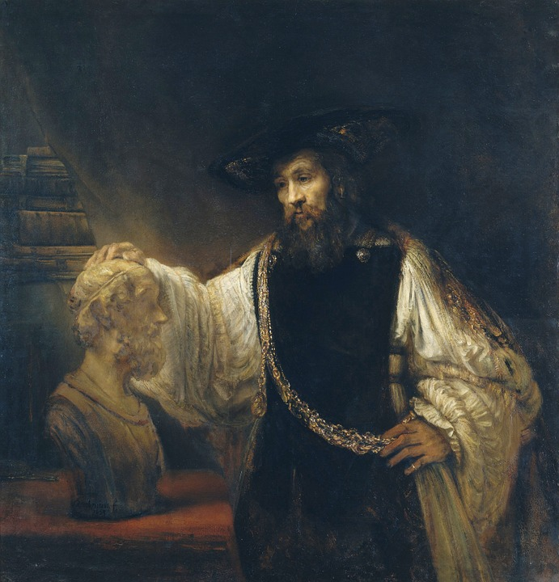

Major philosophical perspectives on ethics
Ethical dilemmas often arise when agents and principals have incompatible incentives
Notes:
Ethical dilemmas often arise when agents and principals have incompatible incentives. Do you know some of the major philosophical perspectives on ethics? [Students answer].
Source of photos:
--Personal photo by the author of the Union Case
--https://pixabay.com/en/rembrandt-aristotle-bust-art-93203/

Slide 22
Philosophical Perspectives on Ethics
Consequentialism: Ethical acts are those that maximize good outcomes or utility (Mill, 1863/1998)
  Do the ends justify the means?
Deontology: Ethics are a matter of principle and duty (Kant, 1796/1996)
  Is it a matter of principle?
Virtue theory: What would a good person do? (Aristotle, 4th Century B.C.E./1998; Hume, 1739/1888)
  Mirror test: How you would feel about your decision if you looked in the mirror afterward?
Notes:
Let’s analyze the case from the standpoint of three of the major philosophical schools of thought on ethics.
The first is consequentialism. From this philosophical perspective, ethical acts are those that produce the best outcomes or maximize utility. Usually in some quantifiable metric, like money or lives saved. This perspective is reflecting in the saying “The ends justify the means.” All that matters is getting a good result. This is a totally legitimate school of ethical thought.
Second, there is deontology. From this perspective, ethics are a matter of principle. Some things are right or wrong regardless of the consequences. All major religions are deontological.
Third, there is virtue theory. This perspective goes back to Aristotle, and asks what a good person would do. Relevant here is the “Mirror Test”: How you would feel about this decision if you looked in the mirror afterward?
References
Aristotle (4th Century, B.C.E./1998). The Nicomachean ethics. Oxford: Oxford University Press.
Hume, D. (1739/1888). A treatise of human nature. Oxford: Oxford University Press.
Kant, I. (1796/2002). Groundwork for the metaphysics of morals. New York: Oxford University Press.
Mill, J.S. (1863/1998). Utilitarianism. Oxford University Press.

Slide 23

Is the deal Andres and The Bull made ethically justified?
Notes:
Do you think the deal Andres and The Bull made is ethically justified? Please write down your opinion quietly on your own. Then we will share as a class. [Students write their choice quietly]. Okay, let's tally votes! By show of hands, who says Yes, it was ethical? Who says No? [The students raise their hand for each of the options and the instructor tallies their votes on a flipchart, whiteboard, or blackboard].
[For example:
Yes: X votes
No: X votes]
Why or why not? [Class discusses].

Slide 24
The losers in the deal?
The Union, in some ways. Collective Action lost its identity and brand as a militant union that has not “sold out”
Workers laid off for political reasons rather than on-the-job performance
Leader Member Exchange Theory (LMX)
  Leaders direct organizational resources towards political supporters and away from opponents (Graen & Uhl-Bien, 1995; Graen & Canedo, 2016).
Notes:
There are some real losers in this deal. Half the workers lost their jobs for for political reasons rather than on-the-job performance. Collective Action as an organization lost its identity and brand as a militant union that has not “sold out.” Andres and Concrear successfully colluded with The Bull at the expense of his opponents within Collective Action.
According to Leader Member Exchange Theory, which is an influential theory of leadership, The Bull’s actions are typical of leaders, who use their position of power to direct organizational resources towards political supporters and away from opponents. From this perspective, this just typical leader behavior.
References
Graen, G. B., & Uhl-Bien, M. (1995). The relationship-based approach to leadership:
Development of LMX theory of leadership over 25 years: Applying a multi-level, multi-domain perspective. Leadership Quarterly, 6(2), 219–247.
Graen, G. B., & Canedo, J. (2016). The new workplace leadership development. Oxford
Bibliography on Management. Oxford University Press, N.Y., New York.

Slide 25
Ethics and the Union Case
1. Consequentialism: Did Andres maximize good outcomes? Did the ends justify the means?
2. Deontology: As a matter of principle, is making the kind of deal Andres made with The Bull ok?
3. Virtue theory: Would a virtuous person do what Andres did?
  Mirror test: How you would feel about making this deal if you looked in the mirror afterward?
Notes:
Let’s analyze the deal from the three perspectives on ethics.
Please quietly write down your opinion to all three of these questions. Then we will share as a class.
1. Did Andres maximize good outcomes?
2. As a matter of principle, is making the kind of deal Andres made with The Bull ok?
3. Would you feel good about yourself as a person if you looked in the mirror after making this deal?
[Students write their judgments quietly]. Okay, let's tally votes! By show of hands, who says Yes, this maximized good outcomes? Who says no? Who says as a matter of principle, this is ok? Who says no? Who would feel good about themselves after making this decision? Who says no?
[The students raise their hand for each of the options and the instructor tallies their votes on a flipchart, whiteboard, or blackboard].
[For example:
Yes: X votes
No: X votes]
So you see that which perspective on ethics you apply strongly affects whether the deal is ok or not. Different legitimate perspectives on ethics lead to different decisions. So think about which perspective you agree with most and will bring to your future ethical decisions.

Slide 26
Leadership and Ethics
High status associated with a consequentialist perspective on ethics (Côté, Piff, & Willer, 2013)
Responsibility as a leader to maximize value for large numbers of stakeholders (Molinsky & Margolis, 2005)
Increased tendency to focus on achieving good outcomes rather than matters of principle
  This is what Andres did in The Union Case
Notes:
Here is something else to ponder. Research shows that higher status is associated with a consequentialist perspective on ethics, a tendency to believe the ends justify the means. Leaders have a responsibility to maximize value for large numbers of stakeholders, that’s a major part of their role. This leads them to focus on achieving good outcomes rather than matters of principle, like Andres did in The Union Case. Again, this is a totally legitimate perspective on ethics, a lot of philosophers believe it is the most logically defensible one.
References
Côté, S., Piff, P.K., & Willer, R. (2013). For whom do the ends justify the means? Social class and utilitarian moral judgment. Journal of Personality and Social Psychology, 104(3), 490-503.
Molinsky, A.L., & Margolis, J.D. (2005). Necessary evils and interpersonal sensitivity in organizations. Academy of Management Review, 30, 245-268.
Uhlmann, E.L., Zhu, L., & Tannenbaum, D. (2013). When it takes a bad person to do the right thing. Cognition, 126, 326-334.

Slide 27
Take-Aways: The Union Case
Agent-principal problems: The interests of agents and those they represent are not necessarily aligned
  Understanding the individual incentive structures of all the parties involved can be the key to successfully reaching an agreement
Three ethical perspectives: Consequentialism (focused on outcomes), deontology (focused on principles), and virtue theory (focused on character)
  All have legitimacy, and often provide different answers about what the ethical thing to do is
  Ethics makes decision making harder, not easier
Notes:
Some take-aways from the Union Case. Remember to watch out for agent-principal problems. The interests of agents and those they represent are not necessarily aligned. Understanding the individual incentive structures of all the parties involved can be the key to successfully reaching an agreement.
Also remember consequentialism -- focused on outcomes, deontology -- focused on principles, and virtue theory -- focused on character. All have legitimacy, and often provide different answers about what the ethical thing to do is. Most of the frameworks we will cover in this class are designed to make decision making easier. In contrast, ethics makes decision making harder and more of a struggle.

