Slide 1
The Prince
06/2024-6921
This slide deck was prepared by Radhika Goel, Nico Dehnert, Varun Goel, Arra Khararjian, and Giovanni Nati, INSEAD MBA Alumni, under the supervision of Martin Schweinsberg, Associate Professor of Organisational Behaviour at ESMT Berlin, Horacio Falcão, Professor of Management Practice of Decision Sciences at INSEAD, and Eric Uhlmann, Professor of Organisational Behaviour at INSEAD, as additional material to the role play “The Prince”.
To access INSEAD teaching materials, go to https://publishing.insead.edu/.
Copyright © 2024 Martin Schweinsberg, Horacio Falcão, Eric Uhlmann.
COPIES MAY NOT BE MADE WITHOUT PERMISSION. NO PART OF THIS PUBLICATION MAY BE, COPIED, STORED, TRANSMITTED, TRANSLATED, REPRODUCED OR DISTRIBUTED IN ANY FORM OR MEDIUM WHATSOEVER WITHOUT THE PERMISSION OF THE COPYRIGHT OWNER.

Slide 2


Multi-Party Negotiations
Notes:
Welcome! Today’s lecture will be on multi-party negotiations. We will bring this topic to life using a role-play exercise.
Source of photo (open source)
https://pixabay.com/illustrations/king-lady-runner-tower-horse-1716907/

Slide 3
Three-Party Exercise: The Prince
Process
3 roles: The NCG, RLS, & ITS movie studios
Find your partners and negotiate in groups of at least 3 students (groups of 4 should double up the ITS role)
Decide within your group who gets which role, and READ ONLY YOUR ROLE!
Timeline (90 minutes in total):
Read your role and plan a strategy (max 15 minutes)
Negotiate in groups of at least three (max 1 hour and 10 minutes)
Fill out 1 copy of the outcome form
Exchange feedback with both partners (5 minutes)
Take a 15 minute break
Role-play rules
You cannot share your role materials or read a role other than your own
You cannot make up outrageous lies (imaginary budgets, fake laws)
Notes:
You will play the roles of the heads of three movie studios negotiating the terms of a film production.
You will have 15 minutes to read your role materials and plan your strategy, then 1 hour and 10 minutes to negotiate with your two partners. At the point please give me your outcome form and exchange some feedback with your counterparts. The lecture will begin again in 1 hour and 40 minutes. Please try to find partners you know less well than the others, and to the extent you can different people than in your previous negotiations. [Students partner up, the instructor hands out role materials and outcome forms, and the students negotiate.]
[During the negotiations, the instructor should walk around and take mental or written notes on some of the negotiations, highlighting tactics and reactions that can be brought up later during the debriefs when students are asked to share their experiences or when key teaching points are made, for instance regarding coalitions].
[As the students come back with their outcome forms, the instructor creates the results slide that appears later in this deck. The trios of students are given their negotiation group number as they turn in their results and are asked to remember it for the debrief].
Note: An alternative approach to creating the pairings is for the instructor to pair students up himself/herself, either by creating pairings before class begins or ad-hoc now during the lecture.
Note: There must be at least one student in each role for this negotiation. The negotiation exercise will not work properly if no one has one or more roles. If students are not divisible into groups of 3, have more than 1 student in one or more roles.

Slide 4
Group | NCG | ITS | RLS | BOR
1
2
3
4
5
6
7
8
9
10
11
Notes:
Here are your breakout room slides for this exercise. Please grab your role materials– they are printed in the color that matches the color of the column your name is listed in on the slide. Then pair up with your two partners, and enjoy the exercise! [Students get their role materials and go to negotiate].
Note: This template students pairings slide is for if the instructor sorts students into negotiating groups beforehand. Students’ individual names are added in the respective columns. If this slide is used, the color background for each role on the slide above should match the color of the role materials that are handed out to students, to avoid confusion. The “BOR” column refers to “Breakout Room” and only applies if the instructor has special rooms for the students to negotiate in. “GROUP” refers to negotiation group number, in other words each group of students who negotiate together.
Note: For each Group, there must be at least one student in each role for this negotiation. The negotiation exercise will not work properly if no one has one or more roles. If students are not divisible into groups of 3, have more than 1 student in one or more roles.

Slide 5
Notes:
Note: Placeholder slide to avoid spoilers

Slide 6
Debrief of The Prince
Take 3 minutes and share with the person next to you:
One thing each of the other negotiators did well
One thing you could have done differently
Notes:
[Students have returned from their negotiations]. Welcome back! I hope you enjoyed the case. We will now debrief The Prince.
Please take 3 minutes and share with the person sitting next to you, who is not necessarily your negotiation partner. One thing that the other negotiators did well in The Prince, and one thing you could have done better. [Students discuss].
Source of photo (open source)
https://pixabay.com/illustrations/king-lady-runner-tower-horse-1716907/

Slide 7
Debrief of The Prince
How did it go negotiating
with multiple counterparts?
Notes:
We will now briefly cover the topic of multi-party negotiations, cases in which there are more than two parties with distinct roles and interests. Did it feel different negotiating with three parties? [Students share their experiences].
Source of photo (open source)
https://pixabay.com/illustrations/king-lady-runner-tower-horse-1716907/

Slide 8
Geometric Increase in Complexity
Notes:
One more party in a negotiation is a geometric addition of complexity, not a symmetric increase. So adding a third party to a two-party negotiation does not increase the complexity and difficulty by 50%, it increases it by much more. Why? [Students answer].
Source of photo (open source)
https://pixabay.com/en/king-lady-runners-tower-horse-1716907/

Slide 9
Alternatives
Notes:
The BATNA is your best alternative to a negotiated agreement, an important consideration in all negotiations. How are alternatives different in multi-party situations? [Students respond].

Slide 10
Alternatives
All negotiators must carefully consider their BATNA (Best Alternative to a Negotiated Agreement)
In multi-party situations, some parties may form a coalition
Move from a three-party to a two-party situation (e.g., RLS and ITS make The Prince without NCG)
Capturing the value at the expense of the excluded party
This internal BATNA makes it more difficult to build interdependence (better-off-togetherness) and trust
Notes:
In multi-party situations, some parties may form a coalition, for instance moving from a three-party to a two-party situation by cutting someone else out of the agreement entirely. Who can do this in The Prince? [Students answer]. Because they jointly hold the legal rights to any film version of the book, RLS and ITS have the “internal BATNA,” the alternative within the negotiation, of forming a coalition and cutting NCG out of the production of The Prince. Even if you are not cut out of the deal, the other parties can form an alliance against you, leaving you with very little value. The possibility of coalitions forming makes it harder to build interdependence and trust among three than two, because of the fear of a coalition against you.
References re alternatives and dyadic (2-party) negotiations
Falcão, H. (2010). Value Negotiation: How to Finally Get the Win- Win Right. Singapore: Prentice Hall.
Thompson, L. (2001). The Mind and Heart of the Negotiator (2nd Edition). Upper Saddle River, NJ: Prentice Hall, 2nd edition
References and further readings on coalitions:
Brion, S., & Anderson, C. (2013). The loss of power: how illusions of alliance contribute to powerholders’ downfall. Organizational Behavior and Human Decision Processes, 121, 129–139.
Caplow, T. (1956). A theory of coalitions in the triad. American Sociological Review, 21(4), 489–493. https://doi.org/10.2307/ 2088718
Chertkoff, J. M. (1966). The effects of probability of future success on coalition formation. Journal of Experimental Social Psychology, 2(3), 265–277. https://doi.org/10.1016/0022- 1031(66)90083-7
Chertkoff, J. M., & Braden, J. L. (1974). Effects of experience and bargaining restrictions on coalition formation. Journal of Personality and Social Psychology, 30(1), 169–177. https:// doi.org/10.1037/h0036615
Diermeier, D., Swaab, R.I., Medvec, V., & Kern, M.C. (2008). The micro-dynamics of coalition formation. Political Research Quarterly, 61, 484-501.
Gamson, W. A. (1961). A theory of coalition formation. American Sociological Review, 26(3), 373–382. https://doi.org/10.1257/ aer.90.4.1072
Gamson, W. A. (1961). An experimental test of a theory of coalition formation. American Sociological Review, 26(4), 565– 573. https://doi.org/10.2307/2090255
Gamson, W. A. (1964). Experimental studies of coalition formation. Advances in Experimental Social Psychology, 1, 81–110. https://doi.org/10.1016/S0065-2601(08)60049-0
Kern, M. C., Brett, J. M., Weingart, L. R., & Eck, C. S. (2020). The “fixed” pie perception and strategy in dyadic versus multiparty negotiations. Organizational Behavior and Human Decision Processes, 157, 143-158. https://doi.org/10.1016/j.obhdp.2020.01.001
Komorita, S. S. (1984). Coalition bargaining. Advances in Experimental Social Psychology, 18(1), 183–245. https://doi.org/ 10.1016/S0065-2601(08)60145-8
Komorita, S. S., Aquino, K. F., & Ellis, A. L. (1989). Coalition bargaining: A comparison of theories based on allocation norms and theories based on bargaining strength. Social Psychology Quarterly, 52(3), 183–196. https://doi. org/10.2307/2786713
Komorita, S. S., & Chertkoff, J. M. (1973). A bargaining theory of coalition formation. Psychological Review, 80(3), 149–162. https://doi.org/10.1037/h0034341 K
Komorita, S. S., & Meek, D. D. (1978). Generality and validity of some theories of coalition formation. Journal of Personality and Social Psychology, 36(4), 392–404. https:// doi.org/10.1037//0022-3514.36.4.392
Komorita, S. S., & Parks, C. D. (1995). Interpersonal relations: Mixed-motive interaction. Annual Review of Psychology, 46, 183–20
Kravitz, D. A. (1981). Effects of resources and alternatives on coalition formation. Journal of Personality and Social Psychology, 41(1), 87–98.
Mannix, E.A. (1993). Organizations as resource dilemmas: the effects of power balance on coalition formation in small groups. Organizational Behavior and Human Decision Processes, 55, 1–22.
Miller, C. E., & Wong, J. (1986). Coalition behavior: Effects of earned versus unearned resources. Organizational Behavior and Human Decision Processes, 38(2), 257–277.
Murnighan, J. K. (1991). The game of 4-3-2. In J. K. Murnighan (Ed.) The dynamics of bargaining games (pp. 129–139). Prentice-Hall.
Polzer, J., Mannix, E., & Neale, M. (1998). Interest alignment and coalitions in multi-party negotiation. Academy of Management Journal, 41, 42-54.
Suesse, J.M., & Ibarra, H. (1997). Building Coalitions. Harvard Business School. 9-497-055.
Swaab, R.I., Kern, M.C., Medvec, V., & Diermeier, D. (2009). Who says what to whom? The impact of communication setting and channel on exclusion from multiparty negotiation agreements. Social Cognition, 27, 381-397.
Swaab, R.I., Postmes, T., & Spears, R. (2008). Identity formation in multiparty negotiations. British Journal of Social Psychology, 47, 167-187.
van Beest, I., Steinel, W., & Murnighan, J. K. (2011). Honesty pays: On the benefits of having and disclosing information in coalition bargaining. Journal of Experimental Social Psychology, 47(4), 738–747. https://doi.org/10.1016/j.jesp.2011.02.013
van Beest, I., van Dijk, E., & Wilke, H. (2004). Resources and alternatives in coalition formation: The effects on payoff, self-serving behaviour, and bargaining length. European Journal of Social Psychology, 34(6), 713–728. https://doi.org/10.1002/ejsp.226
van Beest, I., van Dijk, E., & Wilke, H. (2004). The interplay of self-interest and equity in coalition formation. European Journal of Social Psychology, 34(5), 547–565. https://doi. org/10.1002/ejsp.216
van Beest, I., Wilke, H., & van Dijk, E. (2003). The excluded player in coalition formation. Personality & Social Psychology Bulletin, 29(2), 237–247. https://doi.org/10.1177/0146167202239049
Van Beest, I., Van Kleef, G. A., & Van Dijk, E. (2008). Get angry, get out: The interpersonal effects of anger communication in multiparty negotiation. Journal of Experimental Social Psychology, 44, 993-1002.
Vinacke, W. E., & Arkoff, A. (1957). An experimental study of coalitions in the triad. American Sociological Review, 22(4), 406–414. https://doi.org/10.2307/2089158
Vinacke, W. E., Crowell, D. C., Dien, D., & Young, V. (1964). The effect of information about strategy on a three-person game. Behavioral Science, 11(3), 180–189. https://doi.org/https://doi. org/10.1002/bs.3830110305
Warwick, P. V. (1996). Coalition government membership in West European parliamentary democracies. British Journal of Political Science, 26(4), 471–499. https://doi.org/10.1017/ S0007123400007572
Wilke, H., & Mulder, M. (1971). Coalition formation on the gameboard. European Journal of Social Psychology, 1(3), 339–355. https://doi.org/10.1002/ejsp.2420010305
Wilke, H., & Mulder, M. (1974). A comparison of rotation versus non-rotation in coalition formation experiments. European Journal of Social Psychology, 4(1), 99–102. https://doi.org/ 10.1002/ejsp.2420040109

Slide 11
Win-Win in Multi-Party Situations?
Notes:
All this seems quite cutthroat. How can we negotiate for a win-win in multi-party situations?

Slide 12
Win-Win in Multi-Party Situations?
Three negotiations:
Substance: What is the final objective deal?
Relationships: How do we feel about each other?
Communication: Through what process will we negotiate?
Manage relationships to avoid adversarial coalitions
Move from a coalition mentality to a consensus-building mentality
Communication process becomes of paramount importance
Transparent and open communication if you want to include
Side channels if your aim is to exclude
Notes:
There are always three negotiations proceeding in parallel:
Substance: What is the final objective deal?
Relationships: How do we feel about each other?
Communication: Through what process will we negotiate?
In a multi-party situation you need to manage relationships to avoid adversarial coalitions. And the communication process becomes of paramount importance. You need to proactively set the agenda and facilitate discussion to move the group mindset from a coalition mentality to a consensus-building mentality, from win-lose to win-win.
Reference regarding the three negotiations:
Falcão, H. (2010). Value Negotiation: How to Finally Get the Win- Win Right. Singapore: Prentice Hall.
References re side channels in multi-party negotiations:
Swaab, R.I., Phillips, K.W.P., Diermeier, D., & Medvec, V. (2008). The pros and cons of dyadic side conversations in small groups: The impact of group norms and task type. Small Group Research, 39, 372-390.
Swaab, R.I., Kern, M.C., Medvec, V., & Diermeier, D. (2009). Who says what to whom? The impact of communication setting and channel on exclusion from multiparty negotiation agreements. Social Cognition, 27, 381-397.

Slide 13
 | NCG | ITS | RLS
Alternatives (source of power) | Loss of artistic and financial opportunity to make The Prince | Coalition with RLS (internal BATNA), bankruptcy without deal | Coalition with ITS (internal BATNA), making more bad robot movies if no deal here
Views on profits | Feels high percentage of profits to NCG is only fair | Desperate to get as high % of the profits as possible | Open to share the profits if the film is created and funded jointly
Views on funding movie | Would ideally pay ITS and RLS 1% of profits each for the rights and make movie alone | Wants to reduce financial investment as much as possible, but can go as high as $50 million | Willing and able to fund the film
Notes:
So what are the alternatives for the three studios? [Students answer].

Slide 14
 | NCG | ITS | RLS
Alternatives (source of power) | Loss of artistic and financial opportunity to make The Prince | Coalition with RLS (internal BATNA), bankruptcy without deal | Coalition with ITS (internal BATNA), making more bad robot movies if no deal here
Views on profits | Feels high percentage of profits to NCG is only fair | Desperate to get as high % of the profits as possible | Open to share the profits if the film is created and funded jointly
Views on funding movie | Would ideally pay ITS and RLS 1% of profits each for the rights and make movie alone | Wants to reduce financial investment as much as possible, but can go as high as $50 million | Willing and able to fund the film
Notes:
RLS’s main alternative outside of the negotiation is making more of their terrible robot movies, which are critically panned but make lots of money. Although that might seem ok, RLS is in fact extremely motivated to reach a deal, since The Prince is the only project available to them with a chance for real critical acclaim.
Without a deal here NCG will lose the opportunity to make the follow-up to their only big hit, and ITS will probably go bankrupt.
As I mentioned earlier ITS and RLS have the internal alternative within the negotiation, of cutting NCG out and making the movie just the two of them. If they do this they risk losing a lot of the fan’s interest in The Prince, which follows on the huge success of NCG’s The King.

Slide 15
 | NCG | ITS | RLS
Alternatives (source of power) | Loss of artistic and financial opportunity to make The Prince | Coalition with RLS (internal BATNA), bankruptcy without deal | Coalition with ITS (internal BATNA), making more bad robot movies if no deal here
Views on profits | Feels high percentage of profits to NCG is only fair | Desperate to get as high % of the profits as possible | Open to share the profits if the film is created and funded jointly
Views on funding movie | Would ideally pay ITS and RLS 1% of profits each for the rights and make movie alone | Wants to reduce financial investment as much as possible, but can go as high as $50 million | Willing and able to fund the film
Notes:
ITS is in this deal for the money. They are the most profit oriented of the three studios and also wants to limit their financial exposure. So they want as much of the profits as they can get and to pay for as little of the film’s budget as possible.
RLS wants a big share of the creative control, credit, and profits and is happy to co-fund the film to get there, their financial situation is quite comfortable and they are willing to actively invest money in this project.

Slide 16
 | NCG | ITS | RLS
Views on animated version of The Prince | Views the ITS-RLS animated version as “pathetic” and an “atrocity” | Sees the animated The Prince as a classic and their studio’s best film | Sees the animated The Prince as underappreciated
Views on creative control | Fans want and NCG deserves to make The Prince. Full creative control by NCG will triple revenues. | Believes The Prince will make twice as much money if NCG has creative control; does not trust RLS to make the film. | RLS is a historic studio that should share creative control. The King was a lucky fluke but revenues will be 50% higher with NCG due to the hype.
View on number of films | Willing to turn The Prince into 2 or 3 films if needed to reach a deal | Not mentioned in role, but a Prince trilogy fulfills goal of maximizing profits | Would prefer to make one or at most two movies from The Prince to avoid diluting the story
Notes:
There’s an asymmetry of opinions on this in The Prince, NCG views the animated version as abominable crap whereas RLS thinks its underrated and ITS sees it as the best movie they’ve ever made.
NCG and RLS both want creative control over the film. NCG sees themselves as the rightful stewards of The Prince after their huge success with The King. NCG believes The Prince will make three times as much money if they have full creative control. ITS also wants NCG to lead the film creatively, believing this will double revenues. RLS sees The King as a lucky fluke and wants to share creative credit to restore their historic studio’s reputation after all the robot movies. RLS values NCG’s involvement the least highly, believing that revenues will be 50% higher due to the hype surrounding The King, not because The Prince will actually be a better movie.
There’s also the option NCG has in their back pocket of proposing making two or even a trilogy of movies out of The Prince. NCG is willing to do this reluctantly to increase the financial pie, but RLS is reluctant out of a fear the story will be diluted and they will miss out on their opportunity to make a truly great film. ITS has nothing in their role about making multiple films, but if it comes up this should be music to their ears since it will increase revenues and they are desperate for cash.

Slide 17
Group | Creative Control | Financing Film | Profits | Further Details
1 | N-100 I-0 R-0 | N-100 I-0 R-0 | N-97 I-2 R-1 | The Prince becomes a movie trilogy
2 | N-70 I-20 R-10 | N-40 I-20 R-40 | N-20 I-40 R-40 | If multiple films are produced NCG’s % profits will be higher
3 | N-70 I-10 R-20 | N-40 I-18 R-42 | N-38 I-33 R-29
4 | N-* I-* R-* | N-* I-* R-* | N-* I-* R-* | No deal!
5 | N-* I-* R-* | N-* I-* R-* | N-* I-* R-*
6 | N-* I-* R-* | N-* I-* R-* | N-* I-* R-*
7 | N-* I-* R-* | N-* I-* R-* | N-* I-* R-*
8 | N-* I-* R-* | N-* I-* R-* | N-* I-* R-*
9 | N-* I-* R-* | N-* I-* R-* | N-* I-* R-*
10 | N-* I-* R-* | N-* I-* R-* | N-* I-* R-*
11 | N-* I-* R-* | N-* I-* R-* | N-* I-* R-*
Notes:
*Important note: This is the results slide for The Prince. The instructor has the option of entering the results from the outcome form here during the break. Another option is to look at the outcome forms that the teams turn in and pick interesting results to highlight.
And here are your results. Above, the letters represent the studios– N is for NCG, I is for ITS, R is for RLS. The numbers after the letters are percentages. So for instance, in the first entry above creative control is divided 60% for NCG, 10% for ITS, and 50% for RCG. Does that make sense? Letters are for studios, numbers are for percentages. Under “further details” I’ve summarized elements of your agreements that are not captured by the division of creative control, paying for the film, and division of profits.
So, tell me about your negotiations. [Students share their experiences].
Who used the internal BATNA of forming a coalition and cutting someone out of the deal, and hasn’t share what happened yet? In The Prince RLS and ITS could legally cut out NCG. [Students share their experiences].
Did any groups decide to make more than one film? The general information says the book is 900 pages and that option is mentioned explicitly in NCG’s role. It could be a two-picture series or even a trilogy with that much material to work with. Why not a 5 picture series like Mega-Bots from RLS? [Students share their experiences]. ITS would love to make more movies, and therefore more money, although this option is not mentioned in their role. NCG and RLS are open to making two films to obtain more revenues, but also worried about stretching the story too thin with too many movies.

Slide 18
Deal | % ITS Create | % NCG Create | % RLS Create | % ITS Finance | % NCG Finance | % RLS Finance | % ITS Profit | % NCG Profit | % RLS Profit | Other aspects of deal
YES | 5% | 50% | 45% | 0% | 50% | 50% | 42.50% | 50.00% | 7.50% | 1 additional sequel.
Yes | 0% | 50% | 50% | 0% | 50% | 50% | 0% | 70% | 30% | NCG give 100mil for ITS
Yes | 0% | 0% | 100% | 0% | 0% | 100% | 30% | 0% | 70% | ITS & RLS Agree, NCG out of the picture. Deal 10M upfront & 30% profit sharing, both RLS and ITS agree to resolve previous litigation.
YES | 0 | 55 | 45 | 33.3 | 33.3 | 33.3 | 33.3 | 33.3 | 33.3 | 2nd movie (creative control NCG 80%, RLS 20%, profit share same between 3 parties), 3rd movie (creative control NCG 100%, profit share same), sideline stories (NCG 100% creative control, same profit share between 3 parties)
YES | 0% | 100 | 0% | 20 | 60 | 20 | 20 | 60 | 20 | Trilogy of movies (same condition each) + ITS & RLS will get a mention of "co-creator" for each movie
Yes | 0 | 70% | 30% | 33% | 52% | 15% | 33% | 52% | 15% | ITS has no involvement in further movies, Creative director & screenwriter retain, RLS can be named first in the credits, RLS has active input in production, RLS and NCG have agreed on trilogy collaboration. ITS will give up full creative rights
yes | 0 | 100% | 0 | 15% | 50% | 35% | 33.30% | 33.30% | 33.30% | 2nd movie, 30% creative share for RLS, and financing will be 25% ITS, 30% RLS & 45% NCG, with profit on equal share
YES | 0 | 50 | 50 | 33 | 33 | 34 | 30 | 40 | 30 | 30/40/30 profit share for the first two movies, plus an option for NCG to go for a third movie in which case 100% creative controls, financing and profits for NCG
No
YES | 24 | 52 | 24 | 30 | 30 | 40 | 30 | 30 | 40 | We shall meet for the next movie to have same or better deal
YES | 35 | 50 | 15 | 0 | 50 | 50 | 20 | 40 | 40 | We will have more movie coming later, $50 bigger budget for bigger pie to change the reference
No
Notes:
Note: Sample results from a class of executives at INSEAD.

Slide 19
Deal | % ITS Create | % NCG Create | % RLS Create | % ITS Fin. | % NCG Fin. | % RLS Fin. | % ITS Profit | % NCG Profit | % RLS Profit | Other aspects of deal
No | 33% | 33% | 33% | 33% | 33% | 33% | 33.00% | 33.00% | 33.00% | RLS didn't move from 1% profit to ITS for full creative rights. Equal sharing was agreed upon between NCG and ITS, but wasn't accepted by RLS. Other potential deals didn't come to the table.
Yes | 50% | 0% | 50% | 50% | 0% | 50% | 50% | 0% | 50% | Prince 1 & 2
Yes (Partial) | 0% | 0% | 100% | 0% | 0% | 100% | 0% | 0% | 100% | ITS agrees to sells its rights to RLS for $100mil RLS does the movie on its own, unable to come to an agreement with NCG NCG will create the Princess
Yes | 0% | 50% | 50% | 20% | 50% | 30% | 15% | 74% | 1% | RLS gets 50% creative rights, 50% seats at the creative committee, and 50% co-production rights.RLS profit share increases to 10% (from1%) beyond $2Bn revenue
yes | 0% | 90% | 10% | 0% | 90% | 10% | 10.00% | 80.00% | 10.00% | Trilogy with ITS getting 3% on movie2 and 2% on movie 3. Same arrangement with RLS for movie 2 and 3 than for the movie 1. Agreement for the following adaptations on non-cinema distribution channels and non-INSEAD land: RLS pays for adaptation costs and all get 1/3 on the profit after costs have been recovered.
yes | 5% | 60% | 35% | 5% | 15% | 80% | 33% | 34% | 33% | Over 1 bln: ITS 25%, NCG 30%, RLS 45%; RLS Marketing Machine, ITS/RLS use Animated series for marketing movie; Consortium will make sequel: The Emperor
yes | 30% |  | 70% | 0% |  | 100% | 70% |  | 30% | No agreement with NCG. Agreement between ITS and RLS
Yes | 20% | 60% | 20% | 0% | 50% | 50% | 32% | 32% | 34% | We make 2 movies
Yes | 2.50% | 95% | 2.50% | 25% | 50% | 25% | 25% | 50% | 25% | - 1 Movie. no production interruption due to ITS or RLS trials - 3 companies names appearing in the poster for Creativity under the direction of Ghang Chang - 100% Creativity freedom for the Director with the names of NCG and ITS nevertheless
Yes | 30% | 0% | 70% | 20% | 0% | 80% | 35% | 0% | 65%
Notes:
Note: Sample results from a class of executives at INSEAD.

Slide 20
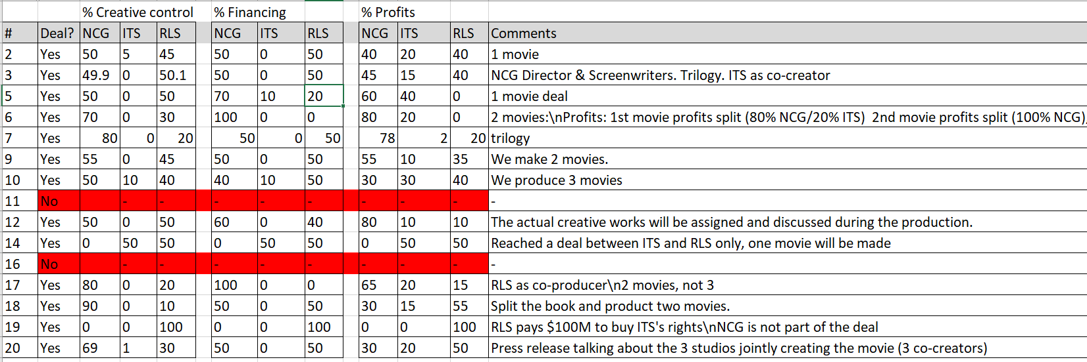
Notes:
Note: Sample results from a large MBA class at INSEAD.

Slide 21
Maximizing the value of the overall deal
NCG has majority creative control over the film, expanding expected revenues for all studios; RLS also has significant creative control
Agree to make a sequel, expanding overall financial revenues
ITS contributes little financially and creatively but still has a substantial share of the profits
RLS and NCG, the wealthy studios, do most of the financing and share profits accordingly
But this is not the best deal for each individual studio…
Notes:
How could you maximize value in The Prince?
Agreeing for NCG to have majority control expands the expected revenues for all 3 studios by some 50%-300%. However, RLS also needs to have creative control since co-producing is a key interest for them.
To maximize financial value, agree to make a sequel although this puts the film at risk creatively.
ITS is desperate for cash, thus it make sense for them to contribute less financially and creatively but still get a cut of the profits.
RLS and NCG are the rich studios, it makes sense for them to do most of the financing and share profits accordingly.
This maximizes value for the overall deal, but this is not the best deal for each individual studio. NCG wants total creative control, and RLS wants a lot. RLS would rather make one movie than two. ITS does have the money to help finance, they’re happy to pay for half and (given their IP rights) get half or a slight majority of the profits.

Slide 22
Underlying interest or goal | Potential creative options
RLS wants to co-create the film for branding and reputational reasons NCG believes the film will be of superior quality and make much more money if they have full creative control ITS agrees with NCG | NCG will retain most creative control behind the scenes, but RLS will be credited as a full co-producer. RLS logo will appear before the NCG logo in all promotional materials. All producer interviews for The Prince will include the RLS producer. RLS could handle all marketing, promotion, and merchandising. NCG could negotiate for the rights to side stories.
ITS is on the verge of bankruptcy and needs cash now NCG and RLS are flush with cash due to the success of The King and Mega-Robots, and are willing to wait for the profits from The Prince to roll in | NCG or RLS offer a flat cash payment up front to ITS for the rights, rather than a percentage of profits that will not materialize for years. ITS could auction the creative rights to NCG and RLS, creating a bidding war and driving up the price. ITS gets a larger share of profits from the 1st movie than from the sequels.
Notes:
Your outcome form gives you the option to come up with agreements and options beyond splitting the percentages on creative control, funding, and profits. If you think about each parties’ underlying interests or goals, there are some potential creative solutions to address them that expand the pie for the negotiation.
Consider creative control vs. creative credit. RLS wants to co-create the film for branding and reputational reasons, NCG believes the film will be of superior quality and make much more money if they have full creative control, and ITS agrees with NCG. You could therefore agree that NCG will retain most creative control behind the scenes, but RLS will be credited as a full co-producer, the RLS logo will appear before the NCG logo in all promotional materials, and all producer interviews will include the RLS producer not just the NCG producer.
Given its proven commercial success with franchises like mega-robots, RLS could even handle all marketing, promotion, and merchandising. But NCG chooses the director and writer team, has script approval, right of final cut over the film, and final say over the designs.
As part of the deal, NCG could negotiate the rights to sideline stories, consistent with their belief they the right studio to have creative control over movies stemming from The Prince and The King. Maybe they can later create further movies or a TV series based on side characters, like we see with “Star Wars” for example.
For ITS, cash is king, they need to get paid and avoid expenditures to stave off bankruptcy. NCG and RLS, in contrast, are doing well financially due to The King and Mega-Bots, and are willing to wait for the profits from The Prince to materialize. So why not agree on a large cash payment to ITS from the creative rights, if its large enough that could be better for them than a percentage of profits from The Prince that will not materialize for years. ITS could even auction the creative rights to NCG and RLS, creating a bidding war and driving up the price.
Because of time preferences differ between the parties, ITS may prefer to have a larger percentage of profits on the first movie than on the sequels, in the event you decide to make two or three movies. In contrast, NCG and RLS are willing to be patient and capture more value in the long term.

Slide 23
Based on a true story
Notes:
This case was loosely based on a true story about a fictional. Can you guess it? [Students try].

Slide 24
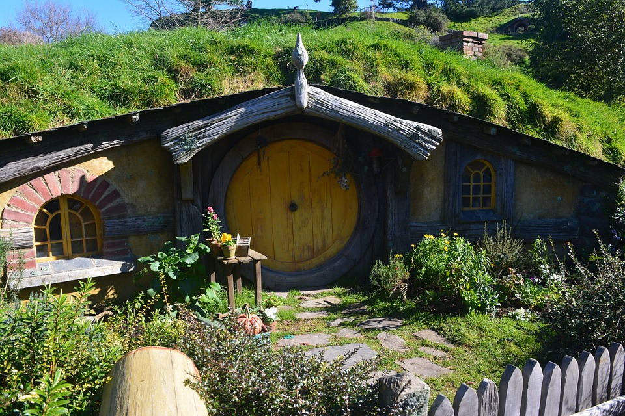
Based on a true story
Notes:
Do any of you recognize this house in the photo? [Students answer]. Right, its Bag End, Bilbo and then Frodo’s house from The Hobbit and The Lord of the Rings movies.
Supporting information:
Nathan, I. (2018). Anything You Can Imagine: Peter Jackson and the Making of Middle Earth. HarperCollins.
Source of photo (open source)
https://pixabay.com/en/new-zealand-the-hobby-the-rings-563759/

Slide 25
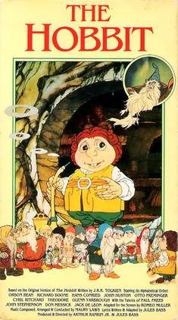
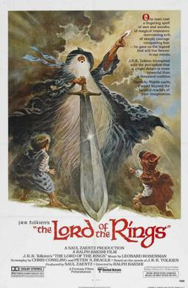
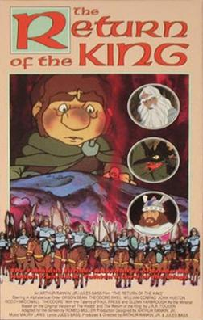
Older animated versions of Tolkien’s works
1977 1978 1980
Notes:
Like in The Prince role-play, there were early animated versions of Tolkien’s films that received a mixed reception from audiences and critics. I liked the animated Hobbit when I was a kid, but others beg to differ.
*Photo sources:
1977 film:
https://en.wikipedia.org/wiki/The_Hobbit_(1977_film)
1978 film
https://en.wikipedia.org/wiki/The_Lord_of_the_Rings_(1978_film)
1980 film
https://en.wikipedia.org/wiki/The_Return_of_the_King_(1980_film)

Slide 26
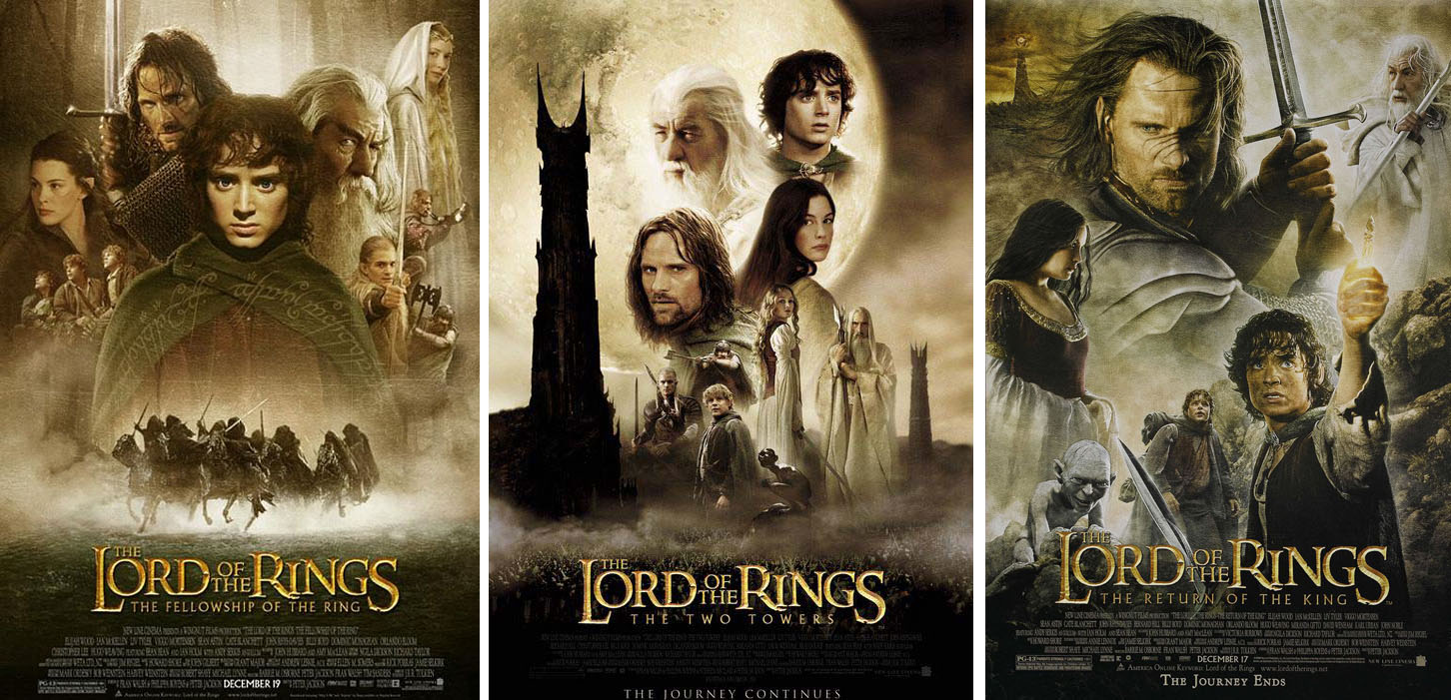
Live action Lord of the Rings Trilogy
Notes:
The live action Lord of the Rings Trilogy, in contrast, received universal acclaim.
References:
Nathan, I. (2018). Anything You Can Imagine: Peter Jackson and the Making of Middle Earth. HarperCollins.
Sibley, B. (2006). Peter Jackson: A Film-maker's Journey. Sydney, AUS: HarperCollins.
https://web.archive.org/web/20151211130624/http://www.empireonline.com/movies/features/trilogy/
https://web.archive.org/web/20160702001439/http://screenrant.com/best-film-movie-trilogies-ever-all-time/
https://web.archive.org/web/20021001123059/http://boxofficemojo.com/alltime/world/
https://web.archive.org/web/20021202080632/http://www.boxofficemojo.com/alltime/domestic.htm
*Photo sources:
LOTR trilogy covers
https://en.wikipedia.org/wiki/The_Lord_of_the_Rings:_The_Fellowship_of_the_Ring
https://en.wikipedia.org/wiki/The_Lord_of_the_Rings:_The_Two_Towers
https://en.wikipedia.org/wiki/The_Lord_of_the_Rings:_The_Return_of_the_King

Slide 27
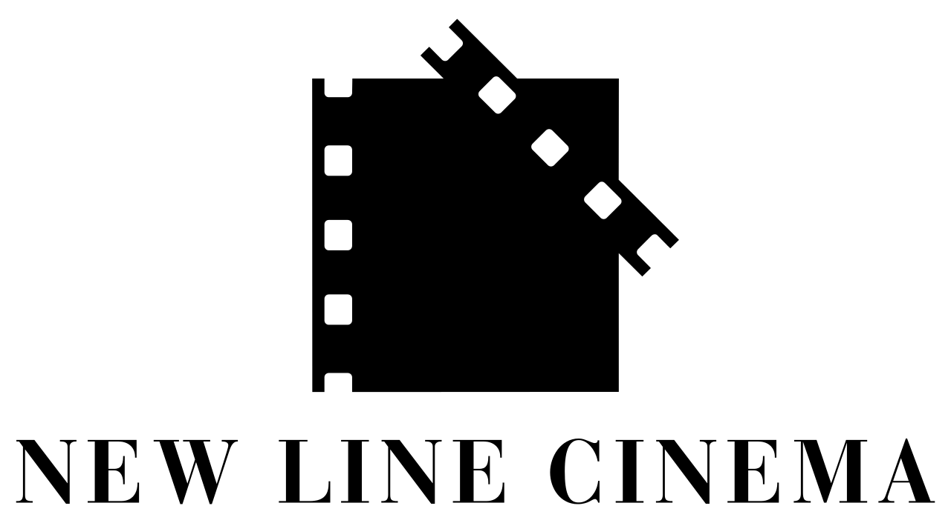
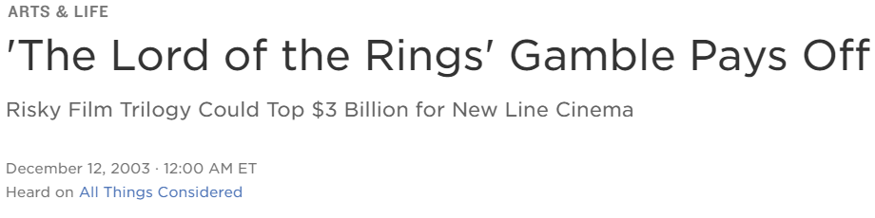
Notes:
The trilogy, based on a series of three books, grossed an average of a billion dollars each for New Line Cinema.
*Photo sources:
New line cinema logo:
https://en.wikipedia.org/wiki/New_Line_Cinema
NPR arts and life headline:
https://www.npr.org/2003/12/12/1544470/the-lord-of-the-rings-gamble-pays-off#:~:text='The%20Lord%20of%20the%20Rings'%20Gamble%20Pays%20Off%20%3A%20NPR&text='The%20Lord%20of%20the%20Rings'%20Gamble%20Pays%20Off%20The%20last,billion%20in%20worldwide%20ticket%20sales.

Slide 28
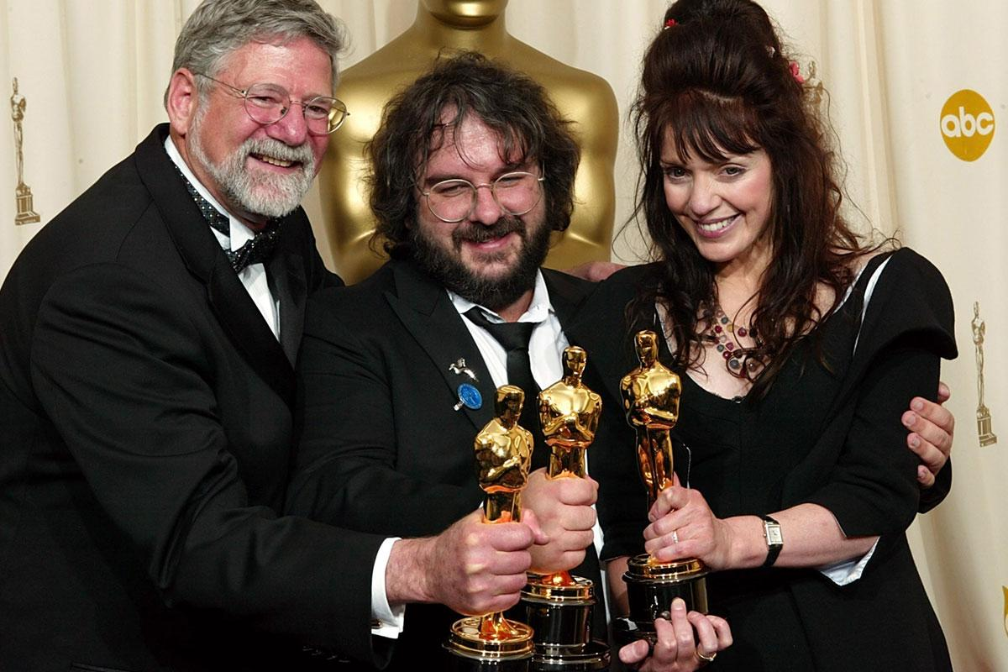
Notes:
The LOTR trilogy also won numerous awards, including best director for Peter Jackson and best adapted screenplay for Fran Walsh and Jackson.
*Photo source:
https://www.vanityfair.com/hollywood/2014/02/return-of-the-king-oscar-oral-history

Slide 29
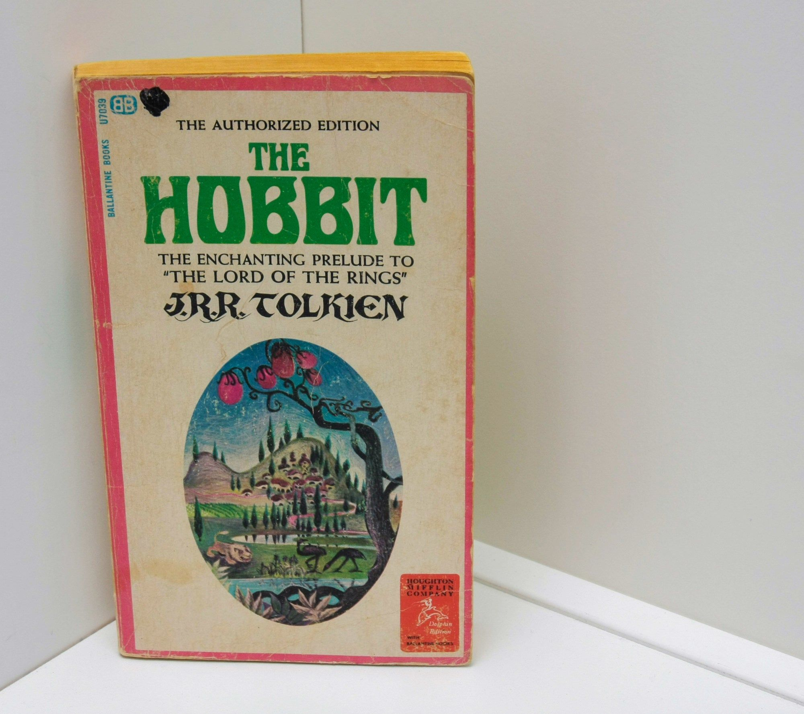
Calls for a live action version of The Hobbit, which is quite short
Notes:
Fans worldwide then called for a movie version of the prequel book The Hobbit to be made by the same creative team.
References
Tolkien, J. R. R. (1966). The Hobbit (3rd ed.). Boston: Houghton Mifflin Company.
Photo source
Personal photo by case author Eric Uhlmann, use with permission

Slide 30

Due to IP complications, multiple parties
were involved with “The Hobbit”
Notes:
Due in part to a complicated intellectual property history, The Hobbit was co-produced by multiple studios, including the studio that made The Lord of the Rings since the public wanted the original creative team involved.
Note: The real parties were
1.United Artists +Metro-Goldwyn-Mayer: Distribution rights
2.New Line Cinema: Directing, writing, and design team from LOTR
3.Saul Zaentz + Tolkien Enterprises: Film and merchandising rights
Supporting links:
https://www.reuters.com/article/entertainmentNews/idUSTRE5875BK20090908
*Photo source: Screenshot from the Warner Brothers Youtube site official trailer for The Hobbit (2 seconds into video)
https://www.youtube.com/watch?v=WJULoHnwoRI
Monika: https://www.theonering.net/torwp/2012/09/20/62046-the-hobbit-an-unexpected-journey-trailer-2-frame-by-frame-analysis-2/

Slide 31
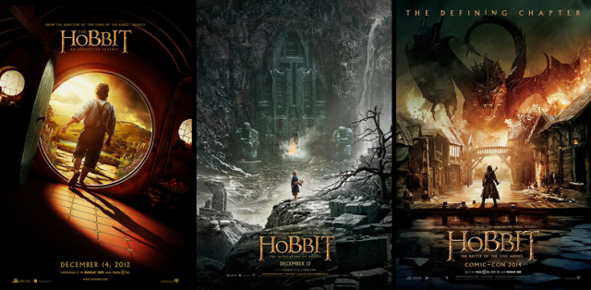
The Hobbit Trilogy
Notes:
Rather than make one movie that made a billion dollars and share the profits, they made three movies that made almost a billion dollars apiece, probably about tripling their financial gains. The press called it a financial “home run”, a huge, huge financial success by industry standards. Who was seen the Hobbit? [Students raise hands]. Did you watch all three films? What did you think of them? [Students share their opinions]. Many fans felt the quality of the films suffered by stretching a rather short book into a trilogy.
Supporting links:
https://www.hollywoodreporter.com/movies/movie-news/box-office-hobbit-desolation-smaug-665787/
https://www.hollywoodreporter.com/movies/movie-news/box-office-hobbit-five-armies-757340/
https://www.hollywoodreporter.com/movies/movie-news/box-office-report-peter-jacksons-403073/
https://web.archive.org/web/20121021000313/http://www.businessinsider.com/will-the-hobbit-gamble-be-worth-the-multi-million-risk-2012-10
https://web.archive.org/web/20101020181056/http://www.telegraph.co.uk/culture/film/film-news/8053833/The-Hobbit-could-be-most-expensive-film-ever-made.html
*Photo source:
https://pokemonwe.com/the-hobbit-trilogy-each-main-characters-worst-decision/

Slide 32
Quotes from reviews of the Hobbit
“…the decision… to stretch this thing into three movies really does a disservice to the characters and story”
"The Hobbit may have been better served by being a single film”
“…the last film of a bloated trilogy”
Notes:
So did the critics. [Instructor reads the quotes on the slide].
Links to reviews of The Hobbit films:
https://collider.com/the-hobbit-4k-review/
https://www.rogerebert.com/reviews/the-hobbit-the-battle-of-the-five-armies-2014#:~:text=%22The%20Hobbit%22%20may%20have%20been,detraction%20from%20its%20overall%20themes.
https://www.theguardian.com/film/2014/dec/14/the-hobbit-battle-five-armies-review-middling-finale-middle-earth
https://www.theatlantic.com/entertainment/archive/2014/12/the-battle-of-the-five-armies-at-least-its-over-now/383876/
https://www.forbes.com/sites/scottmendelson/2015/02/11/the-hobbit-trilogy-grossed-almost-3-billion-and-no-one-cared/?sh=7a2aa2074838

Slide 33
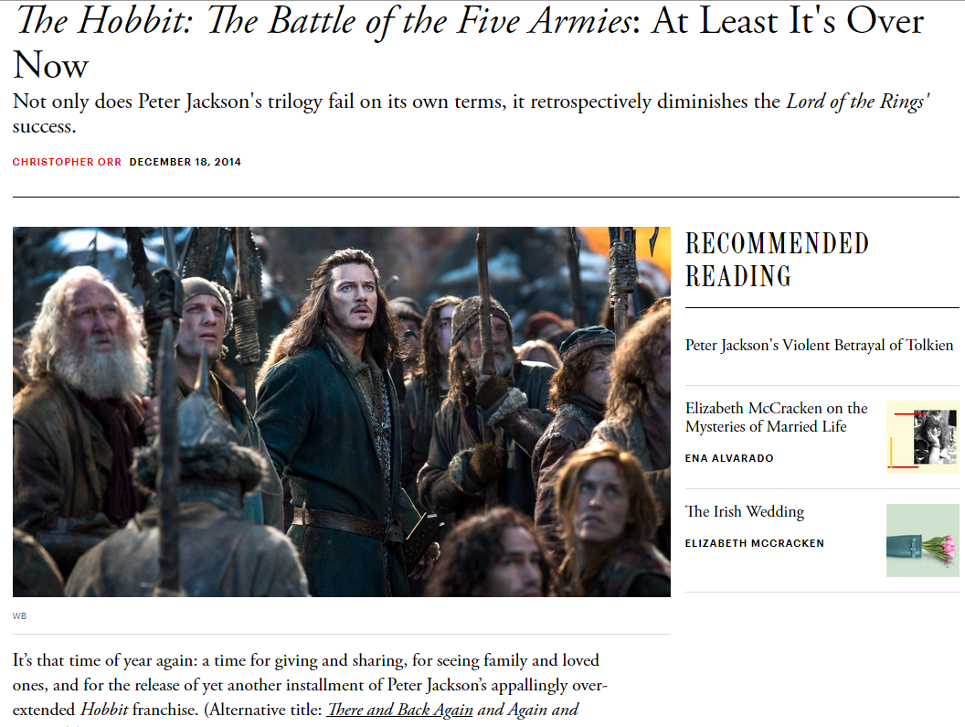

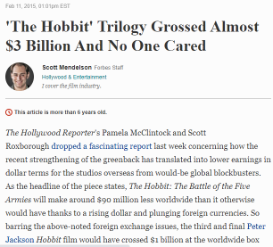
Notes:
[Read the headlines of the articles on the slides]. My guess though is that for folks whose primarily interest in the film was short term financial benefit, they cared a great deal about the 3 billion dollar gross.
Links to reviews of The Hobbit films:
https://collider.com/the-hobbit-4k-review/
https://www.rogerebert.com/reviews/the-hobbit-the-battle-of-the-five-armies-2014#:~:text=%22The%20Hobbit%22%20may%20have%20been,detraction%20from%20its%20overall%20themes.
https://www.theguardian.com/film/2014/dec/14/the-hobbit-battle-five-armies-review-middling-finale-middle-earth
https://www.theatlantic.com/entertainment/archive/2014/12/the-battle-of-the-five-armies-at-least-its-over-now/383876/
https://www.forbes.com/sites/scottmendelson/2015/02/11/the-hobbit-trilogy-grossed-almost-3-billion-and-no-one-cared/?sh=7a2aa2074838
*Photo sources:
Atlantic piece
https://www.theatlantic.com/entertainment/archive/2014/12/the-battle-of-the-five-armies-at-least-its-over-now/383876/
Forbes piece
https://www.forbes.com/sites/scottmendelson/2015/02/11/the-hobbit-trilogy-grossed-almost-3-billion-and-no-one-cared/?sh=1c1693754838

Slide 34
Take-Aways
Multi-party situations involve a geometric increase in complexity of the negotiation
Trust and interdependence are harder to build because of fear of coalitions
An open communication process geared towards consensus building is the key to win-win
Controlling information flow is the key to coalition building and win-lose tactics
Deciding what you value is the first step of a negotiation (was The Hobbit trilogy a massive success or an abject failure?)
Notes:
Some take-aways about multi-party negotiations. Negotiations between more than two parties involve a geometric increase in complexity of the negotiation, in which trust and interdependence become harder to build because of the internal BATNA of some parties forming a coalition. Guiding the communication process towards consensus building and win-win are key to maximizing value and achieving good outcomes.
Also, deciding what you value is the first step of a negotiation. Was The Hobbit trilogy a success or a failure? This depends on your goals, were they financial, artistic, reputation/brand?
Similar questions hold for any negotiation. What are your values? Flowing from that, what are your goals, and what processes will you use to achieve them? Negotiation outcomes can only be evaluated in light of what you went in to accomplish, so make sure you reflect carefully on that.
References and further readings:
Brion, S., & Anderson, C. (2013). The loss of power: how illusions of alliance contribute to powerholders’ downfall. Organizational Behavior and Human Decision Processes, 121, 129–139.
Caplow, T. (1956). A theory of coalitions in the triad. American Sociological Review, 21(4), 489–493. https://doi.org/10.2307/ 2088718
Chertkoff, J. M. (1966). The effects of probability of future success on coalition formation. Journal of Experimental Social Psychology, 2(3), 265–277. https://doi.org/10.1016/0022- 1031(66)90083-7
Chertkoff, J. M., & Braden, J. L. (1974). Effects of experience and bargaining restrictions on coalition formation. Journal of Personality and Social Psychology, 30(1), 169–177. https:// doi.org/10.1037/h0036615
Diermeier, D., Swaab, R.I., Medvec, V., & Kern, M.C. (2008). The micro-dynamics of coalition formation. Political Research Quarterly, 61, 484-501.
Falcão, H. (2010). Value Negotiation: How to Finally Get the Win- Win Right. Singapore: Prentice Hall.
Gamson, W. A. (1961). A theory of coalition formation. American Sociological Review, 26(3), 373–382. https://doi.org/10.1257/ aer.90.4.1072
Gamson, W. A. (1961). An experimental test of a theory of coalition formation. American Sociological Review, 26(4), 565– 573. https://doi.org/10.2307/2090255
Gamson, W. A. (1964). Experimental studies of coalition formation. Advances in Experimental Social Psychology, 1, 81–110. https://doi.org/10.1016/S0065-2601(08)60049-0
Kern, M. C., Brett, J. M., Weingart, L. R., & Eck, C. S. (2020). The “fixed” pie perception and strategy in dyadic versus multiparty negotiations. Organizational Behavior and Human Decision Processes, 157, 143-158. https://doi.org/10.1016/j.obhdp.2020.01.001
Komorita, S. S. (1984). Coalition bargaining. Advances in Experimental Social Psychology, 18(1), 183–245. https://doi.org/ 10.1016/S0065-2601(08)60145-8
Komorita, S. S., Aquino, K. F., & Ellis, A. L. (1989). Coalition bargaining: A comparison of theories based on allocation norms and theories based on bargaining strength. Social Psychology Quarterly, 52(3), 183–196. https://doi. org/10.2307/2786713
Komorita, S. S., & Chertkoff, J. M. (1973). A bargaining theory of coalition formation. Psychological Review, 80(3), 149–162. https://doi.org/10.1037/h0034341 K
Komorita, S. S., & Meek, D. D. (1978). Generality and validity of some theories of coalition formation. Journal of Personality and Social Psychology, 36(4), 392–404. https:// doi.org/10.1037//0022-3514.36.4.392
Komorita, S. S., & Parks, C. D. (1995). Interpersonal relations: Mixed-motive interaction. Annual Review of Psychology, 46, 183–20
Kravitz, D. A. (1981). Effects of resources and alternatives on coalition formation. Journal of Personality and Social Psychology, 41(1), 87–98.
Mannix, E.A. (1993). Organizations as resource dilemmas: the effects of power balance on coalition formation in small groups. Organizational Behavior and Human Decision Processes, 55, 1–22.
Miller, C. E., & Wong, J. (1986). Coalition behavior: Effects of earned versus unearned resources. Organizational Behavior and Human Decision Processes, 38(2), 257–277.
Murnighan, J. K. (1991). The game of 4-3-2. In J. K. Murnighan (Ed.) The dynamics of bargaining games (pp. 129–139). Prentice-Hall.
Polzer, J., Mannix, E., & Neale, M. (1998). Interest alignment and coalitions in multi-party negotiation. Academy of Management Journal, 41, 42-54.
Suesse, J.M., & Ibarra, H. (1997). Building Coalitions. Harvard Business School. 9-497-055.
Swaab, R.I., Kern, M.C., Medvec, V., & Diermeier, D. (2009). Who says what to whom? The impact of communication setting and channel on exclusion from multiparty negotiation agreements. Social Cognition, 27, 381-397.
Swaab, R.I., Postmes, T., & Spears, R. (2008). Identity formation in multiparty negotiations. British Journal of Social Psychology, 47, 167-187.
Thompson, L. (2001). The Mind and Heart of the Negotiator (2nd Edition). Upper Saddle River, NJ: Prentice Hall, 2nd edition
van Beest, I., Steinel, W., & Murnighan, J. K. (2011). Honesty pays: On the benefits of having and disclosing information in coalition bargaining. Journal of Experimental Social Psychology, 47(4), 738–747. https://doi.org/10.1016/j.jesp.2011.02.013
van Beest, I., van Dijk, E., & Wilke, H. (2004). Resources and alternatives in coalition formation: The effects on payoff, self-serving behaviour, and bargaining length. European Journal of Social Psychology, 34(6), 713–728. https://doi.org/10.1002/ejsp.226
van Beest, I., van Dijk, E., & Wilke, H. (2004). The interplay of self-interest and equity in coalition formation. European Journal of Social Psychology, 34(5), 547–565. https://doi. org/10.1002/ejsp.216
van Beest, I., Wilke, H., & van Dijk, E. (2003). The excluded player in coalition formation. Personality & Social Psychology Bulletin, 29(2), 237–247. https://doi.org/10.1177/0146167202239049
Van Beest, I., Van Kleef, G. A., & Van Dijk, E. (2008). Get angry, get out: The interpersonal effects of anger communication in multiparty negotiation. Journal of Experimental Social Psychology, 44, 993-1002.
Vinacke, W. E., & Arkoff, A. (1957). An experimental study of coalitions in the triad. American Sociological Review, 22(4), 406–414. https://doi.org/10.2307/2089158
Vinacke, W. E., Crowell, D. C., Dien, D., & Young, V. (1964). The effect of information about strategy on a three-person game. Behavioral Science, 11(3), 180–189. https://doi.org/https://doi. org/10.1002/bs.3830110305
Warwick, P. V. (1996). Coalition government membership in West European parliamentary democracies. British Journal of Political Science, 26(4), 471–499. https://doi.org/10.1017/ S0007123400007572
Wilke, H., & Mulder, M. (1971). Coalition formation on the gameboard. European Journal of Social Psychology, 1(3), 339–355. https://doi.org/10.1002/ejsp.2420010305
Wilke, H., & Mulder, M. (1974). A comparison of rotation versus non-rotation in coalition formation experiments. European Journal of Social Psychology, 4(1), 99–102. https://doi.org/ 10.1002/ejsp.2420040109

