Slide 1
The Job Negotiation
06/2024-6920
This slide deck was prepared by Martin Schweinsberg, Associate Professor of Organisational Behaviour at ESMT Berlin, Horacio Falcão, Professor of Management Practice of Decision Sciences at INSEAD, Warren Tierney, Postdoctoral Research Associate at INSEAD, and Eric Uhlmann, Professor of Organisational Behaviour at INSEAD, as additional material to the role play “The Job Negotiation”.
To access INSEAD teaching materials, go to https://publishing.insead.edu/.
Copyright © 2024 Martin Schweinsberg, Horacio Falcão, Eric Uhlmann.
COPIES MAY NOT BE MADE WITHOUT PERMISSION. NO PART OF THIS PUBLICATION MAY BE, COPIED, STORED, TRANSMITTED, TRANSLATED, REPRODUCED OR DISTRIBUTED IN ANY FORM OR MEDIUM WHATSOEVER WITHOUT THE PERMISSION OF THE COPYRIGHT OWNER.

Slide 2

Notes:
Before we do anything else please take a few minutes or so to remember what you learnt in our last session. Doesn’t have to be what I taught you, but something that YOU learnt personally, what did YOU take out of the last class? We’re doing this because this is a GREAT RETURN ON INVESTMENT: we’re spending a few minutes on this now so you don’t lose the last few hours we spent together. [Students provide their take-aways. They can either be asked to write down their personal take-away on a sheet of paper for a minute then share with the class, or to share with the class straight away without writing alone first].
Source for photo:
https://pixabay.com/en/time-timer-clock-watch-hour-371226/

Slide 3

Rules for Negotiation Role-Plays
  You may NOT show your role material to your counterpart
  You cannot change or invent facts
  You cannot show your counterpart your point payoff structure
Notes:
Now we have another negotiation exercise. [The instructor holds up the hard copies of the roles]. Let’s first recap our rules for the negotiation exercises. You are not allowed to show your role materials to your counterpart. You are also not allowed to change or invent facts. We will have two negotiation role-plays today, the first one is called The Job Negotiation and the second is called The Dublin Job. Then we will have a lecture on job negotiations. Sounds good? [Students say yes].
Source for photo:
http://www.publicdomainpictures.net/view-image.php?image=164322&picture=judge-gavel

Slide 4

Negotiation Exercise:
The Job Negotiation
Read your role materials and plan (max 15 minutes!)
Negotiate with your counterpart (max 30 minutes!)
Come back to the Amphi and tell me your personal points scores, then take a 15 minute break, then take a 15-minute break
  Each counterpart adds up their points separately
  Please calculate your points totals yourselves
Notes:
For the first role play, you will have 15 minutes to read your role materials and plan your strategy, then 30 minutes to negotiate with your partner. At the point please share your individual points totals with me and take a 15 minute break. Please calculate your points totals yourselves, each counterpart should add up their points separately. The lecture will begin again in one hour. As always, please partner up with someone you know less well than the others, and if at all possible a different person from last time. [Students partner up, the instructor hands out role materials, and the students negotiate.]
[During the negotiations, the instructor should walk around and take mental or written notes on some of the negotiations, highlighting tactics and reactions that can be brought up later during the debriefs when students are asked to share their experiences or when key teaching points are made. For example, if particular pairs of students made value-creating tradeoffs, or if a negotiator used decoy tactics].
[As the students come back with their points totals, the instructor creates the results slide for the class using the excel spreadsheet called “Results_Template_Job Negotiation” and pastes it into the PowerPoint slide called “Your results: The Job Negotiation” later in this deck. The pairs of students are given their negotiation group number as they turn in their results and are asked to remember it for the debrief].
Note: An alternative approach to creating the pairings is for the instructor to pair students up himself/herself, either by creating pairings before class begins or ad-hoc now during the lecture.
Source for photo:
https://pixabay.com/en/job-interview-colleagues-business-437026/

Slide 5
The Job Negotiation
Candidate | PAIR | Recruiter | BOR
 | 1 |  | 251
 | 2 |  | 252
 | 3 |  | 253
 | 4 |  | 254
 | 5 |  | 255
 | 6 |  | 256
 | 7 |  | 257
 | 8 |  | 258
Notes:
Here are your breakout room slides for this exercise. Please grab your role materials– they are printed in the color that matches the color of the column your name is listed in on the slide. Then pair up with your partner, and enjoy the exercise! [Students get their role materials and go to negotiate].
Note: This template students pairings slide is for if the instructor sorts students into negotiating teams beforehand. Student names are added in the respective columns beneath their role. If this slide is used, the color background for each role on the slide above should match the color paper of the role materials that are handed out to students, to avoid confusion. The “BOR” column refers to “Breakout Room” and only applies if the instructor has special rooms for the students to negotiate in. “PAIR” refers to negotiation group number, in other words each pair of students who negotiate with each other.

Slide 6
Take 3 minutes and share with the person next to you:
One thing your counterpart did well in the negotiation
One thing you could have done differently
Notes:
Welcome back! Please take 3 minutes and share with the person sitting next to you, who is not necessarily your negotiation partner. One thing that your counterpart did well, and one thing you could have done better. [Students share with others sitting next to them for a few minutes]. Ok, let’s get started again.

Slide 7
Negotiation Preferences
Martin Schweinsberg, Horacio Falcão,
Warren Tierney, & Eric Luis Uhlmann,
Notes:
Now its time for our debrief of the Job Negotiation. This lecture will focus on the different kinds of preferences that occur in a negotiation, and how we can identify these types of preferences and leverage them to create value and obtain good outcomes. We will talk about job and salary negotiations more generally after our second exercise, the Dublin Job, sounds good? [Students assent].
Source for photo:
https://pixabay.com/en/job-interview-colleagues-business-437026/

Slide 8
Types of Preferences
Common preference: Both counterparts want the same thing
  What were the common preferences?
Conflicting preference: Counterparts having directly opposed preferences
Different preferences: Counterparts value issues to differing degrees (opportunity to make tradeoffs and increase the pie)
Notes:
There are three basic types of preferences in a negotiation. The first is common preferences, where both counterparts want the same thing. The second is conflicting preference, where counterparts having directly opposed preferences. The third is different preferences, where counterparts have opposing preferences to some extent, but value issues to differing degrees– meaning there are opportunities to make tradeoffs and increase the pie.
[Instructor writes on a flipchart:
“Common preferences
Conflicting preferences
Different preferences”
And leaves these terms up on the flipchart for the rest of the lecture].
What was the common preference in The Job Negotiation? [Students answer].

Slide 9
Types of Preferences
Common preference: Both counterparts want the same thing
  Team size: Both sides want a large team
Conflicting preference: Counterparts having directly opposed preferences
Different preferences: Counterparts value issues to differing degrees (opportunity to make tradeoffs and increase the pie)
Notes:
Team size-- both sides want a large team. That’s the common preference.

Slide 10
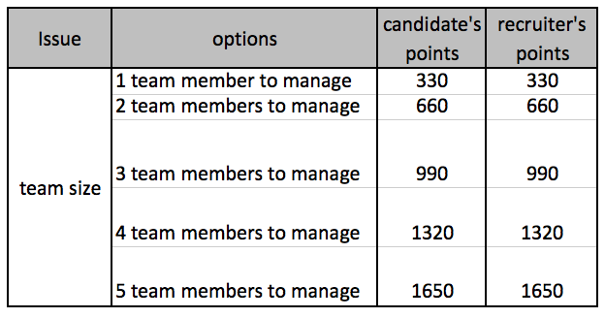
Common Preference
in the Job Negotiation
Distributive
issues
Compatible
issues
Integrative
issues
Salary
Starting date
Notes:
Here are the candidate and recruiter’s point payoffs. As you can see, they are identical for team size. The candidate wants to lead, and the recruiter needs someone who can supervise more people. It’s a common preference. Who realized this? [Instructor raises hand, so do some students]. Who didn’t? [Instructor raises hand, so do some students].

Slide 11
Identifying Common Preferences a Challenge
Negotiators fail to identify common preferences 50% of the time (Thompson & Hrebec, 1996)
Negotiators given exact same preferences failed to reach best agreement 39% of the time! (Thompson, 2001)
Assume the other side’s interests must be directly opposed to ours
Notes:
Because of the tendency to assume we want different things, it can be difficult to identify common preferences in a negotiation. 50% of the time, negotiators fail to identify common preferences, things they want that are identical to what their counterpart wants. In one study, negotiators given the exact same preferences failed to reach the ideal agreement 39% of the time! They wanted exactly the same thing on every issue but still ended up reaching suboptimal agreements, because they came in with the assumption they must want different things and it has to be a battle.
References
Thompson, L. (2001). The Mind and Heart of the Negotiator (2nd Edition). Upper Saddle River, NJ: Prentice Hall, 2nd edition
Thompson, L., and Hrebec, D. “Lose-Lose Agreements in Interdependent Decision Making.” Psychological Bulletin, 1996, 120, 396–409.

Slide 12
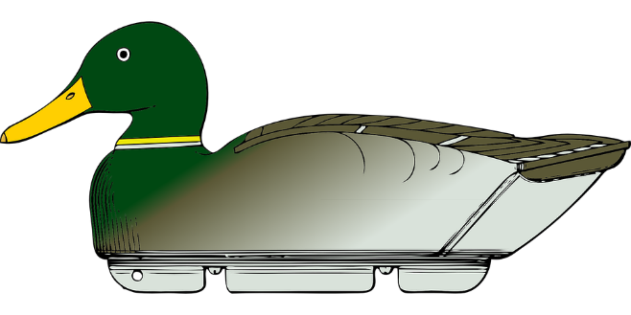
Decoy Tactics
Opponent pretends they want an option they don’t really want
Then trades it for something of value to both of you
Did this happen in any of your negotiations?
20% of experienced negotiation professionals agree to options neither side wants due to backfired decoy tactics
Notes:
A decoy tactic in negotiation occurs when your counterpart pretends they want an option they don’t really want, then trades it for something of value to both of you. Did this happen in any of your negotiations? [The class laughs as some students raise their hands. The students in question discuss how they or a partner used team size strategically, as a decoy, pretending to want a small team to get concessions on another issue]. This could work, but what will happen if your new employee or boss realizes afterward that you tricked them?
Source for photo:
https://pixabay.com/static/uploads/photo/2012/04/12/22/12/duck-decoy-30864_960_720.png

Slide 13
Types of Preferences
Common preference: Both counterparts want the same thing
  Team size: Both sides want a large team
Conflicting preference: Counterparts having directly opposed preferences
  What were the conflicting preferences?
Different preferences: Counterparts value issues to differing degrees (opportunity to make tradeoffs and increase the pie)
Notes:
Conflicting preference occur when the counterparts having directly opposed preferences– they want the opposite thing, to the same degree. What were the conflicting preferences? [Students answer].

Slide 14
Types of Preferences
Common preference: Both counterparts want the same thing
  Team size: Both sides want a large team
Conflicting preference: Counterparts having directly opposed preferences
  Base pay and bonus, office location, start date
Different preferences: Counterparts value issues to differing degrees (opportunity to make tradeoffs and increase the pie)
Notes:
Base pay and bonus, office location, and start date were the conflicting preferences.

Slide 15
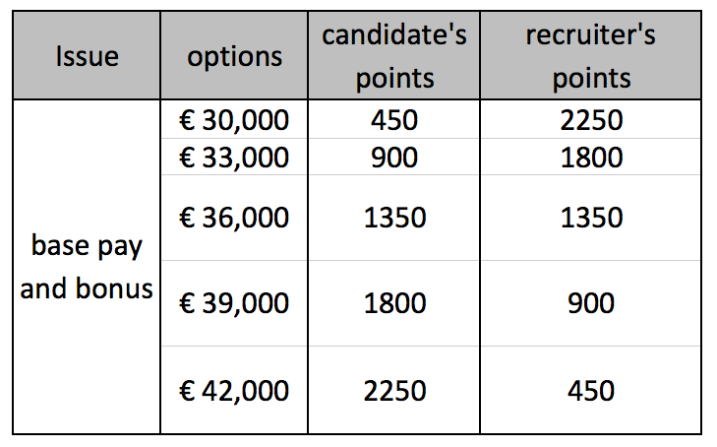
Conflicting Preferences
in the Job Negotiation
Distributive
issues
Compatible
issues
Integrative
issues
Salary
Starting date
Notes:
Here are the points payoffs for base pay and bonus. The counterparts having directly opposed preferences– they want the opposite thing, and they want it to the same degree.

Slide 16
Types of Preferences
Common preference: Both counterparts want the same thing
  Team size: Both sides want a large team
Conflicting preference: Counterparts having directly opposed preferences
  Base pay and bonus, office location, start date
Different preferences: Counterparts value issues to differing degrees (opportunity to make tradeoffs and increase the pie)
  What were these?
Notes:
The third type of preference is different preferences. The counterparts prefer different options, but to different degrees. This is an opportunity to make tradeoffs and increase the pie. I give you want most and give up what I want least. What were these issues in The Job Negotiation? [Students answer].

Slide 17
Types of Preferences
Common preference: Both counterparts want the same thing
  Team size: Both sides want a large team
Conflicting preference: Counterparts having directly opposed preferences
  Base pay and bonus, office location, start date
Different preferences: Counterparts value issues to differing degrees (opportunity to make tradeoffs and increase the pie)
  Holidays (candidate), health insurance (candidate)
  Subsidy for training (recruiter), flex time (recruiter)
Notes:
The candidate values holidays and health insurance more, and the recruiter cares more about the training subsidy and flex time.

Slide 18
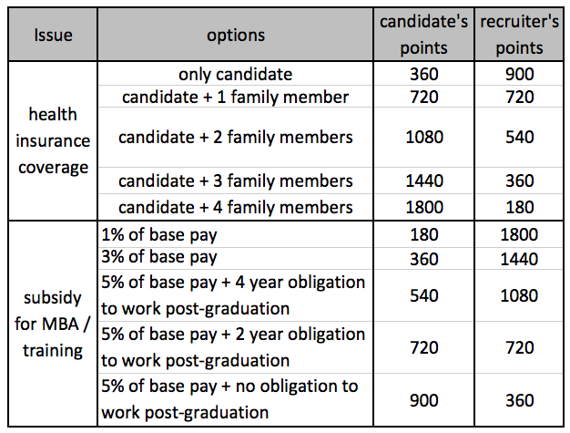
Different Preferences
in the Job Negotiation
Distributive
issues
Compatible
issues
Integrative
issues
Salary
Starting date
Notes:
Here we see the different preferences between the candidate and recruiter on health insurance and training subsidy. They want different things, but the candidate cares twice as much as the recruiter about health coverage, while the recruiter cares twice as much as the candidate does about subsidizing further training.

Slide 19
Avoid a lazy compromise!
1
2
3
Less value is created if you split the difference when counterparts have different preferences
Notes:
If you split the difference on each of these issues, you create only 1620 points worth of value for each issue.

Slide 20
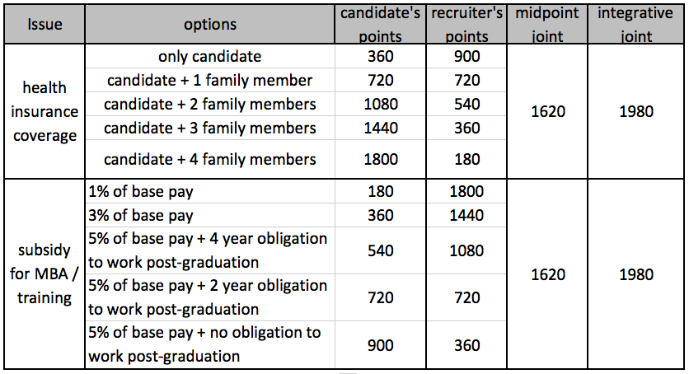
Avoid a lazy compromise!
1
Discover different preferences between counterparts
Use value creating trade-offs to increase the pie
Notes:
If you make trade offs to maximize joint value, the candidate gets great health coverage and the recruiter minimizes training subsidies, you create 1980 points worth of value for each issue. Total value is much greater.
These preferences for particular options are based on different underlying interests. The candidate cares more about health insurance due to illnesses in the family. The recruiter does not want to subsidize a degree for someone who will use the degree to get a better job.

Slide 21
How do you find out what the other side’s interests are?
Notes:
How do you find out what the other side’s interests are? [Students answer].

Slide 22
How do you find out what the other side’s interests are?
Research
Asking directly
Cautiously sharing some of your interests and seeing if they reciprocate
Use multiple equivalent simultaneous offers (MESOs)
  Perspective-taking: See their point of view from a cognitive perspective (Galinsky et al., 2008)
Notes:
You can do your research– possibly online, possibly using your network and asking people who know them or know the industry better than you do. You could ask directly, what do you want out of this agreement? You could cautiously share some of your interests and seeing if they reciprocate. Should you share all your interests at once? [Students answer, no!]. No, that puts them in a position to take advantage of you. Share one interest, a general one, and see if they reciprocate. What if they don’t seem to trust you and don’t want to share anything? [Students answer]. Have you heard of a “multiple equivalent simultaneous offer”, or MESO? [Nobody has]. Basically you make two package offers and ask them which is relatively better for them. Their preference tells you what’s more important to them. Last but not least, you can engage in perspective-taking, trying to see their point of view. I mean this from a cognitive perspective, understanding where they are coming from and what their goals are, not necessarily adopting their emotions and moral values.
References
Galinsky, A. D., Maddux, W. W., Gilin, D., & White, J. B. (2008). Why it pays to get inside the head of your opponent: The differential effects of perspective-taking and empathy in negotiations. Psychological Science, 19, 378-384.

Slide 23
Should you negotiate issues one at a time?
Notes:
Should you negotiate issues one at a time? [Students answer]. What happens if you do that? [Students answer]. Can you create value then? [Students answer].

Slide 24

Should you negotiate issues one at a time?
No! Makes value-creating tradeoffs impossible
Turns what could be a big win-win negotiation into a series of small win-lose negotiations
Notes:
If you negotiate issues one at a time, making value-creating tradeoffs impossible. It turns what could be a big win-win negotiation into a series of small win-lose negotiations. It is better to negotiate all the issues at once and make final commitments only at the end of the discussion.
Source for photo:
https://www.flickr.com/photos/lumaxart/2137737248

Slide 25
Your results: The Job Negotiation
Notes:
I will now present your results for The Job Negotiation.
[Optional, may not be appropriate in cultures with more formal classroom environments]
Can I get a drum roll? [Students create a “drum roll” by tapping their firsts on their desks].

Slide 26
Your results: The Job Negotiation
Notes:
And here are your agreements! [Students react, usually there are a large range of agreements and they are surprised]. Again you can see the alternative possibilities. Other negotiators, with the same role materials but different strategies and different partners, probably got quite different results from yours. The total height of the bars reflects the joint value you created together. Higher bars mean more value creation. The purple bars reflect the value claimed by the candidate and green is the value claimed by the recruiter. This results figure highlights how creating and claiming value are not the same. You can create a lot of value with your partner and get relatively little for yourself, and you can create little joint value but claim a disproportionate share.
So tell me a bit about your deals. [Students share their experiences in the negotiation. If not enough students are speaking, the instructor can choose extreme results– high and low bars, bars with very fair and very disproportionate divisions of value– and ask that negotiating team to share].
Note: What’s shown here are example results from a pilot lecture at INSEAD. During the break, the instructor should have created the results slide for the class using the excel spreadsheet called “Results_Template_Job Negotiation” and pasted it into this PowerPoint slide

Slide 27
Take-Aways: Types of Preferences
Identify the common, conflicting, and differing preferences
Uncover your counterpart’s underlying interests
  Share interests cautiously and ask questions
  Negotiate multiple issues simultaneously
  Use multiple equivalent simultaneous offers
Make value maximizing trade-offs: Avoid the fixed pie bias!
Notes:
A few take-aways regarding types of preferences in a negotiation. Try to identify the common, conflicting, and differing preferences between yourself and your counterpart. Common means you want the same thing, conflicting is you want the opposite, and different means you want different things but to different degrees. To identify types of preferences you need to try to uncover your counterpart’s underlying interests. You can try to do this by sharing interests cautiously and asking questions, negotiating multiple issues simultaneously, and use multiple equivalent simultaneous offers in other words multiple package offers. Once you have identified the differing preferences, make value maximizing trade-offs to expand the pie. And also make sure to get a fair share for yourself.

