Slide 1
The Castaways
06/2024-6918
This slide deck was prepared by Austin Dcosta, Byron Ascott-Evans, Emmanuele Benatti, Fernanda Antunes, Laura Foo, Sam Kaye, and Eric Sullivan, INSEAD MBA Alumni, and Rui Ling, Research Assistant, under the supervision of Martin Schweinsberg, Associate Professor of Organisational Behaviour at ESMT Berlin, Horacio Falcão, Professor of Management Practice of Decision Sciences at INSEAD, and Eric Uhlmann, Professor of Organisational Behaviour at INSEAD, as additional material to the role play “The Castaways”.
To access INSEAD teaching materials, go to https://publishing.insead.edu/.
Copyright © 2024 Martin Schweinsberg, Horacio Falcão, Eric Uhlmann.
COPIES MAY NOT BE MADE WITHOUT PERMISSION. NO PART OF THIS PUBLICATION MAY BE, COPIED, STORED, TRANSMITTED, TRANSLATED, REPRODUCED OR DISTRIBUTED IN ANY FORM OR MEDIUM WHATSOEVER WITHOUT THE PERMISSION OF THE COPYRIGHT OWNER.

Slide 2

Negotiation Exercise: The Castaways
Read your role materials and plan your negotiation strategy (max 20 minutes)
Negotiate with your counterpart (max 40 minutes)
Both counterparts turn in their agreement form from their role materials and take a 20 minute break
Communication rules
No talking in a language you both understand
Drawing pictures is allowed
Notes:
*Important note: This exercise requires additional supplies, for each student 1) a pair of scissors, 2) a thick pen, and 3) some blank sheets of white paper. It is also important to print the role materials single-sided so that students can cut out the pictures on the last pages and use trade them with their negotiation partner.
Our in class lecture for today is called The Castaways. You will have 20 minutes to read your role materials and plan your strategy, then 40 minutes to negotiate with your partner. At the point please share your individual points totals with me and take a 20 minute break. Please calculate your points totals yourselves, each counterpart should add up their points separately. The lecture will begin again in 1 hour and forty minutes.
Please read the communication rules in your role very carefully. Two I want to emphasize. First and foremost, your character does not know the same language as your partner’s character, so no talking in a language you both understand. You can gesture and grunt. [Instructor demonstrates grunted communication and students laugh]. You can also draw in the sand to communicate using a piece of paper and pen. I have paper and pens for you here, please use these [Instructor indicates stack of white paper and thick pens]. You will also need a pair of scissors, to cut out the photos of your property on the last page of the case [Instructor indicates box of scissors].
As always, please partner up with someone you know less well than the others, and if at all possible a different person from your previous negotiations. [Students partner up, the instructor hands out role materials, and the students negotiate.]
[During the negotiations, the instructor should walk around and take mental or written notes on some of the negotiations, highlighting tactics and reactions that can be brought up later during the debriefs when students are asked to share their experiences or when key teaching points are made].
[The instructor should take photos of some of the more amusing drawings students used to try to communicate and include them in the “Some of your drawings in the sand’ slides later in this deck].
[As the students come back with their points totals, the instructor creates the results slide for the class using the excel spreadsheet called “Results_Template_Castaways” and pastes it into the PowerPoint slide called “Your results: The Castaways” later in this deck. The pairs of students are given their negotiation group number as they turn in their results and are asked to remember it for the debrief].
Note: An alternative approach to creating the pairings is for the instructor to pair students up himself/herself, either by creating pairings before class begins or ad-hoc now during the lecture.
Source for photo
https://pixabay.com/en/palm-trees-the-island-of-koh-kood-966602/

Slide 3
The Castaways
Student | PAIR | Islander | BOR
 | 1 |  | 251
 | 2 |  | 252
 | 3 |  | 253
 | 4 |  | 254
 | 5 |  | 255
 | 6 |  | 256
 | 7 |  | 257
 | 8 |  | 258
Notes:
Here are your breakout room slides for this exercise. Please grab your role materials– they are printed in the color that matches the color of the column your name is listed in on the slide. Then pair up with your partner, and enjoy the exercise! [Students get their role materials and go to negotiate].
Note: This template students pairings slide is for if the instructor sorts students into negotiating teams beforehand. Student names are added in the respective columns beneath their role. If this slide is used, the color background for each role on the slide above should match the color paper of the role materials that are handed out to students, to avoid confusion. The “BOR” column refers to “Breakout Room” and only applies if the instructor has special rooms for the students to negotiate in. “PAIR” refers to negotiation group number, in other words each pair of students who negotiate with each other.

Slide 4

The Tapping Exercise
Pair up with another student. You are not allowed to speak to one another.
The tapper will pick a famous song you both know and tap it out on the table
The listener writes down the name of the song
The tapper estimates the likelihood the listener guessed the song right (please write your yes/no prediction down)
Notes:
[Note: Students are now back after doing the Castaways exercise]. Welcome back! We will now do The Tapping Exercise. Pair up with another student. You are not allowed to speak to one another. The tapper will pick a very famous song you both probably know and tap it out on the table, without telling the listener the name of the song. The listener tries to guess the name of the song and writes it down quietly. [Students do the exercise in pairs]. Listeners, how many of you guessed it right? [Students raise hands] Who got the song wrong? [Students raise hands].
Source of photo:
https://pixabay.com/en/sign-language-hand-gesture-28717/

Slide 5
The Tapping Exercise
Pair up with another student. You are not allowed to speak to one another.
The tapper will pick a famous song you both know and tap it out on the table
The listener writes down the name of the song
The tapper estimates the likelihood the listener guessed the song right
50% of tappers believe the listeners will recognize the song
…but only 2.5% of listeners do (Newton et al., 1990)
Notes:
[At this point in the course, students do a lot better than the average person on this task]. Wow, you guys did really well! In scientific studies, 50% of tappers believe the listeners will recognize the song, but only 2.5% of listeners actually do.
Source of photo:
https://pixabay.com/en/sign-language-hand-gesture-28717/
References:
Newton, L. (1990). Overconﬁdence in the communication of intent: Heard and unheard melodies. Unpublished doctoral dissertation, Stanford University, Stanford, CA.

Slide 6
The Curse of Knowledge
We fail to fully take into account that others do not know what we know (Camerer et al., 1989)
An important source of human miscommunication
Examples?
Notes:
Gaps in communication like this are a result of what is called The Curse of Knowledge. We fail to fully take into account that others do not know what we know. What are some examples of this you can think of? [Students answer].
Reference
Camerer, Colin; Loewenstein, George; Weber, Martin (1989). The Curse of Knowledge in Economic Settings: An Experimental Analysis. Journal of Political Economy. 97 (5): 1232–1254.

Slide 7
The Curse of Knowledge
We fail to fully take into account that others do not know what we know (Camerer et al., 1989)
An important source of human miscommunication
Examples?
Directions to someone unfamiliar with the area often incomplete and confusing
Mentors have difficulty putting themselves in the position of a student and therefore explain things unclearly
Notes:
Directions to someone unfamiliar with the area often incomplete and confusing because the direction-giver is not taking the other person’s perspective. Have your ever been getting a ride home from a friend and forgot to tell them where to turn? You forget they don’t know what you know. Another example is mentorship situations. Mentors have difficulty putting themselves in the position of a student, even though they themselves used to be a student, and therefore don’t explain things properly or use too many technical terms.
Reference
Camerer, Colin; Loewenstein, George; Weber, Martin (1989). The Curse of Knowledge in Economic Settings: An Experimental Analysis. Journal of Political Economy. 97 (5): 1232–1254.

Slide 8
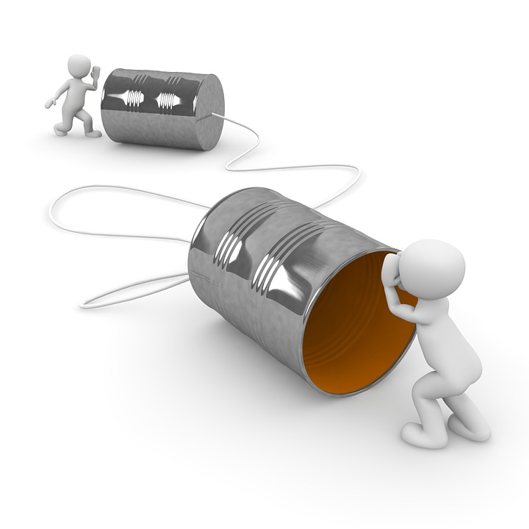
Communication Channels
Notes:
This lecture is about communication and miscommunication across different types of communication channels.
Source for photo
https://pixabay.com/en/communication-phone-call-message-1015376/

Slide 9
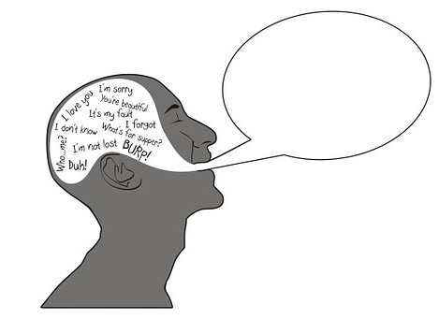
Three Forms of Human Communication
Verbal: Words/language
Notes:
There are three forms of human communication. The first is verbal– words and language.
Source of photos
https://pixabay.com/en/logos-brain-smart-thought-profile-990390/
https://pixabay.com/en/singer-singing-audio-sound-wave-29259/
https://pixabay.com/en/guy-fashion-eyeglasses-crossed-arms-699195/

Slide 10
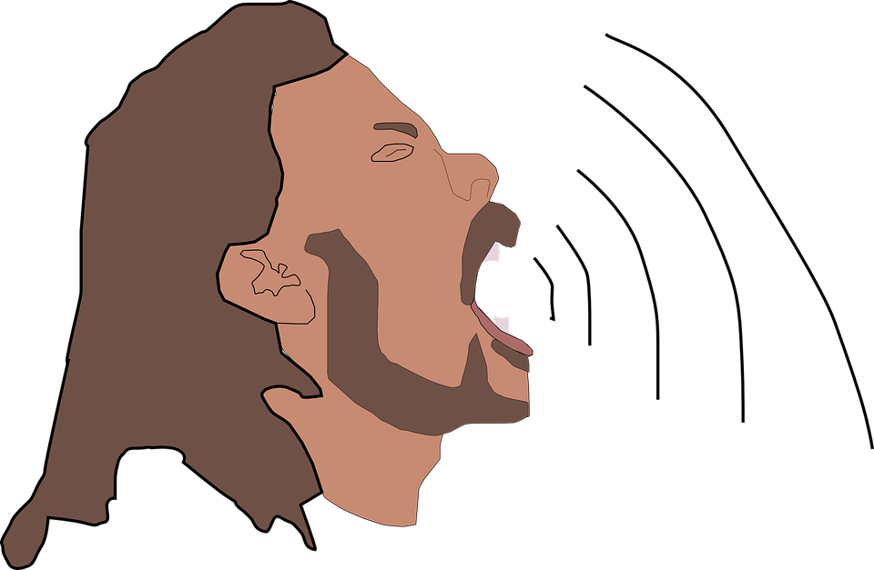
Three Forms of Human Communication
Verbal: Words/language
Paraverbal: Tone and volume of voice
Notes:
The second is paraverbal-- tone and volume of voice
Source of photos
https://pixabay.com/en/logos-brain-smart-thought-profile-990390/
https://pixabay.com/en/singer-singing-audio-sound-wave-29259/
https://pixabay.com/en/guy-fashion-eyeglasses-crossed-arms-699195/

Slide 11

Three Forms of Human Communication
Verbal: Words/language
Paraverbal: Tone and volume of voice
Nonverbal: Facial expressions and body posture
How do you think meaning is most often communicated?
Notes:
The third is nonverbal: facial expressions and body posture. How do you think meaning is most often communicated? [Students answer].
Source of photos
https://pixabay.com/en/logos-brain-smart-thought-profile-990390/
https://pixabay.com/en/singer-singing-audio-sound-wave-29259/
https://pixabay.com/en/guy-fashion-eyeglasses-crossed-arms-699195/

Slide 12
How do humans communicate? (Mehrabian, 1971)
When cues are misaligned:
55% of meaning is communicated nonverbally (face/body
38% paraverbally (tone of voice)
Only 7% of meaning is communicated through words
Notes:
When cues are misaligned, 93% of the meaning of our communication is not in the words. 55% of meaning is communicated nonverbally, using the face and body. Next important is paraverbal, with 38% of meaning conveyed through tone of voice. Again under conditions of cue misalignment, only 7% of meaning is communicated through words.
Source of photo:
https://pixabay.com/en/internet-usage-rights-e-mail-at-1013673/
References
Mehrabian, A. (1971). Nonverbal betrayal of feeling. Journal of Experimental Research in Personality, 5,64-73.

Slide 13
Who here has sent an email that was totally misinterpreted?
Notes:
Who here has sent a work email that was totally misinterpreted? [Students raise hands and share experiences].
Source of photo:
https://pixabay.com/en/internet-usage-rights-e-mail-at-1013673/

Slide 14

Problems with email communication
Who here has sent an email that was totally misinterpreted?
People overestimate extent to which intended tone of their emails comes across (Kruger et al., 2005)
Curse of knowledge even stronger over email
Notes:
People grossly overestimate extent to which intended tone of their emails comes across. The curse of knowledge is even stronger over email.
Source of photo:
https://pixabay.com/en/internet-usage-rights-e-mail-at-1013673/
References
Egocentrism over e-mail: Can we communicate as well as we think?
Kruger, Justin; Epley, Nicholas; Parker, Jason; Ng, Zhi-Wen
Journal of Personality and Social Psychology, Vol 89(6), Dec 2005, 925-936.
http://psycnet.apa.org/journals/psp/89/6/925/

Slide 15




What communication channel should you use to negotiate?
Email?
Phone?
Skype?
Face to face?
Notes:
Given all of this, what communication channel should you use to negotiate? [Students answer].
Source of photos:
https://pixabay.com/en/internet-usage-rights-e-mail-at-1013673/
https://pixabay.com/en/phone-red-vintage-vectors-388838/
https://pixabay.com/en/icons-symbols-skype-button-turn-on-847262/
https://pixabay.com/en/man-avator-person-admin-161282/

Slide 16


Choosing a communication channel (Swaab, Medvec & Diermeier, 2006)
Generally avoid negotiating using impoverished communication channels like email
More failed deals, less value creation, and more conflict
Notes:
Although different channels each have their strengths, as a general principle it is better to avoid negotiating using impoverished communication channels like email. Email communication leads to more failed deals, less value creation, and more conflict.
References
Swaab, R.I., Galinsky, A.D., Medvec, V., & Diermeier, D.A. (2012). The communication orientation model: Explaining the diverse effects of sight, sound, and synchronicity on negotiation and group decision-making outcomes. Personality and Social Psychology Review, 16, 25-53.

Slide 17

When should you not negotiate face to face?
Notes:
When should you not negotiate face to face? [Students answer].
Source of photo
https://pixabay.com/en/pc-computer-hardware-calculator-1595125/

Slide 18
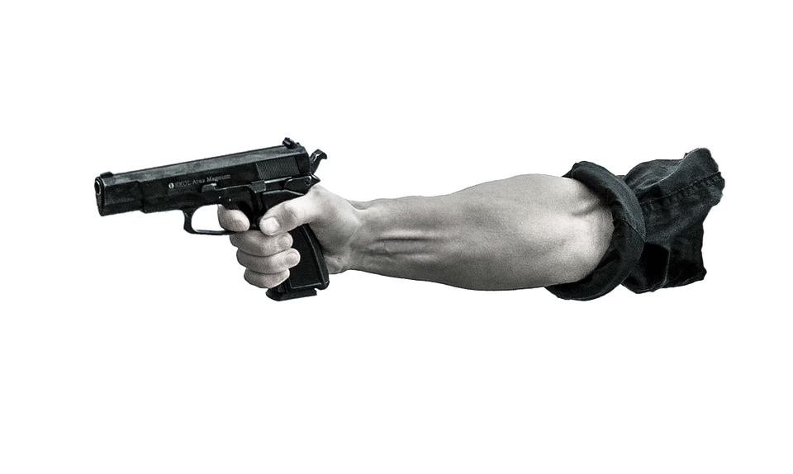
When should you not negotiate face to face?
… When you really, really, hate each other.
In this situation, you should consider an impersonal form of communication, or even an intermediary.
Notes:
When you really, really, hate each other. In this situation, you should consider an impersonal form of communication, or even an intermediary.
Source for photo:
https://pixabay.com/en/pointing-gun-arm-military-war-gun-1632373/
References
Swaab, R.I., Galinsky, A.D., Medvec, V., & Diermeier, D.A. (2012). The communication orientation model: Explaining the diverse effects of sight, sound, and synchronicity on negotiation and group decision-making outcomes. Personality and Social Psychology Review, 16, 25-53.

Slide 19

Debrief: The Castaways
Take 3 minutes and share with your neighbor:
One thing that your counterpart did well in your negotiation
One thing that you could have done better
Notes:
Ok now let’s talk about the Castaways. Please take 3 minutes and share with the person sitting next to you, who is not necessarily your negotiation partner. One thing that your counterpart did well, and one thing you could have done better in The Castaways, from a communication perspective. [Students share with others sitting next to them for a few minutes]. Ok, let’s get started again.
Source for photo
https://pixabay.com/en/palm-trees-the-island-of-koh-kood-966602/

Slide 20
What did you learn about your counterpart?
STUDENTS
ISLANDER
Notes:
What did you learn about your counterpart? [Students answer].

Slide 21
Two parties involved in the negotiation
STUDENTS
Visiting Koh Jum to obtain a diving certification
Are stranded and desperately need to get off the island
Willing to trade personal objects in order to build their own raft and sail back
ISLANDER
From a humble fishing family, speaks a rare dialect
Living alone on an almost deserted island
Interested in acquiring items from the Students and getting them to leave the island as soon as possible
Notes:
The students are stranded and desperately need to get off the island. They are willing to trade their personal belongings, practically everything if necessary, to build their own raft and sail back. The islander is a hermit living alone on an almost deserted island. The islander is intrigued by some of the students’ items but mostly interested in getting them to leave the island as soon as possible.

Slide 22
Payoff structure: Islander’s resources
Resources | Value to Student | Value to Islander
4 logs, 1 rope, 2 small pieces of wood | 2,000 | 150
Islander’s help building the raft | 200 | 0
Ropes | 200 | 50
Logs | 100 | 20
Small piece of wood | 50 | 10
Stones | 0 | 20
Islander resources are generally more valuable to the Students, especially the minimal amount required to build the raft
The Islander’s help is entirely value creating (it costs nothing for him to give it)
The Students don’t want the Islander’s large stones
The Islander’s resources are valued more highly by the Students than their own belongings (worth 850pts)
Notes:
The Islander’s resources are generally more valuable to the Students than they are to him, especially the minimal amount required to build the raft, those items in combination are worth 2,000 points to the Students and only 150 to the Islander.
At the same time, the Islander’s resources are valued more highly by the Students that their own belongings. The Islander’s belongings are worth more to the students than their own belongings at only 850pts. The point system captures the Students’ desperation to get off the island.
The Islander’s help building the raft, if they can reach this understanding, is entirely value creating-- it costs nothing for the Islander to give it and his expert help is worth 200 points to the Students.
One thing the Students don’t want at all is the Islander’s large stones, since they are trying to build a raft. The Islander thinks his stones are valuable because he needs them for his hut.

Slide 23
Payoff structure: Students’ belongings
Belongings | Value to Student | Value to Islander
250$ in cash | 250 | 250
Clothes | 100 | 50
Sunscreen | 100 | 200
Radio | 100 | 100
Diving equipment: wetsuit | 100 | 100
Diving equipment: oxygen bottle | 75 | 10
Diving equipment: harpoon | 50 | 25
Backpack | 50 | 300
Shoes | 50 | 300
Diving equipment: mask | 15 | 75
Diving equipment: fins | 10 | 40
Cans + beer bottles | -50 | 300
Maximum value attainable | 900 | 1,750
Some items are valued the same by both parties
Others present strong valuation asymmetries – the Islander values them much more
Individual parts of parts of the diving equip. are valued differently (despite same total)
Notes:
Now let’s take a look at the value placed on the Students’ belongings. Some items, like the cash which the Islander knows can be used to purchase things from visitors or the wetsuit for staying warm underwater, are valued the same by both parties.
Others present differing preferences– the Islander values the backpack, shoes, and sunscreen much more than the Students do. He also really wants their cans and beer bottles to catch water, and the students want to get rid of those items if possible, its negative 50 points to them if they keep them.
The Individual parts of parts of the diving equipment are valued differently, the Students generally value the expensive items like the oxygen bottle and harpoon, whereas the Islander want items like the diving mask and fins that will make his everyday life easier.
Here we also see that while the Students are more desperate, a deal is indeed possible, since there are items the Islander values quite highly and should be willing to barter for.

Slide 24
What tactics did you use to overcome
the “no-speaking” rule?
Notes:
What strategies did you use to overcome the “no-speaking” rule in your negotiations? [Students answer].
Source for photo
https://pixabay.com/en/palm-trees-the-island-of-koh-kood-966602/

Slide 25
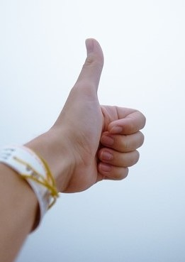
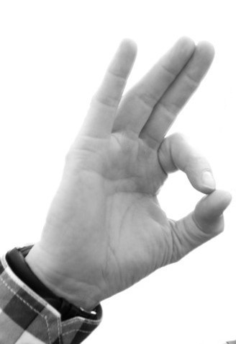
Notes:
Did anybody use gestures to communicate? [Students all nod yes]. What kinds of gestures? [Students demonstrate gestures they used in The Castaways]. What did you mean when you used that gesture? [Students answer]. Does it mean something different in anyone else’s culture? [Students answer].
One thing to watch out for is the different meaning of gestures across cultures. What do these hand gestures on the slide mean in your cultures? [Students answer]. Thumbs up is a positive gesture in the United States and some other cultures, but in parts of the Middle East thumbs up means “up your butt”! In Brazil and Turkey the second hand gesture, which means “Ok” in the U.S. and some other countries, is quite rude and could get you into a lot of trouble too– it means butthole.
In the Philippines and Qatar, gesturing to someone by extending your hand palm up and moving your fingers backward [instructor demonstrates] is very rude.
So be careful with your gestures when communicating across cultures. Don’t assume that the meaning of a gesture to you or in your culture is the same everywhere. We will talk more about culture in later lectures.
Source of photo
https://pixabay.com/en/fingers-gesture-hand-thumbs-up-1867478/

Slide 26
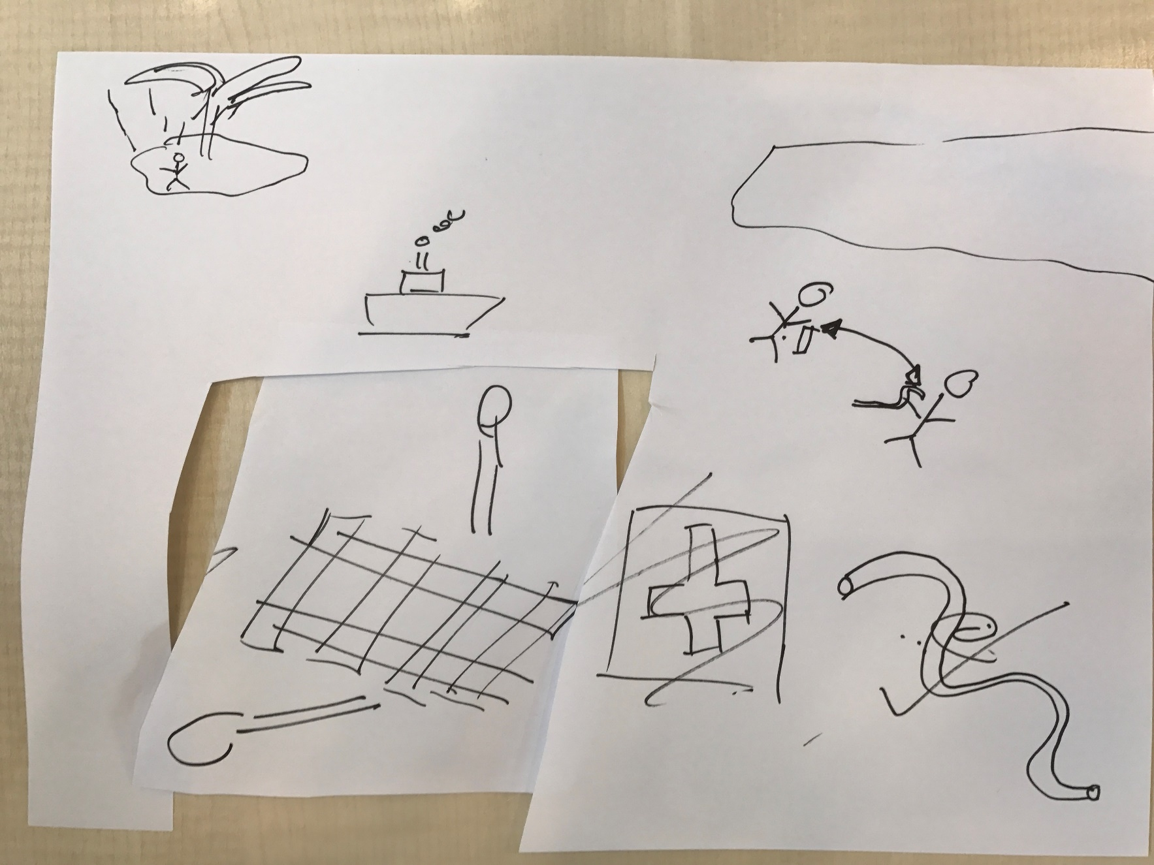
Some of your drawings in the sand
Notes:
Here are some of your drawings in the sand. Which team is this? What were you trying to communicate and was it understood? Walk us through this. [The students whose negotiation the drawing is from answer].
Note: These are example drawings from a pilot course at INSEAD. The instructor should paste in examples from her/his own class.

Slide 27
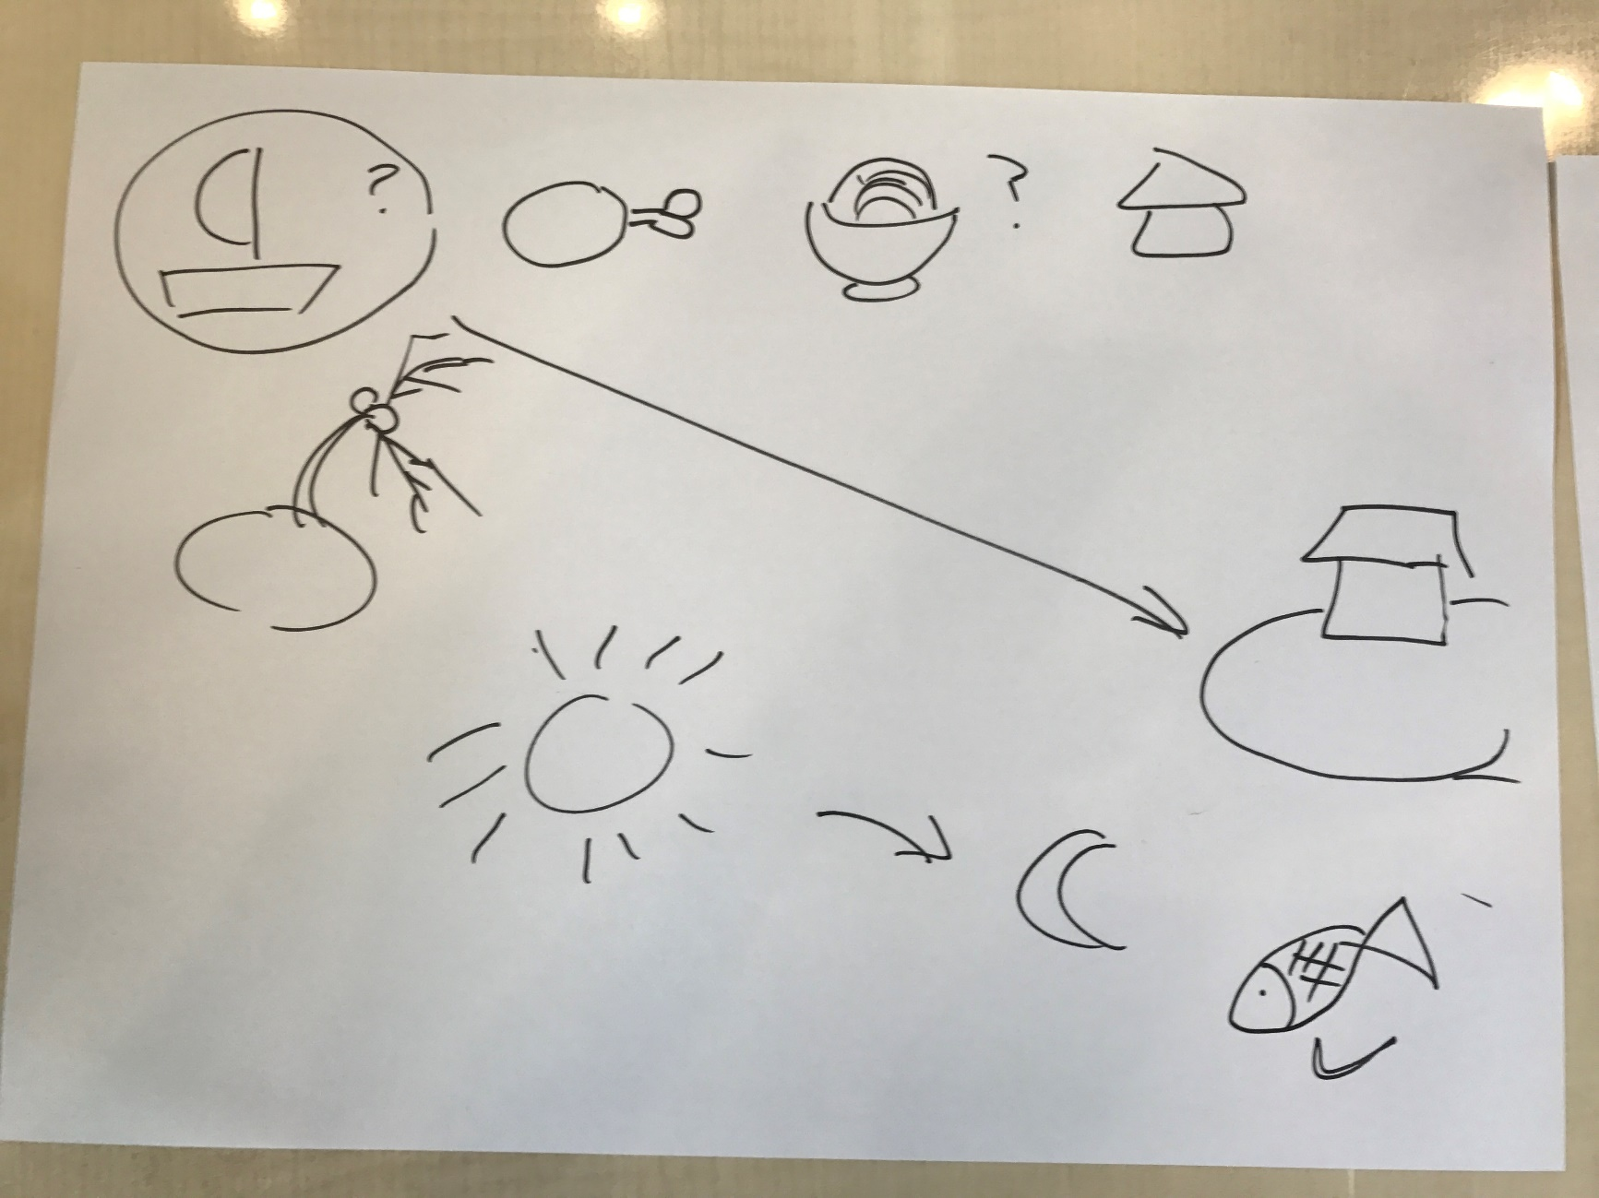
Some of your drawings in the sand
Notes:
Walk us through this page [The students whose negotiation the drawing is from answer]. Did this help you communicate? Were there any lapses or gaps in communication? [The students whose negotiation the drawing is from answer]. So in some cases you can see the curse of knowledge in action, in these drawings, what makes perfect sense to the person who drew them can be very hard for others to understand, it isn’t necessarily obvious to them.
Note: These are example drawings from a pilot course at INSEAD. The instructor should paste in examples from her/his own class. We recommend using more than two examples, time allowing, so students feel included.

Slide 28
Who was the more powerful party?
Why?
Notes:
Who was the more powerful party in The Castaways? Why? [Students answer].

Slide 29
Power imbalance between parties
STUDENTS
Their belongings are worth 850.
However they get penalized by 3,000 if there is no deal.
BATNA: -2,150
ISLANDER
His resources are worth 500 to him.
He has no additional incentive to conclude a deal.
BATNA: 500
Power in negotiation is driven by your Best Alternative to a Negotiated Agreement (BATNA), not by your status
Notes:
The islander is poor and uneducated and the MBA students are comparatively wealthy and well-educated. But your power in a negotiation is based on your Best Alternative to a Negotiated Agreement or BATNA, not by your status. If there is not deal, the Islander loses some value points but is still comfortable. The Students are stranded on an island with no way to get home.

Slide 30
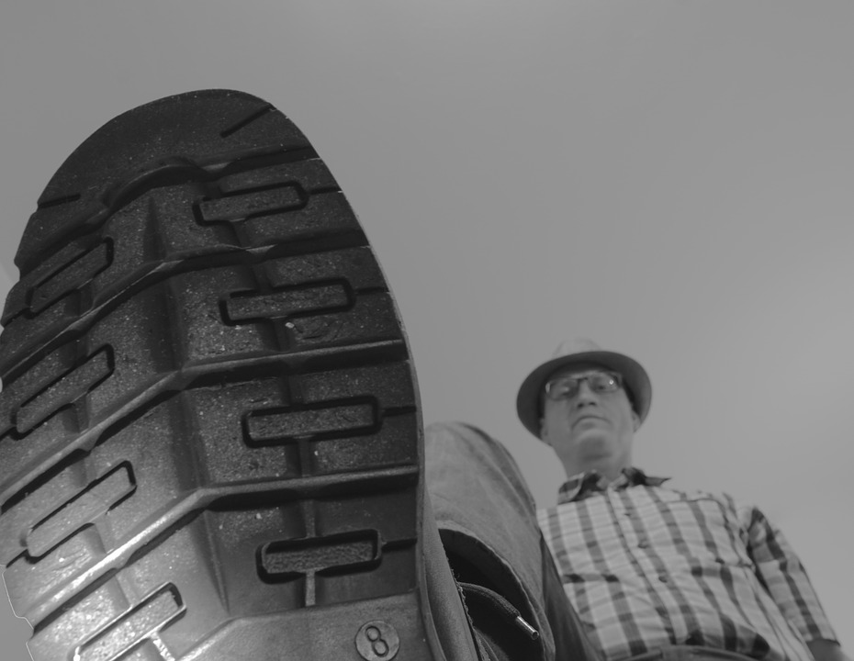
How should you negotiate with someone who has more power than you do?
Notes:
How should you negotiate with someone who has more power than you do? [Students answer]. You should not use win-lose, power-based tactics if you are the low-power party. If the interaction turns into a win-lose negotiation it is you who will get stepped on.
Source of photo
https://pixabay.com/en/trample-push-shoe-shoe-sole-784060/

Slide 31
Did any islanders get a deal and still
keep all their resources?
Notes:
Did any of you agree the Islander would come on the raft with the Students and then row back? Then he can keep the Students’ property and his resources too, its one of the most value-maximizing solution to The Castaways, but also a difficult agreement to reach because of the language barrier.
Note: Only a small percentage of groups come to the optimal solution, which is for the Islander to come on the raft with the Students and then row back. If they do this the Islander can keep the points from any of the students’ belongings he obtained, plus the points from his materials from the raft which revert to him. These extra points are awarded by the instructor if both students describe an agreement along these lines under “shared understandings” in their outcome forms.

Slide 32
Negotiation Pair | Islander | Student | Details on additional understandings
1 | 1675 | 3035
2 | 1365 | 3700
3 | 1860 | 3075
4 | 1620 | 3080
5 | 1890 | 3025
6 | 1900 | 3625
7 | 1600 | 2700
8 | 1720 | 2900 | islander helps with navigation+ directions but not help sail the raft to mainland
9 | 2150 | 3100 | islander sails with student across water and then back to his island- therefore gets all island resources back
10 | 1940 | 3060 | islander sails with student across water and then back to his island- therefore gets all island resources back
11 | 1165 | 2625
12 | 1330 | 3025
13 | 1700 | 3015
14 | 1565 | 3625
15 | 1810 | 3300 | islander takes student across the current and takes her home all the way to Singapore!
16 | 2060 | 2700
17 | 1725 | 3485 | student left only with clothes and raft
18 | 1835 | 2875
19 | 1535 | 3300
20 | 1785 | 2875
Your Results: The Castaways
Notes:
And here are your agreements for The Castaways! [Students react].
So tell me a bit about your deals. [Students share their experiences in the negotiation. If not enough students are speaking, the instructor can choose extreme results– high and low scores, bars with very fair and very disproportionate divisions of value– and ask that negotiating team to share how their negotiation went]. Here’s some of the shared understandings you reached [Instructor shares these– they only count if both sides indicate the same thing despite being unable to converse using words
Who generally got more value, the Students or the Islander? [Students say: Islander!]. Ironic isn’t it, given that he was in the power position? Why would that be? [Students answer]. It is sometimes like this in a negotiation when one person has more power than the other, like a boss and subordinate. The high-power party is better off without a deal than the low-power party is, in other words he or she has the better BATNA. Power comes from your BATNA. But the low-power party may benefit more from actually getting to a deal. If the boss says yes, that could be huge for the employee and cost the boss little. So the low-power party’s range of possible outcomes, from worst to best, may be greater than for the high-power party.
Note: This is an example figure based on a pilot lecture at INSEAD. During the break, the instructor should have created the results slide for the class using the excel spreadsheet called “Results_Template_Castaways” and past it into this PowerPoint slide

Slide 33
Your Results: The Castaways
Notes:
And here are your agreements in the form of a figure. The total height of the bars reflects the joint value you created together. Higher bars mean more value creation. The purple bars reflect the value claimed by the Students and green is the value claimed by the Islander.
Note: This is an example figure based on a pilot lecture at INSEAD. During the break, the instructor should have created the results slide for the class using the excel spreadsheet called “Results_Template_Castaways” and pasted it into this PowerPoint slide
Note: This slide is less interesting than the preceding one, which shows details and special agreements, and could also just be dropped from the presentation.

Slide 34
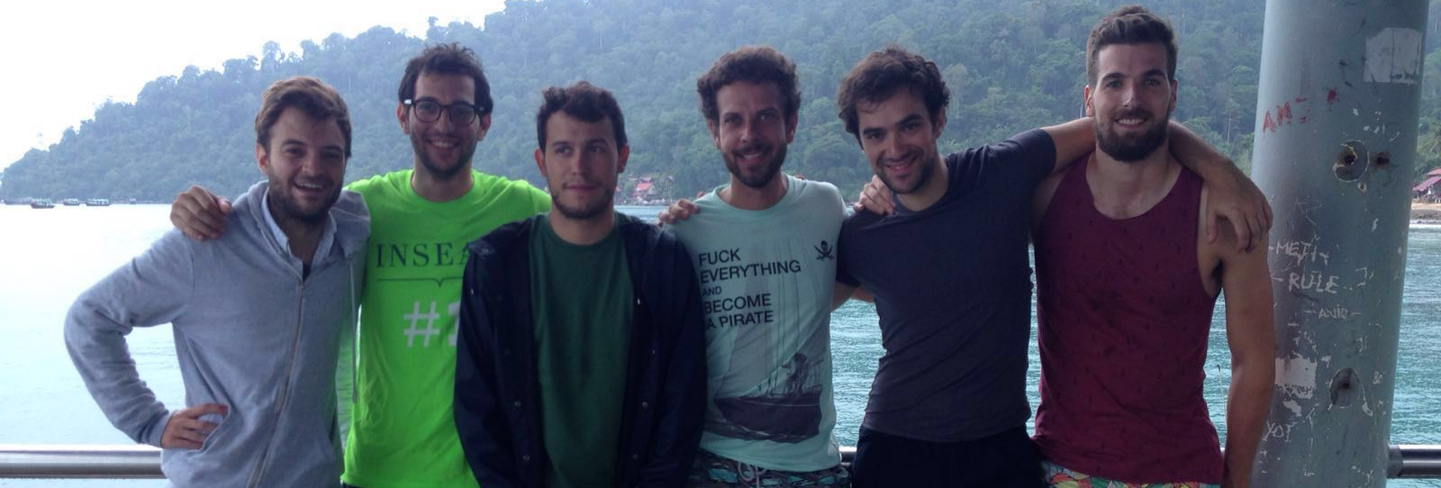
The Real Castaways A group of INSEAD MBA students from the class of December 2016
The situation in the role play is hugely exaggerated…
Notes:
The Castaways is based very loosely on the story of a group of INSEAD MBA students from the class of December 2016 who were stranded on a nearly deserted island and had to negotiate with a local for passage off without sharing the same language. The real Islander made them give up their personal possessions and they agreed due to their poor alternative. The situation in the role play is a huge exaggeration, but there is some truth to it.

Slide 35
Take-Aways
Curse of knowledge in communication: Avoid the assumption others know what you know
Leverage rich communication channels as much as you can to avoid miscommunication
Notes:
Some of the major take-aways from today. Really watch out for the curse of knowledge in communication. Do not assume the other person knows what you know or understand what you mean, this false assumption is a fundamental and powerful psychological bias. And as a general principle, leverage rich communication channels as much as you can. Most of the meaning of what we say is communicated through tone of voice and our nonverbal behavior.

