Slide 1
Magos and Tala Comics
06/2024-6914
This slide deck was prepared by Carmen Ruiz Pozuelo and Alessandro Mazzarini, INSEAD MBA Alumni, and Warren Tierney, Postdoctoral Research Associate at INSEAD, under the supervision of Martin Schweinsberg, Associate Professor of Organisational Behaviour at ESMT Berlin, Horacio Falcão, Professor of Management Practice of Decision Sciences at INSEAD, and Eric Uhlmann, Professor of Organisational Behaviour at INSEAD, as additional material to the role play “Magos and Tala Comics”.
To access INSEAD teaching materials, go to https://publishing.insead.edu/.
Copyright © 2024 Martin Schweinsberg, Horacio Falcão, Eric Uhlmann.
COPIES MAY NOT BE MADE WITHOUT PERMISSION. NO PART OF THIS PUBLICATION MAY BE, COPIED, STORED, TRANSMITTED, TRANSLATED, REPRODUCED OR DISTRIBUTED IN ANY FORM OR MEDIUM WHATSOEVER WITHOUT THE PERMISSION OF THE COPYRIGHT OWNER.

Slide 2

Notes:
Before we do anything else please take a few minutes or so to remember what you learnt in our last session. Doesn’t have to be what I taught you, but something that YOU learnt personally, what did YOU take out of the last class? We’re doing this because this is a GREAT RETURN ON INVESTMENT: we’re spending a few minutes on this now so you don’t lose the last few hours we spent together. [Students provide their take-aways. They can either be asked to write down their personal take-away on a sheet of paper for a minute then share with the class, or to share with the class straight away without writing alone first].
Source for photo
https://pixabay.com/en/time-timer-clock-watch-hour-371226/

Slide 3
Team-on-Team Negotiation Exercise:
Magos and Tala Comics
Read your role materials and plan strategy with your two team members (max 35 minutes)
Negotiate with your counterparts as a 3 on 3 team negotiation (max 45 minutes)
Turn in your outcome form and take a 10 minute break
Notes:
Today we have a team-on-team negotiation exercise. Each of you will be paired with two teammates and negotiate with another team of three. So a three-on-three, team on team negotiation. You will be in groups of 6.
The case is Magos and Tala Comics, the setting is the comic book industry.
You will have 35 minutes to read your role materials and plan your strategy with your teammate, then 45 minutes to negotiate with the other team. Then you take a 10 minute break. The lecture will begin again in 90 minutes. We will discuss your results during the lecture. Sounds good? [Students say yes].
As before, make an effort to partner up with other students you know less well than others, and if when possible different people from your previous negotiations. We have done a lot of negotiations at this point, so its ok if sometimes you are with some of the same people from before again. [Students partner up, the instructor hands out role materials, and the students negotiate.]
[During the negotiations, the instructor should walk around and take mental or written notes on some of the students’ interactions, highlighting tactics and reactions that can be brought up later during the debriefs when students are asked to share their experiences or when key teaching points are made].
[As the students come back with their outcome forms, the instructor has the option of summarizing their agreements in the slide called “Magos and Tala Comics: Your Deals”. Each group of students is told their negotiation group number as they turn in their results and are asked to remember it for the debrief. Another option to simply pick interesting results out from the outcome form and debrief verbally]
Note: An alternative approach to creating the pairings is for the instructor to pair students up himself/herself, either by creating pairings before class begins or ad-hoc now during the lecture.
Note: This exercise should be done in 3-on-3 teams to increase the likelihood at least one person on each side will have some acting ability and get into their role. Magos and TC is a risky exercise to use for an inhibited or disengaged audience because they may not take the cultural communication styles instructions to heart.
Source for photo
https://pixabay.com/en/folders-comiccon-dortmund-fair-1143684/

Slide 4
Magos and Tala Comics
Magos | PAIR | Tala Comics | BOR
 | 1 |  | 251
 | 2 |  | 252
 | 3 |  | 253
 | 4 |  | 254
 | 5 |  | 255
 | 6 |  | 256
 | 7 |  | 257
 | 8 |  | 258
Notes:
Here are your breakout room slides for this exercise. Please grab your role materials– they are printed in the color that matches the color of the column your name is listed in on the slide. Then pair up with your negotiation team, make arrangements to meet the team on the other side of the table, and enjoy the exercise! [Students get their role materials and go to negotiate].
Note: This template students pairings slide is for if the instructor sorts students into negotiating teams beforehand. Student names are added in the respective columns beneath their role. If this slide is used, the color background for each role on the slide above should match the color paper of the role materials that are handed out to students, to avoid confusion. The “BOR” column refers to “Breakout Room” and only applies if the instructor has special rooms for the students to negotiate in. “PAIR” refers to negotiation group number, in other words each pair of students who negotiate with each other.
Note: There are multiple representatives each for Magos and for Tala Comics, so there should be multiple student names in each of the squares in the table.

Slide 5

Take 3 minutes and share with the person next to you:
One thing the other team did well in the negotiation
One thing your team could have done differently
Notes:
[Students are now back in class]. Welcome back! Please take 3 minutes and share with the person sitting next to you, who is not necessarily part of your negotiation group. One thing that the other team did well, and one thing your team could have done better.
Source for photo
https://pixabay.com/en/meeting-businessmen-personal-1219527/

Slide 6

Negotiating Across Cultures
Notes:
By a show of hands, how many of you have spent at least 30% of your time at your most recent job working with people from cultures other than your own? [Students raise hands]. 60%? [Students raise hands]. 90% of your time working with folks from cultures other than your own? [Students raise hands]. Those of you with 90%, tell me about that. [Those students share their experiences– this subgroup are often expats]. If you have lived in a country other than your own, raise your hands. [Students raise hands]. Let’s hear from some of you. [Instructor points at one student after another, and they respond “Russian who lived in the Netherlands,” “Bulgarian who worked in the U.S.”, and so on]. You are a very interesting group. You have so much international experience, but different experience than the person next to you.
Note: This portion of the lecture script is more appropriate for an audience with substantial international work experience, e.g., an international MBA or executive audience.
Source for photo
https://pixabay.com/en/meeting-businessmen-personal-1219527/

Slide 7
Perspective Taking Across Cultures
Caterpillar trying to sell $30 million in gas turbines for
Russian natural gas pipeline project
  Previous negotiations went well
  Final negotiations in Nice, France stalled
What would you do if you were Caterpillar?Realized the Russians didn’t want to go home during the winter
Caterpillar dragged out negotiations Russian negotiators couldn’t return without deal
Notes:
I’d like to introduce the topic of cross-cultural negotiations with a little mini-case. Caterpillar was trying to sell $30 million in gas turbines for a Russian natural gas pipeline project. There were a number of rounds to the negotiations, which had all gone well. But the final negotiations in Nice, France stalled. It seemed the Russians had lost interest in the deal. What would you do if you were Caterpillar? [Students answer].
Reference
Monippally, M. (2010). The persuasive manager: Communication styles for 21st century managers.

Slide 8
Perspective Taking Across Cultures
Caterpillar trying to sell $30 million in gas turbines for
Russian natural gas pipeline project
  Previous negotiations went well
  Final negotiations in Nice, France stalled
Realized the Russians didn’t want to go home during the winter
So what would you do then?ations Russian negotiators couldn’t return without deal
Notes:
They eventually realized the Russians didn’t want to go home during the winter. Russia is beautiful, but cold, the Russian negotiators wanted to stay in beautiful, warm, Nice France. Having realized this, what would you do if you were Caterpillar? [Students answer].
Reference
Monippally, M. (2010). The persuasive manager: Communication styles for 21st century managers.

Slide 9
Perspective Taking Across Cultures
Caterpillar trying to sell $30 million in gas turbines for
Russian natural gas pipeline project
  Previous negotiations went well
  Final negotiations in Nice, France stalled
Realized the Russians didn’t want to go home during the winter
Caterpillar dragged out negotiations. Russian negotiators couldn’t return without a deal and made major concessions.
Notes:
Caterpillar let them drag out negotiations. What the Russian negotiators situation if they’ve taken a long, long, trip to Nice France and then come back home without a deal? They now need to make a deal. Caterpillar got major concessions at the very end. That of course was just national differences in weather. Cultures also differ in deeper, more meaningful ways.
Reference
Monippally, M. (2010). The persuasive manager: Communication styles for 21st century managers.

Slide 10

Defining Culture?
Notes:
So, how would you define culture? Here I am talking about those deeper things that make groups of people unique, not the weather. [Students answer].
Source of photo
https://pixabay.com/en/hand-keep-lens-photography-1030554/

Slide 11
Defining Culture?
“The way of life, especially the general customs and beliefs, of a particular group of people at a particular time.”
-- Cambridge English Dictionary
Culture is a lens we use to interact with the world
  Influences perceptions and behaviors
  Learned by socialization
  Distinguishes groups
  Relatively stable
Notes:
There are many definitions of culture. Here is a particularly nice one from the Cambridge English Dictionary: “The way of life, especially the general customs and beliefs, of a particular group of people at a particular time.” Culture is a lens that we use to perceive the world, that shapes our perceptions and behaviors, is learned from those around us– often at a very young age– distinguishes one group of people from others, and is relatively stable across time.
References
“Culture.” Cambridge English Dictionary. dictionary.cambridge.org. Retrieved July 26, 2015.
http://dictionary.cambridge.org/dictionary/english/culture?a=british

Slide 12

One fish asks another fish "how's the water?"
Notes:
One fish asks another fish "how's the water?“

Slide 13
One fish asks another fish "how's the water?"
The other fish says, "what is water?"
Notes:
One fish asks another fish "how's the water?" The other fish says, "what is water?" Fish do not know they are in water. Culture is like that, its so deeply embedded in our lives that unless we interact regularly with members of other cultures, we may fail to realize that our values, norms, and beliefs are not universal.
Source of photo
https://pixabay.com/en/fish-aquarium-water-1607380/
Relevant quote
“One thing about which fish know exactly nothing is water, since they have no anti-environment which would enable them to perceive the element they live in.” -- Marshall McLuhan
References
Adam Dachis, Fish don’t know they are in water
http://lifehacker.com/5821126/fish-dont-know-theyre-in-water
Derek Sivers, “Fish don’t know they’re in water”
https://sivers.org/fish

Slide 14
Some Important Dimensions of Culture
(Hofstede, 2001; Meyer, 2014)
Collectivism-Individualism
  Valuing the group (we, us) vs. individual (I, me, mine) goals
Notes:
Scientific research has identified a number of important dimensions of culture. I will cover some of the ones most central to negotiation. The first of these you all probably know, it is individualism-collectivism. This is the extent to which a culture places emphasis on groups or individuals.
References
Hofstede, Geert (2001). Culture's Consequences: comparing values, behaviors, institutions, and organizations across nations (2nd ed.). Thousand Oaks, CA: Sage.
Meyer, E. (2014). The Culture Map: Breaking Through the Invisible Boundaries of Global Business.
https://www.insead.edu/faculty-research/publications/books/the-culture-map-breaking-through-the-invisible-boundaries-of-global-business-32867

Slide 15

Handout: National Rankings on Individualism and Collectivism
Notes:
I have a handout for you, it shows national rankings on individualism and collectivism from the famous cross national survey by Hofstede. You can look up places you’ve lived, the country you were from, and countries that interest you. High scores reflect more individualism. [Instructor passes out hard copies of “Handout_Individualism”].
Note: The Hofstede scores are based on a huge cross-national survey of IBM employees, later validated by the massive GLOBE surveys which were not within just one company.
Source of photo:
https://pixabay.com/en/banner-header-continents-country-1158378/

Slide 16
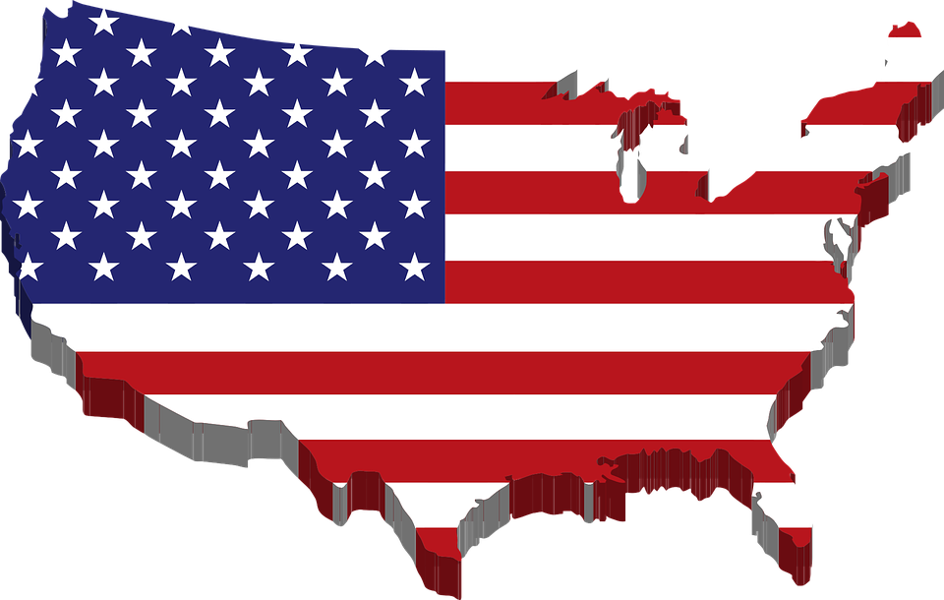
“The squeaky wheel gets the grease.”
- Josh Billings,
U.S. humorist
Notes:
This quote from Josh Billings, “The squeaky wheel gets the grease,” captures the individualism of his native United States. Individuals are rewarded for standing out, even if that is by complaining.
Source of photo:
https://pixabay.com/en/america-borders-country-flag-map-1295554/

Slide 17
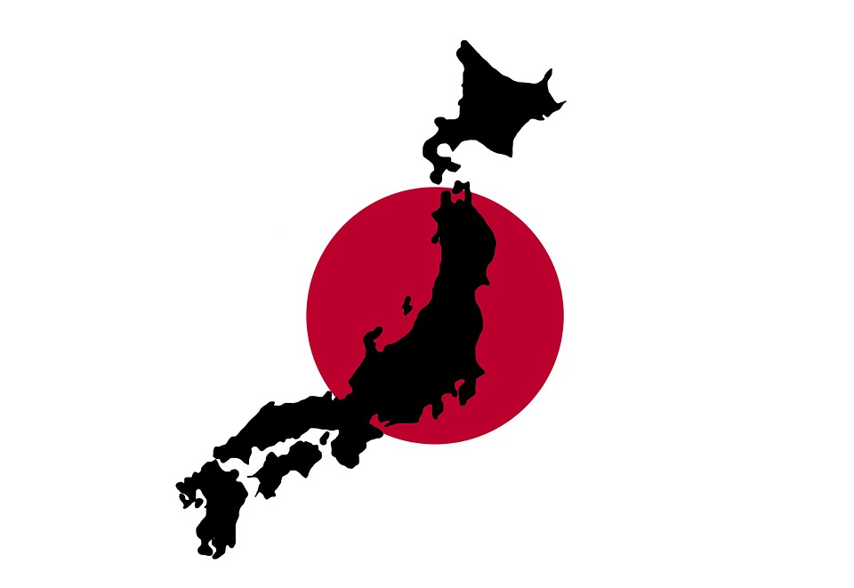
“The nail that sticks out gets hammered down.”
- Traditional
Japanese saying
Notes:
Here is a contrasting quote from Japan, “The nail that sticks out gets hammered down.” [Instructor mimics a hammer smashing a nail with his or her hand]. A very different sentiment, suggesting that those who are too individualistic will be punished for it.
Source for photo:
https://pixabay.com/en/japan-japanese-map-flag-red-112722/

Slide 18
Most Individualistic
National Differences (Hofstede, 2001)
Most Collectivistic
1. United States
2. Australia
3. United Kingdom
4. Canada
5. Hungary
1. Guatemala
2. Ecuador
3. Panama
4. Venezuela
5. Colombia
Notes:
Some of the most individualistic cultures in the world include the United States, Australia, United Kingdom, Canada, and Hungary. The U.S., consistent with some popular stereotypes, is the most individualistic country in the world, at least in Hofstede’s survey.
Some of the most collectivistic countries in the world include Guatemala, Ecuador, Panama, Venezuela, and Colombia. Many people are surprised by this, they expect East Asian countries to be highest in collectivism, but many other regions, such as Latin America, are just as -- if not more -- collectivistic.

Slide 19
Bank employees study
Mexicans bank employees more likely than U.S. bank employees to recommend unqualified friend for job (Zurcher et al., 1965)
Notes:
Let me tell you about a classic study that illustrates how the same behavior can have different meanings in different cultures. The study found that Mexicans bank employees were more likely than U.S. bank employees to recommend unqualified friend for a job. That’s consistent with popular stereotypes and not that surprising.
Reference
Zurcher, L. A., Medow, A., & Zurcher, S. L. (1965). Value orientation, role conflict and alienation from work: A cross-cultural study. American Sociological Review, 30, 539-548.

Slide 20
Bank employees study
Mexicans bank employees more likely than U.S. bank employees to recommend unqualified friend for job (Zurcher et al., 1965)
Construal of study topic
  U.S. employees = honesty
  Mexican employees = friendship
Notes:
The really interesting part came at the end of the study, when the researchers asked participants what they thought the study was about. The U.S. respondents said this is a study about my honesty and integrity, you want to know if I am honest enough to recommend the individual who deserves the job. The Mexicans said this was a study about my loyalty, you want to see if I am a good friend. What kind of a person would leave a friend unemployed and unable to support their family and help a complete stranger instead? That’s cultural differences in individualism and collectivism.
So its not that one culture is ethical and the other is less ethical. People from these different cultures are applying different moral lenses to the same situation.
Reference
Zurcher, L. A., Medow, A., & Zurcher, S. L. (1965). Value orientation, role conflict and alienation from work: A cross-cultural study. American Sociological Review, 30, 539-548.

Slide 21
1. High vs. Low Context Communication
2. Disagreement
3. Scheduling
Handout: National Rankings
on 3 Key Dimensions of Culture
Notes:
I also have a second handout for you, it shows national rankings on three dimensions of culture identified by Professor Erin Meyer in her book The Culture Map. [Instructor passes out hard copies of “Handout_Communication_Disagreeement_Scheduling”]. These national rankings are based on interviews with business executives from all over the world with experience with the cultures in question, and are particularly relevant to culture differences in communication.
Note: The Culture Map scores are based on the perceptions of executives from outside that culture who have worked in the culture.
Source of photo:
https://pixabay.com/en/banner-header-continents-country-1158378

Slide 22
Some Important Dimensions of Culture
(Hofstede, 2001; Meyer, 2014)
Collectivism-Individualism
  Valuing the group (we, us) vs. individual (I, me, mine) goals
High context vs. low context communication
  Communicating indirectly (tone of voice, hints) vs. directly (“I mean what I say and I say what I mean”)
Confrontation vs. Harmony
  Willingness to engage in confrontation vs. avoiding disagreement
Time orientation
  Flexible vs. strict attitude towards time
Notes:
The first of these dimensions is high versus low context communication. In a low context culture, communication is clear and direct. Explicit, simply, and clear. Blue means blue. In a high context culture, good, effective communication is more nuanced. You assume shared reference points.
In low context cultures, people communicate directly, they mean what they say and they say what they mean, as the saying goes in the United States. In high context cultures, communication is in direct, often through tone of voice and hints and body language.
References
Hofstede, Geert (2001). Culture's Consequences: comparing values, behaviors, institutions, and organizations across nations (2nd ed.). Thousand Oaks, CA: Sage.
Meyer, E. (2014). The Culture Map: Breaking Through the Invisible Boundaries of Global Business.
https://www.insead.edu/faculty-research/publications/books/the-culture-map-breaking-through-the-invisible-boundaries-of-global-business-32867

Slide 23
Low context
High vs. Low Context (Meyer, 2014)
High context
1. United States
2. Australia
3. Canada
4. Netherlands
5. Germany
1. Japan
2. Vietnam
3. Korea
4. Philippines
5. Indonesia
Notes:
Some of the most low context cultures in the world include the United States, Australia, Canada, the Netherlands, and Germany. Some of the most high context include Japan, Vietnam, Korea, the Philippines, and Indonesia.

Slide 24
Discussion Questions
Why is Japan the highest context culture in the world and the United States the lowest?
If you have low and high context people working together, how do they perceive each other?
Notes:
Why is Japan the highest context culture in the world and the United States the lowest? [Students answer]. Japan is a relatively closed, island society with a long history. Cultures with more diversity and less history tend to be low context. In the U.S. people from all over the world were thrown together and had to find ways to communicate, so they learned to be very direct with each other.
If you have low and high context people working together, how do they perceive each other? [Students answer]. Lows see highs as vague, lacking transparency, not trustworthy. Highs see lows as condescending: they are saying we are stupid. If we agree on something and you follow up with an email summary, that means you don’t trust me.
People from low context cultures can really offend those from high context cultures with what are perceived as overly blunt and even obnoxious statements. At the opposite end of the spectrum, people from low context cultures may become angered and frustrated when members of high context cultures seem to say one thing and do another. For example, saying they will do a task by a certain date but in the tone of voice implying it is not actually going to happen. Yet this implication is not understood by the person from the low context culture, who takes statement literally.

Slide 25
Buzz Group Discussions
Does your experience match up with the research?
Share personal experiences in which you’ve seen this cultural dimension create misunderstandings
What are some indirect ways of saying yes or no from your cultures?
Notes:
Let’s have some discussions in groups of 2-4, with the people sitting closest to you so you don’t need to leave your seats.
Three questions:
Does your experience match up with the research?
Share personal experiences in which you’ve seen this cultural dimension create misunderstandings
What are some indirect ways of saying yes or no from your cultures?
Please discuss for five minutes. [Students discuss in buzz groups].
Have any of you had interesting experiences with differences in high vs. low context communication that you would like to share? For example, miscommunication between members of different cultures? [Students share their experiences].
What are some indirect ways of saying yes or no from your cultures? [Students share].

Slide 26
How to say “No” in Japan
(Barry, 1992)
Notes:
Here are some ways to say “No” in Japan, according to U.S. humorist David Barry.

Slide 27
How to say “No” in Japan
(Barry, 1992)
I see.
Ah.
Ah-hah.
Yes.
That is very interesting.
Notes:
“I see.”

Slide 28
How to say “No” in Japan
(Barry, 1992)
I see.
Ah.
Ah-hah.
Yes.
That is very interesting.
Notes:
“Ah.”

Slide 29
How to say “No” in Japan
(Barry, 1992)
I see.
Ah.
Ah-hah.
Yes.
That is very interesting.
Notes:
“Ah-hah.”

Slide 30
How to say “No” in Japan
(Barry, 1992)
I see.
Ah.
Ah-hah.
Yes.
That is very interesting.
Notes:
“Yes.” Yes can mean no if said in a certain tone of voice in some cultures.

Slide 31
How to say “No” in Japan
(Barry, 1992)
I see.
Ah.
Ah-hah.
Yes.
That is very interesting.
Notes:
“That is very interesting.” Which basically means, that is the worst idea I have ever heard, and no way are we doing that! So a lot of statements can mean no in a high-context culture where tone of voice and nonverbal hints are extremely important. In Japan, even a little bit of no really means no. In France, you don’t say no, you say no no no no no! [Class laughs].
You can see how this can cause problems in negotiation, if saying “yes” to a proposal can literally mean “no” in some cultures. One western-born Dean at an international business school would come home excited thinking he had landed a lucrative executive education contract with an Asian company, only to follow up and get a confused response since the Asian company had not actually agreed, from their perspective.

Slide 32
High-Context Communication:
More Examples
Indian head shakes
“Now now” in Nigeria
“Can can” in Singlish
“Inshallah” or “God willing” can mean “This will happen” or “No, this will not happen” depending on the country
“Deuxième Degré” in France means the actual meaning
Expression “KY” in Japan means “unable to read the air”
Notes:
Here are some more examples of high context communication.
… Who can demonstrate Indian head shakes and tell us what they mean? [Ideally an Indian student will demonstrate and explain]. In India, headshakes do not mean the same thing they mean in other countries. Sometimes you can shake your head from side to side to mean yes.
… Who knows what “Now now” means in Nigeria? [students answer]. “Now now” in Nigeria means “immediately.” Just “now” doesn’t really mean now, it has to be now now or its not going to happen right away.
… How about what “can can” means in Singlish, the creole language sometimes spoken in Singapore that combines words from different languages? [students answer]. “Can can” in Singlish means “Yes, no problem!”
… How about what “Inshallah.” [students answer]. “Inshallah” literally means God willing. It can indirectly imply “This will happen” or “No, this will not happen” depending on the country. In Kuwait, inshallah means I think it will happen. In Qatar, it means I think it will NOT happen.
… How about what “Deuxieme degree” means in France? [students answer]. This is a term that refers to high context communication itself. The expression “Deuxieme degree” in France means to say something to second degree. The second degree is the actual meaning of what is being said, often expressed indirectly through humor.
… How about what the expression “KY” means in Japan? [students answer]. In Japan KY “unable to read the air”, or unable to tell what the other person is really trying to express. The words behind the words, so to speak.

Slide 33
How can you manage cultural differences in communication?
What if it is your decision how the group will communicate?
What if it is not your decision?
Please discuss in buzz groups for three minutes
Notes:
How can you manage cultural differences in communication? What if it is your decision how the group will communicate? What if it is not? Please discuss in buzz groups of 2-4 people for three minutes. [Students discuss in groups].
Ok, let’s discuss as a class. How to handle cultural differences in communication? [Students share].
If its up to you, establish low context processes for global groups. This is to avoid misunderstandings based not only on cultural differences in communication not just between high context and low context cultures, but also between different high context cultures. A person from Kuwait will likely not know what Indian head shakes mean or what “can can” or “now now” means when communicating with someone from Singapore or Nigeria. It helps if you can switch to low context communication, to be very literal, so you can get on the same page and avoid misunderstandings and conflict.
However, sometimes it isn’t up to you how you will communicate. When negotiating or working with members of low context cultures, be clear and direct. This enhances trust. Recap and repeat. Use bullet points.
When negotiating or working with members of high context cultures, repeat yourself less. Ask for clarifications. Use a cultural bridge, someone familiar with both cultures, if you have one. And try to learn to read the air.

Slide 34
Some Important Dimensions of Culture
(Hofstede, 2001; Meyer, 2014)
Collectivism-Individualism
  Valuing the group (we, us) vs. individual (I, me, mine) goals
High context vs. low context communication
  Communicating indirectly (tone of voice, hints) vs. directly (“I mean what I say and I say what I mean”)
Disagreement
  Willingness to engage in confrontation vs. avoiding confrontation
Time orientation
  Flexible vs. strict attitude towards time
Notes:
Another cultural dimension highly relevant to negotiation is norms related to disagreement. Are people in this culture willingness to engage in confrontation, or do they avoid confrontation and value harmony?
References
Hofstede, Geert (2001). Culture's Consequences: comparing values, behaviors, institutions, and organizations across nations (2nd ed.). Thousand Oaks, CA: Sage.
Meyer, E. (2014). The Culture Map: Breaking Through the Invisible Boundaries of Global Business.
https://www.insead.edu/faculty-research/publications/books/the-culture-map-breaking-through-the-invisible-boundaries-of-global-business-32867

Slide 35
Confrontational
Disagreement (Meyer, 2014)
Avoids Confrontation
1. Israel
2. France
3. Russia
4. Greece
5. Germany
1. Thailand
2. Indonesia
3. Japan
4. Philippines
5. Ghana
Personal experiences to share?
Notes:
Some of the most confrontational cultures in the world include, Israel, France, Russia, Greece, and Germany.
Some of the most conflict-avoidant cultures in the world, places where people hate open and public arguments, include Thailand, Indonesia, Japan, the Philippines, and Ghana.
Have you had any personal experiences with cultural differences in orientation towards disagreement and conflict you would like to share? [Students share their experiences].

Slide 36
“In a good meeting…”
The top answers from three cultures
72% of Chinese businesspeople say “We put a formal stamp on a decision made before the meeting in informal pre-meetings.”
79% of American businesspeople say “A decision is made”
54% of the French businesspeople say “We debate and exchange views”
Notes:
Here are the rest of a study looking at what members from three major cultures say should happen in a good meeting.
72% of Chinese businesspeople say “We put a formal stamp on a decision made before the meeting in informal pre-meetings.”
79% of American businesspeople say “A decision is made.”
54% of the French businesspeople say “We debate and exchange views.”
These answers reflect cultural differences in orientation towards disagreement. In China public disagreement is to be avoided, so the real decisions are made in smaller pre-meetings behind the scenes, to avoid open conflict and arguments.
In France, a good meeting is all about disagreeing, and the meeting can still be a good meeting even if no decision is made.
If people from different cultures come to a negotiation or meeting with different agendas, many will leave unhappy or even angry and frustrated.
References
Erin Meyer: This simple question about meetings reveals a lot about your culture
http://uk.businessinsider.com/there-are-three-totally-different-approaches-to-meeting-around-the-world-2015-2?r=US&IR=T

Slide 37
Cultural Differences in Negotiation Behavior
(Graham, 1985)
In Rome like the Romans?
Silent mins (in 10mins) | Eye contact
5.5 | 1.3
3.5 | 3.3
0 | 5.2
Japan
United States
Brazil
Notes:
Here are the results of a really interesting study. Negotiators from three cultures– Japan, the United States, and Brazil were video recorded and their behaviors during the negotiation analyzed. The researchers looked at the amount of silent periods and eye contact. As you can see here, Japanese negotiators were more likely to be silent and less likely to make eye contact than U.S. negotiators and especially Brazilian negotiators.
References
John L Graham, 1985, Journal of International Business Studies, vol. 16, issue 1, pages 81-96

Slide 38
Cultural Differences in Negotiation Behavior
(Graham, 1985)
In Rome like the Romans?
Silent mins (in 10mins) | Eye contact | “No” (in 30 mins)
5.5 | 1.3 | 5.7
3.5 | 3.3 | 9.0
0 | 5.2 | 83.4
Japan
United States
Brazil
Notes:
The researchers also looked at the number of times the word “no” was stated directly by one or more parties during the negotiation. [Big laugh from the class as the third column appears]. So cultural differences can be quite dramatic.
You can just imagine a Japanese person negotiating with a Brazilian, and the other negotiator keeps touching him and saying no over and over, “No, help, stop touching me!” [Instructor mimics a Japanese person being touched repeatedly and the class laughs].
You may notice that these results do not map exactly onto the national scores on the disagreement dimension. There is more going on in these interactions than just one dimension of culture, as is the case for practically all negotiations. However, U.S.-Japan differences in orientation towards disagreement– in the willingness to say no-- may be a part of it.
References
John L Graham, 1985, Journal of International Business Studies, vol. 16, issue 1, pages 81-96

Slide 39
Some Important Dimensions of Culture
(Hofstede, 2001; Meyer, 2014)
Collectivism-Individualism
  Valuing the group (we, us) vs. individual (I, me, mine) goals
High context vs. low context communication
  Communicating indirectly (tone of voice, hints) vs. directly (“I mean what I say and I say what I mean”)
Disagreement
  Willingness to engage in confrontation vs. avoiding disagreement
Scheduling
  Flexible vs. strict attitude towards time
Notes:
A final dimension I would like to cover is what Meyer calls Scheduling. Do norms in this culture encourage a flexible or strict attitude towards time? For example, is it ok to be late to a meeting or is that rude and disrespectful to the other person?
References
Hofstede, Geert (2001). Culture's Consequences: comparing values, behaviors, institutions, and organizations across nations (2nd ed.). Thousand Oaks, CA: Sage.
Meyer, E. (2014). The Culture Map: Breaking Through the Invisible Boundaries of Global Business.
https://www.insead.edu/faculty-research/publications/books/the-culture-map-breaking-through-the-invisible-boundaries-of-global-business-32867

Slide 40
Strict
Scheduling (Meyer, 2014)
Flexible
1. Germany
2. Japan
3. Sweden
4. Czech Republic
5. Norway
1. Nigeria
2. Kenya
3. Angola
4. Botswana
5. Zimbabwe
Personal experiences to share?
Notes:
Some of the most strict culture regarding time include Germany and Japan, and among the least strict are Nigeria and Kenya. In Nigeria you can be late by German standards and yet not be late.
Have you had any personal experiences with cultural differences scheduling that you would like to share? [Students share their experiences].
References
Erin Meyer: From Switzerland to Nigeria, here are the most and least punctual countries
http://uk.businessinsider.com/here-are-the-most-and-least-punctual-countries-2015-2?r=US&IR=T

Slide 41
Cultural differences in Magos and Tala Comics?
Pozzians
Mazzians
Notes:
So thinking in terms of these dimensions, what are some of the cultural differences in Magos and Tala Comics, between the Pozzians and Mazzians? [Students answer].

Slide 42
Cultural differences in Magos and Tala Comics?
Pozzians
Mazzians
Collectivistic
Greatly value humility and don’t like bragging.
High context communication
Meaning is often communicated indirectly.
Disagreement: Value harmony
Calm all throughout the negotiation. Do not show negative emotions or create conflict.
Scheduling: Strict about time
Efficient and productive. Want to reach an agreement quickly.
Individualistic
Sure of themselves and their creation.
Low context communication
Speaking bluntly considering a form of respect.
Disagreement: Value confrontation
Express negative emotions and willing to engage in conflict.
Scheduling: Flexible about time
Not punctual. Prefers to spend time getting to know the counterpart rather than get down to business.
Notes:
The role play provides an opportunity to experience the challenges and frustrations of negotiating with people with a different negotiation style than your own. To make this point, we had you simulate exaggerated cultural stereotypes. Based on the communication instructions we gave you, Pozzians are more collectivistic, high context in their communication style, and value harmony, but are quite strict about timeliness. Mazzians, on the other hand, are more individualistic, speak quite frankly and directly, are confrontational, and are flexible about time.

Slide 43
What was your experience negotiating
across cultures in Magos and TC?
Notes:
What was your experience negotiating across cultures in Magos and Tala Comics? [Students share their experiences].
Source for photo
https://pixabay.com/en/meeting-businessmen-personal-1219527/

Slide 44
How does negotiating across cultures affect negotiation outcomes?
Notes:
How do you think negotiating across cultures affects negotiation outcomes? Is it easier or harder to create value and reach mutually acceptable deals? [Students answer].
Source for photo
https://pixabay.com/en/meeting-businessmen-personal-1219527/

Slide 45
Culture and Negotiation Outcomes
Cross-culture negotiations result in poorer outcomes (diminished total value) than within-culture negotiations
Due to cultural differences in behaviors, communication styles, and norms
Magos and Tala Comics simulates exaggerated stereotypes, but these are dimensions cultures really do differ on
Notes:
Research shows that cross-cultural negotiations typically result in worse outcomes for both sides than within-culture negotiations. This is due to cultural differences in behaviors, communication styles, and norms that lead to misunderstandings and make it difficult to reach constructive agreements. Magos and Tala Comics simulates exaggerated stereotypes, but these are dimensions cultures really do differ on and such differences really can create huge problems in negotiation contexts.
References
Jean Brett (2000). Culture and Negotiation
http://onlinelibrary.wiley.com/doi/10.1080/002075900399385/abstract

Slide 46
China
average
USA average
Notes:
Although its important to be aware of cultural differences and sensitive to cultural differences like the ones we have talked about, its also critical not to stereotype. So on the one hand, you can make the error of treating your own culture like the water, and not realizing others have different values, norms, and preferences. On the other, you can make the error of treating members of other cultures as more different than you than they really are. What research shows is that perceived cultural differences are greater than actual differences. So for instance, people from the U.S. are stereotyped as more individualistic than they really are, and the Chinese are stereotyped as more collectivistic than they really are.
References
Chiu, C-y., Gelfand, M. J., T. Yamagishi, Shteynberg, G., & Wan, C. (2010). Intersubjective culture: The role of intersubjective perceptions in cross-cultural research. Perspectives on Psychological Science, 5, 482-493.
Quattrone, George A.; Jones, Edward E. (1980). "The perception of variability within in-groups and out-groups: Implications for the law of small numbers.". Journal of Personality and Social Psychology. 38 (1): 141–152.

Slide 47
China
average
USA average
Notes:
Real social distributions look much more like this. There is a different in central tendencies, in the average level of individualism, between the United States and China. However, the difference is not as great as you might think. Moreover, the distributions of individualism-collectivism in each culture overlap a great deal. What this means is that there are plenty of collectivistic, more group-oriented people in the U.S., and plenty of individualistic people in China. In addition, some people from the U.S. are more collectivistic than the average Chinese person, and some Chinese are more collectivistic than the average person in the U.S.
References
Chiu, C-y., Gelfand, M. J., T. Yamagishi, Shteynberg, G., & Wan, C. (2010). Intersubjective culture: The role of intersubjective perceptions in cross-cultural research. Perspectives on Psychological Science, 5, 482-493.

Slide 48
Avoiding Stereotyping
Cultures are a central tendency. There is far more variability in values within than across cultures.
Be aware of cultural differences in values and communication styles, but avoid stereotyping
Treat your negotiation counterpart as an individual
Notes:
So be aware of cultural differences in values and communication and try to be sensitive to them, but treat your negotiation counterpart as an individual not a stereotype.

Slide 49
Magos and TC is based on a true story
In 2010 U.S. based DC Comics interested in translating and selling hit French comic book Lanfeust by Christophe Arleston and Didier Tarquin
Fantasy science fiction stories about an adventurer with magic powers (Lanfeust) and his friend Hebus the domesticated troll
Negotiation resulted in an impasse
As of 2016 Lanfeust was still a phenomenon in France, but had not become the crossover hit it could have been
Notes:
Magos and Tala Comics is very loosely based on a true story. Do you know the comic book Lanfeust? [Students answer]. You probably would not unless you are from France. Lanfeust is a French fantasy science fiction adventure series about a young man with magic powers– Lanfeust-- and his friend Hebus the domesticated troll. It is an absolute smash hit in France, with millions of copies sold. In 2010 DC Comics, one of the big comic book companies from the United States, was really interested in translating and selling in the U.S., but the deal fell through. As of 2016 Lanfeust is still a phenomenon in France, but had not become the crossover hit it might have been. One possibility is that the two sides may have had different valuations of the comic and expectations of future sales.

Slide 50
Different expected future sales for product
Notes:
What were your expected future sales for Magos? Did they differ between the two sides? [Students answer].

Slide 51
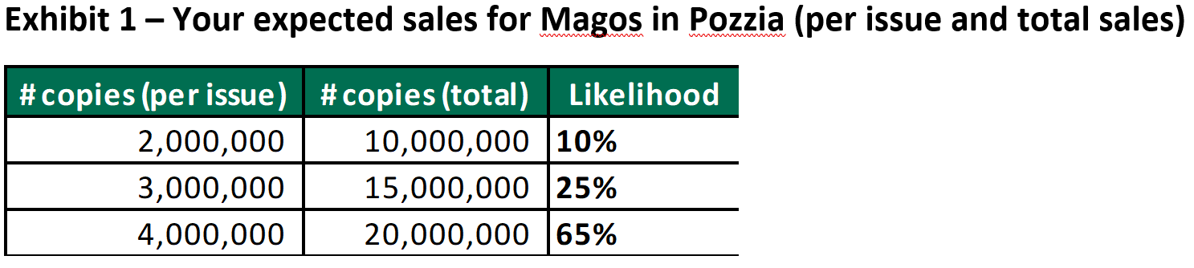
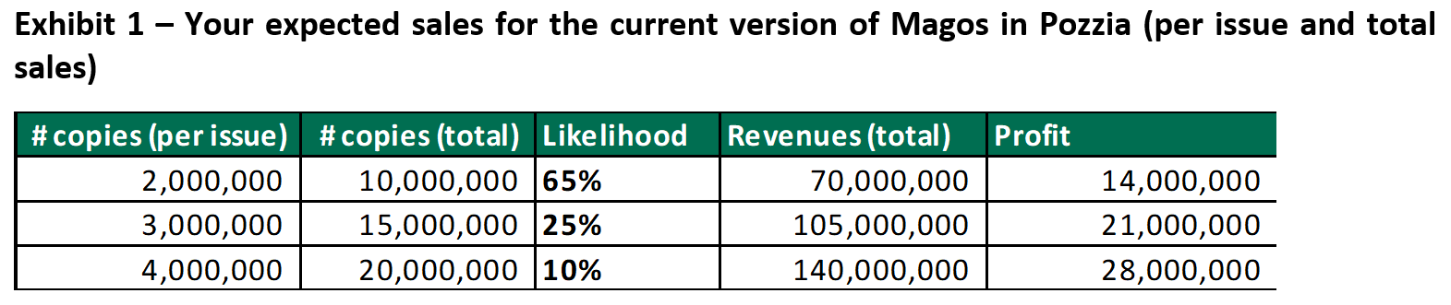
Different expected future sales for product
Role of B.B. – Magos creator
Role of D.W. – Tala Comic’s CEO
Notes:
The Magos side expects blockbuster sales for the comic book in this exciting new market, while Tala Comics is interested in the property but much less optimistic. Here we see the tables in your respective roles.
How might you try to bridge this gap in expectations about the future? What did you do in your negotiations [Students answer, usually mentioning whether the sexual content will be censored or not]. Whether to change the content or not was a bit of a red herring or something to lead you astray and make the negotiation harder, its not the real solution to the problem.

Slide 52

Contingent Contracts
Terms of contract are linked to future events about which there is uncertainty
  Future product sales
  Future employee performance
Can maximize each side’s expected future value
Can reveal deception if present
Most effective if linked to objective outcomes
Notes:
One thing you can do when expectations about the future differ, whether due to culture or something else, is to use what is called a “contingent contract.” The terms of the contract are linked to future events about which there is uncertainty, in this case future product sales. So the contract states that the Magos side’s pay will depend on future, if sales are as high as they expect they will get the pay they demand, but if sales are more in line with Tala Comics’ expectations their payments to the Magos creators will be lower. This has the benefit of maximizing each side’s expected future value from the agreement.
It can also reveal deception if present. If a supplier is “assuring” you they will deliver by a certain day, then ask them to sign a contingent contract with less pay for them if the delivery is not on time. If they won’t sign, maybe they don’t really believe what they are saying.
Contingent contracts are most effective if linked to objective outcomes that both sides can keep verify, such as comic book sales in this case.
Source for photo
https://pixabay.com/en/binding-contract-contract-secure-948442/

Slide 53
Did you use a contingent contract in Magos and Tala Comics?
Contingent contract:
If TC is correct regarding future sales, it will pay Magos less.
If Magos is correct regarding future sales, TC will increase the compensation.
Notes:
By show of hands, how many of you used a contingent contract? [Students raise hands]. This is the best way to reach a mutually acceptable agreement in Magos and Tala Comics.
Source for photo
https://pixabay.com/en/meeting-businessmen-personal-1219527/

Slide 54
Did you add any new issues to create more value?
Notes:
Did you add any new issues to create more value? [Students answer].

Slide 55

Did you add any new issues to create more value?
Potential Magos movie?
Potential Magos TV show?
Potential Magos merchandising?
Developing new comics titles for the Pozzian market?
Notes:
You could make tentative plans for a Magos movie, TV show, and merchandising if the comic is a blockbuster. Or developing future titles with content more geared toward the Pozzian market. Again, some of all of these would be contingent based on sales and TC’s ability to form partnerships with further companies such as movie studios.
Source for photo
https://pixabay.com/en/clapper-board-film-movie-152088/

Slide 56
Magos and Tala Comics: Your Deals
Group | Outcome
1
2
3
4
5
6
7
8
9
Notes:
Here are my summaries of your agreements, please let me know if anything is inaccurate. [Students share their experiences, with the instructor potentially picking out extreme or interesting results].
Note: The instructor has the option of typing quick summaries of each agreement here, into the text box corresponding to each negotiation group (e.g., whether they used a contingent contract), and sharing the summary slide with the class.

Slide 57
Take-Aways
Keep in mind important cultural differences in values and communication styles
  Collectivism-Individualism
  High vs. Low Context Communication
  Disagreement
  Scheduling
Use knowledge of someone’s culture as a working hypothesis, not a strong assumption. Treat others as individuals, not stereotypes.
Use contingent contracts to bridge different expectations about the future
Notes:
Some take-aways about culture and negotiation. Keep in mind important cultural differences in values and communication styles, such as collectivism-individualism, high vs. low context communication, willingness to engage in open confrontation, and strict vs. flexible attitudes towards time. But use knowledge of someone’s culture as a working hypothesis or a guide regarding things you should watch out for, not a strong assumption. Treat your negotiation partner as an individuals, not a stereotype, and you will be more effective as a negotiator. Finally, you can use contingent contracts to bridge different expectations about the future, whether based on culture or anything else.

Slide 58

There are many world cultures, but only two negotiation cultures
Win-Lose: Beat the other side using power and threats
Win-Win: Work with others to get as much for myself as I can Cooperate cautiously
  Be positive, but not naive
Notes:
Although there are many world cultures, there are only two negotiation cultures: win-lose and win-win. Will you try to beat the other side with power, or – carefully and cautiously– start by trying to work with them to get as much value as you can? I hope you take the lessons from this class forward and try to find win-win solutions in your own future negotiations– both across cultures and within them.
Source for photo
https://pixabay.com/en/connect-connection-cooperation-20333/

