Slide 1
Jubilee
06/2024-6912
This slide deck was prepared by Matthijs De Kempenaer, Umair Chishti, Jakub Kasperczyk, Shantanu Jain, and Rodolfo Pelitz, INSEAD MBA Alumni, and Warren Tierney, Postdoctoral Research Associate at INSEAD, under the supervision of Martin Schweinsberg, Associate Professor of Organisational Behaviour at ESMT Berlin, Horacio Falcão, Professor of Management Practice of Decision Sciences at INSEAD, and Eric Uhlmann, Professor of Organisational Behaviour at INSEADadditional material to the role play “Jubilee”.
To access INSEAD teaching materials, go to https://publishing.insead.edu/.
Copyright © 2024 Martin Schweinsberg, Horacio Falcão, Eric Uhlmann.
COPIES MAY NOT BE MADE WITHOUT PERMISSION. NO PART OF THIS PUBLICATION MAY BE, COPIED, STORED, TRANSMITTED, TRANSLATED, REPRODUCED OR DISTRIBUTED IN ANY FORM OR MEDIUM WHATSOEVER WITHOUT THE PERMISSION OF THE COPYRIGHT OWNER.

Slide 2

Notes:
Before we do anything else please take a few minutes or so to remember what you learnt in our last session. Doesn’t have to be what I taught you, but something that YOU learnt personally, what did YOU take out of the last class? We’re doing this because this is a GREAT RETURN ON INVESTMENT: we’re spending a few minutes on this now so you don’t lose the last few hours we spent together. [Students provide their take-aways. They can either be asked to write down their personal take-away on a sheet of paper for a minute then share with the class, or to share with the class straight away without writing alone first].
Source for photo
https://pixabay.com/en/time-timer-clock-watch-hour-371226/

Slide 3

THE JUBILEE
Notes:
Today we have another negotiation challenge for you, its called The Jubilee, and its based on a true story of an INSEAD MBA student, from before he joined the MBA program.
Source of photo:
https://pixabay.com/photos/canal-river-bridge-bike-tree-2643627/

Slide 4
Negotiation role play: Jubilee
This is a 1 on 1 negotiation exercise based on a true story
Timeline:
  Read your case (Max – 15 minutes)
  Negotiate (45 Minutes)
  Complete the outcome form in the School Head’s role and give it to the instructor
  Feedback – 10 minutes (5 minutes each)
Rules:
  You cannot show each other your role materials
  Stick to the information in your role (no outrageous lies!)
Notes:
[The instructor holds up the hard copies of the two roles for the Jubilee exercise, which should ideally be printed in 2 distinct colors]. You will play the roles of two negotiators meeting about a potential deal. There are a few rules. You are not allowed to show your role materials to your counterpart. You are also not allowed to change or invent facts.
For this exercise, I will sort you into pairs. I want you with someone who isn’t one of your close friends, ideally someone you don’t know that well, so please don’t stand next to your friends as you come up to the front. Being paired with someone less familiar to you will make the negotiation exercise work better. You have an hour to read your materials, plan your strategy, and negotiate with your partner.
Once you’re done negotiating, please give each other some feedback. You might use the Stop, Start, Continue, framework. Tell the other person something they should stop doing in negotiation contexts, something they are not doing and should consider starting doing, and finally something they’re doing that really works and they should continue doing.
[The instructor pairs students up, hands out the two different roles to the members of each pair. The pairs of students go negotiate for 60 minutes and return with their outcome form].
[During the negotiations, the instructor should walk around and take mental or written notes on some of the negotiations, highlighting tactics and reactions that can be brought up later during the debriefs when students are asked to share their experiences or when key teaching points are made. So for instance if a particular student moved the discussion from positions to interests during the negotiation this can be highlighted later during the debrief].
Note: Alternative approaches including assigning pairs of students to each other beforehand (see next slide).
Note: The instructor should use the outcome forms to create the excel results display for the class using the excel spreadsheet called “Results spreadsheet for Jubilee negotiation.” As it is not always clear from the outcome form whether students discovered the value with regards to internships, the restaurant, and the auditorium move, she should ask them to clarify their agreements as needed and note this on the outcome form as they turn them in.

Slide 5
Jubilee Organizer | PAIR | School Head | BOR
 | 1 |  | 251
 | 2 |  | 252
 | 3 |  | 253
 | 4 |  | 254
 | 5 |  | 255
 | 6 |  | 256
 | 7 |  | 257
 | 8 |  | 258
Notes:
Here are your breakout room slides for this exercise. Those of you with the role of Jubilee Organizer, shown in the left column in yellow, will negotiate with a counterpart with the role of the School Head, shown in the right column in green. The “pair” column shows your negotiation pairing number and “BOR” shows the room you will be in. So the student with the role of Jubilee Organizer in pair 1 will negotiate with the student with the role of School Head in pair 1 in room 251, the student with the role of Jubilee Organizer in pair 2 will negotiate with the student with the role of School Head in pair 2 in room 252, and so on. Makes sense? [Students say yes]. Ok, please grab your role materials– they are printed in the color that matches the color of the column your name is listed in on the slide, yellow for Jubilee Organizer and green for the School Head. Then pair up with your partner, and enjoy the exercise! [Students get their role materials and go to negotiate].
Note: This template students pairings slide is for if the instructor sorts students into negotiating pairs beforehand. Student names are added in the respective columns beneath “Jubilee Organizer” and “School Head.” If this slide is used, the color background for each role on the slide above should match the color of the role materials that are handed out to students (yellow for Jubilee Organizer, green for School Head), to avoid confusion. The “BOR” column refers to “Breakout Room” and only applies if the instructor has special rooms for the students to negotiate in. “PAIR” refers to negotiation group number, in other words each pair of students who negotiate with each other.

Slide 6
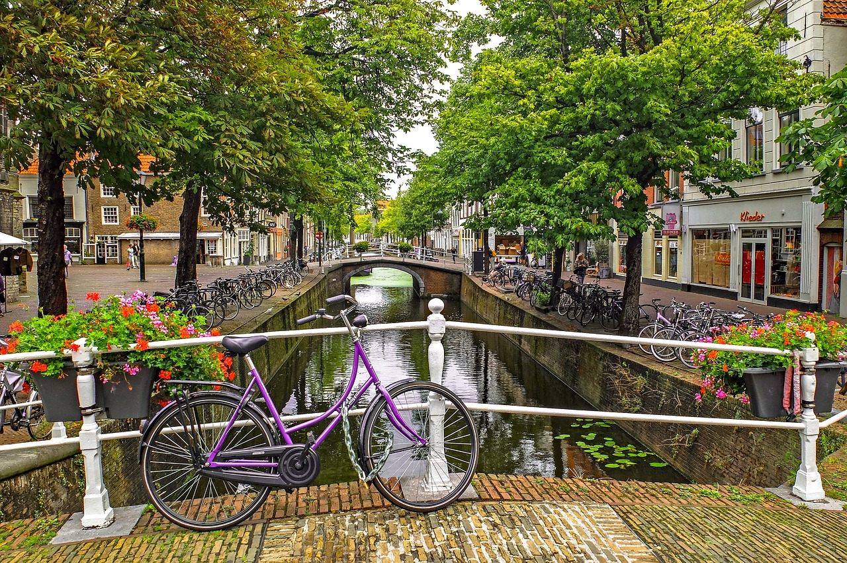
Please turn in your outcome forms for Jubilee
Notes:
Please turn in your outcome forms for Jubilee! [Instructor collects the form from the students].
Note: The instructor should use the outcome forms to create the excel results display for the class using the excel spreadsheet called “Results spreadsheet for Jubilee negotiation.” As it is not always clear from the outcome form whether students discovered the value with regards to internships, the restaurant, and the auditorium move, she should ask them to clarify their agreements as needed and note this on the outcome form as they turn them in.
Source of photo:
https://pixabay.com/photos/canal-river-bridge-bike-tree-2643627/

Slide 7
Debrief: Jubilee
Take 3 minutes and share with the person next to you:
One thing your counterpart did well in the Jubilee negotiation
One thing you could have done differently
Notes:
Welcome back! Please take 3 minutes and share with the person sitting closest to you who is not your negotiation partner. One thing that your counterpart did well, and one thing you could have done better, in the Jubilee case. We do this because we often learn the most from our peers, from sharing experiences. [Students discuss with the person sitting next to them for 3 minutes]. Ok, please wrap up your conversations! Let’s discuss the case as a class.
Source of photo:
https://pixabay.com/photos/canal-river-bridge-bike-tree-2643627/

Slide 8
What was the reservation price for the respective sides?
Jubilee Organizer
School
Head
Negative bargaining zone : -50k
100k
150k
200k
The School Head can also rent the building for a science fair for 200K
euros but this would strain her relationship with the municipality
Notes:
In a negotiation, your reservation price is your bottom line, your worst acceptable price for instance. At the outset of the Jubilee case, this is 200k for the School Head and 150k for the Jubilee Organizer. In addition, the School Head has the BATNA, or Best Alternative to a Negotiated Agreement, of renting the building for a science fair for 200k. This means there is a negative bargaining zone or ZOPA, in other words “zone of possible agreement.” The School Head wants more in rent than the Jubilee Organizer is willing to pay.

Slide 9
What was the reservation price for the respective sides?
Jubilee Organizer
School
Head
Neutral bargaining zone : 0k
100k
150k
200k
Restaurant: 50k
Notes:
However, there are sources of hidden value in the Jubilee case. The Jubilee Organizer is planning to build, and then remove, a restaurant with full kitchen for the festivities. If the two sides agree to leave the restaurant in place for use in the school’s vocational trainings, this is worth 50k to the School Head.

Slide 10
What was the reservation price for the respective sides?
School
Head
Jubilee Organizer
Positive bargaining zone : 20k
100k
130k
150k
200k
Auditorium: 20k
Restaurant: 50k
Notes:
In addition, the Jubilee Organizer plans to move the auditorium and then put it back in place. However, the School Head actually wants the auditorium moved to save energy costs, and this is worth 20k to her.

Slide 11
What was the reservation price for the respective sides?
School
Head
Jubilee Organizer
Positive bargaining zone : 50k
100k
130k
150k
200k
Internships:30k
Auditorium: 20k
Restaurant: 50k
Notes:
Finally, the Jubilee Organizer is shorthanded and would love for some of students at the vocational school to help build the grounds for the festival. The School Head can actually save 30k on her internship program if this is incorporated into the agreement.

Slide 12
To succeed, you often need to move away from positions to underlying interests
 | Jubilee Organizer | School Head
BATNA (Best Alternative to a Negotiated Agreement) | Holding the Jubilee in the University Library Lost scholarship Shame amongst peers + alumni Missed growth opportunity | 200k offer for science fair Troubled relationship with the municipality
POSITIONS | 150k | 200k
INTERESTS | Free extra labor Having a great Jubilee and keeping up the tradition Using savings on rent to hire better musical acts | New restaurant (50k!) New location for the auditorium (and possible energy savings) (20k!) Internships for students (30k!) Strengthened ties with the municipality
Notes:
What the Jubilee case illustrates is the importance of moving from positions– what you say you want on the surface– to underlying interests, or the goals or reasons that led you to adopt those positions. The underling goal of the School Head isn’t 200k, it is to fulfill the needs of her school and students. Only by finding ways to address these interests using a means other than cash payments is an agreement made possible.

Slide 13
Your deals: Jubilee
Notes:
I will now present your negotiation results for Jubilee.
DEBRIEFING WITH THE EXCEL SPREADSHEET:
[Instructor opens the excel file called “Results spreadsheet for Jubilee negotiation” and leave this up during the debrief discussion scripted below].
[Gesturing to the excel file with the class’s results] And here are your agreements! [Students react, usually there are a large range of agreements and they are surprised]. Negotiation simulations have an element of artificiality, but the value is you see the universe of alternative possibilities. Other negotiators, with the same role materials but different strategies and different partners, got very different results from you. So tell me a bit about your deals.
[The instructor might pick out extreme deals, such as impasses with no value discovery, cases where all of the creative solutions were found, or unusually high or low rent prices, and ask the student pair in question how they came to that result.]
Note: The instructor should use the outcome forms to create the excel results display for the class using the excel spreadsheet called “Results spreadsheet for Jubilee negotiation.” As it is not always clear from the outcome form whether students discovered the value with regards to internships, the restaurant, and the auditorium move, she should ask them to clarify their agreements as needed and note this on the outcome form as they turn them in.
VERBAL DEBRIEF, WITHOUT SPREADSHEET:
[If the instructor prefers not to use the excel spreadsheet, the case can also be debriefed verbally with this slide left up on the screen].
Let’s get into your agreements. Please raise your hands if you discovered all three sources of value: restaurant, internships, auditorium. [Students raise hands]. Please raise your hands if you discovered two of three of these additional sources of value, no more and no less. Precisely two extra sources of value. [Students raise hands]. Please raise your hands if you discovered one of three sources of value, no more and no less. Precisely one extra source of value. [Students raise hands]. Please raise your hands if you didn’t get a deal at all, in other words you reached an impasse. [Students raise hands].
Those of you who didn’t get a deal, why not? [Students share their experiences in the negotiation]. Those of you who found all three sources of value, how did you do it? [Students share their experiences in the negotiation].
Your agreements on final monetary price in this class ranged dramatically, from 10k to 250k euros [Note that these 10k and 250k figures are from a pilot lecture at INSEAD; the instructor should use the outcome forms to identify the highest and lowest scores for her class. Price agreements– either extreme scores or all scores-- might also be listed on a flipchart, blackboard, or whiteboard to give students a sense of where they stand relative to their peers]. Those of you who agreed on prices towards the top of this range, how did you get there? [Students share their experiences in the negotiation]. Those of you who agreed to low prices, how was this agreement reached? [Students share their experiences in the negotiation].
Negotiation simulations have an element of artificiality, but the value is you see the universe of alternative possibilities. Other negotiators, with the same role materials but different strategies and different partners, got very different results from you.
REMAINDER OF DEBRIEF (WITH OR WITHOUT SPREADSHEET)
Let’s talk a bit more about process. How transparent were you with each other? What did you disclose? Which information did you hide, and why? [Students share their experiences in the negotiation]. In a negotiation it can be prudent to disclose information reciprocally (information exchange), rather than full unilateral transparency, to avoid being taken advantage of should the other side play win-lose.
A decoy tactic is when one side pretends something you both want, like the internships, is costly for them and trades it for further concessions. Did any of you use decoy tactics, or have decoy tactics used against you? [Students share their experiences in the negotiation]. This illustrates the risks that can come with transparency— revealing a compatible or shared preference might lead to a collaborative win-win conversation with the other side, but may also lead the other side to use that information against you.
Once value has been maximized-- for instance by discovering the value of restaurant, auditorium, and internships-- it must also be claimed. How did you achieve this? Did any of you make strong first offers or counter-offers? [Students share their experiences in the negotiation].
The research shows that strong first offers can help a negotiator claim value in single-issue price-based negotiations, but also tend to prevent value creation. Did any of you fail to discover value and reach a deal in part because of overly aggressive first offers or counter-offers? [Students share their experiences in the negotiation].
How did the negotiations impact the relationship between you? Who built a great relationship? [Students raise hands]. Why? [Students share their experiences in the negotiation]. Who ended up never wanting to see the other character again? [Students raise hands]. Why? [Students share their experiences in the negotiation]. Ideally, we leave the negotiation not just with a good deal on substance (e.g., price and other material issues), but also a good relationship with the counterpart. In the Jubilee case, it seems unlikely you will meet again, but you never know.
Source of photo:
https://pixabay.com/photos/canal-river-bridge-bike-tree-2643627/
References
Galinsky, A. D. (2004). Should you make the first offer? Negotiation, 7, pp. 1-4.
Gunia, B. C., Swaab, R. I., Sivanathan, N. & Galinsky, A. D. (2013). The remarkable robustness of the first-offer effect: Across cultures, power, and issues. Personality and Social Psychology Bulletin, 39, 1547 – 1558.
Sinaceur, M., Maddux, W., Vasiljevic, D., Nuckel, R., & Galinsky, A. D. (2013). Good things come to those who wait: Late first offers facilitate creative agreements in negotiation. Personality and Social Psychology Bulletin, 39, 814-825.
Swaab, R.I., Galinsky, A.D., Medvec, V., & Diermeier, D.A. (2012). The communication orientation model: Explaining the diverse effects of sight, sound, and synchronicity on negotiation and group decision-making outcomes. Personality and Social Psychology Review, 16, 25-53.

Slide 14
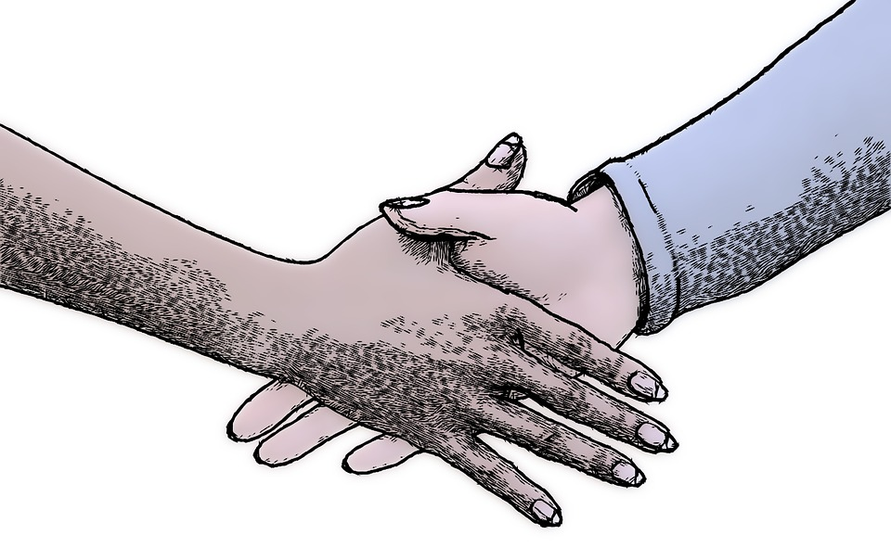
The true story behind the Jubilee
This is a real story of an INSEAD student when he was asked by his university to organize the Jubilee in return for a scholarship
He did manage to convince the School Head to allow the Jubilee, but it was difficult and in multiple rounds of negotiation
Notes:
Like I mentioned, the case is based on a true story of an INSEAD student when he was asked by his university to organize the Jubilee in return for a scholarship. He did manage to convince the School Head to allow the Jubilee, but it was difficult and in multiple rounds of negotiation. The case was tough in real life too, so don’t feel bad if you had a hard time in the exercise.
Source for photo
https://pixabay.com/en/hand-hands-shaking-hands-man-hand-861276/

Slide 15
The true story behind the Jubilee
The Jubilee did take place in the school, with negotiations lasting until mid-June (3 weeks before the Jubilee began)
They were able to discover value with regard to the auditorium and restaurant
The internships did not take place, this was something the counterparts only thought of afterwards
The school does not exist anymore, as a new building has been built on the site
Notes:
The Jubilee did occur, but negotiations lasted all the way till three weeks before the festivities began! They were able to discover value with regard to the auditorium and restaurant, but didn’t realize they could have gotten another win-win with the internships until it was too late. The school does not exist anymore, as a new building has been built on the site. All that’s left of the Lyceum is the great memories of its students and Jubilee attendees, and of course this case.

Slide 16
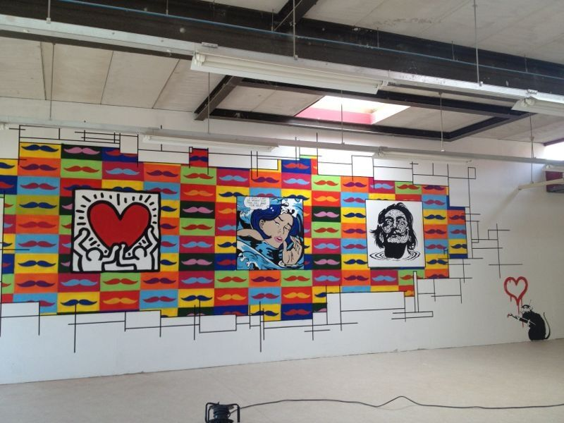
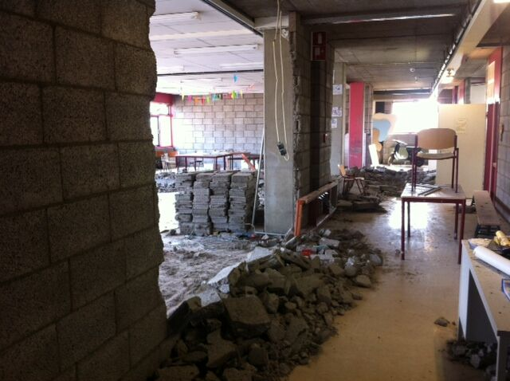
Mural at the new Auditorium
Construction works (this used to be a classroom)
Notes:
Here are some photos from the actual Jubilee from the case. A mural in the auditorium, a classroom being torn apart to build stuff for the festival.
Source of photo:
Personal photos from the Jubilee, used by permission

Slide 17
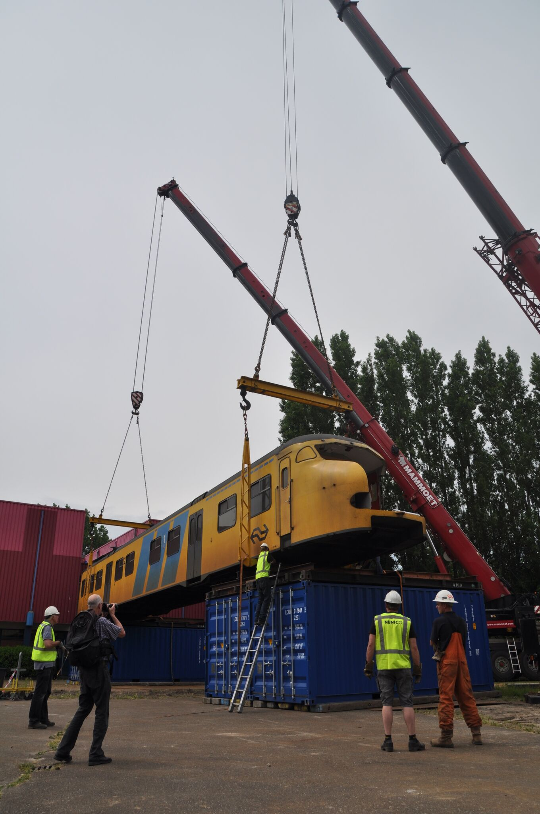
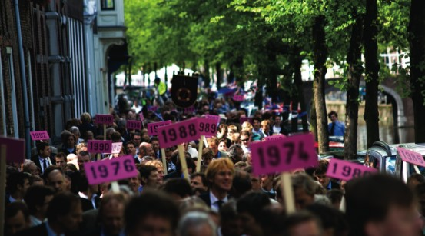
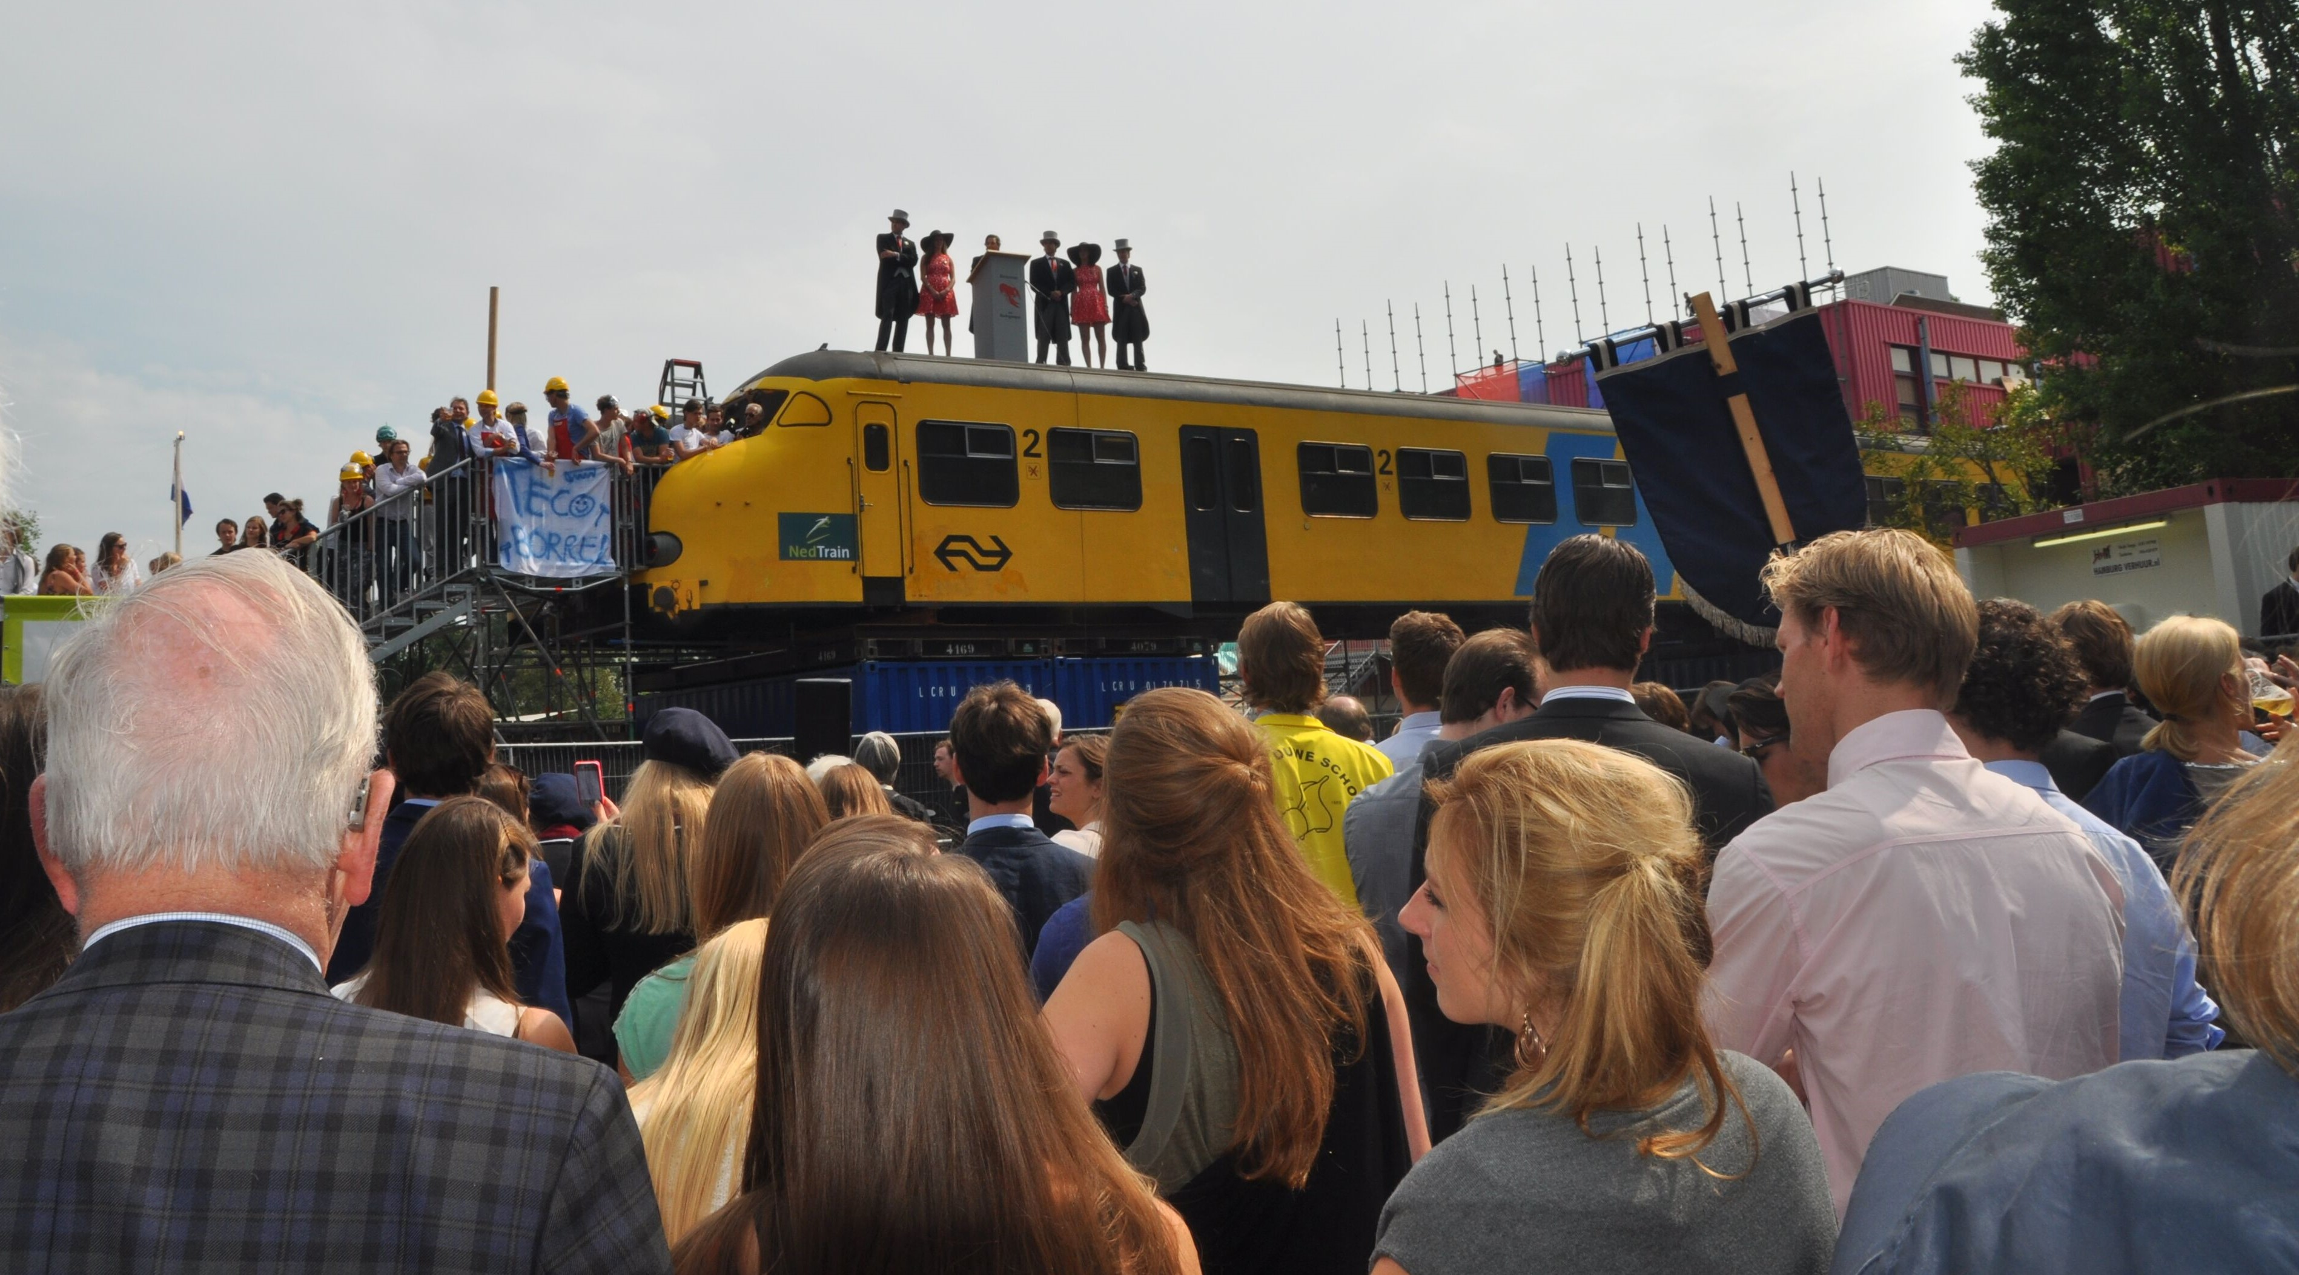
Parade of Alumni, at the official opening of the Jubilee
Opening of Jubilee, with case author on top of a train
Trains being lifted into place, at the entrance to the grounds
Notes:
More photos. A parade of alumni from different years at the opening of the Jubilee, trains being lifted into place at the entrance, the case author and other organizers standing on top of the trains to welcome everyone.
And that’s it for the lecture, thanks so much everyone! In your future negotiations, I hope you remember the Jubilee exercise and move beyond positions, what each side thinks she wants, and move the conversation towards underlying interests.
Source of photo:
Personal photos from the Jubilee, used by permission

