Slide 1
The Joint Bid
06/2024-6911
This slide deck was prepared by Warren Tierney, Postdoctoral Research Associate at INSEAD, under the supervision of Martin Schweinsberg, Associate Professor of Organisational Behaviour at ESMT Berlin, Horacio Falcão, Professor of Management Practice of Decision Sciences at INSEAD, and Eric Uhlmann, Professor of Organisational Behaviour at INSEAD, as additional material to the role play “The Joint Bid”.
To access INSEAD teaching materials, go to https://publishing.insead.edu/.
Copyright © 2024 Martin Schweinsberg, Horacio Falcão, Eric Uhlmann.
COPIES MAY NOT BE MADE WITHOUT PERMISSION. NO PART OF THIS PUBLICATION MAY BE, COPIED, STORED, TRANSMITTED, TRANSLATED, REPRODUCED OR DISTRIBUTED IN ANY FORM OR MEDIUM WHATSOEVER WITHOUT THE PERMISSION OF THE COPYRIGHT OWNER.

Slide 2
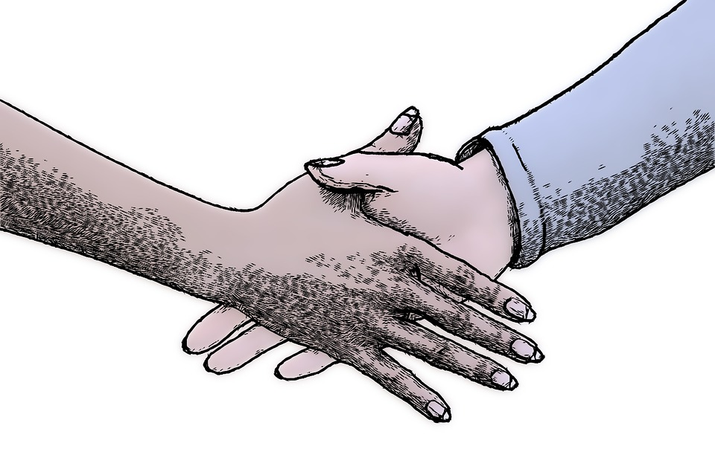
Introduction to Negotiation
Notes:
It’s a pleasure to be here with you today. Our course will cover a perspective on negotiation that we call “Value Negotiation.”
Source for photo
https://pixabay.com/en/hand-hands-shaking-hands-man-hand-861276/

Slide 3
Defining Negotiation?
Notes:
How would you define negotiation? What comes to mind when you think of the word negotiation? [Students answer, usually coming up with definitions that are win-lose oriented, or thinking of words like competition].

Slide 4
Defining Negotiation?
Negotiation is any effort to influence or persuade someone else to a particular course of action (Falcao, 2010)
Negotiation is a skill that can be improved
  Making sure you do negotiate
  Negotiating more effectively when you do
  Making sure that you do negotiate
  Negotiating more effectively when you do so
Notes:
There are a lot of ways to define negotiation. Defined broadly, negotiation is any effort to influence or persuade someone else to a particular course of action. When defined this way, it is clear negotiation is everywhere– we negotiate every day with co-workers, bosses, subordinates, romantic partners, children, service providers, etc. Negotiation isn’t just for people who do sales or business deals as part of their job, its something we all do every day. Negotiation is also a skill that can be improved.
References
Falcao, H. (2010). Value Negotiation: How to Finally Get the Win-Win Right. Singapore: Prentice Hall.
https://www.amazon.com/Value-Negotiation-Finally-Win-win-Right/dp/9810681437

Slide 5
Course Goals
Provide you with theory and methods that will help you negotiate more effectively
  Evidence based management
  Practitioner wisdom
Practice and apply these skills in class exercises and real-world situations
  Try new approaches, leave comfort zone in a safe environment
  Compare negotiation styles and results
Notes:
5
Our course goals are to provide you with theory and methods that will help you negotiate more effectively. We will rely on both an evidence based management approach based on scientific studies of negotiation, and on wisdom from experienced practitioners of negotiation in business settings. We will practice and apply negotiation skills in class exercises, and in your take-home course assignment in real world situations. The in class exercises are an opportunity to try new approaches and leave your comfort zone in a safe environment. Although classroom simulations have an element of artificiality or fakery to them, they allow us to compare results with each other and see the universe of alternative possibilities. Other pairs of negotiators with the exact same role materials will obtain very different results from you because of their different approaches, different partners, and the dynamics between them. In real life settings we rarely find out what could have been. Here in class we will.

Slide 6
Course Overview
Introduction to Value Negotiation, Parts 1 and 2
Job Negotiations
Communication
Team negotiations
Multi-party negotiations
Cross-cultural negotiations
Notes:
6
This class will introduce the topic of negotiations and the move on to topics like jobs, communication channels, negotiating in teams, negotiations involving more than two sides, and cross cultural negotiations.
*Note: Later iterations of the class will add more lectures
Source for photo
https://pixabay.com/en/hand-hands-shaking-hands-man-hand-861276/

Slide 7

Grading
1/3 Attendance and class participation
1/3 “No” journal
1/3 Seven elements preparation sheet
All course readings are optional, and for after each lecture
Notes:
Grading will be based on attendance and class participation, your “No” journal individual assignment, and your Seven elements preparation sheet group assignment. I will tell you more about the 7 elements assignment during our next meeting.
The course readings are all optional and designed to supplement the lectures. You don’t need to read them before class, they are for if you’d like to read more about a particular topic. I hope you get something out of the readings, but I also won’t test you on them. In this class we will learn by doing and applying frameworks to cases, not by memorizing. Sounds good? [Students say: Yes!]
Source for photo:
https://pixabay.com/en/pen-school-notes-grade-memo-162124/

Slide 8

Assignment: “No” Journal
Get 10 “NO!” as answers to requests. Also include the “YES” answers you get along the way
For each “NO” and “YES” you receive, please describe:
1. What did you ask for?
2. Who did you ask?
3. What response did you get? (yes/no/other)
4. Short description of what happened in the negotiation
Our school as an institution (administration, professors, staff) is off limits!
Notes:
Your “No” Journal assignment requires you to get 10 “NO!” as answers to requests you make. The journal then will be the description of these experiences and the challenges you faced. Each request should be realistic and serious while trying to push the limits. Please also include all the “YES” answers you get on the way to receiving ten “NO” answers. You should approach the negotiations with the true intention of getting a “YES,” not just looking for another “NO” to complete the assignment. An important rule-- our school as an institution is off limits—you cannot use “NO” responses from the administration, staff, or professors.
Source for photo:
https://pixabay.com/en/no-negative-whiteboard-presentation-1532783/

Slide 9
We Are All Born Negotiators
Many of us struggle with a lack of self-confidence regarding our negotiation skills
However, we were all born negotiators
Notes:
Many of us struggle with a lack of self-confidence regarding our negotiation skills and fear being rejected when we ask for things, so we don’t ask. However, we were all born negotiators. Small children do not fear rejection, it is something society has taught us to fear.

Slide 10
Who has heard of rejection therapy?
Has anyone tried it?
Notes:
Who has heard of rejection therapy? Has anyone tried it? [Students answer, usually no one has tried this therapy or admits it if they have].

Slide 11

Rejection Therapy
You go out and actively seek rejection
The goal is to desensitize yourself to the pain of rejection
Notes:
In Rejection Therapy, you go out and actively seek rejection. The goal is to desensitize yourself to the pain of rejection. It is a very real pain. Research shows that when we feel rejected, the same parts of the brain are activated as when we feel physical pain. The pain of rejection is real and deep and it can take a lot of effort to overcome it.
Reference for the research on rejection mentioned in the script:
Why rejection hurts: a common neural alarm mechanism for physical and social pain
https://www.ncbi.nlm.nih.gov/m/pubmed/15242688/
Source of photo
https://pixabay.com/en/worthlessness-insignificance-927079/

Slide 12

Goal of the “No Journal”
The goal of the “No Journal” is to make you more comfortable asking for things
  Value claiming is a very important aspect of negotiation
You cannot claim what you do not ask for!
Most students are surprised by how many “Yes” answers they get
Notes:
The goal of the “No Journal” is to make you more comfortable asking for things, to overcome that fear of rejection. Claiming value is a very important aspect of negotiation, and you cannot claim what you do not ask for. Most students are surprised by how many “Yes” answers they get. The assignment will also help desensitize you to the pain of getting “No” answers, the world doesn’t end. Getting rejected along the way is a part of success.
Source of photo:
https://pixabay.com/en/no-negative-whiteboard-presentation-1532783/

Slide 13
Examples from past “No Journals” by students
Asked to rent a tie from a store that sells ties (they said yes)
Notes:
Here are some examples from past “No Journals” by negotiation students. One student asked to rent a tie from a store that sells ties, and they said yes.

Slide 14
Examples from past “No Journals” by students
Asked to rent a tie from a store that sells ties (they said yes)
Ask for a raise (the boss said yes)
Notes:
Another student asked the boss for a raise, and the boss said yes.

Slide 15
Examples from past “No Journals” by students
Asked to rent a tie from a store that sells ties (they said yes)
Ask for a raise (the boss said yes)
Asked to enter nightclub in shorts and flip-flops (they said no)
Notes:
Another student asked to enter a nightclub in shorts and flip-flops, and they said no. That would threaten their coolness.

Slide 16
Examples from past “No Journals” by students
Asked to rent a tie from a store that sells ties (they said yes)
Ask for a raise (the boss said yes)
Asked to enter nightclub in shorts and flip-flops (they said no)
Ask girl interested in since high school out on a date (she said yes!)
Notes:
This is my favorite one. One student asked a girl he was really interested in since high school out on a date, and she said yes. I hope these examples give you some ideas for your own No Journals, but we also want you to be creative and come up with your own requests.
Note: This last bullet point would not be appropriate in some countries, and should be dropped in those cases.

Slide 17

Rules for Negotiation Role-Plays
  You may NOT show your role material to your counterpart
  You cannot change or invent facts
Notes:
This brings us to our very first negotiation role play. [The instructor holds up the hard copies of the two roles for The Joint Bid exercise]. You will play the roles of two negotiators meeting about a potential business deal. There are a few rules. You are not allowed to show your role materials to your counterpart. You are also not allowed to change or invent facts.
Source for photo:
https://pixabay.com/en/law-justice-court-judge-legal-1063249/

Slide 18

Negotiation Exercise:
The Joint Bid
Read your role materials and plan (max 15 minutes)
Find your partner and negotiate (max 15 minutes!)
Debrief of the case is in exactly 30 minutes (you don’t need to tell me the results)
Notes:
For this exercise, you need form pairs. What I would like you to do is to pair up with someone who you don’t like, or at least don’t the look of. [Students laugh]. I’m just kidding, you should pair up with someone who isn’t one of your close friends, ideally someone you don’t know that well. That will make the negotiation exercise work better. You have thirty minutes to read your materials, plan your strategy, and negotiate with your partner. [The students pair up. The instructor hands out the two different roles to each pair of students, who then go negotiate for 30 minutes]
[During the negotiations, the instructor should walk around and take mental or written notes on some of the negotiations, highlighting tactics and reactions that can be brought up later during the debriefs when students are asked to share their experiences or when key teaching points are made. So for instance if a particular student moved the discussion from positions to interests during the negotiation this can be highlighted later].
Note: Alternative approaches including assigning pairs of students to each other beforehand, or the instructor creating pairs on the spot.
Source for photo:
https://pixabay.com/en/alpine-edelwei%C3%9F-ordinary-edelweiss-181720/

Slide 19
The Joint Bid
Kunjur Cosmetics | GROUP | Minavar Pharmaceuticals | BOR
 | 1
 | 2
 | 3
 | 4
 | 5
 | 6
 | 7
 | 8
Notes:
Note: This template students pairings slide is for if the instructor sorts students into negotiating teams beforehand. Student names are added in the respective columns beneath “Kunjur Cosmetics” and “Minavar Pharmaceuticals.” If this slide is used, the color background for each role on the slide above should match the color of the questionnaires that are handed out to students (white for Kunjur Cosmetics, pink for Minavar Pharmaceuticals), to avoid confusion. The “BOR” column refers to “Breakout Room” and only applies if the instructor has special rooms for the students to negotiate in. “GROUP” refers to negotiation group number, in other words each pair of students.

Slide 20

The Arm Exercise
Notes:
Now I would like to do a little exercise with you right here in the classroom. Please pair up with another student in this class and adopt this position. [Instructor gestures toward the image on the slide; the students typically laugh]. I am serious, this is important for your education! To pair up, you may need to change seats, but make sure to find a partner and adopt this physical position with them. [Most students pair up with the person next to them; some students switch seats so they can have a partner].
Source for photo:
https://pixabay.com/en/bench-press-fight-arm-wrestling-1013857/

Slide 21
The Arm Exercise
Pair up with another student and sit next to each other.
You cannot communicate with one another until the end of the exercise.
Your objective is to score as many points for yourself as you possibly can
Rules:
  Each time the back of their hand hits the table, you get $1,000 (imaginary money)
  Keep your eyes closed
  No talking to each other
  15 second time limit
Notes:
This activity is called the Arm Exercise. Your objective is to claim as much value for yourself as you can. The rules are as follows. Each time the back of the other person’s hand hits the table, you get one thousand dollars in imaginary money. You have to keep your eyes closed, so everyone close your eyes. [Students close their eyes; they may need to be reminded to do so by the instructor]. I’m serious, you all need to close your eyes. Eyes closed everyone? [All students should have their eyes closed]. Another rule: you are also not allowed to talk to the other person, so no speaking out loud. There will be a 15-second time limit. Again, the goal is to claim as much value for yourself as you can. On your mark, get, set, GO!!! [Most pairs of students will arm wrestle with each other. A few pairs of students will arrive at the solution to the Arm Exercise, which is to rapidly take turns tapping the other person’s hand against the table without resisting each other]. 1-2-3-4-5-6-7-8-9-10-11-12-13-14-15, stop! You can open your eyes.
Source for photo:
https://pixabay.com/en/bench-press-fight-arm-wrestling-1013857/

Slide 22
Who got the most points?
Notes:
Let’s see how many points everyone got. How many points did each pair of you get? [Instructor goes to the chalkboard, whiteboard, or flipchart and writes down each pair of scores, e.g., 3-2, 5-2, 15-16, 20-21, etc]. So what do you notice about the highest scores? [Students answer]. That’s correct, if one partner got a very high score, the other partner tended to get a very high score too.
Source for photo:
https://pixabay.com/en/bench-press-fight-arm-wrestling-1013857/

Slide 23

The Arm Exercise
The highest scorers cooperate by taking turns touching the back of each person’s hand to the desk
Those of you who did this, how did you arrive at the win-win solution?
Notes:
Those of you who got the highest scores, how did you do it? [High-scoring pairs of students show the class how they solved the Arm Exercise, by rapidly taking turns tapping the other person’s hand against the table without resisting each other]. The highest scorers cooperate by taking turns touching the back of each person’s hand to the desk, without fighting each other. That is the solution to the Arm Exercise.

Slide 24
What was your goal in the Arm Exercise?
Notes:
What was your goal in the Arm Exercise? [Students answer].
Source for photo:
https://pixabay.com/en/bench-press-fight-arm-wrestling-1013857/

Slide 25
What was your goal in the Arm Exercise?
To claim as much value for yourself as you can
We claim the most value for ourselves by working with others to create the most value possible
Notes:
Your goal is to claim as much value for yourself as you can, not to get a better score than your partner. So you shouldn’t care about your opponent’s score. This was not necessarily an arm wrestling exercise. Most people thought of arm wrestling, why? [Students answer– because it seems like an arm wrestling position]. But it doesn’t have to be that way.

Slide 26
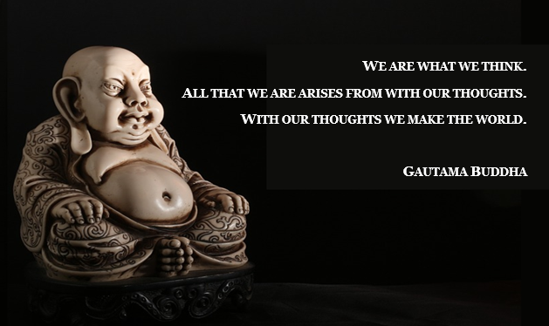
Notes:
Here is one of my favorite quotes, from the Buddha. “We are what we think. All that we are arises with our thoughts. With our thoughts we make the world.” Half a century of research in psychology strongly supports this idea. The assumptions and expectations we bring to a situation drive our thoughts, feelings, and behaviors in that situation. Oftentimes we even elicit from situations what we came in expecting, that is called a self-fulfilling prophecy.
Source for photo:
https://pixabay.com/en/buddha-buddhism-chinese-pu-tai-452028/

Slide 27
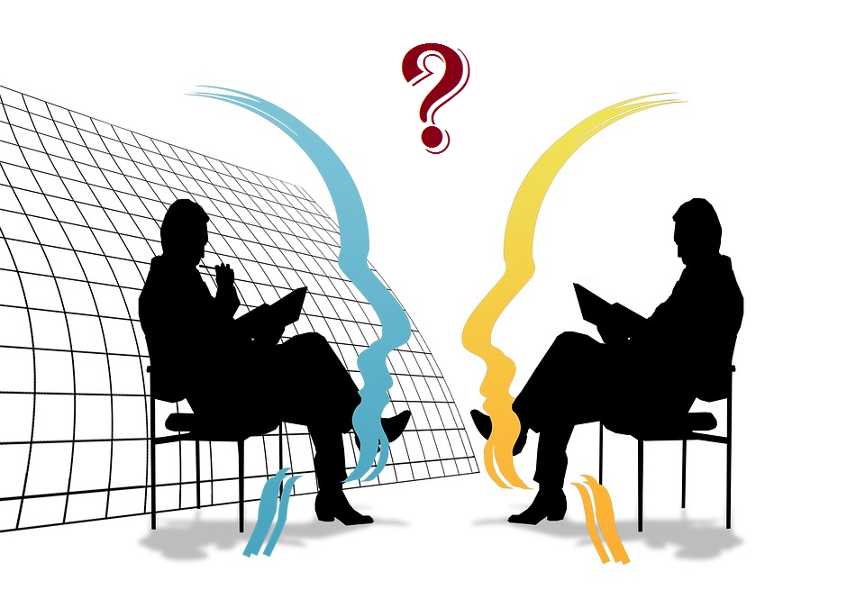
Dangerous assumptions in a negotiation
Our interests are opposed
Fixed pie bias: the value is front of us is all that there is
You are my enemy
Their intentions must be hostile
If they are hostile, I need to reciprocate in kind
The best way is to start safe and attack before being attacked
Notes:
We often come to negotiations with dangerous assumptions. That our goals must be totally opposed to theirs, and that their intentions must be hostile. We also show what is called “the fixed pie bias,” the tendency to assume that the obvious value in front of us is all there is. But the truth is we often get the most for ourselves by understanding and working with others.
Source for photo:
https://pixabay.com/p-77496/?no_redirect

Slide 28
Fundamentals of Value Negotiation, Part I: Creating Value
Martin Schweinsberg, Horacio Falcao,
Warren Tierney, & Eric Luis Uhlmann,
Notes:
Value claiming, which is the topic of your No Journal, is a core component of negotiation, but so is creating value. The rest of this lecture will focus on the topic of creating value in negotiations.
Source for photo
https://pixabay.com/en/connect-connection-cooperation-20333/

Slide 29
Moving from Positions to Interests
Positions: The specific options each person wants
Interests: Why they want it
  Underlying goals and concerns
  Can potentially be satisfied by bringing in new options
Notes:
To create value in a negotiation, it is critical to distinguish between positions and interests - both yours and the parties' with whom you are negotiating. Positions are the specific options each person wants. So, both Israel and Egypt initially took the position that they want Sinai entirely for themselves. A deal seems impossible when thought about in terms of these irreconcilable positions. Interests are why the two counterparts want something, their underlying goals and concerns. These can potentially be satisfied by bringing in new options, in this case a demilitarized zone.

Slide 30
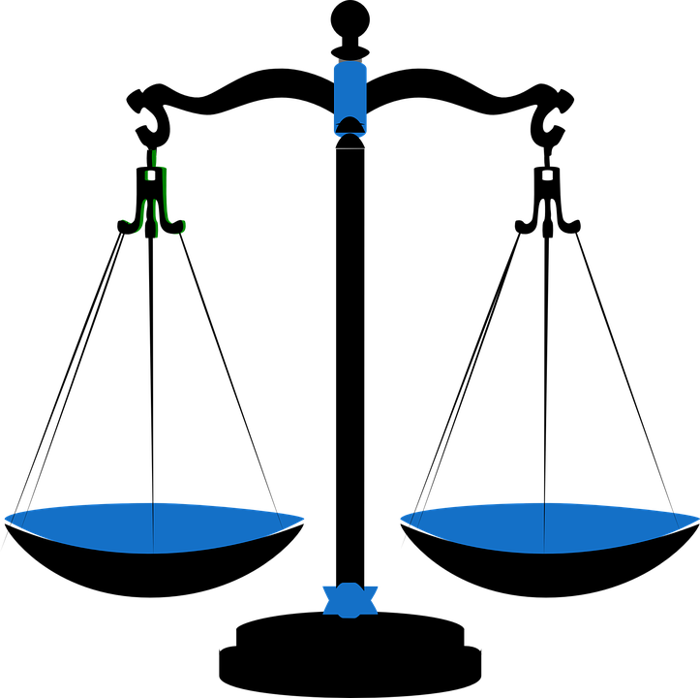
Bringing in More Issues to Expand the Pie
Single-issue negotiations (price) are inherently about claiming value
Bringing in new issues creates opportunities for creative trade offs
  Each side trades what they want least for what they want most
  Both side’s interests are satisfied
Notes:
To create value in a negotiation, it is also critical to move from a single issue to multiple issues– for example, talking about more than just price. Single-issue negotiations on price are inherently win-lose. Bringing in new issues creates opportunities for creative trade offs. Each side trades what they want least for what they want most, and both side’s interests are satisfied.
Source for photo:
https://pixabay.com/en/scales-balance-measure-weigh-blue-309810/

Slide 31
The Joint Bid Debrief
What was the situation in the case?
Notes:
Now it is time to debrief the negotiation exercise. What was the situation in the case? (Students answer).

Slide 32
The Joint Bid Debrief
The government has agreed to commercialize only 100 rare Lith flowers a year
Kunjur Cosmetics wants all 100 flowers for an anti-wrinkle treatment
Minavar Pharmaceuticals wants all 100 flowers for a Parkinson’s treatment
Notes:
The government has agreed to commercialize only 100 of the rare Lith flowers. Both companies want all the flowers so they can make their respective products, an anti-wrinkle cream and a treatment for Parkinson’s disease. .

Slide 33
The Joint Bid Debrief
The government has agreed to commercialize only 100 rare Lith flowers a year
Kunjur Cosmetics wants all 100 flowers for an anti-wrinkle treatment
Minavar Pharmaceuticals wants all 100 flowers for a Parkinson’s treatment
Raise your hand if you realized Kunjur Cosmetics only needed the petals and Minavar Pharmaceuticals only needed the stem of the flower
Notes:
Raise your hand if you realized you needed different parts of the flower. [Half the class raises their hands in triumph, while the other half– who did not get the solution to the case— groan and put their faces in their hands. The whole class laughs]. Kunjur Cosmetics only needed the petals and Minavar Pharmaceuticals only needed the stem of the flower.

Slide 34
The Joint Bid Debrief
What is Minavar Pharmaceuticals and Kunjur Cosmetics’s original position?
  Each wants all 100 fruits = distributive negotiation
What is their underling interest?
  Developing their respective products
These interests are not actually opposed, they can reach an integrative solution and both have what they want
Why did (or didn’t you) reach the solution?
Notes:
What is Minavar Pharmaceuticals and Kunjur Cosmetics’s original position? [Students answer]. What are their underling interests? [Students answer].

Slide 35
The Joint Bid Debrief
What is Minavar Pharmaceuticals and Kunjur Cosmetics’s original position?
  Each wants all 100 flowers
What is their underling interest?
  Developing their respective products
These interests are not actually opposed, they can reach a creative solution and both have what they want
Why did (or didn’t you) reach the solution?
Notes:
Both sides begin by trying to get as many flowers as they can, assuming its at the expense of the other company. If one company wins, the other must lose. But this is a mistaken assumption. They actually want different things, and a win-win solution is possible. One company gets all the petals, and the other all the stems. Why did (or didn’t you) reach the solution? [Students answer].

Slide 36
What other issues did you bring into the negotiation?
Notes:
Those of you who got the solution, did you talk about any other ways you could collaborate with the other company? [Students answer].

Slide 37
What other issues did you bring into the negotiation?
Joint venture for Lith flower processing plus synthetic R&D
Joint lobbying of government for more flowers at a minimum price
Long term contracts with government to avoid entry of third-party competitors
Protection of Lith flowers in their native habitat
Joint research to discover new environments for Lith flowers
Notes:
Since you need different parts of the flower, why not build one factory together to separate the petals and stems? That would save both companies money. Or why not form a partnership to protect the natural habitat of the flowers so there will be more of them for everyone? Or lobby the government together for more flowers at a low price? Or propose a long term contract with the government to avoid third-party competitors coming in? Or engage in joint research on new environments Lith flowers could grow in?

Slide 38
Creating more value for yourself means
understanding and working with others
Notes:
Creating more value for yourself means understanding and working with others. It is unwise to come to a negotiation with the strong assumption that one side has to win and the other has to lose. With our thoughts we make the world. If you approach a negotiation as a win-lose situation it will probably turn into a win-lose situation. You may miss a win-win solution just waiting to be discovered.

Slide 39
Notes:
Here are the results from a well-known study of negotiator effectiveness in the context of law firms in the United States. Contrary to the popular stereotype of a great negotiator as competitive or even aggressive, they found that cooperative negotiators were more successful in the long term.
Reference
Gerald Williams (1983), “legal negotiation and settlement”, pp 111-114.
This finding was replicated in:
Schneider, "Shattering Negotiation Myths," 7 Harvard Negotiation Law Review 143 (2002)

Slide 40
Take 3 minutes and share with the person next to you:
One thing your counterpart did well in the Joint Bid
One thing you could have done differently
Notes:
Please take 3 minutes and share with the person sitting next to you, who is not necessarily your negotiation partner. One thing that your counterpart did well, and one thing you could have done better. [Students discuss with the person sitting next to them for 3 minutes].

Slide 41
Take-Aways: Creating Value
Cooperate constructively with the other to create value
  Focus on interests, not positions
  Bring in multiple issues
Get the win-win right by being positive, but not naive
  Do not assume their good faith or put yourself in a position to get taken advantage of!
Notes:
Here are some take-aways regarding creating value. To obtain the most value for ourselves, we should cooperate constructively with the other person to create more total value. This means focusing on interests, not positions and bring in multiple issues to expand the pie. At the same time, it is critical to get the win-win right by being positive, but not naïve. Give people a chance to work with you, but do not assume their good faith or put yourself in a position to be taken advantage of.

Slide 42
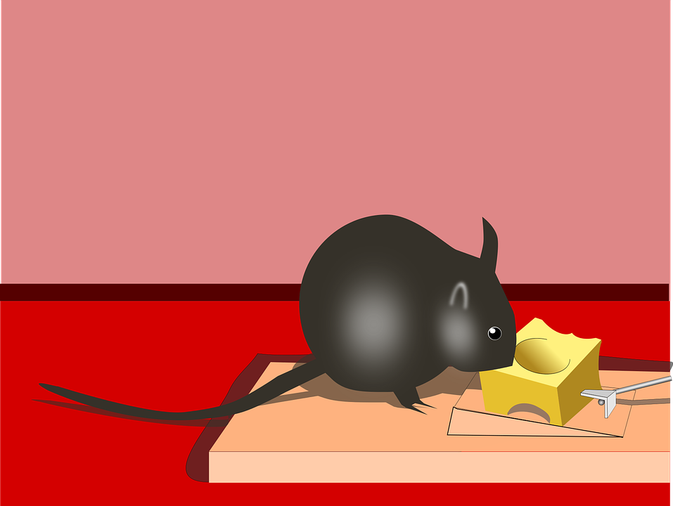
There is no one right way to negotiate
You must always weigh Risk vs. Reward
Notes:
I also want to emphasize that there is no one right way to negotiate. The more cooperative you are, the better your chances of creating value… and the greater the likelihood someone will take advantage of you. You must always weigh the risk vs. reward of cooperating with others, based on what you know about them, the situation, and your relationship with each other.
A question for the class-- should the rat go for the cheese? [Students answer, most saying no]. What if she can disable the mousetrap? What if she is starving? There is no one right strategy, it always depends on the situation.
Source for photo:
https://pixabay.com/en/cheese-mouse-trap-1295728/

Slide 43
Rule #1 of this negotiations class is you do not tell anyone about the contents of this class!
Notes:
One last thing I want to discuss with you. The #1 rule of this negotiations class is you do not tell anyone about the contents of this class. Especially the information from the debriefs of the negotiation exercises. For instance, if other students hear the “secret” of The Joint Bid before they take the class, about the petals and the stem, the exercise will be completely ruined for them. So please keep our secrets safe. Sounds okay? [Students all say yes]. Great, so we have a deal then. Ok, let’s take a 15 minute break. [Students take a break before the second part of the lecture].

