Slide 1
Golden Standard
06/2024-6910
This slide deck was prepared by Astrid Schrader, Julia Snedkova, and Xiaolin Tao, INSEAD MBA Alumni, and Warren Tierney, Postdoctoral Research Associate at INSEAD, under the supervision of Martin Schweinsberg, Associate Professor of Organisational Behaviour at ESMT Berlin, Horacio Falcão, Professor of Management Practice of Decision Sciences at INSEAD, and Eric Uhlmann, Professor of Organisational Behaviour at INSEAD, as additional material to the role play “Golden Standard”.
To access INSEAD teaching materials, go to https://publishing.insead.edu/.
Copyright © 2024 Martin Schweinsberg, Horacio Falcão, Eric Uhlmann.
COPIES MAY NOT BE MADE WITHOUT PERMISSION. NO PART OF THIS PUBLICATION MAY BE, COPIED, STORED, TRANSMITTED, TRANSLATED, REPRODUCED OR DISTRIBUTED IN ANY FORM OR MEDIUM WHATSOEVER WITHOUT THE PERMISSION OF THE COPYRIGHT OWNER.

Slide 2

Notes:
Before we do anything else please take a few minutes or so to remember what you learnt in our last session. Doesn’t have to be what I taught you, but something that YOU learnt personally, what did YOU take out of the last class? We’re doing this because this is a GREAT RETURN ON INVESTMENT: we’re spending a few minutes on this now so you don’t lose the last few hours we spent together. [Students provide their take-aways. They can either be asked to write down their personal take-away on a sheet of paper for a minute then share with the class, or to share with the class straight away without writing alone first].
Source for photo
https://pixabay.com/en/time-timer-clock-watch-hour-371226/

Slide 3
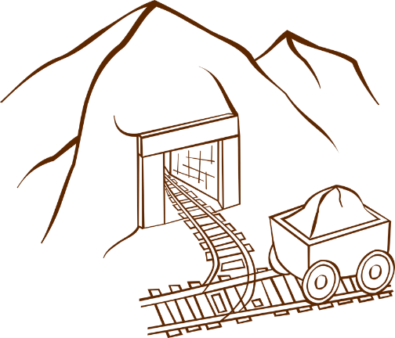
Multi-Party Negotiation: Golden Standard
Read your role materials and negotiate (max 2 hours 15 minutes)
  Back channel rule: Any party can call for a 2-person meeting for 5 minutes with any other party at any time
Give me your outcome form
Debrief in 2 hours 15 minutes
Notes:
We will now have a multi-party negotiation exercise. There are 6 roles in the case. You have 2 hours and 15 minutes to read your role materials and negotiate.
Within those two hours, you can arrange your meetings with each other however you prefer. The government and the head of the company can meet while the heads of the four municipalities meet, the government can meet with the municipalities without the company there, the company can meet with the municipalities, you can have 1-on-1 meetings, or all six of you can all be in a room together. Its totally up to you.
We do have an important “back channel” rule for this negotiation. You have the right to communicate in private 1-on-1 for 5 minutes with anyone else without any interference. Any party can call for a private 2-person meeting with any other party at any time, in other words open a back channel discussion with that other party, and that other party has to have the private 5-minute conversation with you. This is to mimic the reality that in the real world, in a complex negotiation like this taking place over a long span of time there would be opportunities for private conversations.
You can invoke the back channel rule with the same person more than once during the exercise if you want, but you should not call one five minute meeting after another so you are just monopolizing that person’s time. You also cannot call for a five minute meeting with someone when they are already having a five minute meeting with another person.
Once you are done please give me your outcome forms– one is in the role for the Government Representative for each group. In 2 hours and 15 minutes we will meet here and debrief the lecture. Sounds good? [Students say yes].
Please form groups of 6 with at least some people you have not negotiated with much before. Then get your role materials and begin your negotiations. The Government Representative should not show the outcome form to the other group members until an agreement has been reached on all issues and its time to sign a deal. [Students form themselves into groups of 6, get their role materials and complete the exercise].
[During the negotiations, the instructor should walk around and take mental or written notes on some of the students’ interactions, highlighting tactics and reactions that can be brought up later during the debriefs when students are asked to share their experiences or when key teaching points are made].
[As the “government representatives” come back with their outcome sheets, the instructor reviews them to prepare for the debrief discussion, potentially entering the results into the Results slide later in this deck].
Note: An alternative approach to creating the pairings is for the instructor to pair students up himself/herself, either by creating pairings before class begins or ad-hoc now during the lecture.
Note. The ideal amount of time to both read and carry out the exercise is more along the lines of 3 hours rather than 2 hours 15 minutes, given its complexity. The times above listed are to reflect the typical 3 hour length of an MBA negotiations class. If the instructor has 4 hours the ideal time breakdown is 3 hours to read and conduct the exercise and 1 hour to debrief.
Source for photo
https://pixabay.com/en/mine-trolley-lorry-rails-mining-145631/

Slide 4
Golden Standard
Please tell me if your group is missing someone
Group | Golden Standard | Government | Alto de Lucia | Vallenuevo | Paraiso | Tachito | BOR
Group 1
Group 2
Group 3
Group 4
Group 5
Group 6
Group 7
Group 8
Group 9
Notes:
Here are your breakout room slides for this exercise. Please grab your role materials– they are printed in the color that matches the color of the column your name is listed in on the slide. Then pair up with your five partners, and enjoy the exercise! [Students get their role materials and go to negotiate].
Note: This template students pairings slide is for if the instructor sorts students into negotiating groups beforehand. Students’ individual names are added in the respective columns. If this slide is used, the color background for each role on the slide above should match the color of the role materials that are handed out to students, to avoid confusion. The “BOR” column refers to “Breakout Room” and only applies if the instructor has special rooms for the students to negotiate in. “GROUP” refers to negotiation group number, in other words each group of students who negotiate together.
Note: For each Group, there must be at least one student in each role for this negotiation. If students are not divisible into groups of 6, double up roles (i.e., have more than one Golden Standard CEO, Government Representative, or two mayors for one village). The negotiation exercise will not work properly if no one has one or more roles.
Note: If feasible, the instructor should put a student he or she has identified as a strong negotiator in the Golden Standard role as it is the most challenging one.

Slide 5
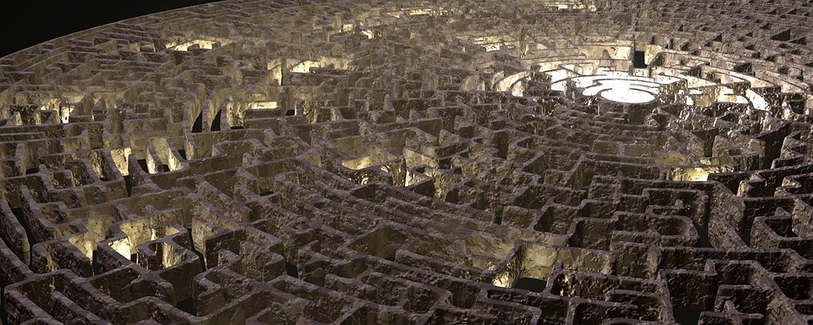
Golden Standard
Notes:
Welcome back! We will now debrief the Golden Standard exercise.
Source for photo
https://pixabay.com/en/maze-graphic-render-labyrinth-2264/

Slide 6
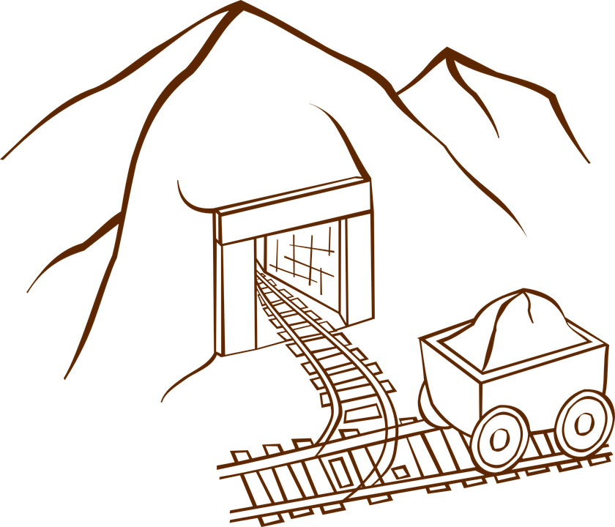
Take 3 minutes and share with the person next to you:
One thing your group did well in terms of managing multiparty dynamics
One thing you could have done differently
Notes:
[Students are now back in class]. Please take 3 minutes and share with the person sitting next to you, who is not necessarily part of your negotiation group. One thing that your group did well in terms of handling multiparty dynamics, and one thing you could have done better in this regard.
Source for photo
https://pixabay.com/en/mine-trolley-lorry-rails-mining-145631/

Slide 7
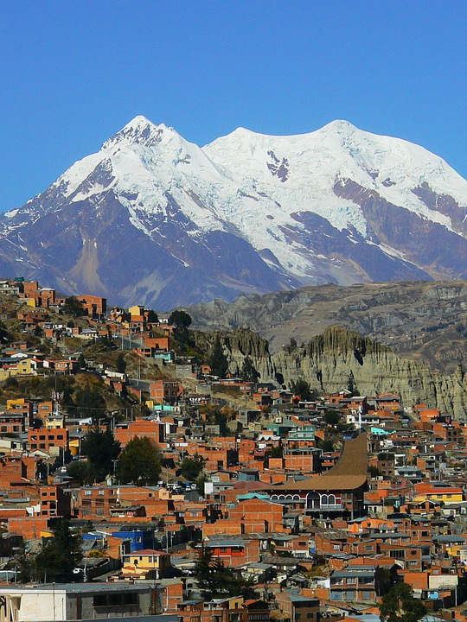
Golden Standard Debrief
Multi-issue
  Scope of mine
  Compensation
Multi-party
  Corporation
  National government
  Leaders of local communities
Multi-cultural
  What are the cultures in GS?
Notes:
Golden Standard is a highly complex, multi-issue, multi-party, and multi-cultural negotiation. We have a variety of environmental, political, and economic issues at play. Will the mine project happen? Will the glaciers be moved to increase the scope of the mine? What will compensation to the local communities look like?
There are six parties, each with a distinct perspective on the conflict. There is the CEO of the Golden Standard Corporation, a representative from the government of the country, and the leaders of four local communities near the mine site who are opposed to the mine and concerned about its environmental dangers to varying degrees.
It is also a multi-cultural negotiation. But what exactly are the cultural divisions in the Golden Standard case? [Students answer]. Is it really Canada versus Latina America, or is it more elites versus non-elites?
Source for photo
https://pixabay.com/en/la-paz-andes-south-america-bolivia-318068/

Slide 8

Take their perspective
Culture is about more than national differences
  There are many cultures within national borders
  Many cultures span borders
Don’t interpret everything through your lens
  They may not value what you value
Notes:
The biggest cultural difference in the Golden Standard case is arguably between the foreign company and the local government elite on the one hand, and indigenous groups who live near the mine on the other. That is where the real fault line in values is. There are many cultures within national borders, and many cultures that cut across national borders. In our last lecture we focused on some systematic differences between nations. Part of the point of Golden Standard is to remind you of the cultural differences inside national borders.
So even when you negotiate within your own culture, like the government representative does in Golden Standard, try to take their perspective. Don’t interpret everything through your lens. They may not value what you value. Ask questions and get information.
Source for photo
https://pixabay.com/en/face-silhouette-brain-communication-535761/

Slide 9
 | GS | Government | 4 Communities
View on mining jobs | GS will eliminate local unemployment crisis | Good for local communities | Destroys traditional agricultural way of life
View on GS funded schools | GS helps poor communities educate youth | Good for local communities | Brainwashing children with government and corporate propaganda
Notes:
Are mining jobs an opportunity to reduce unemployment, or the destruction of a cherished agricultural way of life? It depends on your cultural values. Are free schools and opportunity for a quality education, or an attempt to brainwash youth and wipe out traditional cultural beliefs? The company and government see the jobs and schools as a blessing for the local communities. But most of the local communities see these as a threat to their cherished way of life, the way they have lived for many generations.

Slide 10
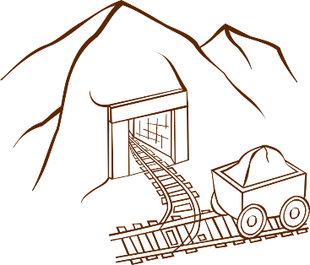
Creating and Claiming Value in Golden Standard
Claiming value:
  Best Alternatives to a Negotiated Agreement?
  What did you hope to get out of the agreement?
Notes:
What were your best alternatives to a negotiated agreement or your BATNAs in Golden Standard? [Students answer].
In a multi-party negotiation there is the added complexity of an internal BATNA, forming a coalition with a subset of the other parties. The four local communities could band together and block the roads to the mine. The company and government could form a coalition with one or more of the local communities that makes blocking the mine no longer feasible.
If local leaders are able to block the roads, how do things look for Golden Standard and the government? [Students answer]. Pretty bad, right? The mine can’t go forward until further notice, and bad press for the company and government, their whole country looks bad to international investors. The government could intervene militarily to break up the road blocks, but this would come with undesirable political costs.
What about your incentives structures, what do you each hope to get out of the mine project if it moves forward? [Students answer].
Source for photo
https://pixabay.com/en/mine-trolley-lorry-rails-mining-145631/

Slide 11
 | GS | Government | 4 Communities
BATNA | Roads to mine blocked by local communities, bad press | Bad press, bad signal to foreign investors | Form coalition and block roads (Government could bring in military)
View on mining jobs | GS will eliminate local unemployment crisis | Good for local communities | Destroys traditional agricultural way of life
View on GS funded schools | GS helps poor communities educate youth | Good for local communities | Brainwashing children with government and corporate propaganda
Compensation to communities | GS has already been generous and socially responsible | GS pays and government controls funds | Want compensation and local control of funds
Scope of mine (moving glaciers) | Wants to move glaciers to access gold deposits | Want to move glaciers to maximize Gov. % of revenue | Most to least opposed to moving glaciers: Vallenuevo, Paraiso, Tachito, Alto de Lucia
Notes:
The company wants the mine approved and glaciers moved to access more gold deposits. They feel they have paid out enough to the communities.
The government wants the mine and glaciers moved too, so they can get their percentage of the mine revenues. The government representative is also incentivized to push for more local jobs, and wants Golden Standard to offer more compensation to the local communities with the funds controlled by… [Students answer]. Who else– the government.
The company and government are in many respects allies. But they have conflicting preferences when it comes to splitting the revenue from the mine between them. Going into their first conversation, each side wants to adjust the provisional figure in their favor.
All four local leaders want to control the compensation funds. Why? [Students answer]. They don’t trust the government.
The communities wants compensation for the problems and dangers the mine brings to their community. But they vary a lot in how opposed they are to the mine and to moving glaciers. In what ways? [Students answer].

Slide 12
 | Vallenuevo | Paraiso | Tachito | Alto de Lucia
Unemployment Rate | 42% | 36% | 28% | 25%
Population | 28,000 | 18,000 | 17,000 | 13,000
Distance from Mine | 45km | 59km | 75km | 95km
Bottom line on glaciers | Leave 3 large + 1 small | Leave 2 large + 1 small | Leave 1 small glacier | May be acceptable to move all glaciers
% of revenues | 2% | 2.5% | 1.5% | 1%
Notes:
Here are the initial positions taken by the four local communities, in the role materials.
Did the Government Representative have a good understanding of what each local community wants that is different from what the others want? [Students answer: No]. No. The government representative incorrectly believes the protesters are solely after money and thinks Golden Standard should focus on Vallnuevo and Paraiso, who have the highest unemployment, and therefore should be most interested in the mining jobs. However, opposition to the mine is a direct function of distance from the mine site, not economic need. Vallenuevo and Paraiso are the geographically closest communities to the mine and therefore the most opposed to the mine.
So for Golden Standard, one strategy would be to try to take the other side’s perspective– who would really be most concerned about this mine– or uncover this information during the conversation. Then try to get Alto de Lucia or Tachito on your side, once you have one community on your side you eliminate the threat of road blocks which requires all four communities to band together into a coalition. Also, politically, the local leaders can no longer tell the world the entire valley is united against the company.
Each municipality has a different figures in mind regarding financial compensation. How did you bring these expectations in line during your initial negotiations? [Students who were local leaders share their experiences].
Golden Standard and the government can potentially exploit the different preferences between the local communities. If at least one community comes over to their side they can prevent the municipalities from blocking the roads to the mine and the potential need to bring in the military which is problematic for them. But the company and government need to uncover each individual community’s interests in order to break their coalition.

Slide 13

Military intervention?
Notes:
Did any governments threaten military action? At what point in the negotiation? How did the local leaders respond to the threat? [Students share their experiences].
Did any governments actually resort to military intervention? How did you end up going with a military solution? [Students share their experiences].
Source for photo:
https://pixabay.com/photos/men-honor-guard-soldiers-67636/

Slide 14
What new issues did you introduce to create value?
Notes:
What new issues did you introduce to increase value? [Students share their experiences]. You had the option in the outcome form to make additional agreements, which allows you to try to come up with creative solutions.
Source for photo
https://pixabay.com/en/mine-trolley-lorry-rails-mining-145631/

Slide 15

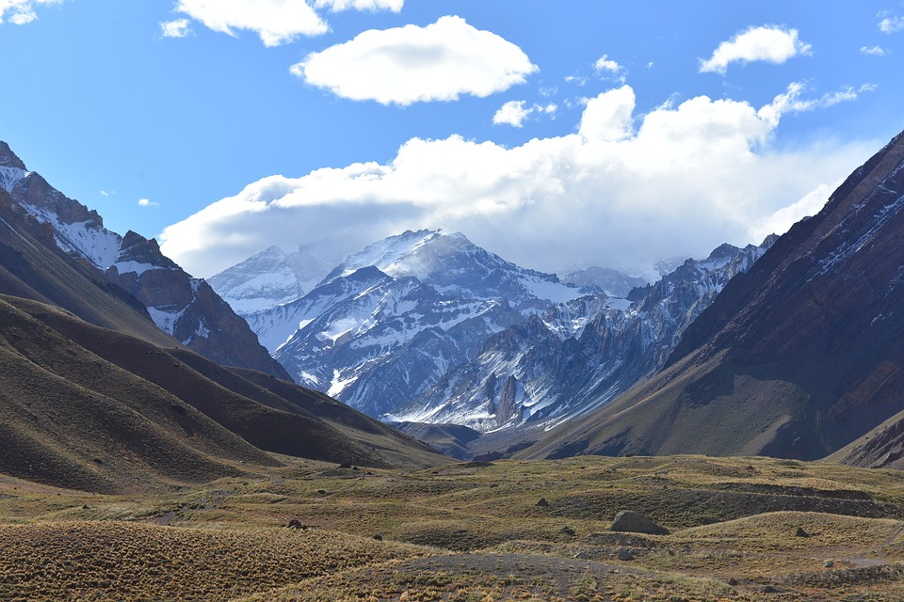
Local control of school curriculums?
Created fund to cover future environmental damage?
Notes:
One thing you could agree to is for control of the school curriculums to pass to the local municipalitieis. Their role says they highly value school infrastructure but reject the government and Golden Standard’s curriculum for their kids as pro-government, corporate brainwashing. So why not leave the schools plan in place but let the local communities decide what is taught in them? The company has already spent a huge amount of money on the schools and buses, why not get some value out of them? This would benefit the local municipalities and potentially allow the company to pay less in new financial compensation.
Did anyone agree to establish local control of the schools in the case? [Students raise hands]. Tell us about how you reached this solution. [Students share].
Another creative option is for Golden Standard and/or the government to establish a fund to cover the costs of any environmental disasters that might happen in the future. Golden Standard has an excellent environmental record and the company genuinely believes they will be able to pull off the project without serious environmental incidents. What do the local communities think? [Students respond]. The local leaders are suspicious and much more pessimistic about the environmental consequences of the mine. So the two sides have different expectations about the future, which you can leverage by creating a contingent contract, who remembers this from a past lecture? [Students respond]. That’s correct, in a “contingent contract” the terms of the contract are linked to future events about which there is uncertainty, in this case the environmental effects of the mine. Golden Standard is confident they won’t have to pay out any money and the local communities feel protected by such a fund, so value is created for the overall negotiation.
Did anyone agree to establish an environmental fund in the case? [Students raise hands]. Tell us about how you reached this solution. [Students share].
Source of photo
https://pixabay.com/en/apple-education-school-knowledge-256261/

Slide 16
Group | % of mine revenues to Gov | Scope of mine (glaciers moved) | Compensation to local communities (amount and who controls) | Mining jobs (#) | Roads blocks (yes/no) | Military intervention (yes/no) | Further details
1 | 28% | 3 large glaciers moved | 9% of gold revenues, locally controlled | 25,000 | No | No | Environmental fund established
2 | 27% | 2 large, 1 small moved | 8% of revenues (V: 3%, P:2%, T: 1.9%, A:1.1%), local control | 20,000 | No | No | Local control of schools
3 | 12% | 1 large, 1 small moved | 12%, by population size | 15,000 | No | No | N/A
4 | 15% | 1 small glacier moved | 11% (V: 3%, P:3.5%, T: 2.5%, A:2%), local control | 20,000 | No | No | Local control of schools
5 | 30% | All glaciers moved | None | 15,000 | Yes | Yes | N/A
Notes:
*Important note: This is the results slide for Golden Standard. The instructor has the option of entering the results from the outcome form here during the break. Another option is to look at the outcome forms that the Government Representatives turn in and pick interesting results to highlight.
Here are brief summaries of your results. So, tell me more about your negotiations. [Students share their experiences].
Who used the internal BATNA of forming a coalition and cutting someone out of the deal? Did any local leaders defect to the government and company’s side? [Students share their experiences].
Note: These are the actual results from a lecture using this case, with INSEAD alumni as participants.

Slide 17
Golden Standard’s Profits
From $20 billion in expected gold revenues, subtract:
  $2 billion for each of 3 large glaciers not moved
  $1 billion for each of 2 small glaciers not moved
From the revised expected gold revenues, subtract:
  Government share of revenues (agreed 20%, want 30%)
  Communities’ share (want 7% total)
  $5 billion in projected project costs
Notes:
Let’s take a look at Golden Standard’s financial bottom line. They start with $20 billion in expected gold revenues, but from this you must subtract billions for each of the glaciers not moved. So if the mine goes forward expected gold revenues could be $20 billion or could be much less, depending on the number of glaciers that are moved to access the gold deposits beneath.
From this, the government originally agreed to 20% of revenues but now wants 30% given all the problems resulting from Golden Standard’s failed outreach campaign. Golden Standard wants the government to come down to 10% given the recent 50% drop in the price of gold has already halved the company’s expected revenues. The communities are demanding a total of 7% in their role materials. So subtract any compensation you have given the government and four communities.

Slide 18
Based on a true story(Smith, 2014)
Notes:
Golden Standard is loosely based on a true story. Are any of you familiar with the Barrick Gold company and their mine at the Pascua Lama site in the Andes mountains? [Students answer].
Source of photo
https://pixabay.com/en/andes-mountain-aconcagua-landscape-1351053/
References
McCormick & Smith, 2014
Barrick Gold, A perfect storm at Pascua Lama, INSEAD case.
Inspection copy available at: http://centres.insead.edu/social-innovation/what-we-do/documents/INSEADSocialInnovationCentre6021-Barrick_Gold-CS-EN-0-06-2014-award-w.pdf

Slide 19
Barrick Gold Case
(McCormick & Smith, 2014)
Founded by Peter Munk in Toronto, Canada in 1980
World’s biggest gold mining company
Policy of responsible mining:
  Careful environmental planning
  Investment in communities
Accolades
  Listed as a Top 100 sustainable company by the NASDAQ
  Featured on Dow Jones Sustainability World Index
  Corporate Knights Global List of sustainable companies
Company share price dropped 50% in value
Notes:
Barrick Gold was founded in 1980 in Toronto, Canada by Peter Munk after an extremely successful business career in other industries. Barrick is the world’s biggest gold mining company with sites all over the world, among these Argentina, the Dominican Republic, Peru, Tanzania, and Zambia. Under Munk‘s leadership, Barrick has a company policy of socially responsible mining, including extensive environmental planning and investment in local communities. They are included on a variety of lists of the world’s most sustainability-focused companies. One of the company’s mottos is that "Doing the right thing is good business.“
References
McCormick & Smith, 2014
Barrick Gold, A perfect storm at Pascua Lama, INSEAD case.
Inspection copy available at: http://centres.insead.edu/social-innovation/what-we-do/documents/INSEADSocialInnovationCentre6021-Barrick_Gold-CS-EN-0-06-2014-award-w.pdf

Slide 20
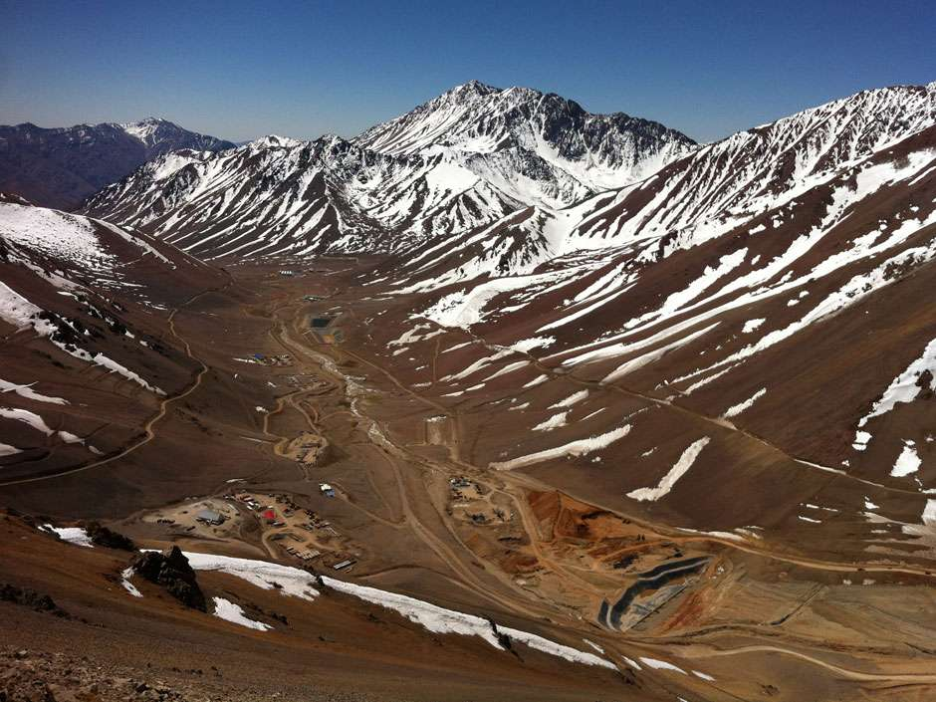
Pascua Lama Project
(McCormick & Smith, 2014)
Barrick Gold made a deal with Chilean and Argentinean governments to mine a huge gold and silver deposit on their border in the Andes
Agreed to over 400 environmental restrictions
Notes:
In an exploration and approval process that started in the mid 1990s, Barrick Gold made a deal with the Chilean and Argentinean governments to access a huge gold and silver deposit they had discovered on the two nations’ border in the Andes. The deal was in certain respects a feat of negotiation genius given that Chile and Argentina have a long-standing border dispute. Yet the company got the proposal approved. As part of this they agreed to over 400 environmental restrictions. The planned Pascua Lama mining site would be the first mine ever to span national borders.
Source of photo
https://pixabay.com/en/andes-mountain-aconcagua-landscape-1351053/
References
McCormick & Smith, 2014
Barrick Gold, A perfect storm at Pascua Lama, INSEAD case.
Inspection copy available at: http://centres.insead.edu/social-innovation/what-we-do/documents/INSEADSocialInnovationCentre6021-Barrick_Gold-CS-EN-0-06-2014-award-w.pdf
https://en.wikipedia.org/wiki/Peter_Munk

Slide 21
Community outreach initiative
1000s of community meetings
Door-to-door visits
Hospital ward for children
School buses
Housing for victims of Chile’s recent earthquake
Laptops and teacher trainings for schools
Dental hygiene program for children
Education program on the valley’s history
$60m in water system improvements
Training progammes for locals interested in mining jobs
Notes:
Barrick also launched a community outreach initiative to win local support for the mine. This included thousands of community meetings, building a hospital ward for kids, and funding school buses, housing, laptops for school kids, education programs, water improvements, and job training programs.
References
McCormick & Smith, 2014
Barrick Gold, A perfect storm at Pascua Lama, INSEAD case.
Inspection copy available at: http://centres.insead.edu/social-innovation/what-we-do/documents/INSEADSocialInnovationCentre6021-Barrick_Gold-CS-EN-0-06-2014-award-w.pdf
https://en.wikipedia.org/wiki/Peter_Munk

Slide 22
Pascua Lama Project
(Smith & McCormick, 2014)
Expected to invest $1.5 billion and extract many billions of dollars worth of gold and silver
Total costs increased to $8.5 billion and extracted …???0 ounces of gold and 0 ounces of silver as of 2016
Company share price dropped 50% in value
Notes:
The company expected to invest $1.5 billion and extract many more billions of dollars worth of gold and silver. At this point, a generation later, they are on track to invest over $8 billion and have extracted– how much gold and silver do you think? [Students provide guesses].
References
McCormick & Smith, 2014
Barrick Gold, A perfect storm at Pascua Lama, INSEAD case.
Inspection copy available at: http://centres.insead.edu/social-innovation/what-we-do/documents/INSEADSocialInnovationCentre6021-Barrick_Gold-CS-EN-0-06-2014-award-w.pdf
https://en.wikipedia.org/wiki/Peter_Munk

Slide 23
Pascua Lama Project
(Smith & McCormick, 2014)
Expected to invest $1.5 billion and extract many billions of dollars worth of gold and silver
Total costs increased to $8.5 billion and extracted 0 ounces of gold and 0 ounces of silver
Company share price dropped 50% in value just in 2013
*From $60 a share to $10 a share between XXX and XXX
Notes:
Nothing. They have extracted 0 ounces of gold and 0 ounces of silver as of 2016. The company’s share price dropped 50% just in 2013 in part due to the mounting problems at this one mine site.
References
McCormick & Smith, 2014
Barrick Gold, A perfect storm at Pascua Lama, INSEAD case.
Inspection copy available at: http://centres.insead.edu/social-innovation/what-we-do/documents/INSEADSocialInnovationCentre6021-Barrick_Gold-CS-EN-0-06-2014-award-w.pdf
https://en.wikipedia.org/wiki/Peter_Munk

Slide 24
Strategic failures
Notes:
Hindsight is always perfect, and maybe it would have gone poorly no matter what. But the company did potentially make some key strategic missteps with regarding to getting local support.

Slide 25
Strategic failures
Unilateral commitments allocating resources early
  Community outreach initiative was to obtain support for the planned mine, not seek permission (process violation)
  Locals saw mining jobs and education initiatives as threat to their way of life (failure to understand others’ interests)
An international counter-coalition formed: Legal campaign, public demonstrations, and bad publicity blocked mine
Engage with stakeholders early, but commit resources late in the game if you can
Notes:
To their credit, they did have an extensive community outreach initiative, much more extensive and generous than other mining companies would have done. But this was to get support for the mine, not ask permission. They never actually asked the local communities if they wanted the mine.
The local communities ended up rejecting the outreach efforts. The local community leaders broadened their coalition to include international environmental groups. There were protests and demonstrations against the mine not only in Chile and Argentina, but also in Canada. A legal campaign, the public demonstrations, and bad publicity successfully blocked the mine as of 2023.
The Barrick Gold case shows the value of taking cultural differences within a nation into account. An agreement with the Chilean and Argentinean governments does not mean support from the Chilean and Argentinean people, the non-elites who in many cases have very different values from those in power. The local indigenous communities rejected the company based not just on the environmental threat, but on their very different set of values. Mining jobs and free school curriculums did not hold the value for them that the company assumed they would. The education curriculum for instance was not seen as faithful to the indigenous traditions of the area and rather as Westernized and government-sponsored propaganda about the history of the region.
References
McCormick & Smith, 2014
Barrick Gold, A perfect storm at Pascua Lama, INSEAD case.
Inspection copy available at: http://centres.insead.edu/social-innovation/what-we-do/documents/INSEADSocialInnovationCentre6021-Barrick_Gold-CS-EN-0-06-2014-award-w.pdf
https://en.wikipedia.org/wiki/Peter_Munk

Slide 26
“They have brought professionals to teach the Huascoaltinos about our own culture. What right do you have to teach us about our own traditions? What right do you have to manipulate our traditions… We will not allow Barrick to destroy our land and culture… if you continue to mine in our lands, you will be complicit in the pollution and destruction of our culture…”
-- Letter to Barrick shareholders
from representatives of local community
Notes:
Here is part of a letter to the Barrick shareholders from representatives of one of the local communities. [quoting letter]. “They have brought professionals to teach the Huascoaltinos about our own culture. What right do you have to teach us about our own traditions? What right do you have to manipulate our traditions… We will not allow Barrick to destroy our land and culture.” Thus, this was clearly seen by the local communities as not just an environmental issue, but also an issue of the preservation of cultural heritage.
References
McCormick & Smith, 2014
Barrick Gold, A perfect storm at Pascua Lama, INSEAD case.
Inspection copy available at: http://centres.insead.edu/social-innovation/what-we-do/documents/INSEADSocialInnovationCentre6021-Barrick_Gold-CS-EN-0-06-2014-award-w.pdf
https://en.wikipedia.org/wiki/Peter_Munk

Slide 27
“It’s not enough to have money. It’s not enough to have reserves. It’s not enough to have great mining people. Today the single most critical factor in growing a mining company is a social consensus – a license to mine.”
-- Peter Munk,
Founder and CEO of Barrick Gold in 2012
Henisz, Dorobantu, & Nartey, “Spinning Gold: The financial returns to stakeholder engagement,” Strategic Management Journal, 2014
Notes:
Peter Munk, the founder of Barrick Gold has discussed what his called the social license to mine. [Quoting Munk] “It’s not enough to have money. It’s not enough to have reserves. It’s not enough to have great mining people. Today the single most critical factor in growing a mining company is a social consensus – a license to mine.”
The academic research bears this out, showing that mines with the support of the local people are much more profitable.
Getting the social license to operate your business means negotiating a sustainable agreement with numerous stakeholders, which even in a simulation like Golden Standard is a huge challenge that requires leveraging a variety of negotiation tactics. That even a self-made billionaire like Peter Munk can fail to do this shows how difficult multi-party negotiations can be, especially when there are fundamental cultural differences in terms of what is valued.
References
McCormick & Smith, 2014
Barrick Gold, A perfect storm at Pascua Lama, INSEAD case.
Inspection copy available at: http://centres.insead.edu/social-innovation/what-we-do/documents/INSEADSocialInnovationCentre6021-Barrick_Gold-CS-EN-0-06-2014-award-w.pdf
https://en.wikipedia.org/wiki/Peter_Munk
Henisz, Dorobantu, & Nartey, “Spinning Gold: The financial returns to stakeholder engagement,” Strategic Management Journal, 2014
Barrick beyond Borders: Peter Munk cites 25 ways Barrick contributes to communities (2012), http://barrickbeyondborders.com/mining/2012/05/peter-munk-cites-25-ways-barrick-contributes-to-communities/

Slide 28

Thank You!!!
Notes:
That’s it for our class, thanks so much! I hope you got a lot out of it, and please stay in touch and feel free to use me as a resource. You know where to reach me.
Source for photo
https://pixabay.com/en/sylvester-new-year-s-day-fireworks-1103947/

