Slide 1
A Game of Chicken
06/2024-6909
This slide deck was prepared by Bernardo Betley, Can Yagli, Ciaran Galvin, Hailey Hu, and Pavani Gulati, INSEAD MBA Alumni, under the supervision of Martin Schweinsberg, Associate Professor of Organisational Behaviour at ESMT Berlin, Horacio Falcão, Professor of Management Practice of Decision Sciences at INSEAD, and Eric Uhlmann, Professor of Organisational Behaviour at INSEAD, as additional material to the role play “A Game of Chicken”.
To access INSEAD teaching materials, go to https://publishing.insead.edu/.
Copyright © 2024 Martin Schweinsberg, Horacio Falcão, Eric Uhlmann.
COPIES MAY NOT BE MADE WITHOUT PERMISSION. NO PART OF THIS PUBLICATION MAY BE, COPIED, STORED, TRANSMITTED, TRANSLATED, REPRODUCED OR DISTRIBUTED IN ANY FORM OR MEDIUM WHATSOEVER WITHOUT THE PERMISSION OF THE COPYRIGHT OWNER.

Slide 2
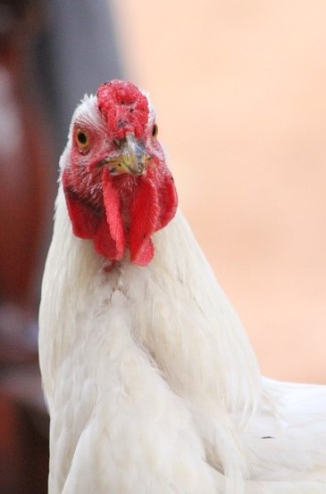
Team Negotiation Exercise:
Game of Chicken
Read your role materials and plan with your teammate (max 30 minutes)
Negotiate with the other team (max 45 minutes)
Turn in your outcome sheet, then take a 15 minute break
Notes:
Today we have a team-on-team negotiation exercise. Each of you will be paired with a teammate and negotiate with two counterparts. So you will be in groups of 4.
This is Game of Chicken, it’s about 2 chicken farmers negotiating with 2 representatives from a microcredit company for a loan. Microcredit involves giving loans to very low income buyers who lack collateral or credit.
You will have 30 minutes to read your role materials and plan your strategy with your teammate, then 45 minutes to negotiate with the other team. When you are done each group of 4 should fill out a copy of outcome form together [Instructor holds up hard copies of “Outcome_Form_Game_of_Chicken”] and give it to me. Then you take a 15 minute break while I enter your results. The lecture will begin again in 90 minutes. Sounds good? [Students say yes].
As before, try to partner up with other students you know less well than others, and if possible different people from your previous negotiations. This will get more difficult to do as the course progresses, so its ok if sometimes you are with the same person from before again. [Students partner up and instructor hands out copies of the negotiation roles and outcome forms. Students read their materials and negotiate.]
[During the negotiations, the instructor should walk around and take mental or written notes on some of the students’ interactions, highlighting tactics and reactions that can be brought up later during the debriefs when students are asked to share their experiences or when key teaching points are made].
[As the students come back with their results, the instructor creates the results slide for the class using the excel spreadsheets called “Results_Template_Game_of_Chicken_Point_Scores” and pastes them into the PowerPoint slide called “Your results: Points Scores” later in this deck. Each group of 4 students is given their negotiation group number as they turn in their results and are asked to remember it for the debrief].
Note: An alternative approach to creating the pairings is for the instructor to pair students up himself/herself, either by creating pairings before class begins or ad-hoc now during the lecture.
Source of photo:
https://pixabay.com/en/animal-chicken-africa-bird-nature-223015/

Slide 3
Game of Chicken
Chicken Farmers | PAIR | CrediGro Representatives | BOR
 | 1 |  | 251
 | 2 |  | 252
 | 3 |  | 253
 | 4 |  | 254
 | 5 |  | 255
 | 6 |  | 256
 | 7 |  | 257
 | 8 |  | 258
Notes:
Here are your breakout room slides for this exercise. Please grab your role materials– they are printed in the color that matches the color of the column your name is listed in on the slide. Then pair up with your negotiation team, and then the team on the other side of the table, and enjoy the exercise! [Students get their role materials and go to negotiate].
Note: This template students pairings slide is for if the instructor sorts students into negotiating teams beforehand. Student names are added in the respective columns beneath their role. If this slide is used, the color background for each role on the slide above should match the color paper of the role materials that are handed out to students, to avoid confusion. The “BOR” column refers to “Breakout Room” and only applies if the instructor has special rooms for the students to negotiate in. “PAIR” refers to negotiation group number, in other words each pair of students who negotiate with each other.
Note: There are Multiple Chicken farmers and CrediGro representatives, so there should be multiple student names in each of the squares in the table.

Slide 4
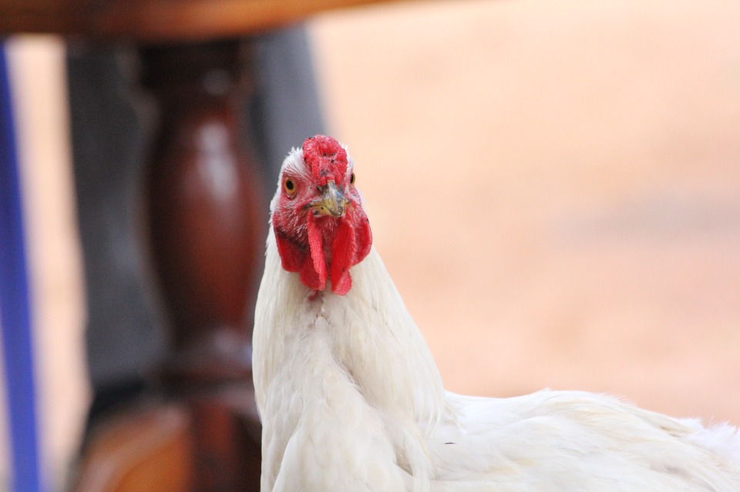
Take 3 minutes and share with the person next to you:
One thing the other team did well in the negotiation
One thing your team could have done differently
Notes:
[Students are now back in class]. Welcome back! Please take 3 minutes and share with the person sitting next to you, who is not necessarily part of your negotiation group. One thing that the other team did well, and one thing your team could have done better.
Source of photo:
https://pixabay.com/en/animal-chicken-africa-bird-nature-223015/

Slide 5

Team Negotiations
Notes:
Today’s lecture will be on the topic of team negotiations. This is a really important topic, most of the negotiations in professional settings that are between different organizations are done in teams.
Source for photo
https://pixabay.com/en/chess-figure-game-play-board-1215079/

Slide 6
What did you learn about the other team in Game of Chicken?
Notes:
So what did you learn about the other team in Game of Chicken? When you looked into their souls, what did you see? [Students answer].
Source of photo:
https://pixabay.com/en/animal-chicken-africa-bird-nature-223015/

Slide 7
Maximizing Joint Value
Identify the issues and options each side values relatively more (differing preferences) and trade them off to maximize total value
What issues provided opportunities to increase the pie by making value-maximizing trade-offs?
Notes:
Different preferences occur when the counterparts value issues to differing degrees. This creates opportunity to make tradeoffs and increase the pie. What issues provided opportunities to increase the pie by making tradeoffs? [Students answer].

Slide 8
Maximizing Joint Value
Identify the issues and options each side values relatively more (differing preferences) and trade them off to maximize total value
CrediGro cares more about inspection frequency and the farmers more about poultry density
Trade greater frequency of inspections for high poultry density to maximize value
Agreeing on Alvaro, who is neither side’s optimal business partner, also maximizes joint value
Notes:
CrediGro cares more about having frequent inspections to protect their investment, and the farmers care more about having high poultry density so they can increase their profits. So you can trade greater frequency of inspections for high poultry density to increase the pie. You could also agree on Alvaro, who is neither side’s optimal business partner, but leads to greater total points than their first options. “Alvaro” situations happen a lot in hiring, organizations hire the candidate no one hates.

Slide 9
Non-Linear Payoffs
Non-linear utility functions need to be taken into consideration
Whose payoffs were non-linear? For what issues?
Notes:
Something new in Game of chicken is the non-linear payoffs. Whose payoffs were non-linear and for what issues? [Students answer].

Slide 10
Non-Linear Payoffs
Non-linear utility functions need to be taken into consideration
CrediGro has a curvilinear utility function on loan size and payback time, preferring options in the middle of those available
In real-life, preferences are often nonlinear
Notes:
For loan size and payback time, CrediGro prefers options in the middle of those available. Why would that be? [Students answer]. Too small a loan or too little time to pay it back does not make sense for CrediGro, they want the farmers to have enough time and capital to make money and pay them back. But too big a loan is too much risk. In real-life we often have non-linear preferences.

Slide 11

Inequivalent Options
For some issues, the counterparts have ranges of options that do not fully overlap
Inspection frequency
Poultry density
Chilling effects: offers worse than the other side’s least acceptable offer can backfire (Schweinsberg et al., 2012)
Notes:
For inspection frequency and poultry density, CreditGro and the chicken farmers have ranges of options that do not fully overlap. What can happens when someone asks for something that is totally out of the realm of possibility for the other side? You get a chilling effect, it backfires. Did this happen in any of your negotiations? [Students share their experiences].
Source of photo:
https://pixabay.com/en/ice-storm-ice-on-branch-branch-329768/
Reference
Schweinsberg, M., Ku, G., Wang, C.S., & Pillutla, M.M. (2012). Starting high and ending with nothing: The role of anchors and power in negotiations. Journal of Experimental Social Psychology, 48, 226–231.
http://www.sciencedirect.com/science/article/pii/S0022103111001880

Slide 12
Points Payoffs: Poultry Density
Julieta: Wants to maximize poultry density (to increase profitability)
CrediGro: Incentive to reduce poultry density (to prevent losses by disease)
0.5 is Julieta’s ideal but out of the question for CrediGro
2.0 is CrediGro’s ideal but out of the question for Julieta
Size of pie: Maximized at 0.6
Notes:
Here are the points payoffs for Poultry Density. As I mentioned earlier, each side wants options that are impossible for the other side.
Note: At this juncture in the lecture all of these points have been covered, so its better to go through the slides with the payoff figures relatively quickly.

Slide 13
Points Payoffs: Inspection Frequency
Julieta: Wants to avoid inspections (hassle and interference)
CrediGro: Incentive to maximize the number of inspections (safeguard loan)
0 is Julieta’s ideal but out of the question for CrediGro
12 is CrediGro’s ideal but out of the question for Julieta
Size of pie: Maximized at 8
Notes:
Here are the points payoffs for Inspection Frequency. Again, each side wants things the other side cannot possibly agree to.
Note: At this juncture in the lecture all of these points have been covered, so its better to go through the slides with the payoff figures relatively quickly.

Slide 14
Points Payoffs: Business Partner
Julieta: Wants to choose Ronaldo (most points)
CrediGro: Wants to choose Felicia (most points)
Size of pie: Maximized with Felicia & Alvaro, but equally split with Alvaro
Notes:
Here are the points payoffs for business partners. Alvaro is the choice that maximizes value and divides that value equally, even if its neither side’s ideal option.

Slide 15
Points Payoffs: Size of Loan
Julieta: Wants to borrow as much as she can
CrediGro: Wants a loan in the middle of the options (too risky to loan a lot)
Size of pie: Maximized at $5,000
Notes:
Here are the points payoffs for loan size. Here you can see CrediGro’s curvilinear preferences, they want a loan in the middle of the available options, so small a loan will not jump-start the chicken farm and too big is too much risk.
Note: At this juncture in the lecture all of these points have been covered, so its better to go through the slides with the payoff figures relatively quickly.

Slide 16
Points Payoffs: Loan Payback Time
Julieta: Incentive to increase loan payback period
CrediGro: Keen to decrease loan payback period but does not want unrealistic time frame (1 year)
Size of pie: Maximized at 2 years
Notes:
Here we have loan payback time. CrediGro again has curvilinear preferences, to maximize value you need to find the point where the two lines meet, the black line for Julieta and dotted line for CrediGro. When they cross, the pie or joint value is greatest.
Note: At this juncture in the lecture all of these points have been covered, so its better to go through the slides with the payoff figures relatively quickly.

Slide 17
Who had better alternatives?
Notes:
Who had better alternatives in Game of Chicken? [Students answer]. What will Julieta do if there is no deal? [Students answer]. How about CrediGro? [Students answer]. What’s that worth to them? [Students answer].

Slide 18
Who had better alternatives?
CrediGro has a better BATNA or Best Alternative to a Negotiated Agreement than the Julieta Chicken Farm (40 points vs. 30 points)
In real life, the farmers would typically need the loan more than the lenders need the business
Sometimes expanding the pie benefits one counterpart more than the other
Interactions between corporations and small businesses in emerging markets can be like this
Notes:
CrediGro has a better BATNA than the Julieta Chicken Farm. If there is no deal, Julieta takes out loans from family for a value of 30 points. CrediGro will not make a deal below 40 points because that is what pursuing alternative loan opportunities is worth to them.
This is true to life, I think-- in real life, the farmers would typically need the loan more than the lenders need to make the loan. That doesn’t mean an agreement or win-win solution isn’t possible, just that one side needs the deal more than the other.
Win-win solutions in most negotiation exercises are symmetric-- both sides win equally. But that’s not very realistic. In real life, expanding the pie typically benefits one side more than the other. Win-win solutions can be really unfair. Its like this in Game of Chicken. CrediGro benefits more from tradeoffs than the chicken farmers. Interactions between corporations and small businesses in emerging markets are often like this, both sides are helped but the more powerful party gets helped more.
In negotiations, I encourage you to focus on getting the best result for yourself that you can, and not worry about the other side doing well too or even unfairly better than you. That can be difficult to do emotionally at the time, but you’ll thank yourself in the long run.

Slide 19
Julieta’s maximum possible points are 62 (vs. 6 for CrediGro)
CrediGro’s maximum possible points are 65 points (vs. 19 for Julieta)
Pie is maximized with an uneven 37 (Julieta) to 53 (CrediGro) point split
Notes:
Here’s the whole spectrum of theoretically possible results. Julieta’s maximum possible points are 62, CrediGro’s maximum possible points are 65 points. Those numbers are unlikely because they require the other side accepting less than their reservation points of 30 and 40. Again, I’ll send you all these slides in case you want to take a closer look and analyse your own results in more depth.
Maximizing the pie means an unfair result, 53 points for CrediGro and 37 for Julieta. Some chicken farmers get more than 37 points, so creating value and claiming value for yourself are not always goals that are aligned with one another.

Slide 20
Your Results: Points Scores
Impasse
Impasse
Notes:
And here are your agreements! [Students react]. The total height of the bars reflects the joint value you created together. Higher bars mean more value creation. The red bars reflect the value claimed by CrediGro and green is for the chicken farmers.
So tell me a bit about your deals. [Students share their experiences in the negotiation. If not enough students are speaking, the instructor can choose extreme results– high and low bars, bars with very fair and very disproportionate divisions of value– and ask that negotiating team to share].
Note: What’s shown here are example results from a pilot lecture at INSEAD. During the break, the instructor should have created the results slide for the class using the excel spreadsheet called “Results_Template_Game_of_Chicken_Point_Scores” and pasted it into this PowerPoint slide. Impasses (leading to 40 for CrediGro and 30 for Julieta chicken farm) can be indicated with a text box and the word “impasse” in red font.
Note: Here are the relevant items from the Outcome Form used to create this figure
Total points obtained by CrediGro: points
Note: These are the total points adding up across all issues, Size of the Loan + Loan Payback Time + Business Partner Support + Poultry Density + Inspection Frequency, using CrediGro’s payoff structure.
Total points obtained by the Chicken Farmers: points
Note: These are the total points adding up across all issues, Size of the Loan + Loan Payback Time + Business Partner Support + Poultry Density + Inspection Frequency, using the Chicken Farmers’ payoff structure.

Slide 21

Sustainable Relationships
Long-term sustainable relationships are key in many situations
CrediGro and the Julieta Chicken Farm could do more mutually beneficial business together in the future IF this negotiation goes well
Notes:
As we’ve talked about before, a negotiation isn’t just about the value you get now, its also abut the long term relationship. CrediGro and the Julieta Chicken Farm could do business together long into the future if this interaction goes well. You don’t want to be a relationship sucker who gives away all the value in the hopes of being friends, but you should value good relationships in addition to getting a good deal now. The best result would be to get both, and some of you achieved this.
Source of photo:
https://pixabay.com/en/refugees-economic-migrants-1020256/

Slide 22

Your Results: Partner Ratings “Would you do business with your counterparts long-term?”
Why would you or wouldn’t you?
Notes:
So those of you who gave each other low ratings as a future partner, why wouldn’t you do business with your counterparts again? [Students share their experiences in the negotiation and the bases for their ratings. If not enough students are speaking, the instructor can choose extreme results from the outcome forms and ask that negotiating team to share].
Source of photo:
https://pixabay.com/photos/job-interview-hiring-hand-shake-3790033/

Slide 23
Who is better at claiming value,
individuals or teams?
What about creating value?
Notes:
Who is better at claiming value, individuals or teams? [Students answer]. How about creating value? [Students answer].
Source for photo
https://pixabay.com/en/chess-figure-game-play-board-1215079/

Slide 24
Team Negotiations
Teams have an advantage over individuals in both creating and claiming value (Thompson et al., 1996)
Creating value: Exchange more information and get at interests better
Claiming value: Strength in numbers
But only if team roles and strategies are well coordinated!
Importance of active preparation among team members in order to reduce chances of conflict among members during final negotiation
Notes:
What research shows is that teams do better than individuals at both creating and claiming value. Creating value, because they talk more, exchange more information, and get at interests better. Claiming value because of the human tendency to conform to groups, there is psychological strength in numbers. But this team advantage only occurs if the team’s roles and strategies are well coordinated. You need to be on the same page as your teammates or negotiating as part of a team could even be worse than working alone. So its critical to actively prepare together before the negotiation to reduce chances of conflict within the team during the final negotiation.
Reference
Thompson, L., E., Peterson, S. W., Brodt, S. (1996). Team negotiation: An examination of integrative and distributive bargaining. Journal of Personality and Social Psychology, 70(1), 66–78.
http://psycnet.apa.org/journals/psp/70/1/66/

Slide 25


Challenges and Best Practices of
Negotiating in Teams
Challenges
Coordination
Communication
Justifying presence
Intimidation
Best practices
Team roles
Team composition
Communication transparency
Notes:
What are some of the big challenges looking at teams negotiations?
The first is coordination. When preparing together, you need to work on your coordination. Protocols.
The communication issues are significant. If the team is not coordinated, communication with the other side will be poor.
Another problem is lack of intimacy. With teams on both sides, it is harder to build intimacy and connection with the other side.
Justifying presence. Sometimes you invite people and they feel like they have to say something, because they were invited.
In team negotiations, think about intimidation. If you bring 8 people and they bring 2, they may feel you’re trying to intimidate them.
A perverse internal problem is a false sense of security. The probability someone will accidentally reveal too much to the other side is actually higher now. Bringing lots of people can send the other side the wrong message and expose yourself to mistakes. Bringing a lot of people can also send the message you really need this. Can send a message of weakness. Or it may look like your decision processes are likely to be cumbersome and complicated, so maybe I don’t want to do a deal with you.
Some best practices.
It is good to assign roles. If you have a high agreeable person, you might put them in the first phase of the conversation. If you have a low agreeable person, you might put them in the second phase of the conversation. You might love the person, but if they’re really, really difficult, you might not put them in either phase and handle it yourself. Have a leader. Doesn’t need to be an authoritarian leader. Could be coordinator. A legitimizer. “My colleague is better prepared to deal with the numbers and will discuss that with you.”
In terms of team composition, small is beautiful. Bring who you need, no more, no less. I’m a big fan of teams of two. One person can take notes, the other takes lead. Sit back, pay attention, listen more. A lot of advantages. The advantage of going from 2 to 3 are more marginal and risks start escalating. If want more than 2, have a pretty good reason. I’m talking about the team at the table. You can have a team of 10 people, but 8 wait at home. Others are part of the preparations and debrief.
Be communication transparent. Yes I’m taking notes, and I’m happy to share them later, or us them to create a summary email. I’m using a spreadsheet so I can more easily come up with an answer for you.
Instead of announcing a break, propose one. Avoid an us vs. them mentality. Create a friendly environment.
Source of photo:
https://pixabay.com/photos/startup-meeting-brainstorming-594090/

Slide 26


Did anyone use good cop/bad cop? (One member of the team is cooperative and the other hostile)
Who was good and who was bad?
Notes:
Did anyone use good cop/bad cop as their negotiation strategy, or face a good cop and bad cop? This is when one member of the team is nice and the other not so nice. [Students share their experiences].
The strategy is based on the idea that the bad cop uses power to intimidate you, and the good cop uses apparent relationship moves to manipulate. In both cases, they are trying to extract value from the other side.
[Directed to teams who used good cop bad cop, once identified]. Was it an act, or were you a real good cop and bad cop? [Students share their experiences].
Did any teams switch the good cop and bad cop roles during the negotiation? [Students answer]. I occasionally have students swap who is the good and bad cop in the middle of the negotiation. It is not very effective. [Students laugh].
The research suggests it should be called bad cop – good cop, since it’s a more effective manipulation tactic when the bad cop is first rather than the good cop.
As strategy, bad cop-good cop is full of risks. This is clearly a power-based, manipulation-based, win-lose approach. Its also famous, and therefore easy to spot. The other side might call you out on playing bad cop good cop. The advantages are canceled out if the other side is aware. The good cop isn’t building any relationship because the other side knows its just manipulation. So it becomes very easy for a bad cop good cop strategy to unravel. Bad cop good cop became popular because its very simple. Because of that negotiation teams tend to underprepare, “you be the good cop and I’ll be the bad cop.” It might be misaligned with personality. So after a while the bad cop isn’t bad enough anymore. “It’s not me”. A lot of the brain space is taken up by the acting. If you have more power, bad cop good cop may work. But if you have less power, this is not your favorite choice.
Reference
Brodt, S. E., & Tuchinsky, M. (2000). Working together but in opposition: An examination of the “good cop/bad cop” negotiating team tactic. Organizational Behavior and Human Decision Processes, 81(2), 155–177
Hilty, J. A., & Carnevale, P. J. (1993). Black-hat/white-hat strategy in bilateral negotiation. Organizational Behavior and Human Decision Processes, 55(3), 444–469.
The Good Cop, Bad Cop Negotiation Strategy
https://www.pon.harvard.edu/daily/batna/the-good-cop-bad-cop-negotiation-strategy/
Source of photos:
https://pixabay.com/en/policeman-officer-stop-cop-uniform-23796/
https://pixabay.com/en/cop-police-police-officer-uniform-156506/

Slide 27
Defense against good cop/bad cop tactic?
Notes:
What are some defenses you used against a good cop/bad cop? [Students share their experiences].
Source of photos:
https://pixabay.com/en/policeman-officer-stop-cop-uniform-23796/
https://pixabay.com/en/cop-police-police-officer-uniform-156506/

Slide 28
Defense against good cop/bad cop tactic?
Divide their team
Ask the good cop what he/she thinks of what the bad cop is saying
Team advantage in negotiation disappears if roles and strategy are poorly coordinated
Notes:
Here’s one thing you could try. Try asking the good cop for his or her response to what bad cop is saying. If they are truly not on the same page, this could cause conflict within their team. If it is a dirty trick, just a ploy, it could reduce their ability to coordinate their strategy. Either way their team coordination goes down.

Slide 29
Take-Aways
Maximizing joint and individual value can be complicated
Non-linear utility functions
Non-overlapping preferences
One side may benefit disproportionately or “unfairly”
Team up! Teams claim and create and more value
But make sure to coordinate team roles and strategies beforehand
Notes:
A few take-aways. First, maximizing joint and individual value can be complicated, since people often have non-linear utility functions, want options that are not possible for the other side, or win-win solutions might be lopsided and unfair. We tried to capture these complexities in Game of Chicken.
Second, team up! Teams claim and create and more value, they are better all-around negotiators than lone individuals are. But also make sure to coordinate your team roles and strategies beforehand so you can reap the benefits of being in a team.

