Slide 1
Augusta
06/2024-6906
This slide deck was prepared by Omer Rosenblum, INSEAD MBA Alumnus, Wilson Cyrus-Lai, Research Assistant at INSEAD, under the supervision of Martin Schweinsberg, Associate Professor of Organisational Behaviour at ESMT Berlin, Horacio Falcão, Professor of Management Practice of Decision Sciences at INSEAD, and Eric Uhlmann, Professor of Organisational Behaviour at INSEAD, as additional material to the role play “Augusta”.
To access INSEAD teaching materials, go to https://publishing.insead.edu/.
Copyright © 2024 Martin Schweinsberg, Horacio Falcão, Eric Uhlmann.
COPIES MAY NOT BE MADE WITHOUT PERMISSION. NO PART OF THIS PUBLICATION MAY BE, COPIED, STORED, TRANSMITTED, TRANSLATED, REPRODUCED OR DISTRIBUTED IN ANY FORM OR MEDIUM WHATSOEVER WITHOUT THE PERMISSION OF THE COPYRIGHT OWNER.

Slide 2

Coalitions
Notes:
Welcome! Our lecture today is on the fascinating topic of coalitions.
Source of photo (open source, creative commons)
https://www.brooklynmuseum.org/exhibitions/dinner_party/
RELEVANT LINKS
Brooklyn Museum: The Dinner Party by Judy Chicago https://www.brooklynmuseum.org/exhibitions/dinner_party
Judy Chicago Hits Back at ‘Dinner Party’ Criticism https://www.frieze.com/article/judy-chicago-hits-back-dinner-party-criticism
Note: The Augusta case is named after the famed Byzantine Empress, Augusta Theodora

Slide 3
Augusta Exercise
Process
4 roles: Conservative, Liberal, Labour, Libertarian
Form groups of 4, decide who gets which role, and READ ONLY YOUR ROLE!
Groups of 5 should double up the Libertarian role
Groups of 6 should double up the Libertarian and Liberal party roles
Side channel rule: Each party has the right to hold a single 5-minute side discussion with each other party. Longer if both parties interested.
Timeline (1 hour and 45 minutes in total):
Read your role and plan a strategy (max 15 min)
Negotiate in your group (max 1 hour and 15 minutes)
All four political parties must be present when the deal is finalized, so that parties in danger of exclusion can make last-minute counter-offers
Libertarian completes the outcome form and provides it to the instructor
Take a 15 minute break
You are allowed to lie, e.g., promise to join a coalition and then back out
Notes:
We bring this topic to life with a coalition building challenge. You will play the roles of four political parties in the fictional nation of Augusta. You must attempt to build a coalition government.
You will have 15 minutes to read your role materials and plan your strategy, then 1 hour and 30 minutes to negotiate with your three partners. At the point please give me 1 outcome form for each negotiation group. The Libertarian party fills out the outcome form on behalf of the whole group. Please try to find partners you know less well than the others, and to the extent you can different people than in your previous negotiations.
A few communication rules.
You free to meet with anyone who would like to meet with you. This could be in groups of 4, 3, or 2.
We also have a side channel rule. Each party has the right to obligate a single 5-minute side discussion with each other party, even if the other party does not want to. In other words, one during the negotiation, the liberals can force the conservatives, libertarians, and labour party to speak to them to the side. The idea here is to break open communication when strong coalitions form early.
In addition, all four political parties must be present when the deal is finalized, so that parties in danger of exclusion can make last-minute counter-offers. No ideal is final until everyone has had a change to make a last minute counter.
Last but not least, in this negotiation, you are allowed to lie. In particular, you can promise to join a coalition and then back out. No verbal, handshake, or written contract is binding. All that matters is what it says on the outcome form that is turned in to me at the end of the exercise.
Note: An alternative approach to creating the pairings is for the instructor to pair students up herself, either by creating pairings before class begins or ad-hoc now during the lecture.
Important note: There must be at least one student in each role for this negotiation. The negotiation exercise will not work properly if no one in the negotiation group has one or more roles. If students are not divisible into groups of 4, have more than 1 student in one or more roles. Groups of 3, 2, and 1 students are NOT viable for the Augusta case, at least four and up to seven students would work.

Slide 4
Four-Party Coalition Exercise: Augusta
The country of Augusta just held national elections between four political parties
The Parliament in Augusta is made up of 120 seats
To form a coalition government, a 61-vote majority is required
The government is formed by the parties in the coalition and consists of 6 ministers
The 6 ministers are divided among the coalition parties as agreed by them in the coalition agreement
The Labour party
40 seats
The Liberal party
15 seats
The Conservative party
51 seats
The Libertarian party
14 seats
Notes:
There is much more detail in your case roles, but I will give you a general overview of the situation.
The country of Augusta just held national elections between four political parties, who competed for seats in Parliament. The Parliament in Augusta is made up of 120 seats. To form a coalition government, a 61-vote majority is required. The parties in the governing coalition allocate 6 ministers between them as part of their agreement to form a government together.
Thus you must decide who is in the governing coalition. Not all parties have to be-- the government could include four parties, three, or even two, so long as you control at least 61 votes. Simultaneously, you must also decide how many ministers each party in the coalition government gets.
You are starting from different negotiating positions. Based on the last election, the conservatives have 51 seats, the libertarians 14 seats, the liberal party 15 seats, and the labour party 40 seats. Again, whatever coalition forms a government must control at least 61 seats and agree on how to allocate ministers between them.
If a governing coalition holding at least 61 votes is not achieved, new elections will be held. Good luck!
[Students partner up, the instructor hands out role materials and outcome forms, and the students negotiate.]

Slide 5
Group | Labour | Liberal | Conservative | Libertarian | BOR #1 | BOR #2
1
2
3
4
5
6
7
8
9
10
11
Notes:
Here are your breakout room slides for this exercise. There are four political parties in each negotiation group. Each group gets two BORs so you can shuffle back and forth between meetings.
Please grab your role materials– they are printed in the color that matches the color of the column your name is listed in on the slide. Then pair up with your three partners, and enjoy the exercise! [Students get their role materials and go to negotiate].
Note: This template students pairings slide is for if the instructor sorts students into negotiating groups beforehand. Students’ individual names are added in the respective columns. If this slide is used, the color background for each role on the slide above should match the color of the printed role materials that are handed out to students, to avoid confusion. The “BOR” column refers to “Breakout Room” and only applies if the instructor has special rooms for the students to negotiate in. “GROUP” refers to negotiation group number, in other words each group of students who negotiate together.
Note: For each Negotiation Group, there must be at least one student in each role for this negotiation. The negotiation exercise will not work properly if no one has one or more roles. If students are not divisible into groups of 4, have more than 1 student in one or more roles.
Note: Ideally, the instructor should book two BORs per negotiation group to allow students to allow for side discussions between two parties rather than all four. If possible, the two breakout rooms for each negotiation group should be adjacent to one another, to facilitate transitions between meetings. Students can also be asked to improvise spaces on campus.

Slide 6
Notes:
Note: Placeholder slide to avoid spoilers

Slide 7
Debrief of Augusta Role-Play
Take 3 minutes and share with the person next to you:
One thing the other negotiators did well in forming coalitions
One thing you could have done differently
Notes:
[Students have returned from their negotiations]. Welcome back! I hope you enjoyed the case. We will now debrief the Augusta role play.
Please take 3 minutes and share with the person sitting next to you, who is not necessarily one of your negotiation partners. One thing that the other negotiators did well in Augusta, and one thing you could have done better. [Students discuss].
Source of photo (open source, creative commons)
https://www.brooklynmuseum.org/exhibitions/dinner_party/

Slide 8
Coalitions
Multiple parties cooperate to pursue common goals they cannot achieve alone
Tend to be instrumental and unstable
Mixed motives: both cooperative (common interests) and competitive (value division) elements
Internal alternative within the negotiation to join a different coalition leads to suspicion and mistrust
Alternatives are dynamic and contingent on emerging coalitions
Notes:
A coalition consists of multiple parties cooperating to pursue common goals they cannot achieve alone, or are at least much less likely to achieve on their own.
Coalitions tend to be instrumental and unstable.
One reason is that coalitions generally a mixed-motive dilemma. Both the dilemma to cooperate to pursue common interests, and a competitive element since coalition members also need to divide value between them. In the Augusta case, some or all the political parties cooperate to form a government, but must also divide the ministers between them. The competitive value-division element risks fracturing the coalition and may tempt parties to pursue other coalitions.
All negotiations, including both two-party and multi-party negotiations, feature alternatives. The Best Alternative to a Negotiated Agreement of each party is the highest value alternative they have outside the negotiation. Multi-party situations are further characterized by an internal BATNA within the negotiation to form an agreement or coalition with a subset of parties, excluding one or more counterparts. This fear of exclusion by others and betrayal by one’s own coalition members can lead to an environment of suspicion and mistrust in multi-party negotiations, adding further instability.
It is because of the coalition element that multi-party negotiations are associated with more exclusion and less value creation than dyadic or two-party negotiations.
References and further readings on coalitions:
Brion, S., & Anderson, C. (2013). The loss of power: how illusions of alliance contribute to powerholders’ downfall. Organizational Behavior and Human Decision Processes, 121, 129–139.
Caplow, T. (1956). A theory of coalitions in the triad. American Sociological Review, 21(4), 489–493. https://doi.org/10.2307/ 2088718
Chertkoff, J. M. (1966). The effects of probability of future success on coalition formation. Journal of Experimental Social Psychology, 2(3), 265–277. https://doi.org/10.1016/0022- 1031(66)90083-7
Chertkoff, J. M., & Braden, J. L. (1974). Effects of experience and bargaining restrictions on coalition formation. Journal of Personality and Social Psychology, 30(1), 169–177. https:// doi.org/10.1037/h0036615
Diermeier, D., Swaab, R.I., Medvec, V., & Kern, M.C. (2008). The micro-dynamics of coalition formation. Political Research Quarterly, 61, 484-501.
Gamson, W. A. (1961). A theory of coalition formation. American Sociological Review, 26(3), 373–382. https://doi.org/10.1257/ aer.90.4.1072
Gamson, W. A. (1961). An experimental test of a theory of coalition formation. American Sociological Review, 26(4), 565– 573. https://doi.org/10.2307/2090255
Gamson, W. A. (1964). Experimental studies of coalition formation. Advances in Experimental Social Psychology, 1, 81–110. https://doi.org/10.1016/S0065-2601(08)60049-0
Kern, M. C., Brett, J. M., Weingart, L. R., & Eck, C. S. (2020). The “fixed” pie perception and strategy in dyadic versus multiparty negotiations. Organizational Behavior and Human Decision Processes, 157, 143-158. https://doi.org/10.1016/j.obhdp.2020.01.001
Komorita, S. S. (1984). Coalition bargaining. Advances in Experimental Social Psychology, 18(1), 183–245. https://doi.org/ 10.1016/S0065-2601(08)60145-8
Komorita, S. S., Aquino, K. F., & Ellis, A. L. (1989). Coalition bargaining: A comparison of theories based on allocation norms and theories based on bargaining strength. Social Psychology Quarterly, 52(3), 183–196. https://doi. org/10.2307/2786713
Komorita, S. S., & Chertkoff, J. M. (1973). A bargaining theory of coalition formation. Psychological Review, 80(3), 149–162. https://doi.org/10.1037/h0034341 K
Komorita, S. S., & Meek, D. D. (1978). Generality and validity of some theories of coalition formation. Journal of Personality and Social Psychology, 36(4), 392–404. https:// doi.org/10.1037//0022-3514.36.4.392
Komorita, S. S., & Parks, C. D. (1995). Interpersonal relations: Mixed-motive interaction. Annual Review of Psychology, 46, 183–20
Kravitz, D. A. (1981). Effects of resources and alternatives on coalition formation. Journal of Personality and Social Psychology, 41(1), 87–98.
Mannix, E.A. (1993). Organizations as resource dilemmas: the effects of power balance on coalition formation in small groups. Organizational Behavior and Human Decision Processes, 55, 1–22.
Miller, C. E., & Wong, J. (1986). Coalition behavior: Effects of earned versus unearned resources. Organizational Behavior and Human Decision Processes, 38(2), 257–277.
Murnighan, J. K. (1991). The game of 4-3-2. In J. K. Murnighan (Ed.) The dynamics of bargaining games (pp. 129–139). Prentice-Hall.
Polzer, J., Mannix, E., & Neale, M. (1998). Interest alignment and coalitions in multi-party negotiation. Academy of Management Journal, 41, 42-54.
Suesse, J.M., & Ibarra, H. (1997). Building Coalitions. Harvard Business School. 9-497-055.
Swaab, R.I., Kern, M.C., Medvec, V., & Diermeier, D. (2009). Who says what to whom? The impact of communication setting and channel on exclusion from multiparty negotiation agreements. Social Cognition, 27, 381-397.
Swaab, R.I., Postmes, T., & Spears, R. (2008). Identity formation in multiparty negotiations. British Journal of Social Psychology, 47, 167-187.
van Beest, I., Steinel, W., & Murnighan, J. K. (2011). Honesty pays: On the benefits of having and disclosing information in coalition bargaining. Journal of Experimental Social Psychology, 47(4), 738–747. https://doi.org/10.1016/j.jesp.2011.02.013
van Beest, I., van Dijk, E., & Wilke, H. (2004). Resources and alternatives in coalition formation: The effects on payoff, self-serving behaviour, and bargaining length. European Journal of Social Psychology, 34(6), 713–728. https://doi.org/10.1002/ejsp.226
van Beest, I., van Dijk, E., & Wilke, H. (2004). The interplay of self-interest and equity in coalition formation. European Journal of Social Psychology, 34(5), 547–565. https://doi. org/10.1002/ejsp.216
van Beest, I., Wilke, H., & van Dijk, E. (2003). The excluded player in coalition formation. Personality & Social Psychology Bulletin, 29(2), 237–247. https://doi.org/10.1177/0146167202239049
Van Beest, I., Van Kleef, G. A., & Van Dijk, E. (2008). Get angry, get out: The interpersonal effects of anger communication in multiparty negotiation. Journal of Experimental Social Psychology, 44, 993-1002.
Vinacke, W. E., & Arkoff, A. (1957). An experimental study of coalitions in the triad. American Sociological Review, 22(4), 406–414. https://doi.org/10.2307/2089158
Vinacke, W. E., Crowell, D. C., Dien, D., & Young, V. (1964). The effect of information about strategy on a three-person game. Behavioral Science, 11(3), 180–189. https://doi.org/https://doi. org/10.1002/bs.3830110305
Warwick, P. V. (1996). Coalition government membership in West European parliamentary democracies. British Journal of Political Science, 26(4), 471–499. https://doi.org/10.1017/ S0007123400007572
Wilke, H., & Mulder, M. (1971). Coalition formation on the gameboard. European Journal of Social Psychology, 1(3), 339–355. https://doi.org/10.1002/ejsp.2420010305
Wilke, H., & Mulder, M. (1974). A comparison of rotation versus non-rotation in coalition formation experiments. European Journal of Social Psychology, 4(1), 99–102. https://doi.org/ 10.1002/ejsp.2420040109

Slide 9
How did it go trying to build a coalition?
Notes:
How did it go trying to form a governing coalition? [Students share their experiences and the instructor attempts to work as many of the points from the take-away slide and teaching note into this conversation as possible].
Source of photo (open source, creative commons)
https://www.brooklynmuseum.org/exhibitions/dinner_party/
From the teaching note, regarding take-away points for the Augusta lecture:
Debrief lecture
Multi-party negotiations involving more than 2 counterparts lead to geometric, rather than linear increase in complexity.
A coalition involves two or more parties who agree to cooperate to achieve a shared goal. Coalitions form when power is distributed evenly, and parties cannot accomplish their goals or hold power alone. Coalitions are often mixed-motive situations in which the participants need to cooperate with one another, but must also divide value among themselves, and may be tempted by alternative arrangements with other parties.
In two-party (dyadic) interactions, negotiators must always consider their BATNA or Best Alternative to a Negotiated Agreement. This is what happens if the two parties fail to reach an agreement and must go outside the negotiation to seek alternative means to satisfy their goals. Multi-party negotiations often have the added complexity of the Internal BATNA. That is, counterparts will often have the option of cutting one or more counterparts out of the agreement and reaching a deal with an alternative set of partners within (i.e., internal to) the negotiation. This tends to increase suspicion and reduce trust in multiparty situations, since everyone is afraid of being cut out of the deal.
Coalitions and agreements involving only a subset of the parties are especially likely to form when private communication is possible, as in the early rounds of Augusta and in many real-life multiparty situations. To avoid parties being excluded from the deal, you should encourage public communication as much as possible (Swaab et al 2008). Virtual communication settings can promote coalition formation since the multiple channels available (e.g., video meetings, emails, text messages, voice calls) can facilitate private communications between subsets of parties.
Establishing trust in multiparty situations involving relative strangers (or known rivals) is often very difficult, or at least unrealistic in a brief time frame. Trust involves a willingness to expose oneself to unilateral harm or betrayal from someone else, and is slow to build and easily lost. Far more feasible is to foster interdependence, the sense that we are better off together. In other words, you should try to convince a given counterpart that her or his individual goals are most likely to be satisfied by forming a coalition or agreement with you. Build coalitions around shared interests.
Having developed a positive prior reputation helps build your coalition, as does convincing the other that you are likely to do repeat (iterative) deals together and that this could be a fruitful long-term partnership. Demonstrating that your coalition is already forming and that others are best served joining now and getting a better deal (“more ministers”), rather than waiting until it is too late and getting a bad deal or being cut out entirely, can be especially persuasive.
Further Practitioner-Oriented Readings and Viewings
When Multi-Party Negotiations Hit Gridlock
https://knowledge.insead.edu/leadership-management/when-multi-party-negotiations-hit-gridlock-3517
Is Kim Jong-un Crazy, and Other FAQs on North Korea
https://knowledge.insead.edu/strategy/is-kim-jong-un-crazy-and-other-faqs-on-north-korea-8341
Doha Reborn, But Keep Making Baby Steps
https://knowledge.insead.edu/blog/insead-blog/doha-reborn-but-keep-making-baby-steps-3087
Renegotiating Peace in Colombia
https://knowledge.insead.edu/blog/insead-blog/renegotiating-peace-in-colombia-5002
Domination Is a Very Risky Negotiation Strategy https://knowledge.insead.edu/blog/insead-blog/domination-is-a-very-risky-negotiation-strategy-4450#MCwP2Zb1Rmux1xbZ.99
Common Goals Not Necessary for Win-Win Negotiations
https://knowledge.insead.edu/blog/insead-blog/common-goals-not-necessary-for-win-win-negotiations-4542#KUGVc8pTkxtcX8gH.99

Slide 10
Augusta Parliament Seats
The Labour party
40 seats
The Liberal party
15 seats
The Conservative party
51 seats
The Libertarian party
14 seats
Asymmetries in alternatives and interests
Notes:
Here again are the seats won by each political party in the last Augustan election. We see huge asymmetries in seats held, yet no party can form a government alone, a coalition holding at least 61 seats is needed. There are also important asymmetries in alternatives and interests.

Slide 11
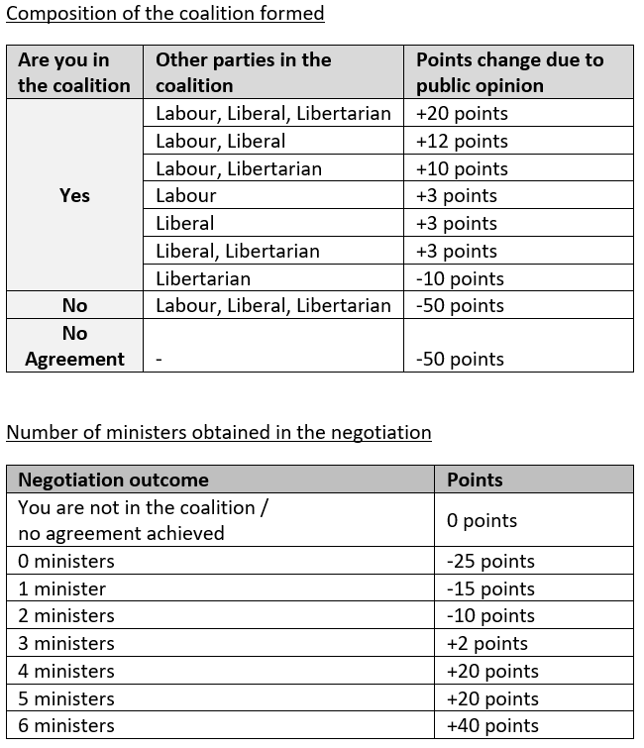
Conservative Party Payoffs
Supporters want a broad coalition with many parties
Wants 4 or more ministers given election victory
Failure to form a government or not being part of the governing coalition a disaster
Governing coalition with just the Libertarian party non-preferred due to poor relationship between the leaders
Notes:
First, the biggest party- the Conservatives, with a whopping 51 seats in the Augusta Parliament. Their voters want a broad coalition with many parties in order to hold on to power long term. Given the 51 seats in Parliament won in the last election, the Conservative party’s supporters expect 4 or more ministers. Failure to form a government or not even being a part of the governing coalition would be a disaster for the Conservatives. Given the animosity between their respective leaders, the party’s voters do not want a government with just the Conservatives and Libertarians, believing this will lead to a coalition that cannot govern effectively.
Quoting From the Conservative Party role:
As usual in recent elections, your party has received the largest number of seats in the Augusta Parliament – 51 seats. However, you still do not have an outright majority in the Parliament and must form a coalition with at least one additional party in order to govern. Your use-to-be political deputy and ally, now the head of the new Libertarian party, somehow managed to receive 14 seats in the elections. This is far more seats than you expected, and a result obtained mainly through attacking you personally in TV ads and hateful public speeches.
Following the elections, you conducted a survey among your voters and obtained the following insights:
Given your recent history as the ruling party in Augusta for the last few elections, your voters expect you to lead the discussions and form a wide-consensus government with a stable and functioning coalition.
The voters of the Conservative party believe that the key to staying in power for a long time is to form coalitions that are wide as possible (i.e., includes many political parties), allowing the Conservative party to serve as the balancing factor within the government.
Given the number of seats you have obtained, your voters want to see you have control over the actions of the government, expressed through the number of ministers you will have. They will not reward anything less than 4 ministers.
After many years in power your voters will not tolerate a government that is formed without you, or a no agreement situation.
The voters are concerned about the possibility of your forming a governing coalition with only the Libertarian party. They believe that this limited coalition will not be able to govern successfully, leading you to lose power in the next election.
Going into the negotiations in a strong position, you remain concerned about the possibility of the other three political parties forming a government without you. Although unlikely, there is still a chance of that happening, and your advisors urge you to be active in the first round of the negotiations and form strong alliances.

Slide 12
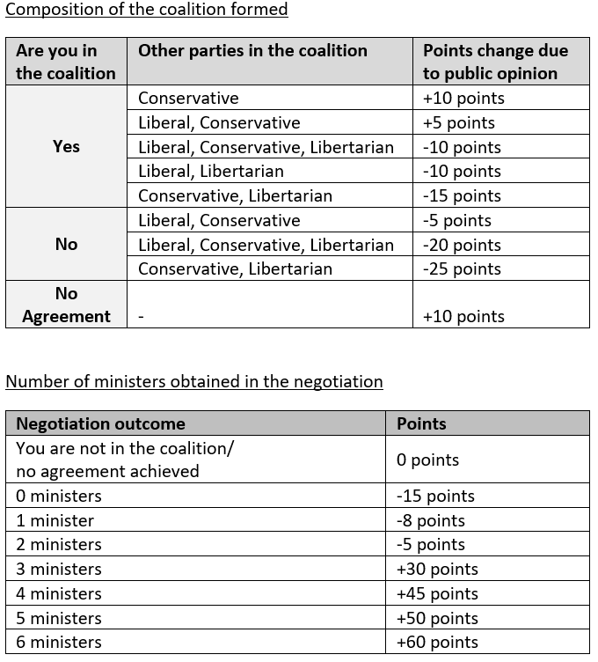
Labour Party Payoffs
If partner with the Conservative party, prefers the Liberals be left out so that Labour retains power
Do not want the Conservative party and the Libertarian party to form a coalition together
Do not want to work with the Libertarian party at all
Aim for at least 3 ministers
Notes:
The second biggest party is Labour. If they partner with the Conservative party, they prefer the Liberal party be left out so that Labour retains its power and voice in the government. Labour fears the Conservative party and the Libertarian party might form a right-wing coalition together. In addition, they do not want to govern together with the Libertarians themselves. Holding a solid 40 seats in the Parliament, Labour aims for at least 3 ministers.
Quoting from the Labour party role
The last election produced great results for your Labour party. Your party enjoyed a boost from the poor performance of the Liberal party in the last governing coalition, helping you achieve 40 seats in the Parliament as some previously Liberal voters switched to supporting Labour.
Following the elections, you conducted a survey of your voters and obtained the following insights:
You are constrained by what your voters prefer heading into the negotiations. Ideally, your voters would prefer that only you and the Liberal party form a coalition together. As this 2-party government is not viable (since you do not hold enough combined seats in Parliament), your voters’ desires leave you a very narrow area to navigate in. If in the end you form a government with the Conservative party, your voters will prefer the Liberal party be left out so that Labour retains its power and independent voice.
Your voters will strongly dislike it if the Conservative party and the Libertarian party form a coalition together without any Liberal party or Labour party presence to create a more centrist government.
Your voters will not appreciate it if you form a government with the Libertarian party unless you have a serious impact on the decisions made by that government (i.e., Labour receives many ministers).
After years of not being in power, your voters will value very much having impact on policy matters. They will punish you harshly if you fail to translate your electoral achievement to government ministers, in other words obtaining at least 3 ministers in the upcoming government.
Given all this and your absence from the last government, you know you need to find a way to be a part of this coalition and control enough ministers to give you real power. You are ready to take bold actions to try and form a coalition that will suit you. Going into the negotiations, your advisors urged you to be active and try to take initiative, rather than wait for offers and alliances to come to you.

Slide 13
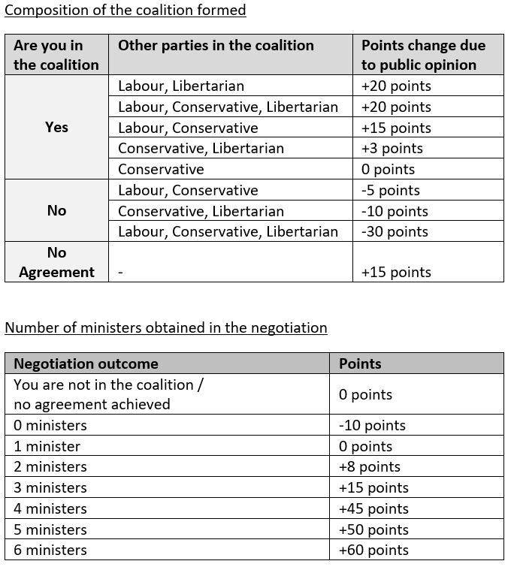
Liberal Party Payoffs
Prefer a wide coalition with many parties, especially Labour
Does not want to be left out of the governing coalition
Wants two or more ministers
Benefits from “no agreement” and new elections
Notes:
The Liberal party, with just 15 seats, would like to be part of a wide coalition that includes many parties. They would be especially excited to work with the likewise left-wing Labour party. They do not want to be left out of the governing coalition, but they could actually benefit from no government being formed and new elections being held. Labour aims for 2 or more ministers if they are part of the governing coalition.
Quoting from the Liberal party role:
The last election results were poor for your Liberal party, which suffered a big fall in public support leading to an all-time low of only 15 seats in Parliament. Given the extensive polling you have done, you link the voter dissatisfaction with the Liberal party with the fact that you were in the previous government with the Conservative party yet they controlled 5 of 6 ministers, allowing them to drive decision making and enforce a clear Conservative policy. Still, you personally remain respected among all players in the political system, and are considered to be an elder statesperson of Augusta.
Following the elections, you conducted a survey among your voters and obtained the following insights:
Due to your moderate political views and your unifying political persona, your voters will very much prefer if you are part of a wide coalition that includes many parties.
You would potentially benefit from a “no agreement” scenario in which no government (i.e., coalition of parties holding at least 61 seats) is formed. The latest polls indicate you will probably get a much better result if a new election were to take place, since the Labour and Conservative parties are perceived by many as too extreme to govern the great country of Augusta.
Given the loss of seats you suffered because of the previous, Conservative-dominated coalition government, your voters prefer a scenario that has you in the government together with the Labour party. This is to avoid being bullied for the entire term of the next coalition.
It is important to take into consideration that if a coalition government is formed with all the other parties and you are left outside, your voters will be very upset.
If a coalition government is formed without the Conservative party, your voters believe that you will have the upper hand because of your greater experience than the leaders of the Labour and Libertarian parties.
Discussing with your trusted advisors, you realize that although you obtained only 15 seats in the election, you are in quite a unique position going into this negotiation. The known animosity between the leaders of the Conservative and the Libertarian parties, the desire of the Labour party to be part of the government, and your centric position on the political board, makes your 15 seats a desired asset to any government. Although you are a small party who may not be able to dictate terms openly, you could be the queen or king maker, having points of connection with every party in the negotiation.
Also, your advisors remind you, don’t forget that a “no agreement” outcome is also a desirable outcome. New elections will likely lead to gains for your party, improving your political and negotiation position.
Your advisors urge you to leverage your position, understand the needs of the other parties coming into the negotiation, and form alliances starting from the first round of negotiations. “Don’t be afraid to play with various options to reach an optimal solution” your most trusted advisor told you before you left the room, “be the queen or king maker.”

Slide 14

Libertarian Party Payoffs
Would like to form a right wing government together with the Conservative leader, despite past personal conflicts
Do not want to work with the left wing Labour party
Aim for at least 1 minister
Benefit from “no agreement” and new elections being held
Notes:
With just 14 seats in Parliament, the Libertarians are the newest party and recently broke way from the Conservative party due to a personal conflict between their leaders. However, the Libertarian leader is willing to put the personal differences aside and form a right-wing government together with the Conservatives. However, the Libertarians do not want to form a coalition with the Labour party, who are at the opposite end of the political spectrum. The Libertarians aim for at least 1 minister if they are in the government. In the even no government is formed, the Libertarians could actually benefit from new elections, framing this as the faulty leadership of the established parties.
Quoting from Libertarian party role
This election was your first after you quit the Conservative party due to a personal conflict with its leader and formed your new Libertarian party. After all the pundits wondered whether you would even have enough votes to enter the Parliament, you finished the election night with a fantastic result of 14 seats! Your political advertisements and speeches legitimately questioning the credibility of the head of the Conservative party clearly resonated with the public.
Following the elections, you conducted a survey of your voters and obtained the following insights:
The ideal government, in the eyes of your voters, is a government consisting of you and the Conservative party alone. Only with this government do your voters feel that you can fulfil a true conservative agenda, as promised in your campaign.
Your voters strongly resent the Labour party due to their left-wing economic agenda. It will be hard to “sell them” a coalition government including the Labour party unless you obtain a highly favourable outcome in terms of the number of ministers you control.
If a government is not formed during these negotiations (i.e., no agreement is reached), you could spin this off in the media as another example of the faulty leadership of the Conservative party, and potentially obtain even more seats in the new elections that would be held.
You have met with your most trusted advisors to analyse the survey results and strategize for the coming negotiation. Given your past history with the head of the Conservative party, you believe they will prefer not to have you in their governing coalition as a sole partner. Therefore, you need to strive and create alliances with other political parties during the negotiations. As a new political party, your ultimate objective is to be a meaningful part of the government with a real voice and decision power. You know you do not have a lot of options going into the negotiation, and you are willing to try and make bold moves with the Liberal party or even with the Labour party to create coalitions that will address your supporters’ needs.
At the same time, your advisors have reminded you not to forget that “no agreement” and holding new elections is in fact an excellent outcome for your Libertarian party. Thus, you are strongly motivated to stop a coalition that does not include you from forming, or a coalition that includes you but in a weak position with no voice.
“Be bold!”, your closest advisor tells you. “You are part of the grown-up table now, show that you belong.”

Slide 15
A few potential alliances and coalitions
Notes:
Let me share just a few of the many examples of alliances and coalitions that might emerge in the Augusta role play.

Slide 16
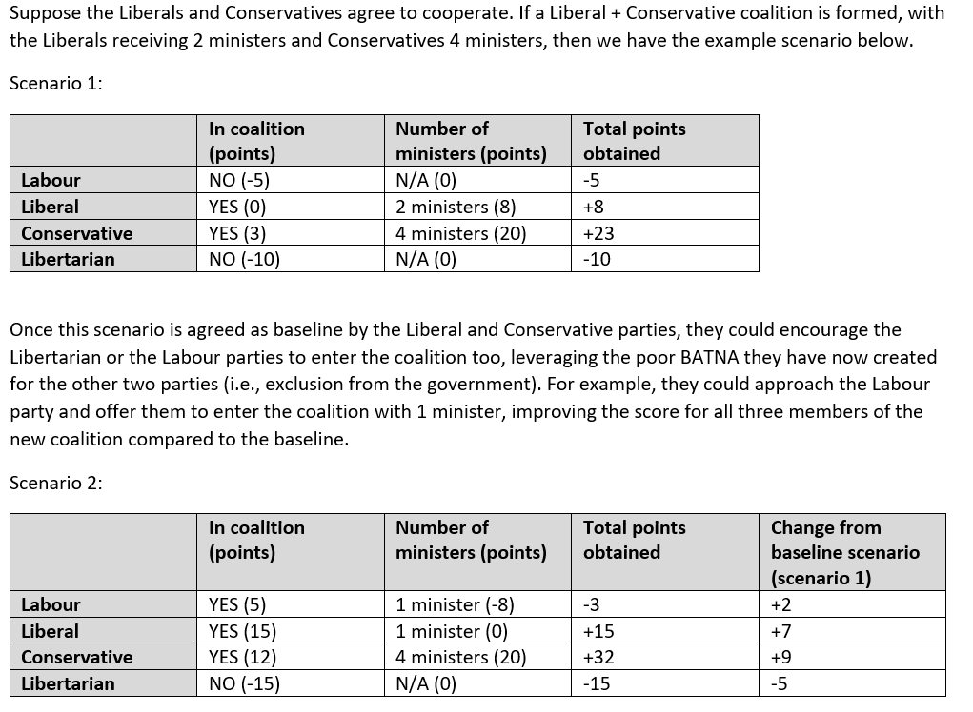
Notes:
Suppose the Liberals and Conservatives agree to cooperate. If a Liberal + Conservative coalition is formed, with the Liberals receiving 2 ministers and Conservatives 4 ministers, then we have this scenario, with the Labour and Libertarian parties cut out of the deal and receiving negative points.

Slide 17
Notes:
Once this scenario is agreed as baseline by the Liberal and Conservative parties, they could encourage the Libertarian or the Labour parties to enter the coalition too, leveraging the poor BATNA they have now created for the other two parties (i.e., exclusion from the government). For example, they could approach the Labour party and offer them to enter the coalition with 1 minister, improving the score for all three members of the new coalition compared to the baseline. Now Labour has a positive score and the Liberal and Conservative parties have even more positive scores.

Slide 18
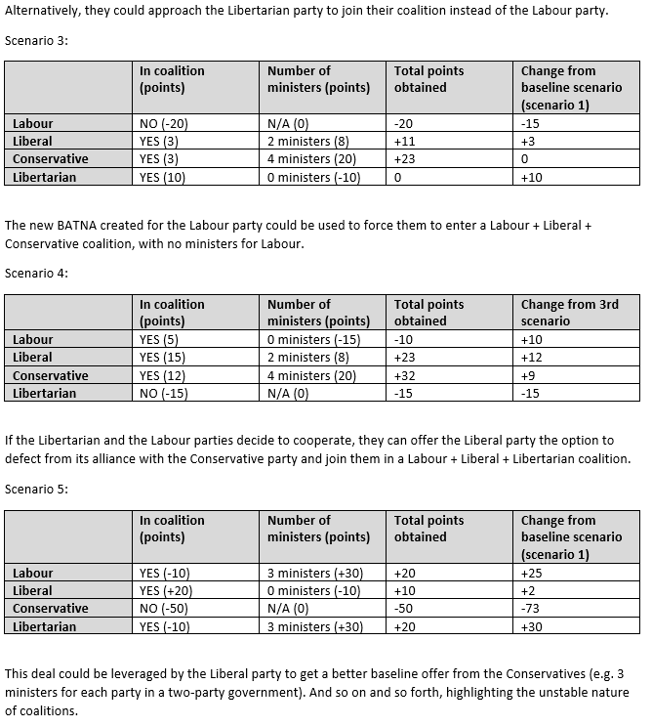
Notes:
Alternatively, the Liberal and Conservative parties could approach the Libertarian party to join their coalition instead of the Labour party, as shown here.

Slide 19
Notes:
The new, deteriorated Best Alternative to a Negotiated Agreement or BATNA) created for the Labour party could be used to force them to enter a Labour + Liberal + Conservative coalition, with no ministers for Labour.
Such dynamic BATNAs that change in light of emerging coalitions are a key properly of many complex multi-party negotiations.
This example also illustrates the principle of forming early alliances in coalition situations. An early alliance can change the alternatives of the counterparts– now they may need to join your coalition or be excluded from the deal entirely. If the Conservatives and Liberals form an early alliance, they can easily extract concessions from Labour or the Libertarians to join the government late in the game.

Slide 20
Notes:
If the Libertarian and the Labour parties decide to cooperate, they can offer the Liberal party the option to defect from its alliance with the Conservative party and join them in a Labour + Liberal + Libertarian coalition.
This deal could be leveraged by the Liberal party to get a better baseline offer from the Conservatives (e.g. 3 ministers for each party in a two-party government). And so on and so forth, highlighting the unstable and instrumental nature of coalitions.
When alternatives are dynamic, aspirations must be so as well. You might enter the negotiation confident and aiming for many ministers. Then as a coalition forms against you and is poised to exclude you, you might lower your aspirations and put a value proposition to one or more opposing parties to switch sides and form a government with you instead. That’s a rational response to your alternative shifting and becoming far more negative than before.

Slide 21
Summary table of the previous scenarios
 | Labour | Liberal | Conservative | Libertarian
Scenario 1 | -5 | +8 | +23 | -10
Scenario 2 | -3 | +15 | +32 | -15
Scenario 3 | -20 | +11 | +23 | 0
Scenario 4 | -10 | +23 | +32 | -15
Scenario 5 | +20 | +10 | -50 | +20
Numerous potential outcomes exist in the Augusta case,
with no clear optimal solution
Notes:
This table summarizes the five example scenarios I just summarized, which are just a few of many possible outcomes.
Numerous potential outcomes exist in the Augusta case, with no clear optimal solution that maximizes value for everyone while hurting no one.

Slide 22
What type of deal did you reach? How did you divide the ministers between you?
No government
All four parties
Conservative-Libertarian
Labour-Liberal-Conservative
Labour-Conservative
Liberal-Conservative
Liberal-Conservative-Libertarian
Labour-Liberal-Libertarian
Labour-Conservative-Libertarian
Notes:
Time to share your results! [Instructor presents results for the class using the excel results sheet, which automatically calculates points based on coalition agreements and numbers of ministers for each party]. Please raise your hand if you’d like to share what happened in your group, or have a question about how another group arrived at their results. [Students discuss the negotiation outcomes as a class].

Slide 23
Which country is Augusta?
Notes:
Augusta is based on historical events. Can anyone guess which country is the real Augusta? [Students try to guess].

Slide 24

Which country is Augusta?
Notes:
Augusta is many places and people, capturing coalition dynamics seen across the world and throughout history.
Source of photo (open source, creative commons)
https://www.publicdomainpictures.net/en/view-image.php?image=86447&picture=planet-earth

Slide 25
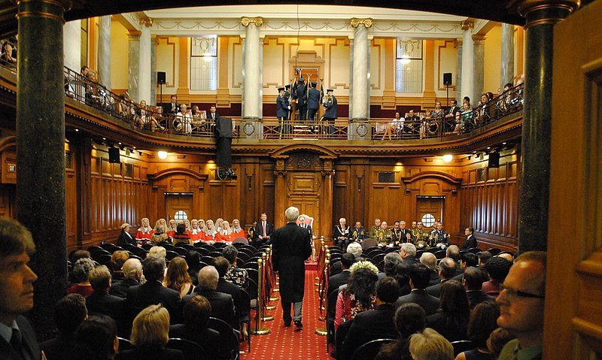
New Zealand
Notes:
You find coalition dynamics in every corner of the world, for example in New Zealand.
Source of photo (open source, creative commons)
https://commons.wikimedia.org/wiki/File:Gg-state-opening-parliament-2011-008.jpg

Slide 26
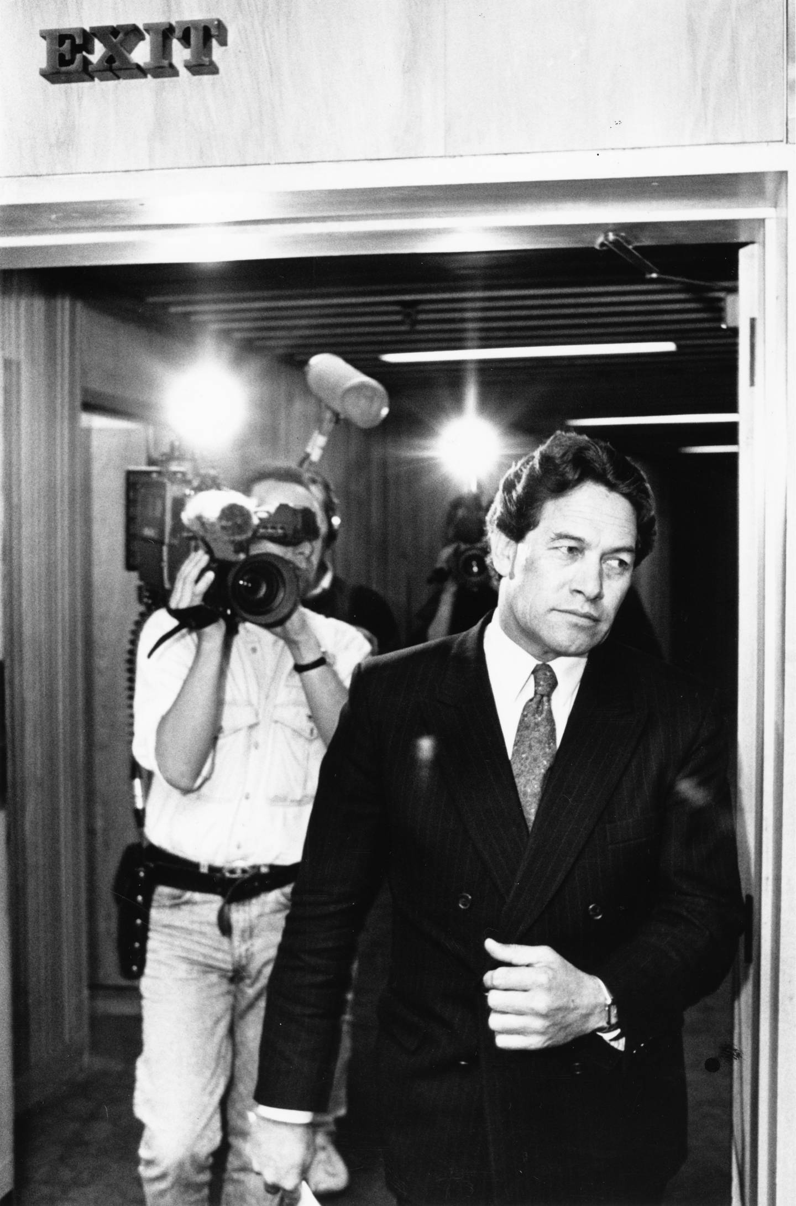
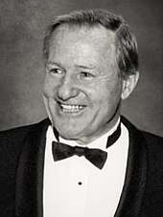
Jim Bolger, Prime Minister of New Zealand and leader of the conservative National Party, fires former political ally MP Winston Peters from the cabinet
Rebellious MP Winston Peters after being fired from the National caucus (October 1992)
Notes:
Let’s go back to 1992. Jim Bolger, the Prime Minister of New Zealand and leader of the conservative National Party, fires his former political ally and Member of Parliament Winston Peters. Here we see Winston after being thrown out of the government.
*Source of photos:
https://en.wikipedia.org/wiki/Winston_Peters#/media/File:Bolger,_1992.jpg
https://www.nzherald.co.nz/nz/the-big-read-winston-peters-the-kingmaker/V67PNQ3AERRUJVPD5J6U66HRGY/
SUPPORTING LINKS
https://www.nzherald.co.nz/nz/new-zealand-first-party-leader-winston-peters-how-the-kingmaker-could-become-pm/I32KLXWNXTZZGNYKEFKRAY4OIY/
https://thespinoff.co.nz/politics/04-10-2020/the-boxer-and-the-towel-a-short-history-of-winston-peters-politician/
https://liberation.typepad.com/liberation/2008/11/nz-first-party-history-2-fourth-national-govt-expulsion.html
https://www.nzherald.co.nz/nz/winstons-first-fifteen/Q55GGPEQLAQA5UMXPVFZDGEOKY/
Hames, M. (1995). Winston First: The Unauthorised Account of Winston Peters' Career. Auckland: Random House New Zealand.
https://books.google.com.sg/books?id=5V9JAQAACAAJ&redir_esc=y
Wishart, I. (2014). Winston: The Story of a Political Phenomenon (1st ed.). Auckland: Howling at the Moon Publishing.
https://books.google.com.sg/books?id=MMfUoQEACAAJ&redir_esc=y

Slide 27
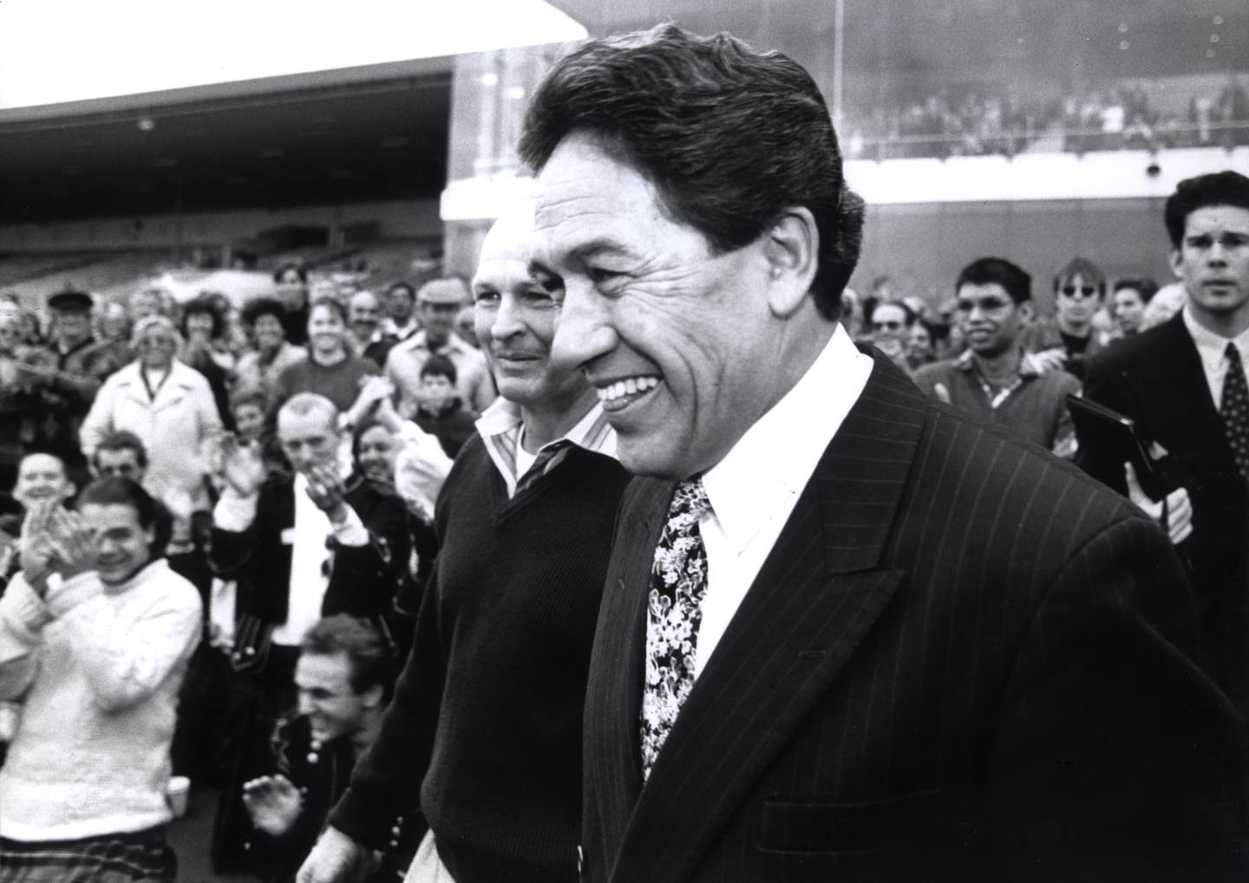
In 1993, Winston launches his populist party New Zealand First at a racetrack
Notes:
The next year, Winston launched his new political party, New Zealand First, at a racetrack.
*Source of photo
https://www.nzherald.co.nz/nz/the-big-read-winston-peters-the-kingmaker/V67PNQ3AERRUJVPD5J6U66HRGY/
Alternative photo source
https://www.nzherald.co.nz/nz/winstons-first-fifteen/Q55GGPEQLAQA5UMXPVFZDGEOKY/
SUPPORTING LINKS
https://www.newsroom.co.nz/2017/07/29/40392/reading-the-tea-leaves-from-1996
https://www.parliament.nz/resource/en-NZ/00PLLawRP99111/4d5c2cf501956d02710301e0b3284ae8bc5758f7
Hames, M. (1995). Winston First: The Unauthorised Account of Winston Peters' Career. Auckland: Random House New Zealand.
https://books.google.com.sg/books?id=5V9JAQAACAAJ&redir_esc=y
Wishart, I. (2014). Winston: The Story of a Political Phenomenon (1st ed.). Auckland: Howling at the Moon Publishing.
https://books.google.com.sg/books?id=MMfUoQEACAAJ&redir_esc=y

Slide 28

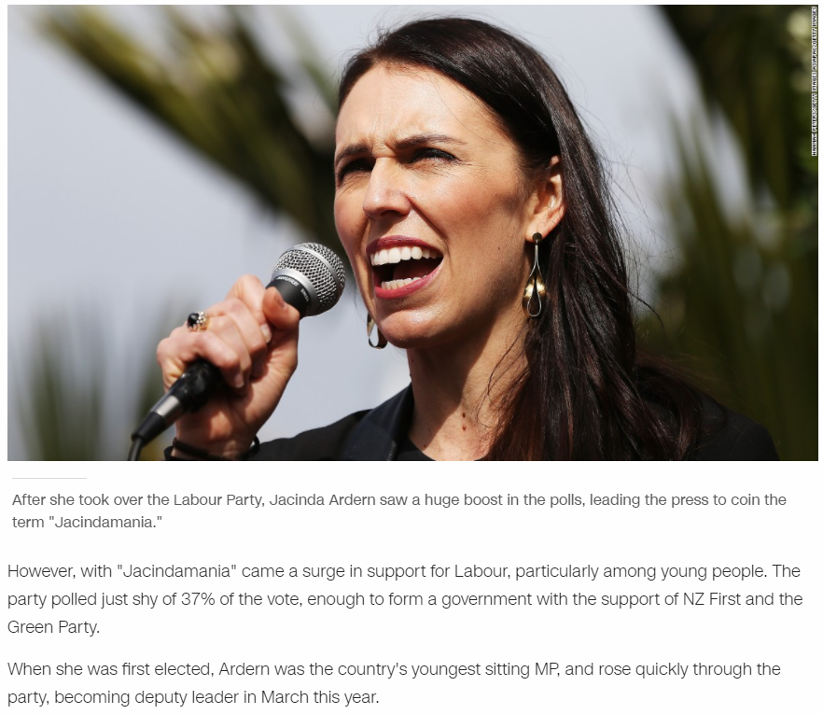
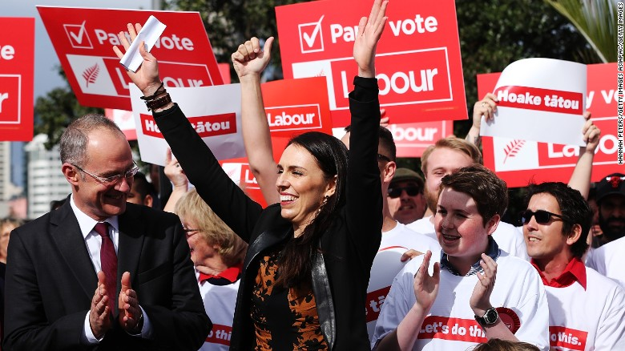
National party wins the 2017 election, but Labour leader Jacinda Ardern builds a coalition of smaller parties
Notes:
Now let’s flash-forward to 2017, when New Zealand Labour politician Jacinda Ardern rose to power by building a wide-ranging coalition.
*Source of photo:
https://edition.cnn.com/2017/10/19/asia/new-zealand-election/index.html
SUPPORTING INFORMATION
Ardern and Davis to lead Labour negotiating team
https://www.rnz.co.nz/news/political/340286/ardern-and-davis-to-lead-labour-negotiating-team
NZ First talks with National, Labour begin
https://www.stuff.co.nz/national/politics/97564343/nz-first-talks-with-national-labour
Jacinda Ardern: Who is New Zealand's next prime minister?
https://www.abc.net.au/news/2017-10-19/jacinda-ardern-who-is-new-zealands-next-prime-minister/9067330
New PM Jacinda Ardern joins an elite few among world, NZ leaders
https://web.archive.org/web/20171026033659/http://www.newshub.co.nz/home/politics/2017/10/new-pm-jacinda-ardern-joins-an-elite-few-among-world-nz-leaders.html
Green Party ratifies confidence and supply deal with Labour - NZ Herald
https://www.nzherald.co.nz/nz/green-party-ratifies-confidence-and-supply-deal-with-labour/QOR4ECRXQLZ2HEB6AQ7S6NUVNY/
Jacinda Ardern reveals ministers of new government
https://www.nzherald.co.nz/nz/jacinda-ardern-reveals-ministers-of-new-government/URWMRXTQ6RQI7M3MHHMRCKRQF4/
New government ministers revealed | RNZ News
https://www.rnz.co.nz/news/political/342329/new-government-ministers-revealed
New Zealand: Jacinda Ardern to become Prime Minister – CNN
https://edition.cnn.com/2017/10/19/asia/new-zealand-election/index.html

Slide 29
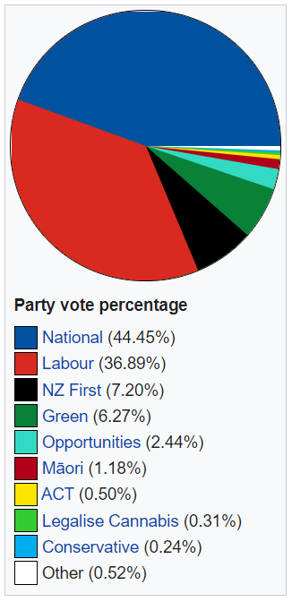
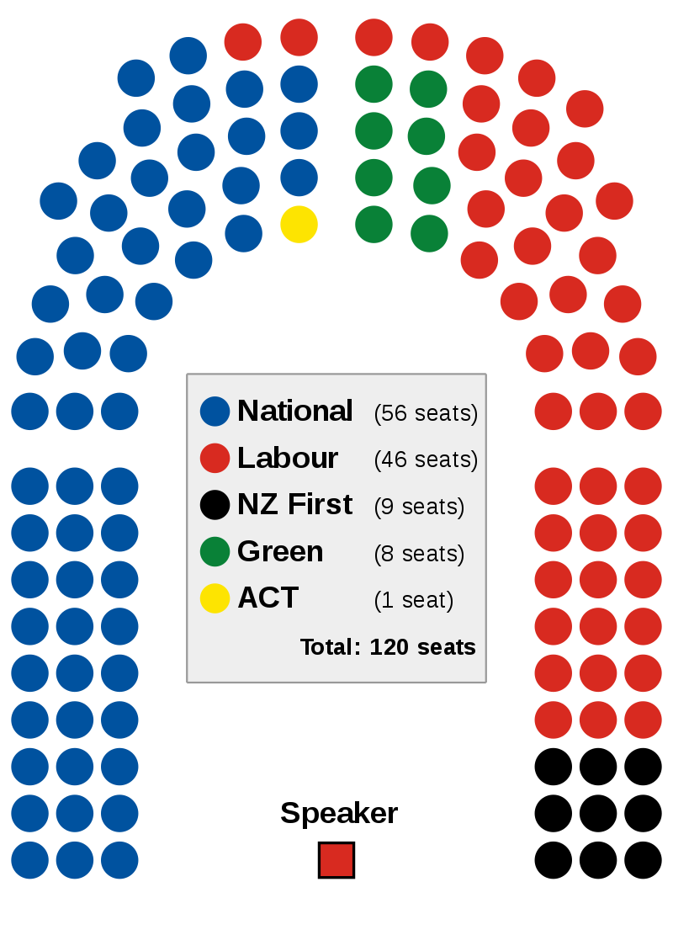
Notes:
Here are the 2017 election results. National won 45% of the party vote to Labour’s 37%, a clear victory. But a small but crucial minority of seats are held by New Zealand first, with 9 seats, and the Greens with 8.
*Source of photos:
https://en.wikipedia.org/wiki/2017_New_Zealand_general_election
https://en.wikipedia.org/wiki/2017_New_Zealand_general_election#/media/File:New_Zealand_Parliament_Lab-NZF_coalition_seating_plan,_2017.svg
Legalise Cannabis got only one third of a percentage of the vote, so they sadly don’t get a seat in parliament.
SUPPORTING INFORMATION
https://en.wikipedia.org/wiki/2017_New_Zealand_general_election

Slide 30
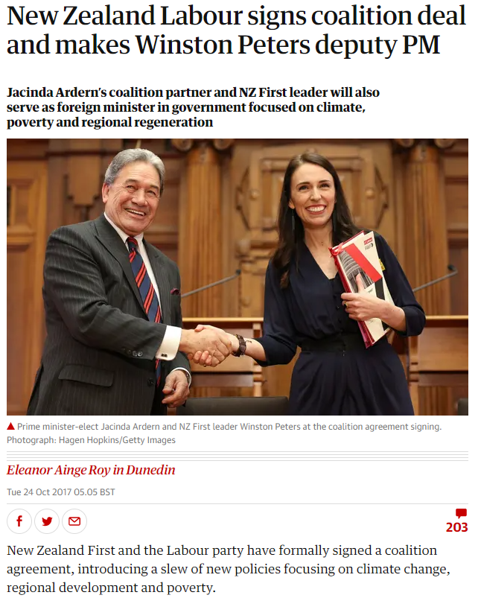
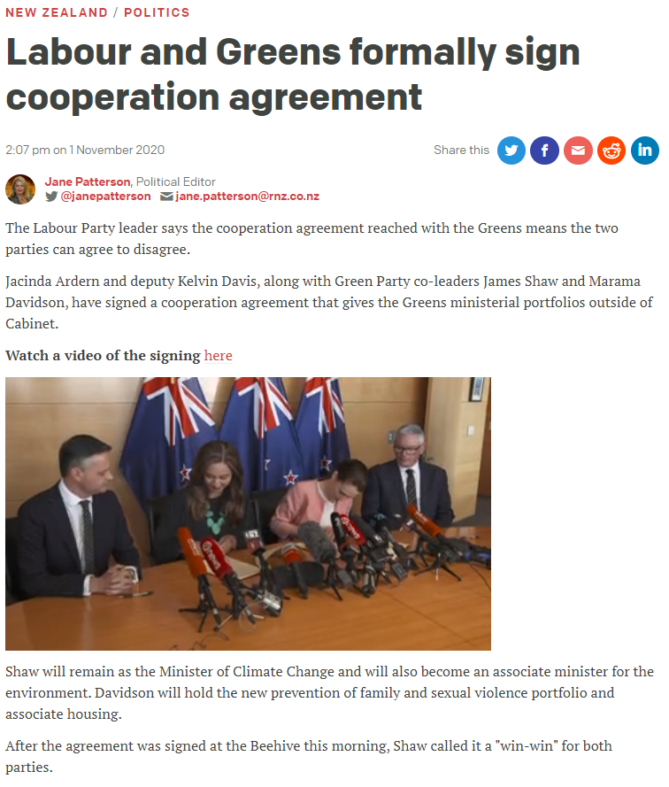
Notes:
Even though the conservative National party got the most votes and hence the most seats in parliament, Ardern cut them out of the government by forming a partnership with Winston’s small New Zealand First party as well as the even smaller Green party led by Marama Davidson. In the terms of the Augusta case, she built a “Liberal-Labour-Libertarian” coalition of the weaker players, with the “Conservatives” not in the government at all.
She successfully split the conservative coalition between the National and NZ first parties, which had previously formed a government together, making the better offer. Winston became her deputy PM. Look at his face! I’d be happy too. Weaker parties can get a great deal in coalition negotiations if they are in the queenmaker or kingmaker position and part of the winning coalition.
*Source of photos:
https://www.theguardian.com/world/2017/oct/24/new-zealand-kingmaker-winston-peters-deputy-prime-minister-foreign
https://www.rnz.co.nz/news/national/429597/labour-and-greens-formally-sign-cooperation-agreement
SUPPORTING INFORMATION
New Zealand Labour signs coalition deal and makes Winston Peters deputy PM
https://www.theguardian.com/world/2017/oct/24/new-zealand-kingmaker-winston-peters-deputy-prime-minister-foreign
Jacinda Ardern is next prime minister of New Zealand, Winston Peters confirms – as it happened
https://www.theguardian.com/world/live/2017/oct/19/new-zealand-election-winston-peters-prime-minister-bill-english-jacinda-ardern-live
New Zealand Greens accept Ardern's offer of 'cooperation agreement'
https://www.theguardian.com/world/2020/oct/31/new-zealand-greens-accept-arderns-offer-of-cooperation-agreement
NZ First, Green Party, Labour coalition deals revealed
https://www.stuff.co.nz/national/politics/98170259/nz-prime-minister-elect-jacinda-ardern-reveals-cost-of-coalition
Labour and Greens formally sign cooperation agreement
https://www.rnz.co.nz/news/national/429597/labour-and-greens-formally-sign-cooperation-agreement
Marama Davidson
https://www.teaomaori.news/election/candidates/marama-davidson

Slide 31
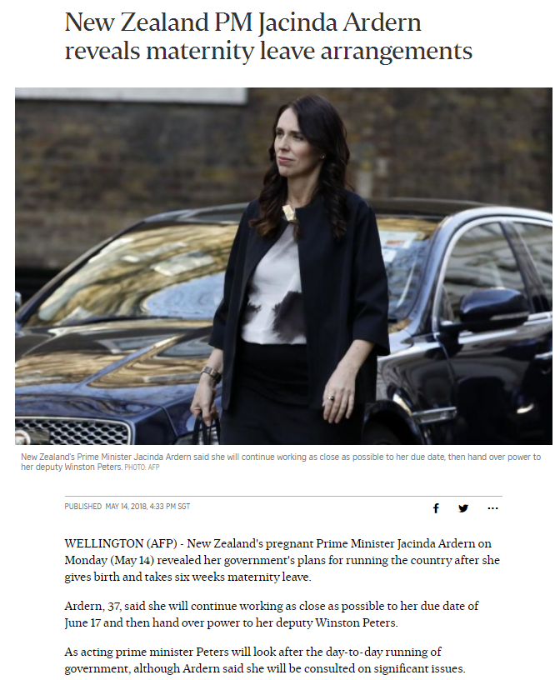
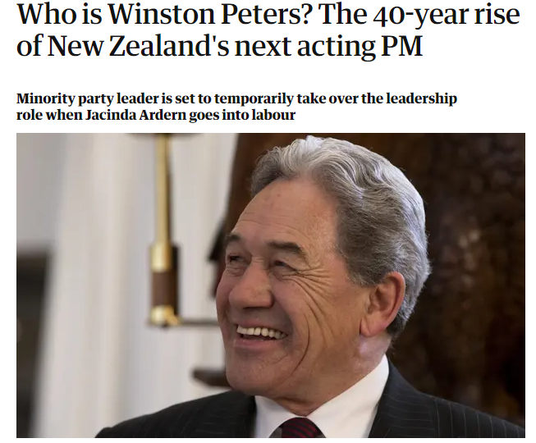
Winston gets to be acting prime minister
for 6 weeks while Ardern on maternity leave
Notes:
Winston even got to be acting Prime Minister for 6 weeks in 2018 while Ardern was on maternity leave.
*Source of photos:
https://www.straitstimes.com/asia/australianz/new-zealand-pm-jacinda-ardern-reveals-maternity-leave-arrangements
https://www.theguardian.com/world/2018/jun/16/who-is-winston-peters-the-40-year-rise-of-new-zealands-next-acting-pm
SUPPORTING INFORMATION
https://www.straitstimes.com/asia/australianz/new-zealand-pm-jacinda-ardern-reveals-maternity-leave-arrangements
https://www.theguardian.com/world/2018/jun/16/who-is-winston-peters-the-40-year-rise-of-new-zealands-next-acting-pm

Slide 32
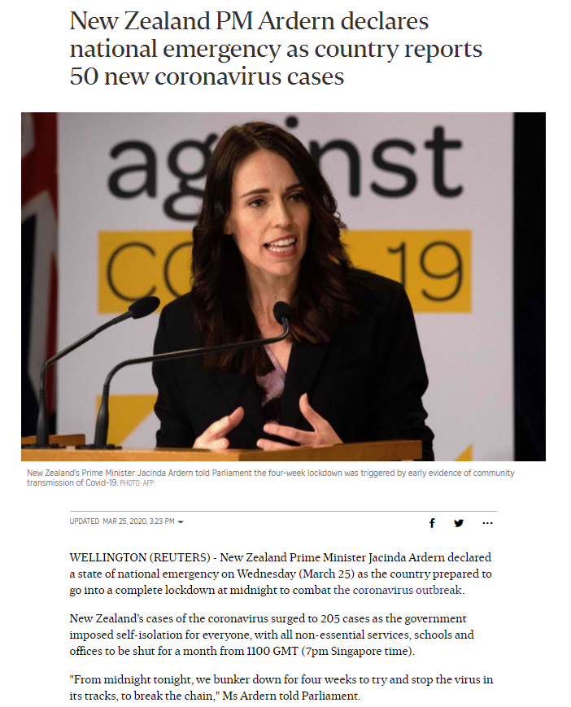
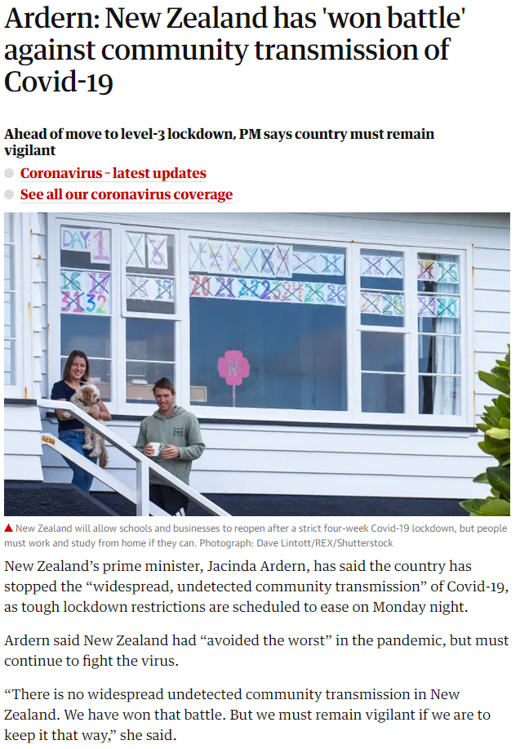
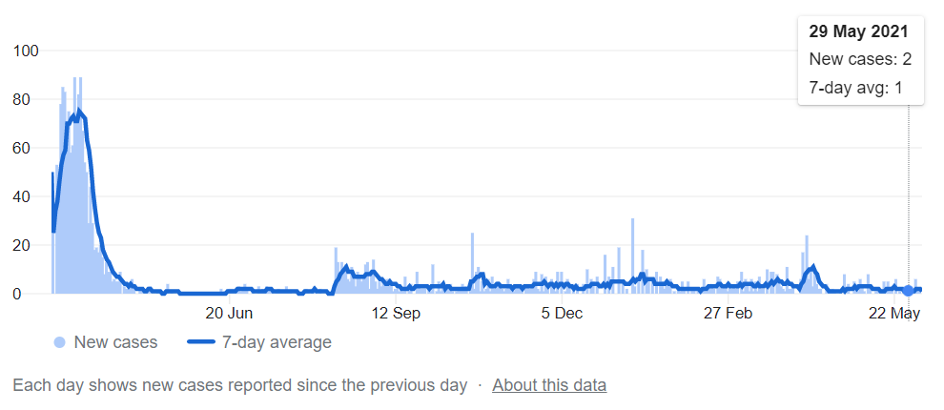
Notes:
Shortly after, Ardern led her government to a historic success combating the COVID-19 pandemic, further cementing her legitimacy and political support.
*Source of photos:
https://www.straitstimes.com/asia/australianz/new-zealand-pm-ardern-declares-national-emergency-as-country-reports-47-new
https://www.theguardian.com/world/2020/apr/27/new-zealand-prepares-to-lift-strict-lockdown-after-eliminating-coronavirus
SUPPORTING INFORMATION
New Zealand PM Ardern declares national emergency as country reports 50 new coronavirus cases
https://www.straitstimes.com/asia/australianz/new-zealand-pm-ardern-declares-national-emergency-as-country-reports-47-new
New Zealand PM Ardern declares state of emergency to tackle coronavirus
https://www.channelnewsasia.com/news/world/new-zealand-state-emergency-covid19-coronavirus-jacinda-ardern-12573536
Ardern declares victory against spread of coronavirus
https://www.straitstimes.com/asia/australianz/ardern-declares-victory-against-spread-of-virus
Jacinda Ardern Sold a Drastic Lockdown With Straight Talk and Mom Jokes
https://www.nytimes.com/2020/05/23/world/asia/jacinda-ardern-coronavirus-new-zealand.html
New Zealand Lifts Lockdown as It Declares Virus Eliminated, for Now
https://www.nytimes.com/2020/06/08/world/australia/new-zealand-coronavirus-ardern.html
Ardern: New Zealand has 'won battle' against community transmission of Covid-19
https://www.theguardian.com/world/2020/apr/27/new-zealand-prepares-to-lift-strict-lockdown-after-eliminating-coronavirus
https://www.google.com/search?q=covid+new+zealand+2021&rlz=1C1JZAP_enSG903SG904&oq=covid+new+zealand+2021&aqs=chrome..69i57j0i22i30l9.3813j0j4&sourceid=chrome&ie=UTF-8

Slide 33
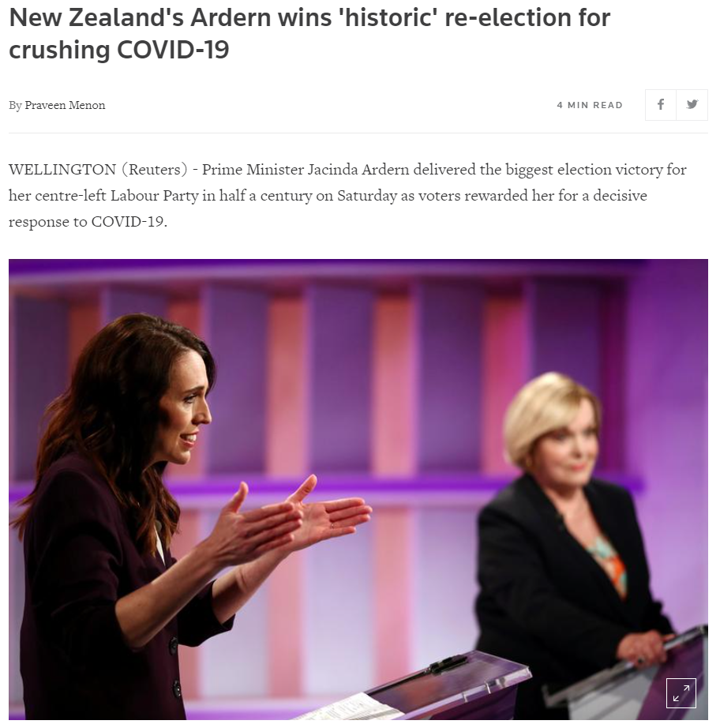
In 2020, Labour won an outright majority (65 seats of 120), and a plurality of the party vote in 72 of 73 New Zealand electorates
The second-worst result ever for the National Party
Notes:
In the 2020 election, her Labour party won an outright majority of Parliament seats – 65 of 120 seats – and the plurality of the party vote in 72 of 73 electorates. The 2020 election was also historic for her rivals the conservative National party, their second-worst result ever.
*Source of photo:
https://www.reuters.com/article/uk-newzealand-election-idUSKBN2712ZI
SUPPORTING INFORMATION
New Zealand's Ardern wins 'historic' re-election for crushing COVID-19
https://www.reuters.com/article/uk-newzealand-election-idUSKBN2712ZI
Two routes to precarious success: Australia, New Zealand, COVID-19 and the politics of crisis governance
https://journals.sagepub.com/doi/full/10.1177/0020852320972465
Policy and institutional responses to COVID-19: New Zealand
https://www.brookings.edu/research/policy-and-institutional-responses-to-covid-19-new-zealand/
New Zealand's Covid-19 response the best in the world, say global business leaders
https://www.theguardian.com/world/2020/oct/08/new-zealands-covid-19-response-the-best-in-the-world-say-global-business-leaders
New Zealand urged 'don't let virus divide you' as Covid frustration builds
https://www.theguardian.com/world/2021/mar/02/new-zealand-urged-dont-let-virus-divide-you-as-covid-frustration-builds
Beating the virus: an examination of the crisis communication approach taken by New Zealand Prime Minister Jacinda Ardern during the Covid-19 pandemic
https://www.tandfonline.com/doi/full/10.1080/13678868.2020.1779543
New Zealand’s Prime Minister May Be the Most Effective Leader on the Planet
https://www.theatlantic.com/politics/archive/2020/04/jacinda-ardern-new-zealand-leadership-coronavirus/610237/
Discover the Crisis Leadership Tactics New Zealand Used to Crush the Coronavirus
https://sites.utexas.edu/itsyourcareer/discover-the-crisis-leadership-tactics-new-zealand-used-to-crush-the-coronavirus/
The Land of the Long White Cloud: Turning New Zealand’s Recovery into Sustained Growth
https://www.imf.org/en/News/Articles/2021/05/25/na052521-the-land-of-the-long-white-cloud-turning-new-zealands-recovery-into-sustained-growth
New Zealand isn't just flattening its coronavirus curve. It's squashing it
https://www.washingtonpost.com/world/asia_pacific/new-zealand-isnt-just-flattening-the-curve-its-squashing-it/2020/04/07/6cab3a4a-7822-11ea-a311-adb1344719a9_story.html
Election 2020: Jacinda Ardern claims biggest Labour victory in 50 years
https://www.stuff.co.nz/national/politics/300135131/election-2020-jacinda-ardern-claims-biggest-labour-victory-in-50-years

Slide 34
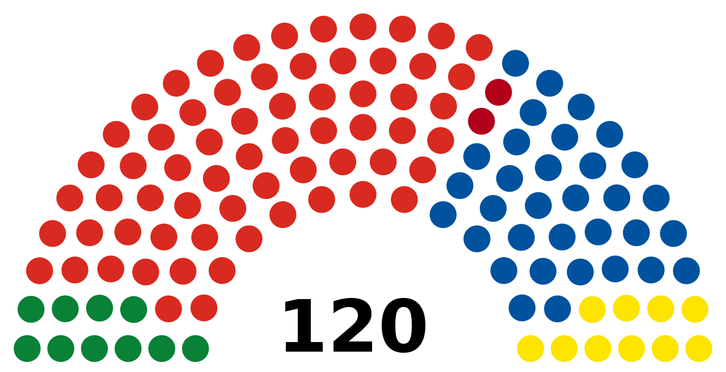
Notes:
Here are the 2020 election results.
*Source of photo:
https://en.wikipedia.org/wiki/2020_New_Zealand_general_election#/media/File:NZ_House_2020.svg
SUPPORTING INFORMATION
https://en.wikipedia.org/wiki/2020_New_Zealand_general_election
https://en.wikipedia.org/wiki/2020_New_Zealand_general_election#/media/File:NZ_House_2020.svg

Slide 35
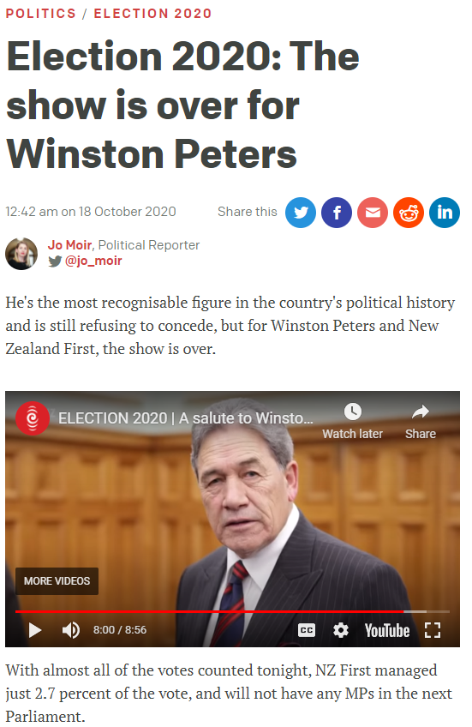
Notes:
Winston Peters’ NZ First party didn’t win any seats and is out of the government again. Note that Ardern didn’t cut him out of the coalition, the New Zealand voters did.
*Source of photo:
https://www.rnz.co.nz/news/political/428594/election-2020-the-show-is-over-for-winston-peters
SUPPORTING INFORMATION
Election 2020: The show is over for Winston Peters
https://www.rnz.co.nz/news/political/428594/election-2020-the-show-is-over-for-winston-peters
Kingmaker no more: Winston Peters consigned to NZ political history
https://www.theguardian.com/world/2020/oct/17/kingmaker-no-more-winston-peters-consigned-to-nz-political-history

Slide 36
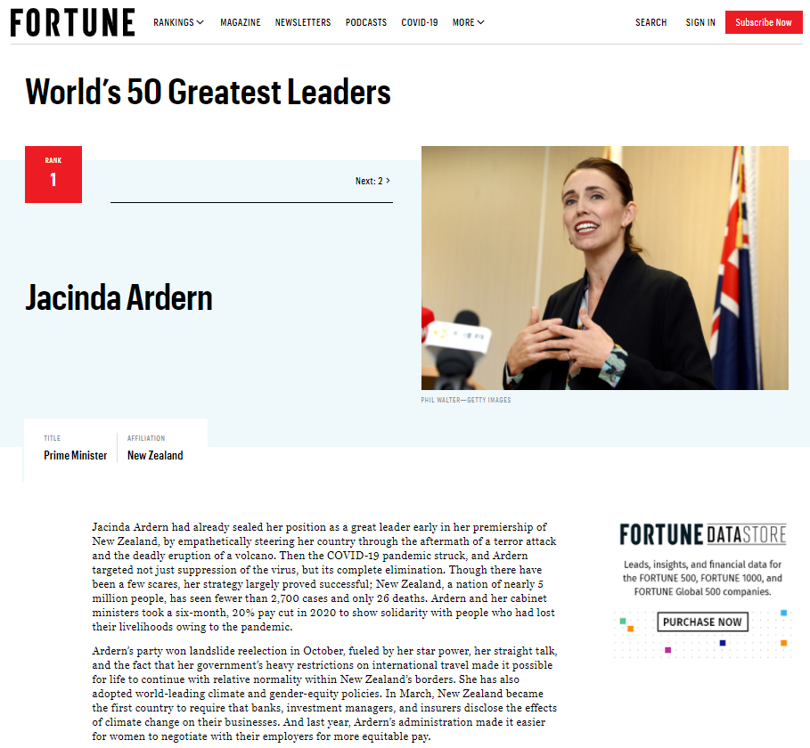
Notes:
In 2021, Fortune magazine named Ardern the world’s top leader.
*Source of photo
https://fortune.com/ranking/worlds-greatest-leaders/2021/jacinda-ardern/
SUPPORTING INFORMATION
Prime Minister Jacinda Ardern tops Fortune magazine's world's greatest leaders list
https://www.stuff.co.nz/national/politics/125132824/prime-minister-jacinda-ardern-tops-fortune-magazines-worlds-greatest-leaders-list
Jacinda Ardern | Fortune
ps://fortune.com/worlds-greatest-leaders/2021/jacinda-ardern/

Slide 37
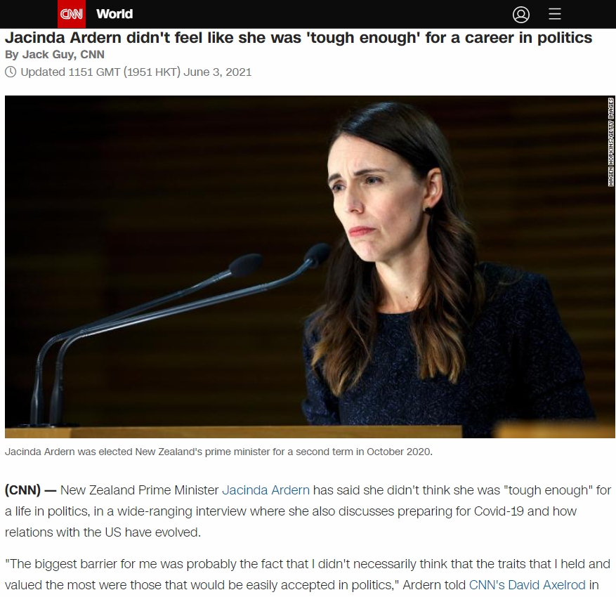
Notes:
A lot of people feel uncomfortable with multi-party coalition situations, feeling– sometimes correctly– that they promote win-lose or even ethically compromised tactics that are inconsistent with their personality and values. Interesting, Ardern was initially one of them. Her case shows different kinds of people and approaches can succeed in building coalitions.
*Source of photo
https://edition.cnn.com/2021/06/03/asia/axe-files-jacinda-ardern-interview-scli-intl/index.html
SUPPORTING INFORMATION
Jacinda Ardern didn't feel like she was 'tough enough' for politics - CNN
https://edition.cnn.com/2021/06/03/asia/axe-files-jacinda-ardern-interview-scli-intl/index.html
New Zealand Prime Minister Jacinda Ardern breaks the mould of 'thick-skinned' politicians
https://www.abc.net.au/news/2021-06-04/jacinda-ardern-thought-she-was-not-tough-enough-for-politics/100190510

Slide 38
“I didn't know that I was tough enough for politics. I had it in my head… that you had to be quite thick skinned — you certainly can't be the emotional type. My advice would be: do not change yourself, do not think that to succeed you have to fit the mould of what you see around you… And perhaps in doing so you might better reflect a whole other part of society that hasn't felt reflected or seen in that place.”
--Jacinda Ardern, Prime Minister
of New Zealand, 2021
Notes:
A quote from Ardern. [Instructor reads quote above].
The Augusta case was about political coalitions, but many of the same dynamics and points apply to workplace politics and workplace coalitions.
SUPPORTING INFORMATION
Jacinda Ardern didn't feel like she was 'tough enough' for politics - CNN
https://edition.cnn.com/2021/06/03/asia/axe-files-jacinda-ardern-interview-scli-intl/index.html
New Zealand Prime Minister Jacinda Ardern breaks the mould of 'thick-skinned' politicians
https://www.abc.net.au/news/2021-06-04/jacinda-ardern-thought-she-was-not-tough-enough-for-politics/100190510
Quote: "I didn't know that I was tough enough for politics," she said.
Since her appointment as New Zealand's prime minister, Ms Ardern has led her country through natural disasters, a terrorist attack and the COVID pandemic. "I had it in my head, for good reason, that you had to be quite thick skinned — you certainly can't be the emotional type," she said. "That assumes that all political leaders need to be really thick skinned, that it's not OK to be a sensitive person in politics.“ …"My advice would be: do not change yourself, do not think that to succeed you have to fit the mould of what you see around you … And perhaps in doing so you might better reflect a whole other part of society that hasn't felt reflected or seen in that place."
Further Jacinda Ardern quotes:
https://www.independent.co.uk/life-style/women/jacinda-ardern-quotes-christchurch-shooting-coronavirus-motherhood-a9634056.html
“To me, leadership is not about necessarily being the loudest in the room, but instead being the bridge, or the thing that is missing in the discussion and trying to build a consensus from there.”
“I do find it difficult. I go through the exact same emotion any other parent does when I’m away from her for a period of time... The guilt of whether or not I’m a good enough daughter, sister, partner, mother – show me a woman who doesn’t.”
“I am not the first woman to multitask. I am not the first woman to work and have a baby – there are many women who have done this before.”
Chapman, M. (2020). Jacinda Ardern: A New Kind of Leader. Stroud, United Kingdom: The History Press Ltd.
https://www.bookdepository.com/Jacinda-Ardern-Madeleine-Chapman/9780750996068?redirected=true&utm_medium=Google&utm_campaign=Base2&utm_source=SG&utm_content=Jacinda-Ardern&selectCurrency=SGD&w=AF7JAU9S67BR4UA8VRZL&pdg=pla-824982385150:cmp-6485098310:adg-77818344677:crv-381246268071:pos-:dev-c&gclid=EAIaIQobChMIvfjSkbOO8QIVuoNLBR23dQP-EAQYAyABEgKZU_D_BwE
Duff, M. (2019). Jacinda Ardern: The Story Behind an Extraordinary Leader. Allen & Unwin. https://www.amazon.com/Jacinda-Ardern-Behind-Extraordinary-Leader-ebook/dp/B07Y7R3L5J
I Know This to Be True: Jacinda Ardern on Kindness, Empathy and Strength
https://www.fishpond.com.sg/Books/I-Know-This-to-Be-True-Nelson-Mandela-Foundation/9781990003035?utm_source=googleps&utm_medium=ps&utm_campaign=SG&gclid=EAIaIQobChMIvfjSkbOO8QIVuoNLBR23dQP-EAQYAiABEgIfkPD_BwE

Slide 39
Notes:
Note: Blank divider slide

Slide 40
Option 1 for quotes about workplace politics: book authors

Slide 41
Coalitions in Workplaces
“If you want to work in corporate, then you should know how to play chess.” ― Honeya
Notes:
A quote on workplace politics: [Instructor reads the quotes].
SUPPORTING LINKS
https://www.amazon.com/berurinnfiruha-moni-atarashiikurasikkuonngakuno-Japanese-honeya-ebook/dp/B08KXVNYGL
https://www.enkiquotes.com/office-politics-quotes.html
https://www.quoteslyfe.com/quote/If-u-want-to-work-in-Corporate-55841
https://feedingtrends.com/quotes-on-office-politics-motivational-inspirational
https://www.amazon.com/Jean-Hollands/e/B001HP1U7Y%3Fref=dbs_a_mng_rwt_scns_share

Slide 42
Coalitions in Workplaces
“The person who says ‘I'm not political’ is in great danger. Only the fittest will survive, and the fittest will be the ones who understand their office's politics.”
― Jean Holland
Notes:
Another quote. [Instructor reads out the quote above].
SUPPORTING LINKS
https://www.amazon.com/berurinnfiruha-moni-atarashiikurasikkuonngakuno-Japanese-honeya-ebook/dp/B08KXVNYGL
https://www.enkiquotes.com/office-politics-quotes.html
https://www.quoteslyfe.com/quote/If-u-want-to-work-in-Corporate-55841
https://feedingtrends.com/quotes-on-office-politics-motivational-inspirational
https://www.amazon.com/Jean-Hollands/e/B001HP1U7Y%3Fref=dbs_a_mng_rwt_scns_share

Slide 43
Option 2 for quotes about workplace politics: alumni

Slide 44
Coalitions in Workplaces
“It’s incredible how political [Company X] is. It’s like moving chairs: whenever someone gets promoted they just get all their friends to move with them.”
“What happens with the people who already had these jobs?”
“They have to have friends in other places or they lose their jobs.”
- Alum, 4 levels from CEO of top 30 multinational
Notes:
Here, a quote from an alum. [Instructor reads out the quote above].

Slide 45
“I never knew how political everything is. Everything.”
- Alum, investment banking
Coalitions in Workplaces
Notes:
Another quote from an alum. [Instructor reads out the quote above].

Slide 46
Notes:
Note: Blank divider slide

Slide 47
Workplace Coalition Matrix (Block, 1987; Suesse & Ibarra, 1997)
High
Bedfellows Low trust but high agreement Share your views, but the relationship is weak Affirm their agreement and shared temporary interests | Allies High trust and high agreement Share your views and a bond of trust You can count on them and they can count on you (usually reciprocal)
Adversaries Low trust and low agreement Will resist your attempts to negotiate Sometimes not worth trying to convert them Create a sense of inevitability | Opponents High trust but low agreement The relationship is strong but your views on this issue conflict Affirm your foundation of trust Persuade them with logic and evidence
Agreement
Fence Sitters
Low
Low
Trust
High
Notes:
In work situations where you are trying to build a coalition to support or opposite something, consider using the coalition matrix. Parse the parties involved into the following categories, depending on whether you trust them and whether they agree with you.
Allies– people you agree with and trust. You can count on them for your coalition.
Bedfellows– people who agree with you, but the trust relationship is not there. For these folks, emphasize your common interests and goals for this negotiation, and also work to build trust and turn them into allies.
Opponents are people you trust, but who don’t agree with you. Try to persuade them with legitimate arguments, your good relationship provides the basis for a rational conversation based on logic and evidence.
Try to persuade fence-sitters who you do not know well, but are neither opposed or supportive of your ideas, to join your side.
Identify your adversaries, people you don’t trust and who disagree with you. Depending on the situation and how much support you need, it may not be worth spending a lot of effort trying to get them on your side. What you can do with adversaries is isolate them and lead them to feel a sense of inevitability– your coalition is too strong and going to win, and they are only going to hurt themselves by opposing you. At the same time, remember the shadow of the future, you may need this person for a future coalition so manage your relationship carefully and don’t close the door to becoming allies one day. You never know where your journey will take you, or who will be at your side for it.
SUPPORTING LINKS
Block, P. (1987). The Empowered Manager: Positive Political Skills at Work. San Francisco: Jossey-Bass Publishers.
Suesse, J.M., & Ibarra, H. (1997). Building Coalitions. Harvard Business School. 9-497-055.
https://executivecoachingconcepts.com/allies-vs-adversaries/
https://coachingforleaders.com/podcast/328/

Slide 48
Take-Aways: Coalitions
Coalition negotiations are characterized by dynamic alternatives and low trust due to the fear of being excluded from the deal
Manage counterparts to create alliances
Identify allies, bedfellows, opponents, and adversaries early on
Build interdependence (better off togetherness) before trust
Persuade fence-sitters that an alliance with you serves their interests
Consider the other parties’ reputation and social capital, and build your own
Aggressive early offers and power moves may backfire, leading a coalition to form against you (“strength is weakness”)
The communication negotiation is key
Open and transparent communication to include
Side channels and private communications to exclude
Notes:
Some take-aways about coalition formation. Negotiations between more than two parties involve a geometric, not linear, increase in the complexity of the negotiation. Trust becomes harder to build because of the internal alternative within the negotiation of a subset of parties forming a coalition, cutting one or more parties out of the deal entirely.
To build alliances, you should identify likely allies, bedfellows, opponents, fence-sitters, and adversaries and choose your strategy accordingly. Do this as early as you can. You saw in Augusta that an early alliance can change the alternatives of the counterparts– now they may need to join your coalition or be excluded from the deal entirely. If the Conservatives and Liberals form an early alliance, they can easily extract concessions from Labour or the Libertarians to join the government late in the game.
Although this principle of forming early alliances is generally true, it is not always true. As we saw in the case of Bennet and the Israeli Parliament, a small party can get a great deal by playing queenmaker or kingmaker and having a decisive late role in which coalition wins. At the same time, this is a high risk strategy since the small party would risk exclusion if one or more sides is able to build a coalition without then.
Another general principle is to form coalitions around shared interests. Rather than focusing on building trust with those who do not trust you already, build interdependence, or a sense of shared interests and being better off standing together. Never forget that most people are out for themselves. So make sure you frame your proposals in terms of how it is good for them personally, not just why it is good for the organization.
Consider the other players’ reputations. Is this someone known for keeping their word, or not? Build a reputation for yourself as trustworthy and honorable and more people will want to collaborate rather than compete with you.
In the Augusta role play, you might benefit in terms of your final points from false promises and last-minute betrayals, but in the long term you will end up having difficulties forming partnerships due to a lack of trust and bad relationships. Think about the next election, so to speak, not just this one.
Remember that you are trying to win people over to your side. Be careful about making early self-serving offers that claim a lot of value for you. Trying to “anchor” the negotiation early on in a multi-party situation may lead a coalition to form against you and lead to a final deal that does not include you at all. If the Conservative Party stakes out the early position that they want 5 or 6 ministers, thinking that if they must they will then concede a minister and end up with their initial goal of 4-5, they risk a Labour-Liberal-Libertarian coalition forming and cutting them out of the government entirely. Indeed, powerful parties may enter multi-party situations overconfident and holding “alliance illusions” that others will flock to their side, only to end up cut out of the deal altogether. Researchers call this the “strength is weakness” effect, such that powerful parties tend to get surprisingly poor outcomes in multi-party situations because coalitions form against them.
Think back on how those two-party, three-party, open, and four-party meetings changed the conversation and multi-party dynamics. The key to building coalitions that exclude others is side channels and private communication. To achieve a grand coalition that includes everyone, negotiate for open and transparent communication processes.
Coalition negotiations have the reputation as promoting competitive win-lose tactics, betrayal, and deception. However, some aspects of the win-win approach shine especially strong when it comes to coalition formation. Individuals with reputations as trustworthy coalition partners, who put legitimate proposals with a value proposition for others on the table, are often the most successful in building coalitions. This is especially true in iterative negotiations you see in Parliaments and workplaces, where the same players meet again and again.
Note: The instructor should try to work as many of these take-aways as possible earlier in the lecture, in particular when discussing the results from the negotiation groups in the class.
Note: If students ask about the win-lose feel of the Augusta case, the instructor can point out that in real life its not a zero-sum division of 0-6 ministers. Negotiators seeking to build a coalition can make integrative trade-offs regarding who holds which ministry. For example an environmentally oriented Green party will prefer some ministries to others, and may accept fewer ministries so long as these are close to their core values. In some cases, coalition governments can create new ministries and posts to expand the pie.
Academic references and further reading:
Bäck, H., & Dumont, P. (2008). Making the first move. Public Choice, 135(3–4), 353–373. https://doi.org/10.1007/s11127- 007-9267-5
Baron, D. P., & Ferejohn, J. A. (1989). Bargaining in legislatures. The American Political Science Review, 83(4), 1181-1206.
Beersma, B., & de Dreu, C. K. W. (2002). Integrative and distributive negotiation in small groups: Effects of task structure, decision rule, and social motive. Organizational Behavior and Human Decision Processes, 87(2), 227-252.
Block, P. (1987). The Empowered Manager: Positive Political Skills at Work. San Francisco: Jossey-Bass Publishers.
Brion, S., & Anderson, C. (2013). The loss of power: how illusions of alliance contribute to powerholders’ downfall. Organizational Behavior and Human Decision Processes, 121, 129–139.
Caplow, T. (1956). A theory of coalitions in the triad. American Sociological Review, 21(4), 489–493. https://doi.org/10.2307/ 2088718
Chertkoff, J. M. (1966). The effects of probability of future success on coalition formation. Journal of Experimental Social Psychology, 2(3), 265–277. https://doi.org/10.1016/0022- 1031(66)90083-7
Chertkoff, J. M., & Braden, J. L. (1974). Effects of experience and bargaining restrictions on coalition formation. Journal of Personality and Social Psychology, 30(1), 169–177. https:// doi.org/10.1037/h0036615
Diermeier, D. (2006). Coalition government. In Oxford Handbook of Political Economy, ed. B. Weingast and D. Wittman. New York: Oxford University Press.
Diermeier, D., & Gailmard, S. (2006). Self-Interest, Inequality, and Entitlement in Majoritarian Decision-Making. Quarterly Journal of Political Science, 1(4), 327-350.
Diermeier, D., & Merlo, A. (2000). Government turnover in parliamentary democracies. Journal of Economic Theory, 94, 46-79.
Diermeier, D., Eraslan, H., & Merlo, A. (2003). A structural model of government formation. Econometrica, 71(1), 27-70.
Diermeier, D., Swaab, R.I., Medvec, V., & Kern, M.C. (2008). The micro-dynamics of coalition formation. Political Research Quarterly, 61, 484-501.
DeLuca, J.M. (1992). Political Savvy: Systematic Approaches to Leadership behind-the-Scenes. Horsham: LRP Publications.
Falcão, H. (2010). Value Negotiation: How to Finally Get the Win- Win Right. Singapore: Prentice Hall.
Galinsky, A. D. (2004). Should you make the first offer? Negotiation, 7, pp. 1-4.
Gamson, W. A. (1961). A theory of coalition formation. American Sociological Review, 26(3), 373–382. https://doi.org/10.1257/ aer.90.4.1072
Gamson, W. A. (1961). An experimental test of a theory of coalition formation. American Sociological Review, 26(4), 565– 573. https://doi.org/10.2307/2090255
Gamson, W. A. (1964). Experimental studies of coalition formation. Advances in Experimental Social Psychology, 1, 81–110. https://doi.org/10.1016/S0065-2601(08)60049-0
Gunia, B. C., Swaab, R. I., Sivanathan, N. & Galinsky, A. D. (2013). The remarkable robustness of the first-offer effect: Across cultures, power, and issues. Personality and Social Psychology Bulletin, 39, 1547 – 1558.
Huffaker, D., Swaab, R.I., & Diermeier, D. (2011). The language of coalition formation in online multiparty negotiations. Journal of Language and Social Psychology, 30, 66-81.
Kahan, J. P., & Rapoport, A. (1984). Theories of coalition formation. New York: Erlbaum.
Kern, M. C., Brett, J. M., Weingart, L. R., & Eck, C. S. (2020). The “fixed” pie perception and strategy in dyadic versus multiparty negotiations. Organizational Behavior and Human Decision Processes, 157, 143-158. https://doi.org/10.1016/j.obhdp.2020.01.001
Komorita, S. S. (1984). Coalition bargaining. Advances in Experimental Social Psychology, 18(1), 183–245. https://doi.org/ 10.1016/S0065-2601(08)60145-8
Komorita, S. S., Aquino, K. F., & Ellis, A. L. (1989). Coalition bargaining: A comparison of theories based on allocation norms and theories based on bargaining strength. Social Psychology Quarterly, 52(3), 183–196. https://doi. org/10.2307/2786713
Komorita, S. S., & Chertkoff, J. M. (1973). A bargaining theory of coalition formation. Psychological Review, 80(3), 149–162. https://doi.org/10.1037/h0034341 K
Komorita, S. S., & Meek, D. D. (1978). Generality and validity of some theories of coalition formation. Journal of Personality and Social Psychology, 36(4), 392–404. https:// doi.org/10.1037//0022-3514.36.4.392
Komorita, S. S., & Parks, C. D. (1995). Interpersonal relations: Mixed-motive interaction. Annual Review of Psychology, 46, 183–20
Kravitz, D. A. (1981). Effects of resources and alternatives on coalition formation. Journal of Personality and Social Psychology, 41(1), 87–98.
Mannix, E.A. (1993). The influence of power, distribution norms and task meeting structure on resource allocation in small group negotiation. International Journal of Conflict Management, 4, 5–23.
Mannix, E.A. (1993). Organizations as resource dilemmas: the effects of power balance on coalition formation in small groups. Organizational Behavior and Human Decision Processes, 55, 1–22.
Mannix, E.A. (1994). Will we meet again? Effects of power, distribution norms, and scope of future interaction in small group negotiation. International Journal of Conflict Management, 5, 343–368.
Mannix, E.A., Thompson, L.L., & Bazerman, M.H. (1989). Negotiation in small groups. Journal of Applied Psychology, 74, 508–517.
Miller, C. E., & Wong, J. (1986). Coalition behavior: Effects of earned versus unearned resources. Organizational Behavior and Human Decision Processes, 38(2), 257–277.
Murnighan, J. K. (1991). The game of 4-3-2. In J. K. Murnighan (Ed.) The dynamics of bargaining games (pp. 129–139). Prentice-Hall.
Pinkley, R. L., Conlon, D. E., Sawyer, J. E., Sleesman, D. J., Vandewalle, D., & Kuenzi, M. (2019). The power of phantom alternatives in negotiation: How what could be haunts what is? Organizational Behavior and Human Decision Processes, 151, 34–48. https://doi.org/10.1016/j.obhdp.2018.12.008
Polzer, J. T., Mannix, E. A., & Neale, M. A. (1998). Interest alignment and coalitions in multiparty negotiation. Academy of Management Journal, 41, 42-54.
Riker, W. H. (1962). The theory of political coalitions. New Haven: Yale University Press.
Suesse, J.M., & Ibarra, H. (1997). Building Coalitions. Harvard Business School. 9-497-055.
Swaab, R. I., Phillips, K. W., & Schaerer, M. (2016). Secret conversation opportunities facilitate minority influence in virtual groups: The influence on majority power, information processing, and decision quality. Organizational Behavior and Human Decision Processes, 133, 17-31.
Swaab, R.I., Galinsky, A.D., Medvec, V., & Diermeier, D.A. (2012). The communication orientation model: Explaining the diverse effects of sight, sound, and synchronicity on negotiation and group decision-making outcomes. Personality and Social Psychology Review, 16, 25-53.
Sinaceur, M., Maddux, W., Vasiljevic, D., Nuckel, R., & Galinsky, A. D. (2013). Good things come to those who wait: Late first offers facilitate creative agreements in negotiation. Personality and Social Psychology Bulletin, 39, 814-825.
Swaab, R.I., Phillips, K.W.P., Diermeier, D., & Medvec, V. (2008). The pros and cons of dyadic side conversations in small groups: The impact of group norms and task type. Small Group Research, 39, 372-390.
Swaab, R.I., Kern, M.C., Medvec, V., & Diermeier, D. (2009). Who says what to whom? The impact of communication setting and channel on exclusion from multiparty negotiation agreements. Social Cognition, 27, 381-397.
Swaab, R.I., Postmes, T., & Spears, R. (2008). Identity formation in multiparty negotiations. British Journal of Social Psychology, 47, 167-187.
Thompson, L. (2001). The Mind and Heart of the Negotiator (2nd Edition). Upper Saddle River, NJ: Prentice Hall, 2nd edition
van Beest, I., Steinel, W., & Murnighan, J. K. (2011). Honesty pays: On the benefits of having and disclosing information in coalition bargaining. Journal of Experimental Social Psychology, 47(4), 738–747. https://doi.org/10.1016/j.jesp.2011.02.013
Van Beest, I., & Van Dijk, E. (2007). Self-interest and fairness in coalition formation: A social utility approach to understanding partner selection and payoff allocations in groups. European Review of Social Psychology, 18, 1-43.
Van Beest, I., Van Dijk, E., De Dreu, C. K. W., & Wilke, H. A. M. (2005). Do-no-harm in coalition formation: Why losses inhibit exclusion and promote fairness cognitions. Journal of Experimental Social Psychology, 41, 609-617
van Beest, I., van Dijk, E., & Wilke, H. (2004). Resources and alternatives in coalition formation: The effects on payoff, self-serving behaviour, and bargaining length. European Journal of Social Psychology, 34(6), 713–728. https://doi.org/10.1002/ejsp.226
van Beest, I., van Dijk, E., & Wilke, H. (2004). The interplay of self-interest and equity in coalition formation. European Journal of Social Psychology, 34(5), 547–565. https://doi. org/10.1002/ejsp.216
Van Beest, I., Van Kleef, G. A., & Van Dijk, E. (2008). Get angry, get out: The interpersonal effects of anger communication in multiparty negotiation. Journal of Experimental Social Psychology, 44, 993-1002.
van Beest, I., Wilke, H., & van Dijk, E. (2003). The excluded player in coalition formation. Personality & Social Psychology Bulletin, 29(2), 237–247. https://doi.org/10.1177/0146167202239049
Van Beest, I., Wilke, H., & Van Dijk, E. (2004). The interplay of self-interest and equity in coalition formation. European of Journal of Social Psychology, 34, 547-565.
Van Beest, I., & Williams, K. D. (2006). When inclusion costs and ostracism pays, ostracism still hurts. Journal of Personality and Social Psychology, 91, 918-928.
van Dijk, E., De Cremer, D., & Handgraaf, M. J. J. (2004). Social value orientations and the strategic use of fairness in ultimatum bargaining. Journal of Experimental Social Psychology, 40(6), 697–707. https://doi.org/10.1016/j.jesp.2004.03.002
Vinacke, W. E., & Arkoff, A. (1957). An experimental study of coalitions in the triad. American Sociological Review, 22(4), 406–414. https://doi.org/10.2307/2089158
Vinacke, W. E., Crowell, D. C., Dien, D., & Young, V. (1964). The effect of information about strategy on a three-person game. Behavioral Science, 11(3), 180–189. https://doi.org/https://doi. org/10.1002/bs.3830110305
Warwick, P. V. (1996). Coalition government membership in West European parliamentary democracies. British Journal of Political Science, 26(4), 471–499. https://doi.org/10.1017/ S0007123400007572
Wilke, H., & Mulder, M. (1971). Coalition formation on the gameboard. European Journal of Social Psychology, 1(3), 339–355. https://doi.org/10.1002/ejsp.2420010305
Wilke, H., & Mulder, M. (1974). A comparison of rotation versus non-rotation in coalition formation experiments. European Journal of Social Psychology, 4(1), 99–102. https://doi.org/ 10.1002/ejsp.2420040109
Wissink, J., Ilja van Beest, I., Pronk, T., & van de Ven, N. (2021). Strength is still a weakness in coalition formation: Replicating and understanding the strength-is-weakness effect. Personality and Social Psychology Bulletin.
https://journals.sagepub.com/doi/full/10.1177/01461672211005883
Further Practitioner-Oriented Readings and Viewings
When Multi-Party Negotiations Hit Gridlock
https://knowledge.insead.edu/leadership-management/when-multi-party-negotiations-hit-gridlock-3517
Is Kim Jong-un Crazy, and Other FAQs on North Korea
https://knowledge.insead.edu/strategy/is-kim-jong-un-crazy-and-other-faqs-on-north-korea-8341
Doha Reborn, But Keep Making Baby Steps
https://knowledge.insead.edu/blog/insead-blog/doha-reborn-but-keep-making-baby-steps-3087
Renegotiating Peace in Colombia
https://knowledge.insead.edu/blog/insead-blog/renegotiating-peace-in-colombia-5002
Domination Is a Very Risky Negotiation Strategy https://knowledge.insead.edu/blog/insead-blog/domination-is-a-very-risky-negotiation-strategy-4450#MCwP2Zb1Rmux1xbZ.99
Common Goals Not Necessary for Win-Win Negotiations
https://knowledge.insead.edu/blog/insead-blog/common-goals-not-necessary-for-win-win-negotiations-4542#KUGVc8pTkxtcX8gH.99
From the teaching notes, regarding take-away points for the Augusta lecture:
Debrief lecture
Multi-party negotiations involving more than 2 counterparts lead to geometric, rather than linear increase in complexity.
A coalition involves two or more parties who agree to cooperate to achieve a shared goal. Coalitions form when power is distributed evenly, and parties cannot accomplish their goals or hold power alone. Coalitions are often mixed-motive situations in which the participants need to cooperate with one another, but must also divide value among themselves, and may be tempted by alternative arrangements with other parties.
In two-party (dyadic) interactions, negotiators must always consider their BATNA or Best Alternative to a Negotiated Agreement. This is what happens if the two parties fail to reach an agreement and must go outside the negotiation to seek alternative means to satisfy their goals. Multi-party negotiations often have the added complexity of the Internal BATNA. That is, counterparts will often have the option of cutting one or more counterparts out of the agreement and reaching a deal with an alternative set of partners within (i.e., internal to) the negotiation. This tends to increase suspicion and reduce trust in multiparty situations, since everyone is afraid of being cut out of the deal.
Coalitions and agreements involving only a subset of the parties are especially likely to form when private communication is possible, as in the early rounds of Augusta and in many real-life multiparty situations. To avoid parties being excluded from the deal, you should encourage public communication as much as possible (Swaab et al 2008). Virtual communication settings can promote coalition formation since the multiple channels available (e.g., video meetings, emails, text messages, voice calls) can facilitate private communications between subsets of parties.
Establishing trust in multiparty situations involving relative strangers (or known rivals) is often very difficult, or at least unrealistic in a brief time frame. Trust involves a willingness to expose oneself to unilateral harm or betrayal from someone else, and is slow to build and easily lost. Far more feasible is to foster interdependence, the sense that we are better off together. In other words, you should try to convince a given counterpart that her or his individual goals are most likely to be satisfied by forming a coalition or agreement with you. Build coalitions around shared interests.
Having developed a positive prior reputation helps build your coalition, as does convincing the other that you are likely to do repeat (iterative) deals together and that this could be a fruitful long-term partnership. Demonstrating that your coalition is already forming and that others are best served joining now and getting a better deal (“more ministers”), rather than waiting until it is too late and getting a bad deal or being cut out entirely, can be especially persuasive.

Slide 49

A coalition doesn’t have to be a manipulative conspiracy, it can also be an ethical alliance -- Prof. Herminia Ibarra
Notes:
Don’t forget that assembling support is the key to achieving great things. As Professor Herminia Ibarra has put it, a coalition doesn’t have to be a manipulative conspiracy, it can also be an ethical alliance.
*Source of photo
https://thinkers50.com/biographies/herminia-ibarra/
SUPPORTING INFORMATION
Ibarra, H., & Hunter, M.L. (2007). How Leaders Create and Use Networks. https://hbr.org/2007/01/how-leaders-create-and-use-networks
Suesse, J.M., & Ibarra, H. (1997). Building Coalitions. Harvard Business School. 9-497-055.

Slide 50

“Never doubt that a small group of thoughtful, committed people can change the world; indeed, it’s the only thing that ever has.”
-- Margaret Mead, The Wagon and the Star
Notes:
I’ll leave you with this lovely quote from Margaret Mead, “Never doubt that a small group of thoughtful, committed people can change the world; indeed, it’s the only thing that ever has.”
Source of photo (open source, creative commons)
https://picryl.com/media/dr-margaret-mead-half-length-portrait-facing-right-reading-book-world-telegram
SUPPORTING INFORMATION
Ibarra, H., & Hunter, M.L. (2007). How Leaders Create and Use Networks. https://hbr.org/2007/01/how-leaders-create-and-use-networks
Margaret Mead, The Wagon and the Star. Quoted in Joel M. DeLuca, Political Savvy: Systematic Approaches to Leadership behind-the-Scenes. Horsham: LRP Publications, 1992. Page 83.
Suesse, J.M., & Ibarra, H. (1997). Building Coalitions. Harvard Business School. 9-497-055.
https://womenyoushouldknow.net/the-complicated-legacy-of-famed-anthropologist-margaret-mead/

